Slide 1
How Psychologists Can Partner with Lay Health Workers to Promote Equity in
Children’s Mental Health
Miya Barnett, Ph.D.
Associate Professor
University of California, Santa Barbara
Notes:
THANK You

Slide 2
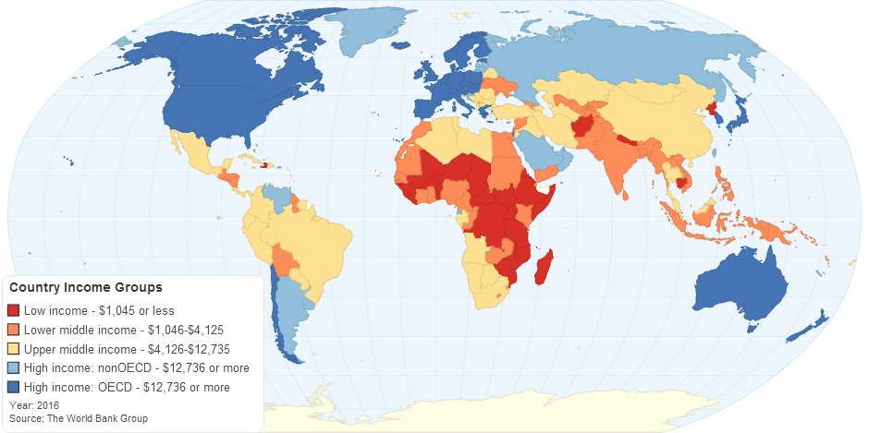
The Global Mental Health Gap
72-93% of individuals who need treatment in LMICs do not receive it
239,000 additional providers needed
WHO Mental Health Gap Action Programme
Bruckner et al., 2011; WHO, 2008; 2010; Roll et al, 2013
Notes:
Prior to COVID

Slide 3
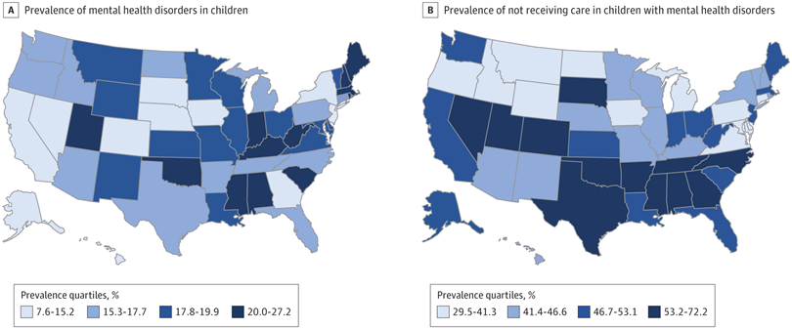
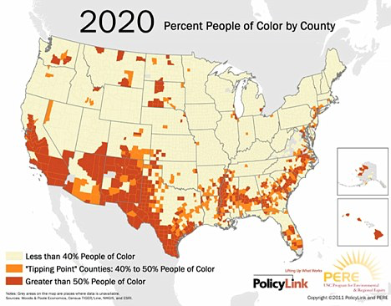
Inequities in the United States
Whitney & Peterson, 2019
Notes:
The ability to reach more children, including ethnic and racial minority families with quality care is one of the most urgent issues facing our field. First map shows areas where children with MH disorders do not receive, second map shows maps with high concentrations of people of color – correlated. Major changes include an every diversifying population, the ACA has increased the focus on increasing access to care and the provision of evidence-based care, in fact the NIMH has identified the need to strengthen the public health impact of federally-funded research as one of the key strategies for their strategic plan for research

Slide 4
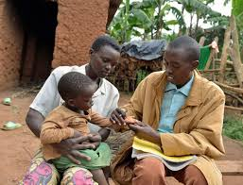
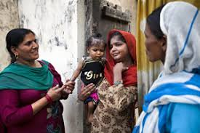
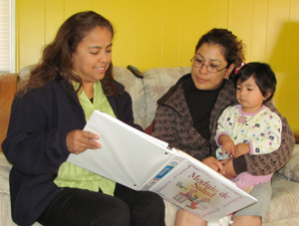
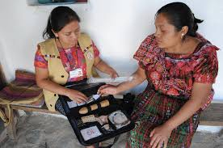
Lay Health Workers
Promotoras, natural helpers, peer providers
Lived experience
Cultural similarities
No formalized mental health training

Slide 5
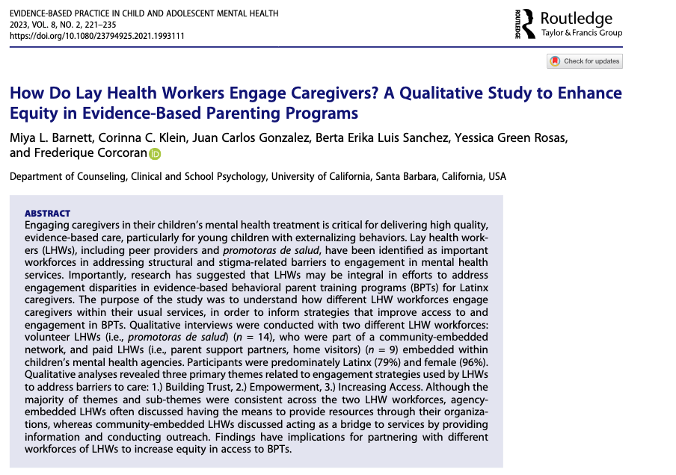

Slide 6
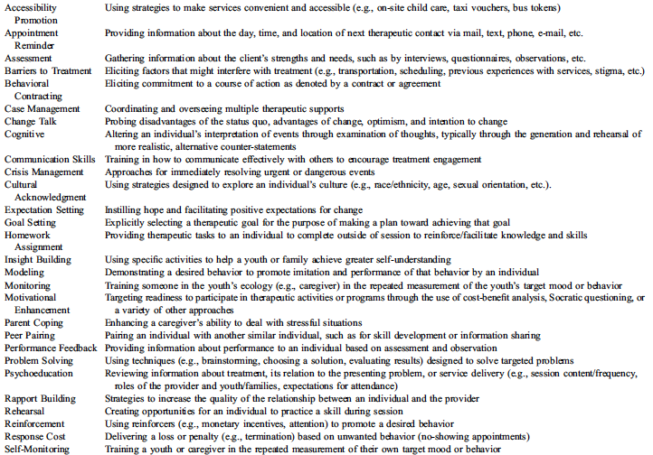
Evidence-Based Engagement Strategies
Becker et al., 2017

Slide 7
Method
Community-academic partnership
Mixed methods study (quan + QUAL)
Semi-structured interviews
Coding, co-occurrence, consensus analysis approach

Slide 8
Participants
23 Participants
  14 Promotoras (Community-Embedded Volunteers)
  9 Parent Support Partners (Agency Embedded Employees)
79% Latina/o
60.7% immigrants
Predominately Spanish speaking
64.3% primary caregivers

Slide 9
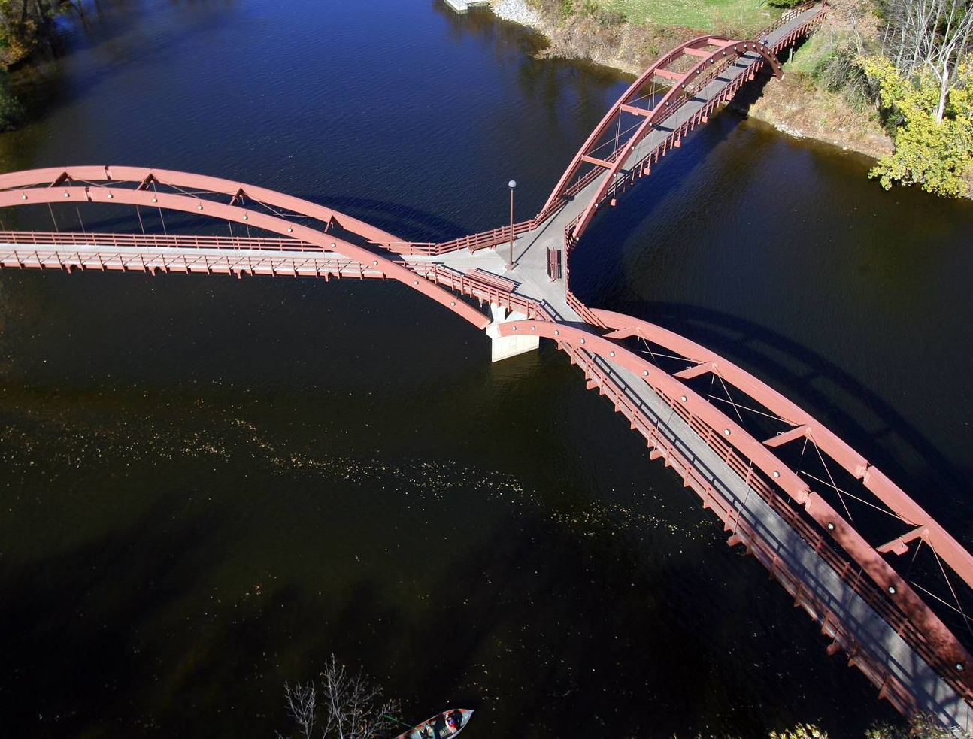
Mi rol es un puente: Bridges for the community
Culture
Future
“I think a promotora is a good connection for our community because we know the culture, we know our language, we know the needs, so this is a door we open.”
Services

Slide 10
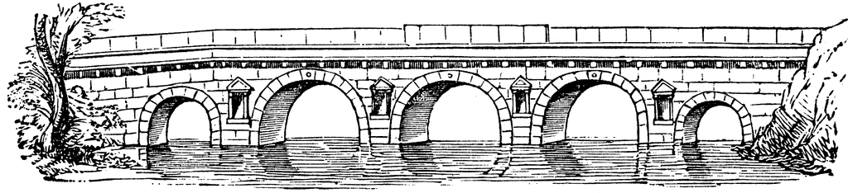
Building the Bridge
First, before presenting anything,
first I become friends with these people and we chat and we have a relationship, and then after that, these people open up and that’s when you make the connections.
The strategies we have learned at training are strategies we teach parents, and if these strategies don’t work, the only thing to do is give a referral to a professional
Build Trust
Education
Motivational Enhancement
Cultural Acknowledgement
Referral

Slide 11
Lay Health Workers
Bilingual providers
Specialized roles
Supply
Inadequate workforce
Culturally, linguistically competent services
Demand
Stigma
Lack of knowledge
Logistical barriers
Conduct outreach
Address barriers
Reduce stigma
Mental Health Disparities
Mental Health Parity
Barnett, Lau, & Miranda, 2018, Annual Review of Clinical Psychology
Notes:
Wrote and submitted a K01 Mentored Scientist Award which proposed a hybrid effectiveness-implementation trial of an implementation intervention that trains lay health workers to conduct engagement services that include outreach, in-home skill promotion, and strategies to address barriers to care. Will address supply and demand determinants of disparities

Slide 12
Lay Health Worker Roles
Demand Supply
Outreach/ Navigator
Screen
Provide referrals
Auxiliary Support/ Task Sharing
Promote adherence and engagement
Address barriers to care
Task-Shifting
Stepped-Care Models
Serve as primary providers
Community outreach
Case management
Barnett et al., 2018; Annual Review of Clinical Psychology

Slide 13
Lay Health Worker Mobilization
Compared lay health worker implementation in U.S. & low- and middle-income countries (LMIC)
Challenges in the U.S. and high-income countries
  Appropriate roles
  Licensure and certification requirements
  Implementation supports needed
Barnett et al., 2018, Admin. & Policy in Mental Health & Mental Health Services Research

Slide 14
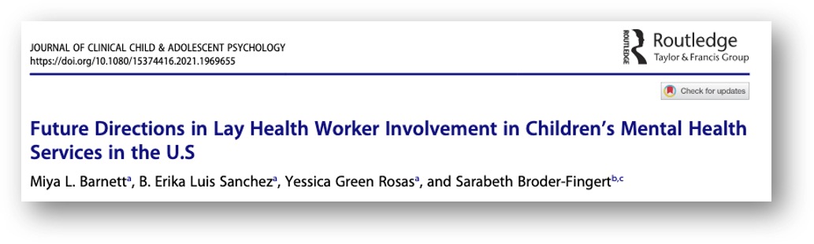
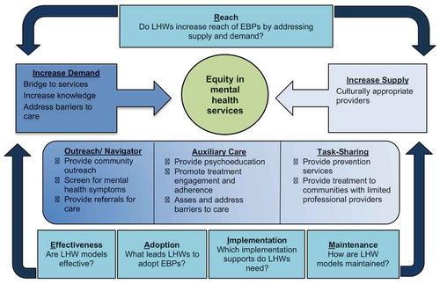

Slide 15
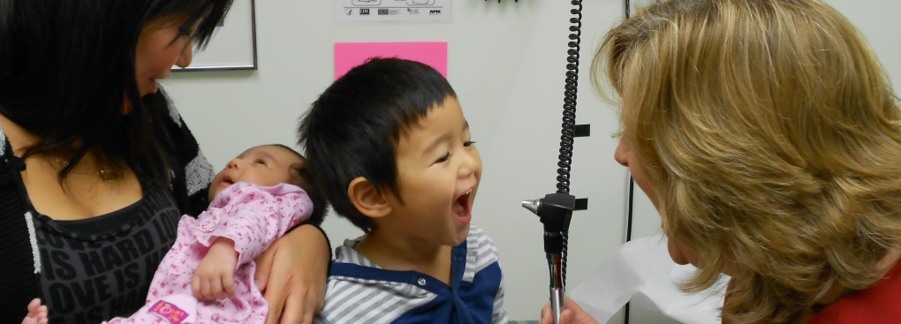
Navigation Services
The Santa Barbara Resiliency Project

Slide 16
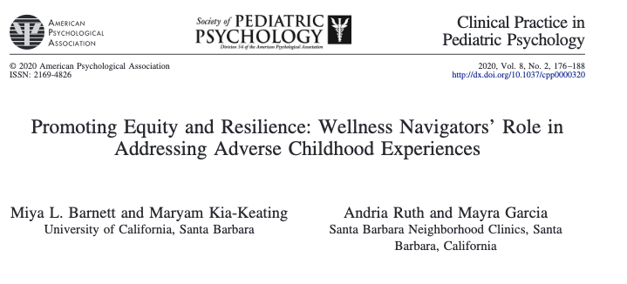
267 visits
249 screened
127 met eligibility (1+ infant ACEs/ 2+ Caregiver ACEs)
99 families enrolled
52 received additional referrals
Bilingual/ bicultural navigators
  Support screening for Adverse Childhood Experiences (ACEs)
  Enrollment in RCT
    Wellness Navigation
    Wellness Navigation + Prevention Parenting Programs
  Referrals to community resources

Slide 17
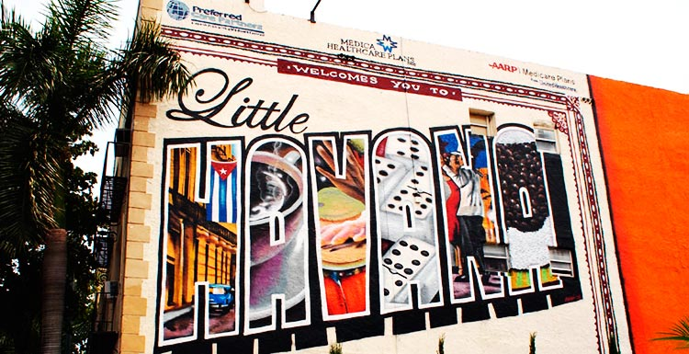
Auxiliary Care
The PCIT + Natural Helpers Program

Slide 18

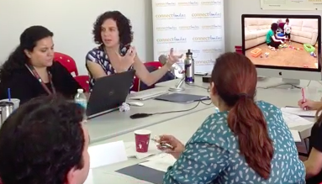

Developing the PCIT + NH Model
Notes:
I developed and evaluated a 7-day protocol to train 5 LHW, who were monolingual Spanish speaking immigrants in Little Havana, as care extenders, who referred families to a PCIT clinic at the University of Miami, addressed barriers to care, and promoted skill development in the home through modeling and brief feedback on parent practice.

Slide 19
Professional Provider
Assessment
PCIT Treatment
Consultation
PCIT + NH
Model
Natural Helper
Outreach
Care Coordination
Emotional and Logistic Support
Home Practice

Slide 20
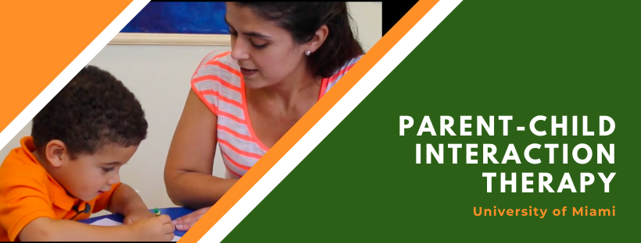
Does PCIT+NH Increase Reach?
Comparison of families typically served in university-based clinic (N = 418) and those served by PCIT+NH (N = 42)
  Grant funded services
  Majority Latinx community
PCIT Clinics embedded within community agencies
  Little Havana
  Overtown
  Homestead
Reach
Effectiveness
Adoption
Implementation
Maintenance
Davis, Garcia, Rothenberg, Barnett et al., 2022, Children & Youth Services Review

Slide 21
Does PCIT+NH Increase Equity in Reach?
PCIT + NH
University Based Clinic

Slide 22
Does PCIT+NH Increase Equity in Reach?
PCIT + NH
University Based Clinic

Slide 23
Does PCIT+NH Increase Equity in Reach?
PCIT + NH
University Based Clinic
Notes:
53% made under 35,000 in NH sample, 30% in Program population. High school is 2 words, Say university based clinics

Slide 24
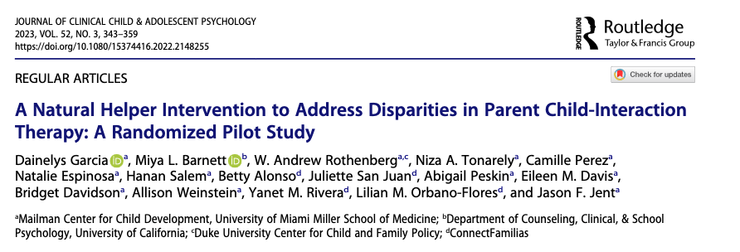
Is PCIT + NH Effective?
Randomized Control Trial
  PCIT
  PCIT +NH
81 Families
Outcomes
  Engagement
  Parent Skills and Stress
  Child Behaviors
Reach
Effectiveness
Adoption
Implementation
Maintenance
Garcia, Barnett et al., 2022, Journal of Clinical Child & Adolescent Psychology

Slide 25
Is PCIT + NH Effective?
 | Standard PCIT | PCIT +NH | Effect size
Homework | 53-63% | 61-68% | Small
Complete Treatment | 43% | 57% | Small
Parent Skills | Relationship Skills Discipline Skills | Relationship Skills Discipline Skills* | Small to medium
Parent Stress | Within Normal Limits | Within Normal Limits | No effect
Child Behavior Problems | BASC Compliance ECBI WNL | BASC* Compliance* ECBI WNL | Small to medium
Notes:
Change PCIT Lingo to be understandable

Slide 26
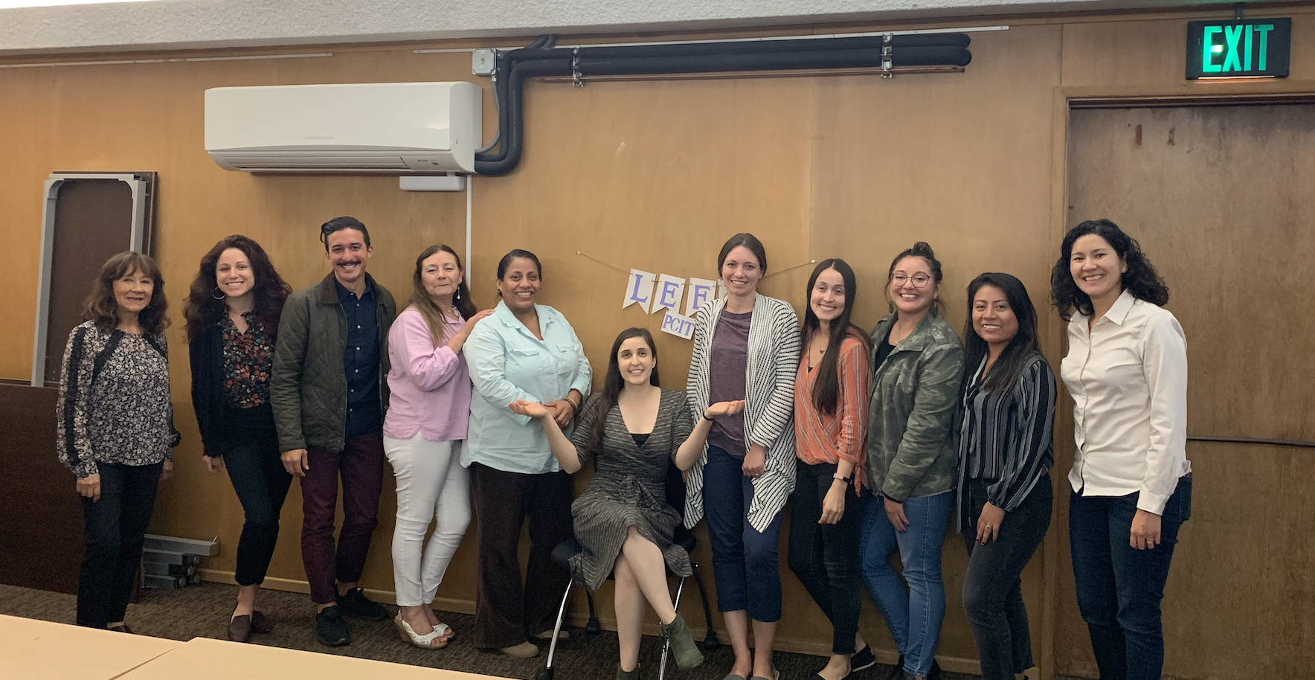
Do LHWs Adopt PCIT Practices?
PCIT knowledge
Attitudes towards positive discipline
Child-led skills
Effective discipline
Reach
Effectiveness
Adoption
Implementation
Maintenance
Barnett et al., 2016, Children & Youth Services Review; Barnett et al., 2019, BMJ Open

Slide 27
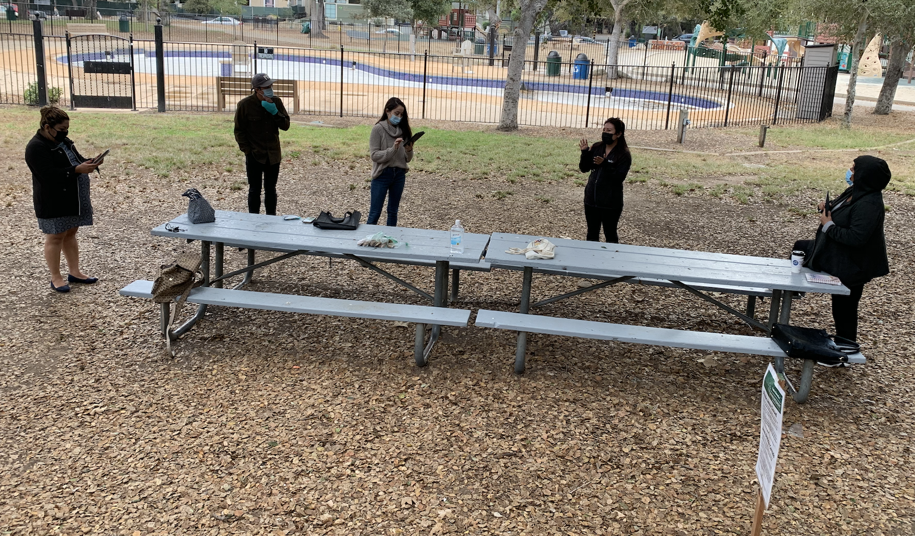
How are LHW models Implemented?
Challenge | Solution
Referrals to PCIT | LHW discusses PCIT prior to case assignment
Internal Capacity for Spanish Speaking families | No outreach Focus on retention and completion
Cultural humility | LHWs consult with therapists
Telehealth | Increase training Shared experiences
Reach
Effectiveness
Adoption
Implementation
Maintenance
K01
Notes:
Mariana and Erika – could you add/ expand some points here

Slide 28
How to Maintain LHW Models
System Capacity
Financing
Expanding families served
Reach
Effectiveness
Adoption
Implementation
Maintenance

Slide 29
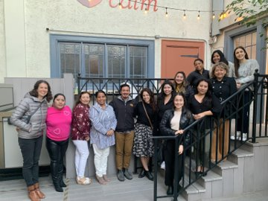
Acknowledgements
Partnerships
University of Miami PCIT 305
Connect Familias
CALM
Santa Barbara Promotora Network
Santa Barbara Neighborhood Clinics
The PADRES Lab
JC Gonzalez
Corinna Klein
Erika Luis Sanchez
Jessica Green Rosas
Hanan Salem
Juliana Ison
Kaela Farisse
Funding
The Children’s Trust
NIMH
The Implementation Research Institute
Child Intervention and Prevention Services Fellowship

Slide 30
Thank you!
Questions?

Slide 31
Source Citation for this Presentation
With website link
Barnett, M. (2024). How Psychologists Can Partner with Lay Health Workers to Promote Equity in Children’s Mental Health [PowerPoint slides]. Retrieved from https://sccap53.org/.
Without website link
Barnett, M. (2024). How Psychologists Can Partner with Lay Health Workers to Promote Equity in Children’s Mental Health [PowerPoint slides]. Webinar sponsored by the Society of Clinical Child and Adolescent Psychology, Division 53 of the American Psychological Association. New York, NY.

