Slide 1
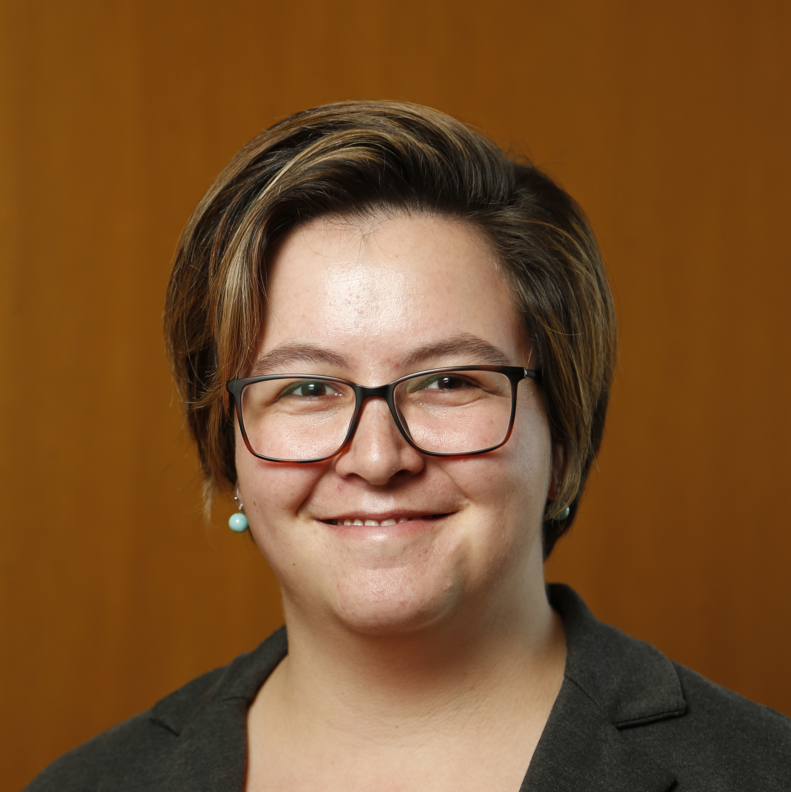


The Kids Are Alright: Affirming CBT with LGBTQ+ Youth and their Families
Ilana Seager van Dyk, Ph.D.
Senior Lecturer, Massey University
@DrIlanaSvD
www.ilanaseagervandyk.com
Funding from Yale FLAGS, Society
for the Advancement of Psychotherapy
Moderator: Leigh Spivey-Rita, Ph.D.
Licensed Psychologist & Medical Instructor, Duke University

Slide 2

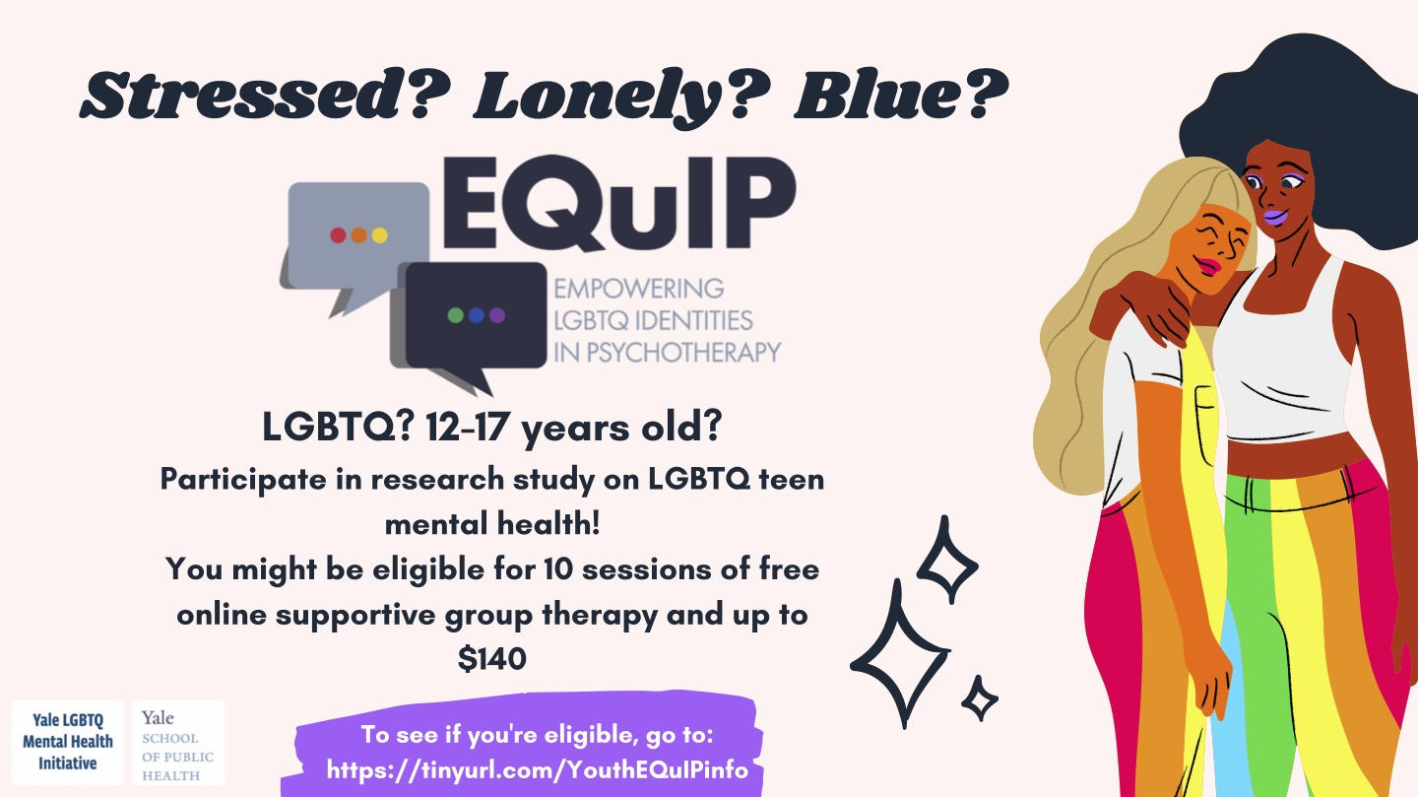
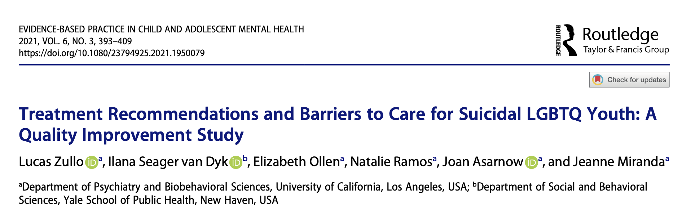
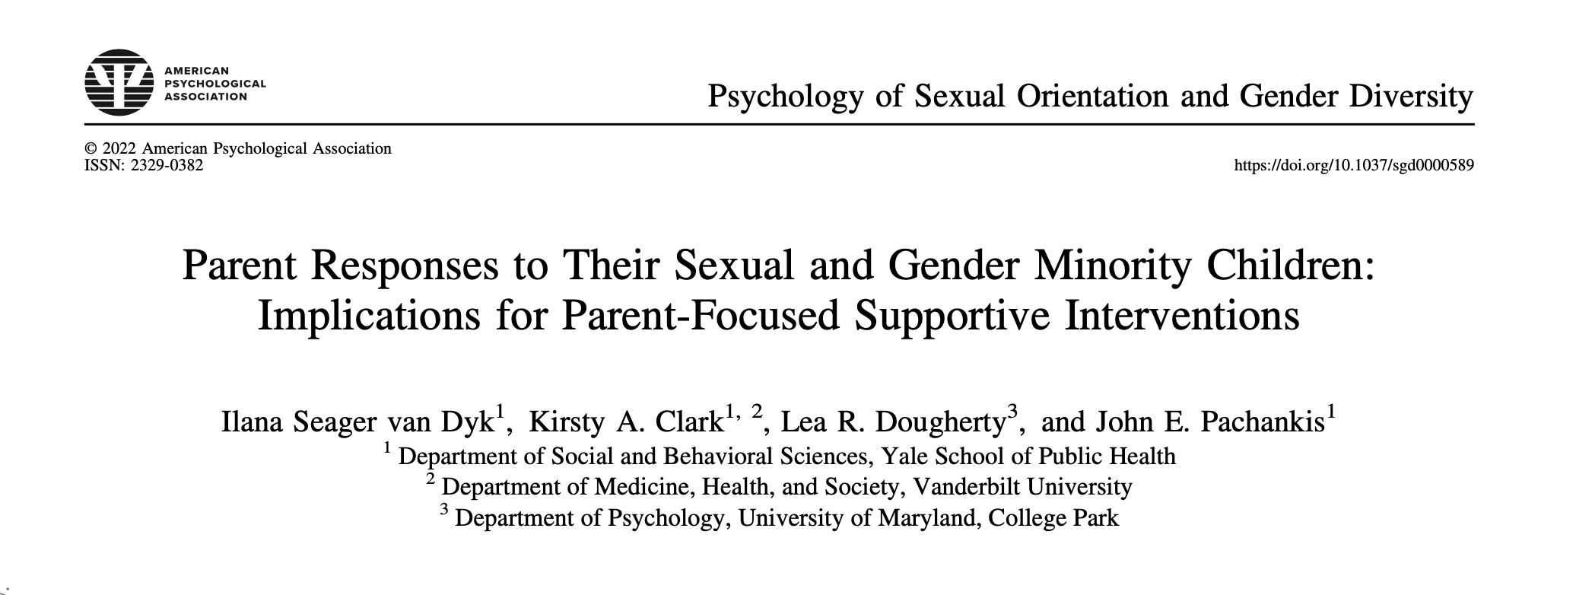
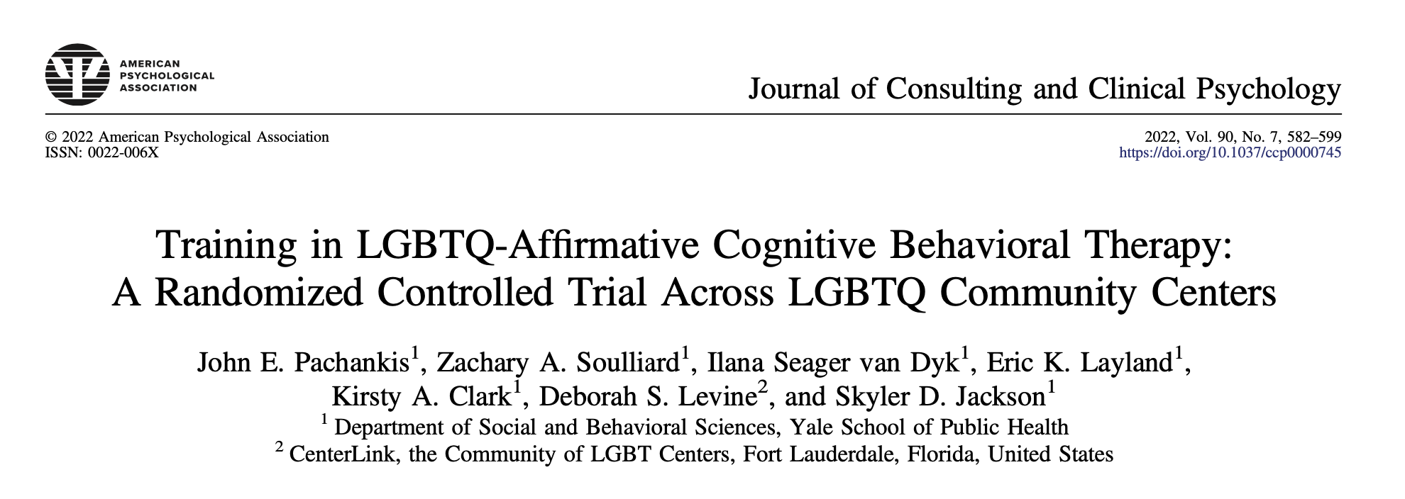
MY RELEVANT BACKGROUND

Slide 3
AGENDA
The Basics
Adapting CBT Techniques
Cognitive
Behavioral
Working with Parents/Caregivers
Resources and Q&A

Slide 4
The Basics

Slide 5
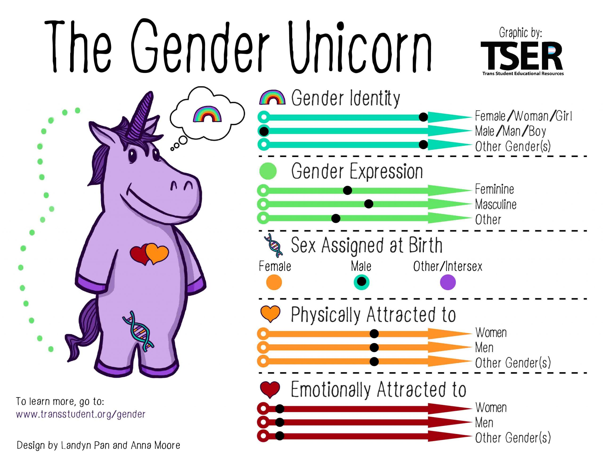
PSYCHOEDUCATION
How I identify
How I look and express myself
The sex classification that I was assigned at birth
Who I am sexually attracted to
Who I am romantically/ emotionally attracted to
Notes:
Gender Identity: How I identify.
One’s internal sense of being male, female, neither of these, both, or another gender(s). For transgender people,
their own internal sense of gender identity and their sex assigned at birth are not the same.
Gender Expression/Presentation: How I look and express myself.
The physical manifestation of one’s gender identity through clothing, hairstyle, voice, body shape, etc. Most
transgender people seek to make their gender expression (how they look) match their gender identity (who they
Sex Assigned at Birth: The sex classification that I was assigned at birth.
The assignment and classification of people as male, female, intersex, or another sex based on a combination of
anatomy, hormones, and chromosomes. This is usually decided at birth or in utero, and is usually based on genitalia.
Sexually Attracted To: Whom I am sexually attracted to.
The group of people or genders to which a person can become sexually attracted to, if at all.
Romantically/Emotionally Attracted To: Whom I am romantically/emotionally attracted to.
The group of people or genders to which a person can become romantically, emotionally, or spiritually attracted to, if
at all.

Slide 6
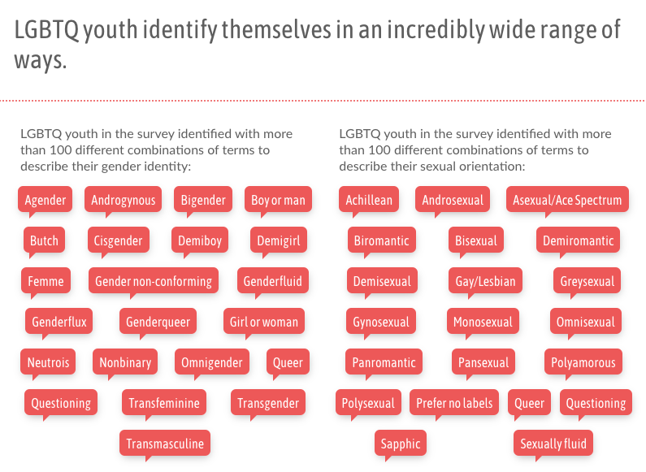
PSYCHOEDUCATION
Trevor Project, National Survey on LGBTQIA+ Youth Mental Health 2020: https://www.thetrevorproject.org/survey-2020

Slide 7
LGBTQIA+ YOUTH MENTAL HEALTH
LGBTQIA+ youth experience disproportionately high rates of mental illness compared to cis-, het- peers (Ferguson et al., 1999; Mustanski et al., 2010)
Difference emerges as early as 9yo and continues into adulthood (Seager van Dyk et al., under revision; Pachankis et al., 2022)
Vulnerable populations within LGBTQIA+ umbrella
Nonmonosexual youth (e.g., bisexual, pansexual)
Trans/gender diverse youth (particularly those of colour)
40% of LGBTQIA+ respondents seriously considered attempting suicide in the past twelve months; >50% of trans & nonbinary youth
Trevor Project, National Survey on LGBTQIA+ Youth Mental Health 2020: https://www.thetrevorproject.org/survey-2020

Slide 8
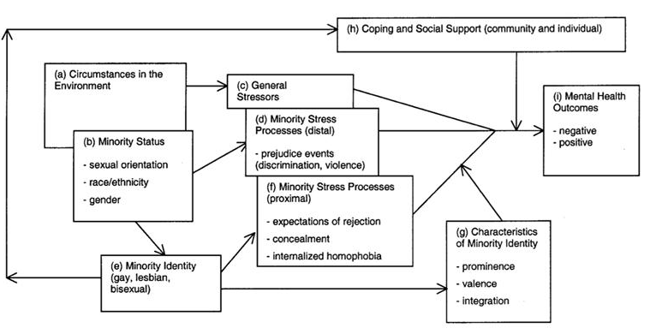
MINORITY STRESS THEORY
Meyer, 2003
Notes:
Minority stress theory basically states that sexual minorities experience unique stressors, including
Distal (or external) stressors like discrimination, prejudice, etc. related to sexual orientation
Proximal (or internal) stressors like internalized homophobia (believing negative stereotypes/ideas about being a sexual minority)
These stressors interact with two potential moderators (and potential treatment targets!) to predict an individual’s mental health
Coping and social support resources
Characteristics of minority identity (i.e., how important your sexual minority identity is to you, how good/bad you feel about your sexual minority identity, and how well that aspect of your identity is integrated into your broader sense of self)

Slide 9
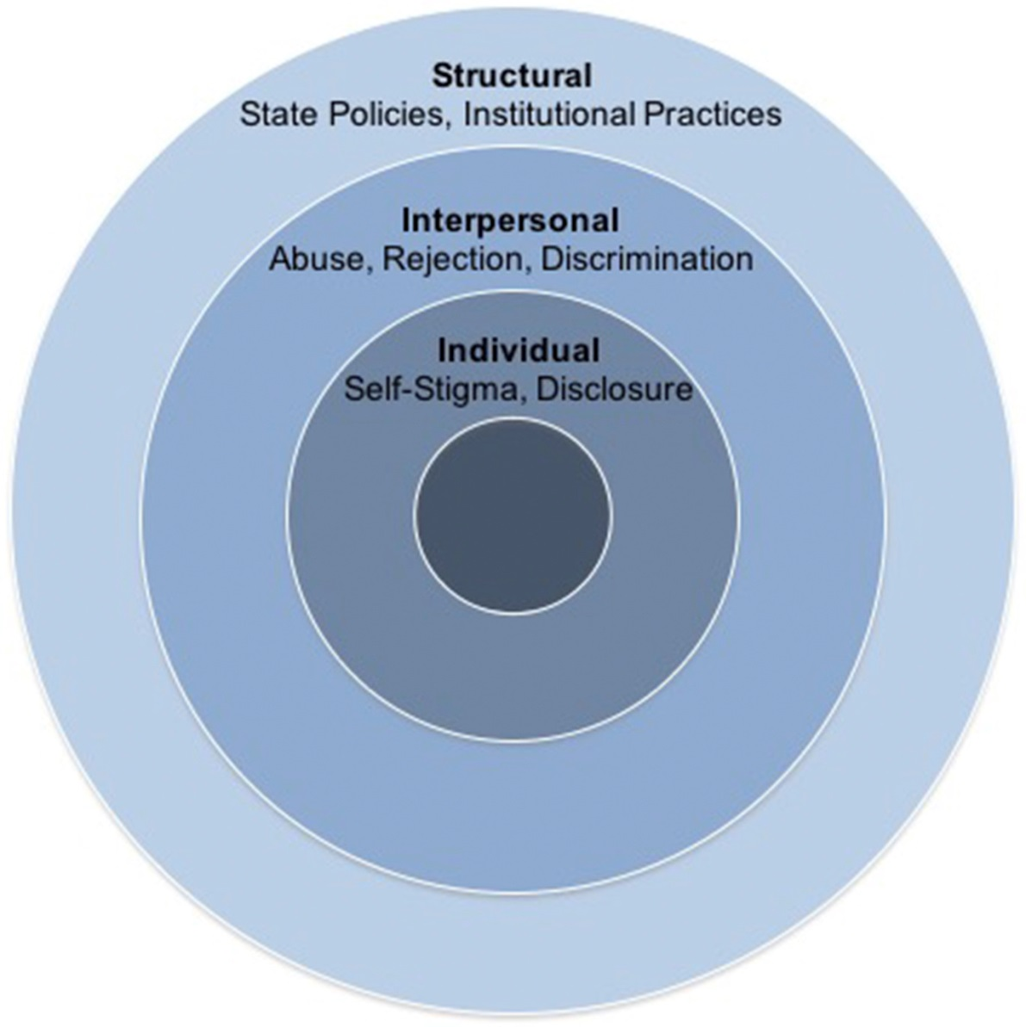
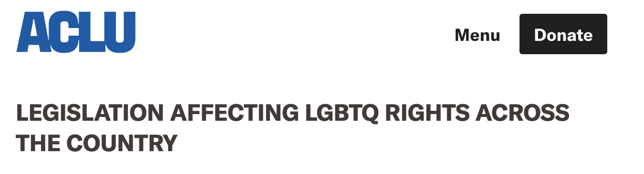
THE INVALIDATING ENVIRONMENT: MINORITY STRESS
Understand what LGBTQIA+ youth in your state / region are facing in terms of legal challenges / school policies
https://www.aclu.org/legislation-affecting-lgbtq-rights-across-country
Notes:
Q: As a PhD student in Florida, do you have any state-specific advice for people?
We can also think about minority stressors through a structural stigma lens
Sexual minorities experience stigma and prejudice at a broader societal level, in interpersonal interactions, and intra-personally.

Slide 10
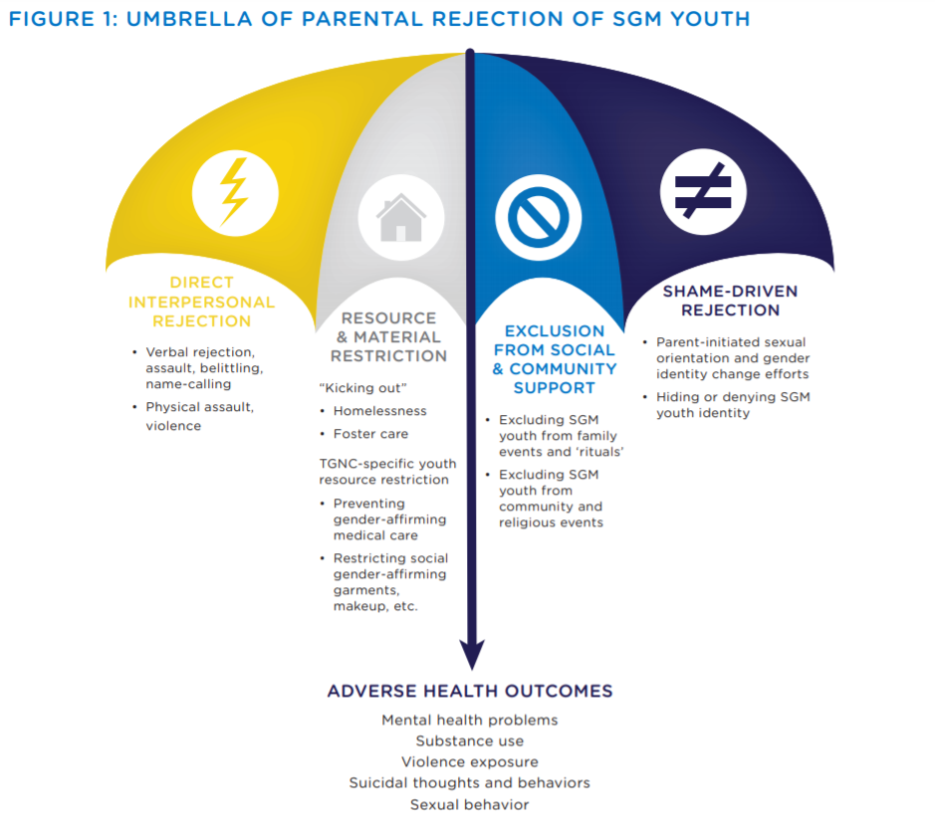
MINORITY STRESS
40% of homeless youth are LGBTQ (2.5 million)
29% of LGBTQ youth have experienced homelessness, been kicked out, or run away
1 in 3 LGBTQ youth report being physically threatened in their lifetime
61% of TGNC youth report being prevented/discouraged from using the bathroom that corresponds with their gender identity
Trevor Project, National Survey on LGBTQ Youth Mental Health 2020: https://www.thetrevorproject.org/survey-2020

Slide 11
SEXUAL IDENTITY DEVELOPMENT
It’s hard enough figuring out who you are as a teen without adding a stigmatized identity to the mix
Many different models of sexual minority identity development
Awareness of being different
Exploring what that could mean
Committing to sexual minority identity & integrating with broader sense of self
Showing that identity outwardly (coming out)
Entering the LGBTQ community

Slide 12
GENDER IDENTITY DEVELOPMENT
Gender identity development
Awareness of gender — by 3yo
Gender stability — 4-5yo
Believe they will be X gender when they grow up
Classic questions to test gender stability (Slaby & Frey, 1975) – “were you a little girl or a little boy when you were a baby?” “will you be a mommy or a daddy when you grow up?”
Gender constancy — 6-8yo
Understand that they can violate gender norms and that will not change their gender
Classic question to test constancy “if you wore a dress, would you be a girl?”
Strongly influenced by stereotypes
Kristina Olson — social transition in these young gender diverse kids removes mental health disparity (Olson et al., 2016)

Slide 13
SUPPORTING IDENTITY DEVELOPMENT
BELIEVE YOUTH – if they say they are LGBTQ+, you don’t have to “figure out” if they really are. Only explore further if they want to.
Invite youth to explore their identities in session
Is sex, sexuality, or gender something you want to talk about here?
What would you like me to call you today? What pronouns?
Normalize their experience of feeling different (if they do)
Activities:
Gender unicorn
Activities/rewards that align with different identities – debrief to see what feels right for them
Behavioral experiments
Help them connect with role models/resources (even if only online) **great resilience builder**

Slide 14
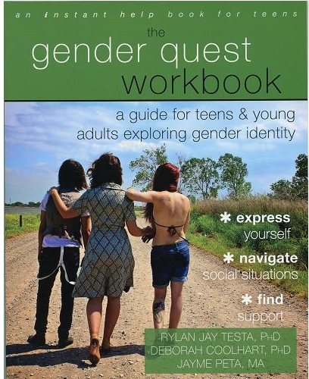
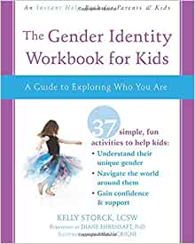
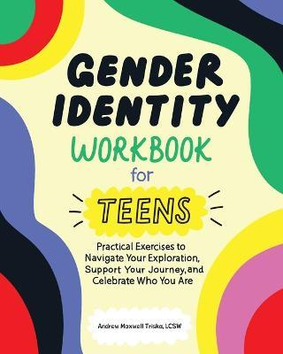
WORKBOOKS

Slide 15
How does your setting signal to LGBTQIA+ youth that this is a safe, inclusive space for them?

Slide 16
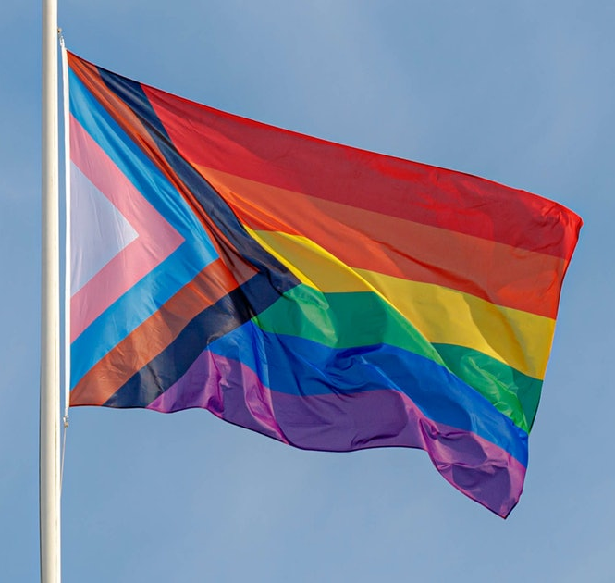


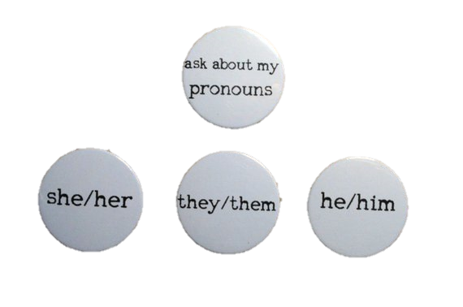

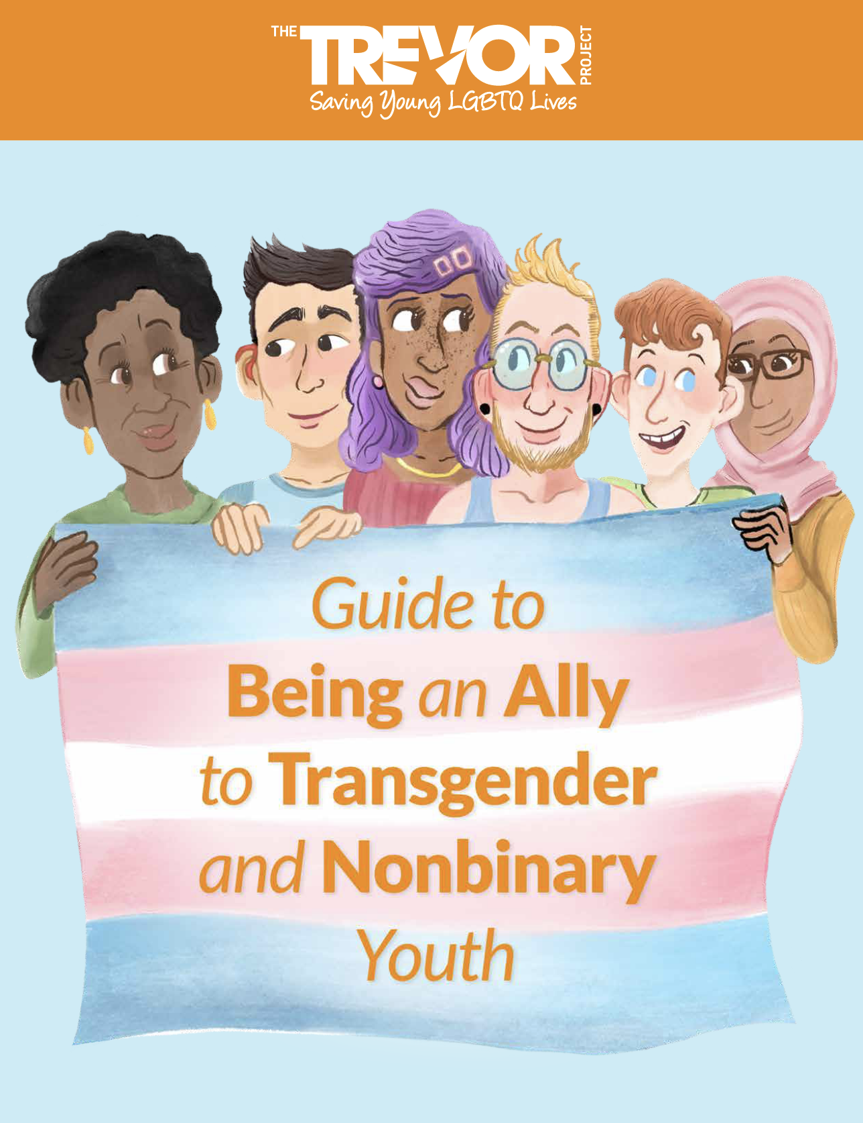




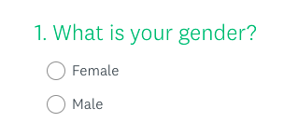




Supportive environment
Resources
Decorations
Pronouns
Website
Intake forms
Books
All-gender restroom

Slide 17
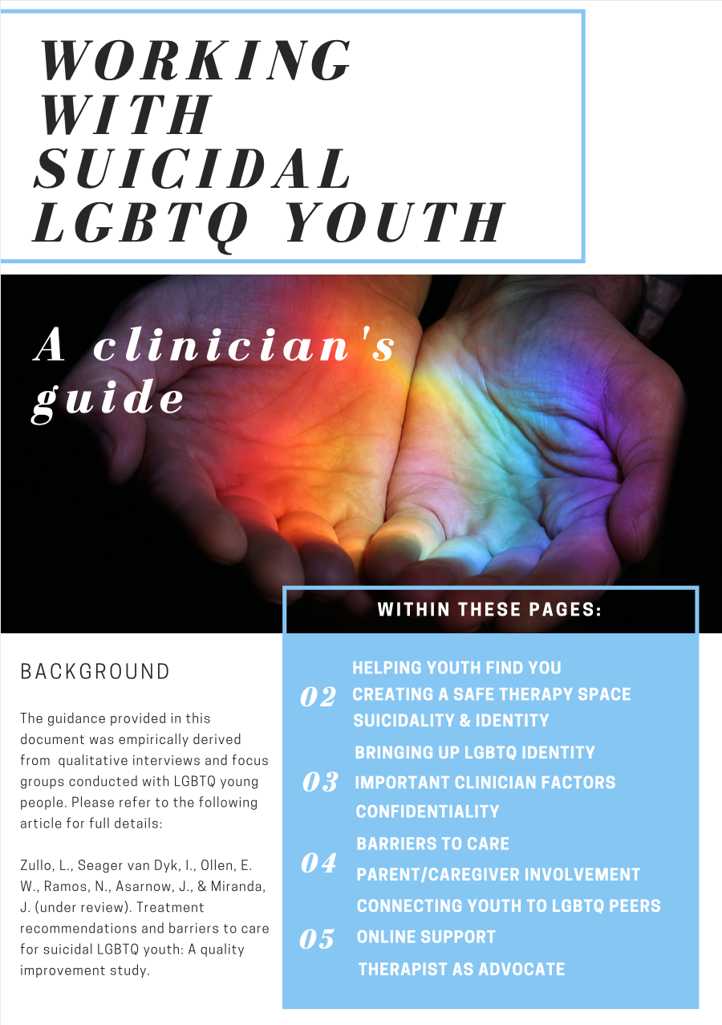
HOW TO BRING UP LGBTQIA+ IDENTITIES WITH YOUTH
Provide multiple opportunities for youth to disclose (forms, discussion of peers and support, intake questions)
Show that you are open, but don’t force the issue
Do not bring up LGBTQIA+ status in front of parents
Normalize LGBTQIA+ identity in assessment and therapy
Vary the gender/sexuality of your examples
Hi, I use she/her pronouns. How would you like me to refer to you?
Zullo, L., Seager van Dyk, I., Ollen, E. W., Ramos, N., Asarnow, J.R., & Miranda, J. (2021). Treatment recommendations and barriers to care for suicidal LGBTQ youth: A quality improvement study. Evidence-Based Practice in Child and Adolescent Mental Health, 6(3), 393-409. https://doi.org/10.1080/23794925.2021.1950079

Slide 18
SHOULD YOU DISCLOSE YOUR OWN LGBTQIA+ (OR ALLY) IDENTITY TO CLIENTS?

Slide 19
Adapting CBT Techniques

Slide 20
ASSESSING MINORITY STRESS
Common minority stressors
Discrimination
Rejection sensitivity
Internalized stigma
Concealment & impression management
Minority stress measures
Gender Minority Stress and Resilience Measure for Adolescents (GMSR-A)
Hidalgo, M. A., Petras, H., Chen, D., & Chodzen, G. (2019). The Gender Minority Stress and Resilience Measure: Psychometric validity of an adolescent extension. Clinical Practice in Pediatric Psychology, 7(3), 278. https://doi.org/10.1037/cpp0000297
LGB Identity Scale (LGBIS)
Mohr, J. J., & Kendra, M. S. (2011). Revision and extension of a multidimensional measure of sexual minority identity: The Lesbian, Gay, and Bisexual Identity Scale. Journal of Counseling Psychology, 58(2), 234–245. https://doi.org/10.1037/a0022858
What is the best thing about being LGBTQ?
What are some things that make being LGBTQ stressful? For example, some youth describe challenges at school around bathrooms, or bullying. Have you experienced anything like that?

Slide 21
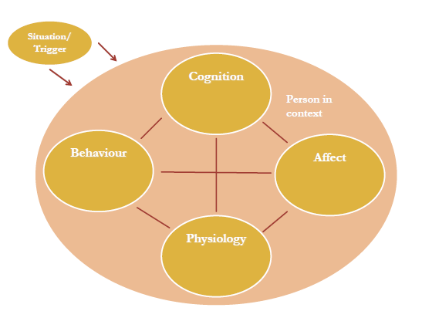
MINORITY STRESS & CASE CONCEPTUALIZATION
Psychoeducation about minority stress & the impact on the client’s life can also help the client recognize that the fault is not with them – it is with an unjust, anti-LGBTQ society

Slide 22
COGNITIVE STRATEGIES
Case Example: Jordan (they/them) , a 17 yo non-binary high school student diagnosed with GAD. Jordan worries about starting university next year, their health and health of their family, being outed, and finances. Jordan worries that if their family found out about their gender identity, they would not want to pay for college.
Worry Thought: ”If I come out, my family will not pay for college”
How would you use standard cognitive therapy techniques here?
Notes:
You all know CBT. Here’s a potential distortion. What do you do? Answer: what evidence do you have family is not supportive, problem solving, options: problem solve for college tuition, consider values around coming out
Be mindful that asking “what’s the worst that could happen” could intensify client’s realistic fears, some youth experience rejection, being “disowned”, homelessness, and/or physical assaults / violence after coming out

Slide 23
COGNITIVE STRATEGIES
General rules for making cognitive strategies LGBTQ+-affirming:
Not everything is a distortion
First, check the facts of the situation
If a thought is inaccurate, restructure the thought
If a thought is accurate, problem solve the situation

Slide 24
BEHAVIORAL STRATEGIES
A lot of your standard behavioral strategies can be easily adapted to use with LGBTQIA+ teens
Behavioral experiments
Exposures
Assertiveness skills / behavioral skills training**
Main thing to be cognizant of as a clinician are issues of safety for the LGBTQIA+ teen, and the accuracy of the fear
E.g., assessing risk of parental rejection, homelessness, violence, etc.

Slide 25
BEHAVIORAL STRATEGIES
Case example: Emily is a 15yo lesbian who believes that she could never handle her parents knowing about her sexual orientation. She is convinced that they hate all LGBTQIA+ people, but when you ask for examples, she can’t think of any. Based on your discussions with the parents, you have no immediate safety concerns.
How could you use behavioral experiments in this situation?
Making a comment about an LGBTQIA+ character on a TV show
Asking to go to an LGBTQIA+ event like Pride with a friend
Wearing a rainbow scrunchie
Notes:
Jose is a 15yo gay man who fears being evaluated negatively in social situations with family, friends, and strangers.

Slide 26
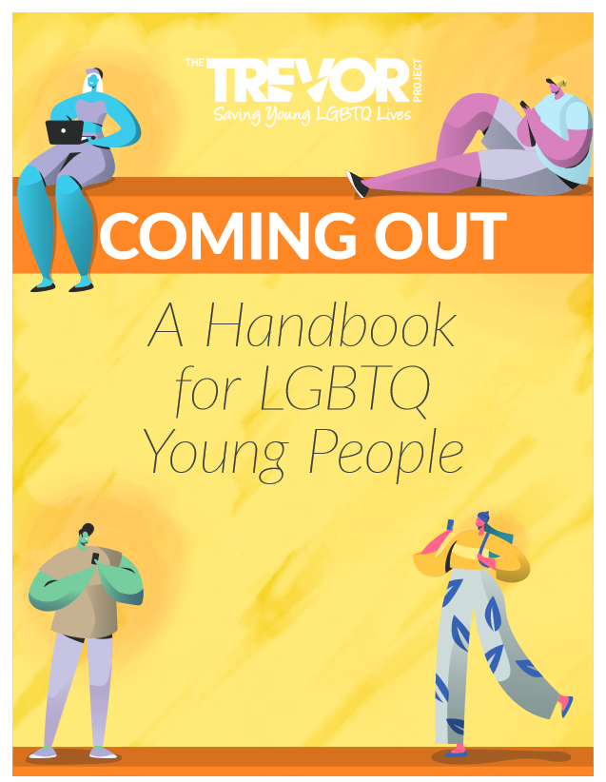
HELPING YOUTH NAVIGATE COMING OUT
Trevor Project guide
https://www.thetrevorproject.org/wp-content/uploads/2021/07/Coming-Out-Handbook.pdf
Planning ahead:
How to come out (calling, texting, in-person)
Timing, location
How could the person respond? How can I prepare for that?
Testing the waters
Support
Safety
Supporting parents (see later slides)
Notes:
Additional ways to apply these youth, and here is more specific information. More to consider:
Cope ahead plan for time and place
If the worst happens, could you handle it

Slide 27
BEHAVIORAL STRATEGIES
Example exposure hierarchy
Coming out
Give coming out letter to dad 100 100
Come out to mom when we’re home alone 90 70
Come out to my sister while we’re on a walk 60 60
Leave a PFLAG flyer in the mailbox 40 60
Practice saying in the mirror, “I’m gay” 30 50
Practice writing down the words, “I’m gay” 30 45

Slide 28
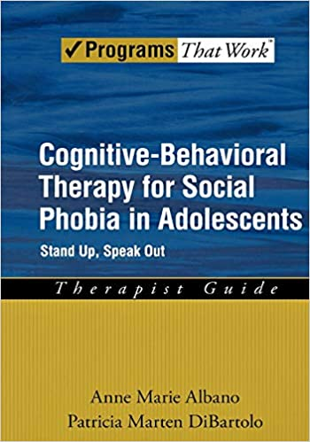

BEHAVIORAL STRATEGIES
Assertiveness skills / behavioral skills training
Literature shows that this is particularly important for LGBTQIA+ folks who receive messages of invalidation from a young age
DEAR MAN
Others’ rights are respected
Own rights are denied
Own and other rights are respected
Own rights are respected
Other’s rights are denied

Slide 29
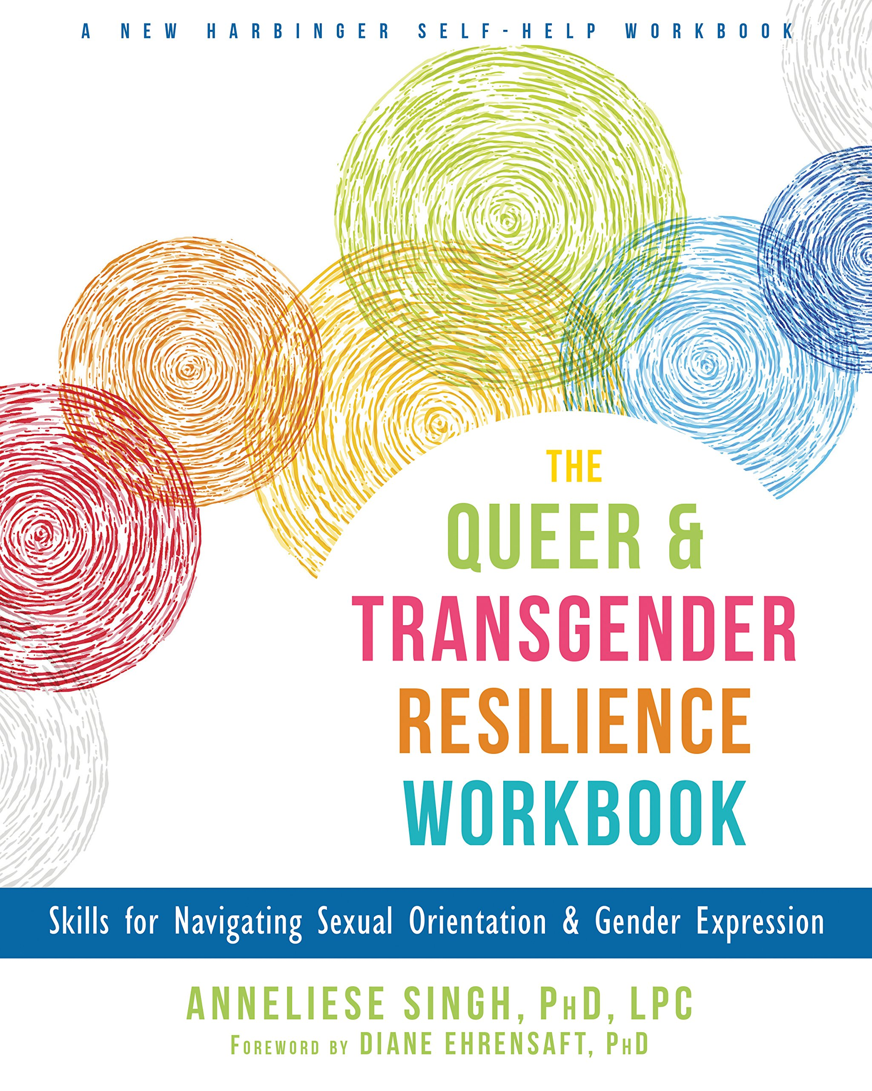
BEHAVIORAL STRATEGIES
Consider including positive identity building as well
e.g., “I’ll never be a respected doctor now…”
Homework exercise: find a successful LGBTQIA+ doctor on Twitter or online somewhere

Slide 30
Working with Parents / Caregivers
Notes:
Question: How are techniques adapted to address challenges with family acceptance with caregivers who are not supportive/affirming?

Slide 31
TREATMENT PREFERENCES
Most parents of LGBTQIA+ youth wanted
To receive services to help them cope with their LGBTQIA+ child’s identity
Most parents were ambivalent about whether the sessions were joint with child
1-4 parent sessions, each lasting 1 hour
Most LGBTQIA+ youth wanted clinicians to
Make decisions about parent involvement jointly with the youth
Meet with parents separately to reduce burden on youth
Psychoeducation about LGBTQIA+ identity
Provide parents with the opportunity to express their current feelings in open & genuine way
Encourage parents to accept their child & normalize LGBTQIA+ identities
Seager van Dyk, I., Clark, K. A., Dougherty, L. R., & Pachankis, J. E. (2022). Parent responses to their sexual and gender minority children: Implications for parent-focused supportive interventions. Psychology of Sexual Orientation and Gender Diversity. Advance online publication. https://doi.org/10.1037/sgd0000589
Zullo, L., Seager van Dyk, I., Ollen, E. W., Ramos, N., Asarnow, J., & Miranda, J. (2021). Treatment recommendations and barriers to care for suicidal LGBTQIA+ youth: A quality improvement study. Evidence-Based Practice in Child and Adolescent Mental Health, 6(3), 393-409. https://doi.org/10.1080/23794925.2021.1950079

Slide 32
GOALS OF PARENT WORK
Reduce burden on youth
Allow parents to acquire important (potentially life-saving) information
Allow parents to feel heard, process this news a little
Ideally separate session(s) from youth
Sometimes a good opportunity for co-therapy
Could be as brief as 1 session, as many as 8 (e.g., group-based format)

Slide 33
KEY PARENT INTERVENTION: PSYCHOEDUCATION
Definitions: what is LGBTQ? How is gender identity different from sexual orientation?
Gender unicorn as a tool
Provide education about the importance of family support as a protective factor
LGBTQIA+ youth who reported high levels of support from at least one adult had 40% lower odds of a past-year suicide attempt compared to youth with no such supportive adult (Green et al., 2021)
Provide education about poor outcomes (school, mental health) for youth who are rejected

Slide 34
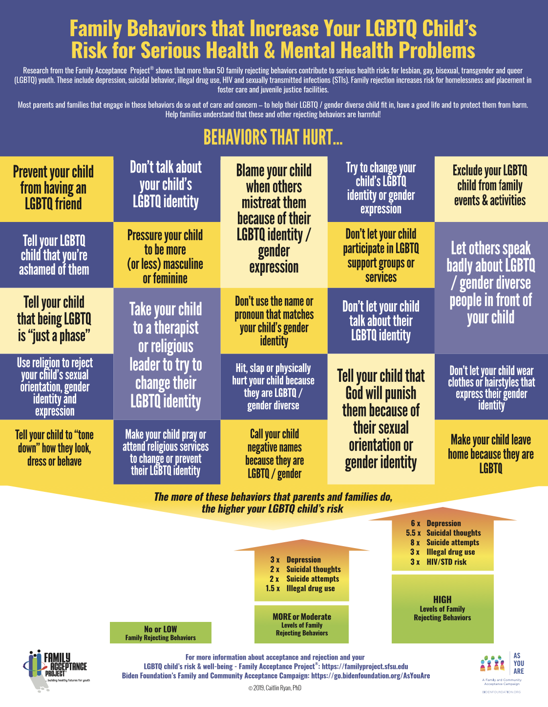
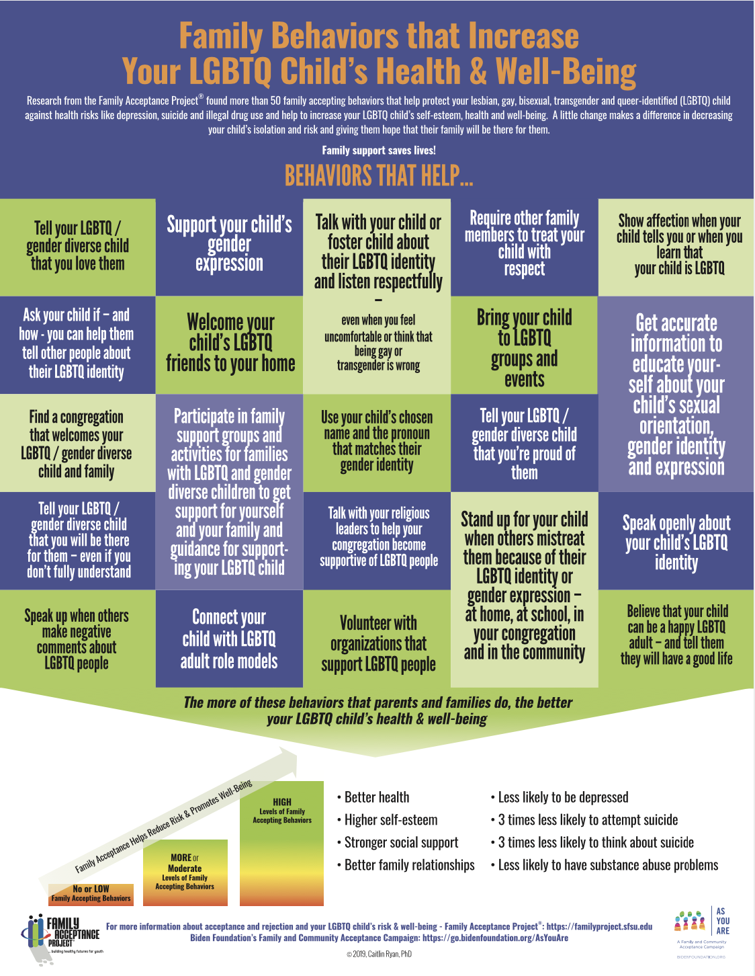

Slide 35
How to handle when parents are not supportive of using child's correct pronouns

Slide 36
STRATEGIES FOR CHALLENGING PARENTS
Align with parents on aim to support their child
Softly, softly (unless safety concerns)
Hear them out fully; validate what you can; stay true to your affirming principles
Connect parents with support groups, books, websites, etc.
If parent-child relationship is too contentious, consider teaming up with another clinician

Slide 37
TRANSITION-RELATED CONCERNS
Many parents of gender diverse youth may be concerned about transition-related issues
There is no one way to transition — many gender diverse folks never use hormones or have surgeries
Social: clothing, name, pronouns, voice, hair removal
Legal: changing name on identification, at school, etc.
Medical: puberty blockers, hormone therapy
Surgical: **not typically done in youth services**
Important to make sure parents aren’t making assumptions about what their child wants
Connect parents/families with resources from the community
Gender Spectrum: https://www.genderspectrum.org/
TransYouth Family Allies: http://www.imatyfa.org/
Stand with Trans: https://standwithtrans.org/
Caring for LGBTQ Youth: Tips for Parents & Caregivers: https://www.youtube.com/watch?v=DAxLlj7SJn8

Slide 38
TRANSITION-RELATED CONCERNS
Impact on mental health
Youth who have socially transitioned (living as the gender they identify as) do not have higher levels of depression, relative to their cisgender peers (Olson et al., 2016)
Youth with access to medical interventions (puberty blockers, hormones) show better psychological functioning following access to care (Costa et al. 2015) and a decrease in suicidality (Allen et al., 2019)
“But what if they change their mind?”
“Retransitions” are infrequent (Olson et al., 2022)
Among a sample of 317 trans youth with a baseline mean age of 8.1 years, at 5 years post-social transition…
94% continued to identify with a binary trans identity
3.5% identified as nonbinary
2.5% identified as cisgender
Olson, K. R., Durwood, L., Horton, R., Gallagher, N. M., & Devor, A. (2022). Gender identity 5 years after social transition. Pediatrics. https://doi.org/10.1542/peds.2021-056082

Slide 39
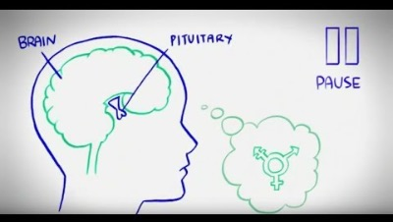
TRANSITION-RELATED CONCERNS
Puberty Blockers at Seattle Children’s: https://www.youtube.com/watch?v=-_ldEpFoJCI

Slide 40
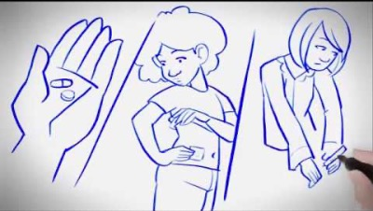
TRANSITION-RELATED CONCERNS
Feminizing Hormone Therapy at Seattle Children’s: https://www.youtube.com/watch?v=8_gdLCXKl5Y

Slide 41
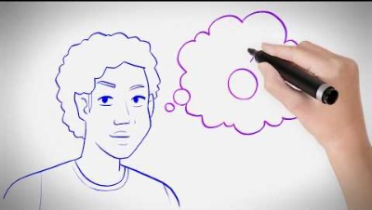
TRANSITION-RELATED CONCERNS
Masculinizing Hormone Therapy at Seattle Children’s: https://www.youtube.com/watch?v=-_ldEpFoJCI

Slide 42
EXAMPLE SURGERY LETTER
NAME is a AGE y.o. patient in my care since DATE. NAME is seeking INTERVENTION for the treatment of Gender Dysphoria.
NAME identifies as GENDER and goes by X pronouns. NAME notes that they first knew their gender identity differed from their assigned sex during childhood, and this difference only became more apparent in high school when NAME felt disconnected and different from their ASSIGNED SEX peers. NAME has socially transitioned, successfully and consistently living in a gender role congruent with their affirmed gender since YEAR. Despite this, NAME reports significant anxiety, depression, and distress due to the incongruence between their anatomy and their gender identity.
By my independent evaluation, I have diagnosed NAME with Gender Dysphoria (ICD-10 F64.1). They have expressed a persistent desire for INTERVENTION. INTERVENTION will address their Gender Dysphoria and fulfill their goals by aligning their body with their gender identity.
NAME is stably housed and is currently preparing for their post-operative recovery. They have no issues with illicit drug use or abuse. Their behavioral health history is notable for XYZ, for which they are in treatment. In my assessment, there are no active behavioral health concerns that would complicate INTERVENTION or impact decision-making or informed consent.
NAME meets and exceeds the criteria as set forth by the World Professional Association for Transgender Health for INTERVENTION. They demonstrate a full ability to understand risks and benefits of the procedure. They appear capable of making an informed decision about undertaking surgery.
I recommend and refer NAME to undergo INTERVENTION as the next appropriate step in treating their Gender Dysphoria. I am available for assistance in coordination of care. If you have any questions or concerns, please do not hesitate to contact me.

Slide 43
Resources

Slide 44
RESOURCES

Slide 45
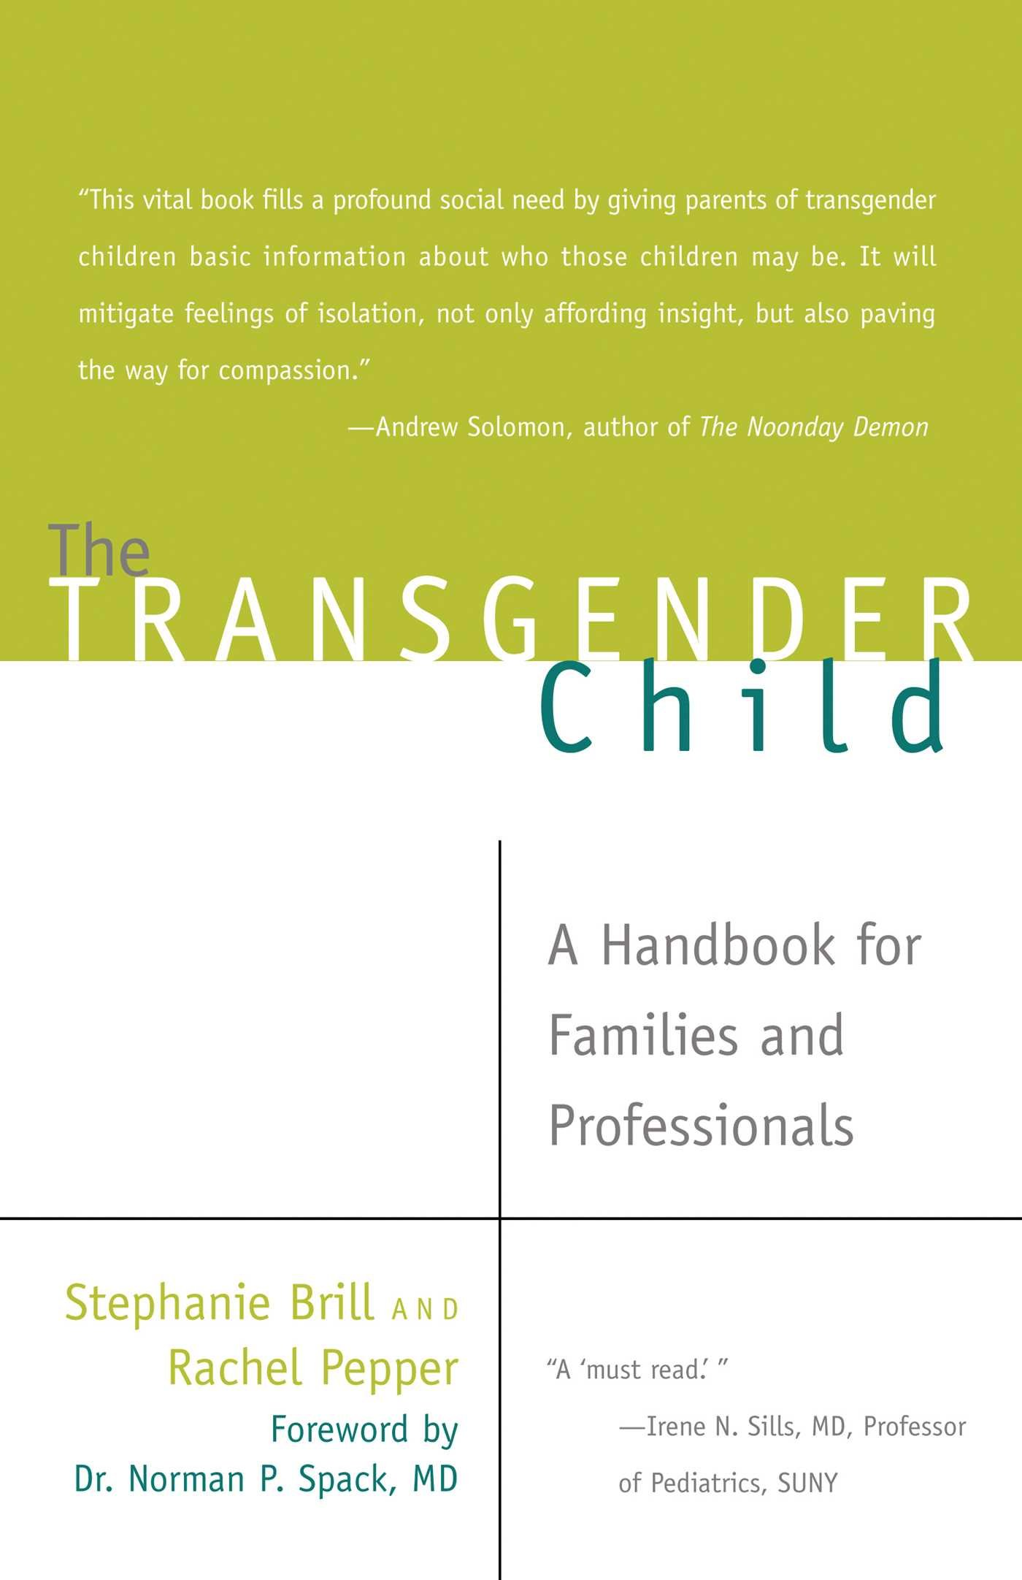
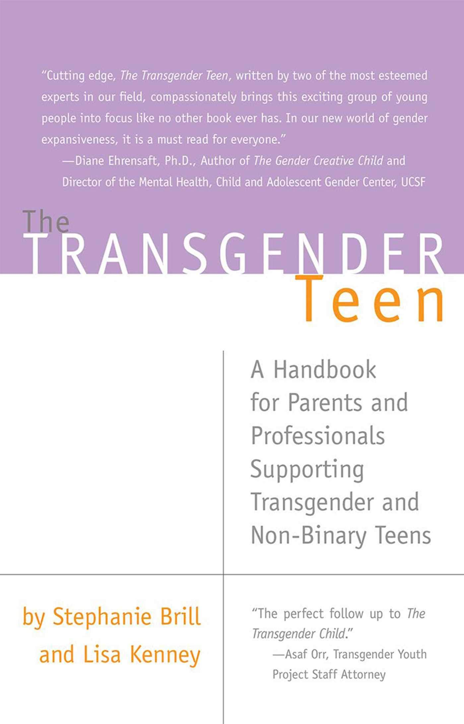
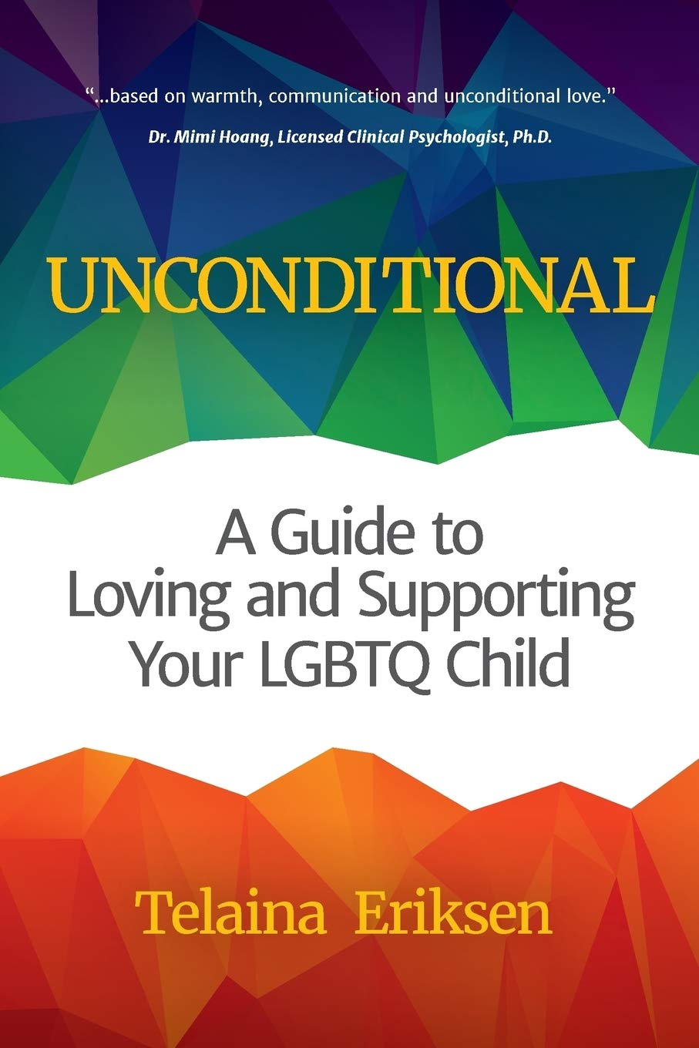

RESOURCES FOR PARENTS

Slide 46
RESOURCES
The Trevor Project
Crisis services (phone, text, IM), social network (TrevorSpace)
https://www.thetrevorproject.org/resources/
Coming out guide: https://www.thetrevorproject.org/wp-content/uploads/2019/10/Coming-Out-Handbook.pdf
Family Acceptance Project
https://familyproject.sfsu.edu/
ABCT Sexual and Gender Minority Special Interest Group
https://www.abctsgmsig.com/resources.html
https://drive.google.com/file/d/11XcsXKMtvzYqBAW6kbAqWWqj5y6lwoEM/view
APA Guidelines on Psychological Practice with Trans Folks / Sexual Minority Folks
https://www.apa.org/practice/guidelines/transgender.pdf
https://www.apa.org/about/policy/psychological-sexual-minority-persons.pdf
World Professional Association for Transgender Health – Standards of Care 8
https://www.tandfonline.com/doi/pdf/10.1080/26895269.2022.2100644

Slide 47

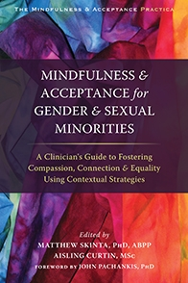
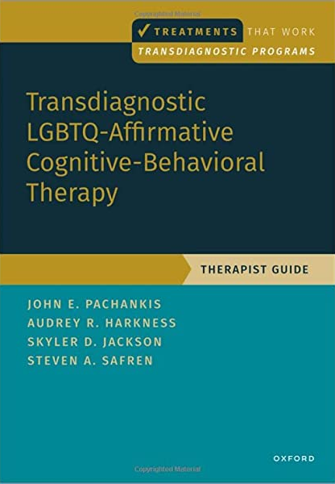
RESOURCES

Slide 48
Thank you! Questions?
i.seagervandyk@massey.ac.nz
www.ilanaseagervandyk.com

Slide 49
Source Citation for this Presentation
With website link
Seager van Dyk, I. (2022). The Kids Are Alright: Affirming CBT with LGBTQ+ Youth and their Families [PowerPoint slides]. Retrieved from https://sccap53.org/resources/education-resources/webinars/
Without website link
Seager van Dyk, S.K. (2022). The Kids Are Alright: Affirming CBT with LGBTQ+ Youth and their Families [PowerPoint slides]. Webinar sponsored by the Society of Clinical Child and Adolescent Psychology, Division 53 of the American Psychological Association. New York, NY.

