Slide 1
R. Bob Smith PhD. Excellence in Psychological Assessment Webinar
Bob Smith Award was created to recognize Bob Smith, Ph.D. for his many years of service to the psychological profession by upholding the highest standards when creating and publishing evidence based psychological assessments. Bob began his career as a psychologist and later went on to found Psychological Assessment Resources (PAR).
The individual or organization selected must be committed to an evidence-based approach to assessment.
SCCAP members will receive a free CE credit from the proceeds from this endowed award. Certificates will be emailed to all attendees within 2 weeks.
Join us on Twitter! @SCCAP53

Slide 2

Assessing the Limited Prosocial Emotional Specifier: A Case Study in Evidence-based Assessment & Diagnosis
Presented by: Paul J. Frick PhD, Louisiana State University
Moderator: Jill Ehrenreich-May, PhD, University of Miami
The webinar will use the assessment of limited prosocial emotions as a case example of evidence-based principles for clinical assessments. Research on the basic characteristics of callous-unemotional traits and research showing their clinical importance, which led to their inclusion as a specifier in the DSM-5 for the diagnosis of Conduct Disorder, will be presented. The development and use of rating scales and clinician ratings to assess CU traits will be discussed, including how research should inform their use in clinical assessments

Slide 3
Audience Questions and Answers
Submit a question during the webinar:
Post your questions for the Q&A segment! On right side of screen, click on the Questions tab on the Go-To-Webinar control panel, and submit your questions

Slide 4
Specifier for Conduct Disorder in the DSM-5: “with Limited Prosocial Emotions”
American Psychiatric Association, 2013
To qualify for this specifier, a person must have displayed at least two of the following characteristics persistently over at least 12 months and in multiple relationships and settings. These characteristics reflect the individual’s typical pattern of interpersonal and emotional functioning over this period and not just occasional occurrences in some situations. To assess the criteria for the specifier, multiple information sources are necessary. In addition to the individual’s self-report, it is necessary to consider reports by others who have known the individual for extended periods of time (e.g., parents, teachers, co-workers, extended family members, peers).

Slide 5
Specifier for Conduct Disorder in the DSM-5: “with Limited Prosocial Emotions”
American Psychiatric Association, 2013
Lack of Remorse or Guilt: Does not feel bad or guilty when he/she does something wrong (exclude remorse when expressed only when caught and/or facing punishment). The individual shows a general lack of concern about the negative consequences of his or her actions. For example, the individual is not remorseful after hurting someone or does not care about the consequences of breaking rules..
Callous-Lack of Empathy: Disregards and is unconcerned about the feelings of others. The individual is described as cold and uncaring. The person appears more concerned about the effects of his or her actions on him or herself, rather than their effects on others, even when they result in substantial harm to others.

Slide 6
Specifier for Conduct Disorder in the DSM-5: “with Limited Prosocial Emotions”
American Psychiatric Association, 2013
Unconcerned about Performance: Does not show concern about poor/problematic performance at school, work, or in other important activities. The individual does not put forth the effort necessary to perform well, even when expectations are clear, and typically blames others for his or her poor performance.
Shallow or Deficient Affect: Does not express feelings or show emotions to others, except in ways that seem shallow, insincere, or superficial (e.g., actions contradict the emotion displayed; can turn emotions “on” or “off” quickly) or when emotional expressions are used for gain (e.g., emotions displayed to manipulate or intimidate others).

Slide 7
ICD-11
World Health Organization, 2018
6C91.0005 Conduct-dissocial disorder, childhood onset with limited prosocial emotions. Meets all definitional requirements for Conduct-dissocial disorder, childhood onset. In addition, the individual exhibits characteristics that are sometimes referred to as ‘callous and unemotional’. These characteristics include:
a lack of empathy or sensitivity to the feelings of others and a lack of concern for others’ distress;
a lack of remorse, shame or guilt over their own behavior (unless prompted by being apprehended);
a lack of concern over poor performance in school, work, or other important activities;
limited expression of emotions, particularly positive or loving feelings toward others, or only doing so in ways that seem shallow, insincere, or instrumental; and
a relative indifference to the probability of punishment;

Slide 8
An Evidence-Based Approach to Assessing and Diagnosing Limited Prosocial Emotions
What are you trying to assess?
Why are you trying to assess it?
How should you assess it?

Slide 9


I. What are Callous-Unemotional Traits?

Slide 10
Source: Debrito et al., 2021

Slide 11
Dimensions of Psychopathy in Children
Callous-Unemotional
Is unconcerned about the
feelings of others
Does not feel bad or
guilty
Is unconcerned about
school work
Does not keep promises
Does not show emotions
Does not keep same
friends
Narcissism
Thinks he/she more
important than others
Brags excessively about
accomplishments
Uses or cons others
Can be charming in
ways that seem
insincere
Becomes angry when
corrected
Impulsivity
Acts without thinking
Does not plan ahead
Engages in risky
activities
Blames others for
mistakes
Gets bored easily
Source: Frick, Bodin, & Barry, 2000

Slide 12
The Affective Components of Conscience

Slide 13
Dimensions of Psychopathy in Clinic- Referred Children
Christian, Frick, Hill, Tyler, & Frazer, 1997
B
B
C
B
A
A
N=38
N=29
N=11

Slide 14
CU Traits in Clinic-Referred Children
Christian, Frick, Hill, Tyler, & Frazer, 1997
 | Clinic Control | Impulsive Conduct | CU Conduct
 | (n=38) | (n=29) | (n=11)
Impulsivity | 7.9 a | 19.9 b | 22.4 b
(SD) | (2.9) | (3.7) | (3.7)
CU Traits | 5.3 a | 8.4 b | 16.1 c
(SD) | (2.3) | (2.3) | (1.9)
ODD | 5% | 90% | 100%
CD | 0% | 45% | 55%
ADHD | 74% | 100% | 100%
Age | 8.2 | 8.9 | 9.9
(SD) | (1.7) | (2.6) | (1.7)

Slide 15
CU Traits in Clinic-Referred Children
Christian, Frick, Hill, Tyler, & Frazer, 1997
 | Clinic Control | Impulsive Conduct | CU Conduct
 | (n=38) | (n=29) | (n=11)
CBCL Aggression | 5.7 a | 17.8 b | 22.8 c
(SD) | (4.84) | (9.45) | (9.55)
CBCL Delinq. | 1.4 a | 4.3 b | 7.9 c
(SD) | (1.09) | (3.19) | (7.02)
Police Contacts | 0% a | 14% ab | 36% b
Parental APD | 8% a | 14% ab | 40% b

Slide 16
Callous-Unemotional Traits and Reward Dominance
Barry, Frick, DeShazo, McCoy, Ellis, & Loney, 2000
B
A
A
A

Slide 17
The Development of Prosocial Emotions
Frick & Kemp, 2021
Ties it to normal developmental processes
A fearless temperament
Warm parenting
Differentiates it from other processes involved in behavioral regulation.
Explains some of the key clinical features (e.g., aggression)
Allows for preventive programs to be implemented before conduct problems become severe.

Slide 18
II. Why Assess Callous-Unemotional Traits?

Slide 19
CU Traits and Severity of Antisocial Behavior in Youth
Frick, Ray, Thornton, & Kahn, 2014
118 published studies (70 cross-sectional and 48 longitudinal) of children and adolescents
105 (89%) found evidence that CU or psychopathic traits were associated with more severe antisocial and aggressive behavior (Mn = .33; -.15-.84)
91 used CU traits specifically
30 showed CU traits were associated with antisocial outcomes controlling for conduct problem severity
25 controlling for impulsivity/ADHD
4 controlling for aggression separate from other conduct problems
4 controlling for childhood-onset to conduct problems

Slide 20
Predictive Utility of CU Traits CONTROLLING for Other Indices of Severity
McMahon et al., 2010
Predictor (Grade 7) | Adult Arrests (n=754) | ASPD Symptom Count (n=511) | APSD Diagnosis (n=503)
CU Traits | .87 ** | .46 * | .30 *
CD Sx/Dx | .43 ** | .19 | -.02
ODD Sx/Dx | -.17 | .19 | .20
ADHD Sx / Dx | .00 | -.04 | .01
Childhood onset | -.11 | .58 * | .33 *
Standardized regression coefficients showing independent contribution. * p < .05; ** p < .01; Adult = 2 years post-high school. For continuous outcomes (adult arrests and ASPD criterion count), the criterion counts of CD, ODD, and ADHD were included as covariates. For the binary outcome (ASPD diagnosis), CD, ODD, and ADHD diagnoses were included as covariates.

Slide 21
CU Traits and Unique Correlates to Antisocial Behavior in Youth
Frick, Ray, Thornton, & Kahn, 2014
33 studies of cognitive correlates, 26 studies of emotional correlates, 32 studies of biological correlates, and 20 studies of temperamental/personality correlates
Reduced responsiveness to negative emotional stimuli, especially pain or distress cues
Abnormal responses to punishment cues
Negative correlations with fear/anxiety/neuroticism, especially controlling for level of conduct problems

Slide 22
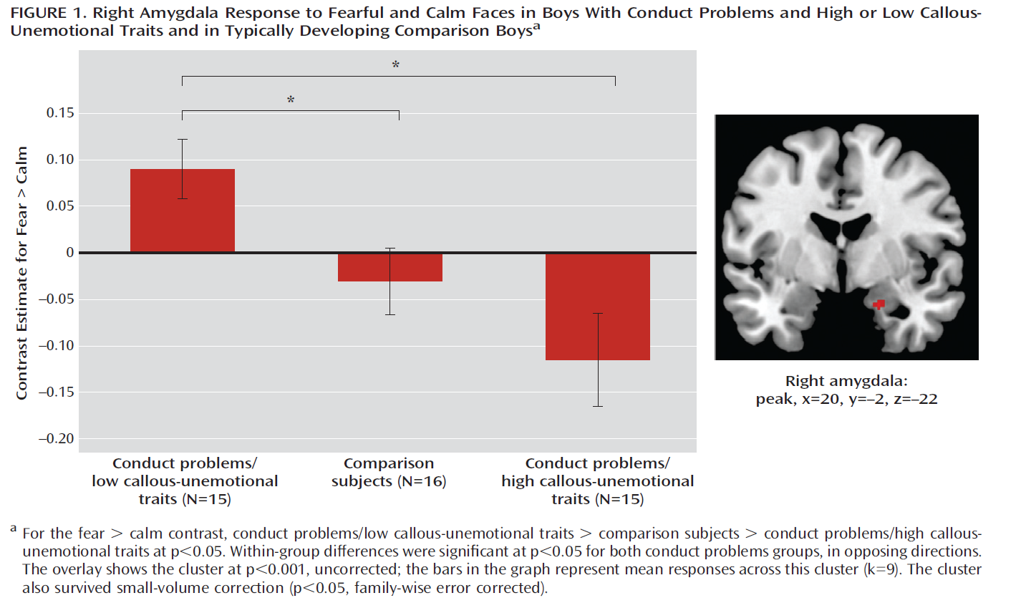
Unique Characteristics of Chilren with Conduct Problems with and without Callous-Unemotional Traits
Viding et al., 2012

Slide 23
Some Clues for Treating Children with CU Traits
21 studies of treatment response in children and adolescents with psychopathic traits (n=8) or CU traits (n=13) (Frick et al., 2014)
17 studies (85%) showed that CU or psychopathic traits were related to poor response to treatment.
Juvenile justice system (Falkenbach et al., 2003; Gretton et al., 2001; Spain et al., 2004)
Less likely to participate in treatment
Lower quality of participation
Higher rates of recidivism after treatment
Inpatient psychiatric hospitalization (Stellwagen & Kerig, 2010)
Longer lengths of stay
More physically restrictive interventions (e.g., seclusion and physical restraint)
Outpatient summer treatment (Haas et al., 2011)
Negatively associated with 9 of 14 outcome measures.

Slide 24
Evaluation of Functional Family Therapy for Adolescents with CU Traits
White, Frick, Lawing, & Bauer, 2013
134 arrested adolescents referred to CMH for FFT
Ages 11 - 17 (Mn= 15.34; SD= 1.34)
72% male / 59% African-American
Offense type:
45% status
22% violent
19% property
6% drug

Slide 25
Evaluation of Functional Family Therapy for Adolescents with CU Traits
White, Frick, Lawing, & Bauer, 2013
 | Emotional Symptoms | Relations w Parents | Interpersonal Relations | Aggression | Conduct Problems
Pre-Tx | .41 *** | -.41 ** | -.34 ** | .62 ** | .64 **
Post-TX
TX Change | -.24 * | .07 | -.02 | -.40 ** | -.27 **
Correlations are with CU Traits; treatment change measured by subtracting post-treatment scores from pre-treatment scores; COM=Client Outcome Measure; * p <.05 ; ** p < .01

Slide 26
Evaluation of Functional Family Therapy for Adolescents with CU Traits
White, Frick, Lawing, & Bauer, 2013
 | Base Rate | Priors | CP | CU
DURING TREATMENT
All charges | 48% | 1.238 ** | .995 | 1.029
Violent charges | 15% | 1.221 ** | .949 * | 1.165 **
6 MONTH POST
All charges | 42% | 1.100 * | 1.004 | 1.035
Violent charges | 14% | 1.118 * | .997 | 1.082ª
12 MONTH POST
All charges | 63% | 1.072 | 1.005 | 1.013
Violent charges | 22% | 1.134 * | .998 | 1.032
Coefficients are odds ratios from logistic regression analyses; ª p = .057; * p < .05; *** P < .01

Slide 27
Evaluation of Functional Family Therapy for Adolescents with CU Traits
White, Frick, Lawing, & Bauer, 2013
 | Emotional Symptoms | Relations w Parents | Interpersonal Relations | Aggression | Conduct Problems
Pre-Tx | .41 *** | -.41 ** | -.34 ** | .62 ** | .64 **
Post-TX | .23 * | -.38 ** | -.31 ** | .45 ** | .36 **
TX Change
 | Youth – COM | Parent –COM | Therapist COM | Sessions Attended | Treatment Drop-Out
Post-TX | -.21 * | -.28 ** | -.16
Correlations are with CU Traits; treatment change measured by subtracting post-treatment scores from pre-treatment scores; correlations in parenthesis are partial correlations controlling for pre-treatment scores; COM=Client Outcome Measure; * p <.05 ; ** p < .01

Slide 28
Parent-Child Interaction Therapy-CU
Enhances PCIT by:
Coaching parents to engage in warm, emotional responsive parenting
Shifts emphasis away from punishment to reward to change behavior
Adds Coaching and Rewarding Emotional Skills (CARES) module to target empathy.

Slide 29
Parent-Child Interaction Therapy-CU
Uncontrolled test (Kimonis et al., 2018)
23 families of 3 to 6 year old children (87% boys) with conduct problems and elevated CU traits
21 weekly one-hour sessions (6 CARE sessions)
Decreased child conduct problems, CU traits, and increased empathy, with “medium” to “huge” effect sizes (ds = 0.7 – 2.0)
Maintained gains at 3 months with 75% of treatment completers no longer being clinical significant for conduct problems.

Slide 30
III. How to Assess Callous-Unemotional Traits

Slide 31
A. The Inventory of Callous-Unemotional Traits

Slide 32
Callous-Unemotional Traits
Is unconcerned about the feelings of others.
Does not feel bad or guilty.
Is unconcerned about school work.
Does not show emotions.
Does not keep promises.
Does not keep the same friends.

Slide 33
Callous-Unemotional Traits
Is unconcerned about the feelings of others.
Does not feel bad or guilty.
Is unconcerned about school work.
Does not show emotions.
Does not keep promises.
Does not keep the same friends.

Slide 34
Inventory of Callous- Unemotional Traits
Ciucci et al., 2013; Essau et al. 2006; Fanti et al., 2009; Kimonis et al., 2008; Roose et al, 2010
I feel bad or guilty when I do not care if I get into trouble
I do something wrong (I)
What I think is “right” and
I apologize (“say I’m “wrong” is different from what
sorry”) to persons I hurt (I) other people think
I easily admit to being I do not feel remorseful when I
wrong (I) do something wrong.

Slide 35
Inventory of Callous- Unemotional Traits
Ciucci et al., 2013; Essau et al. 2006; Fanti et al., 2009; Kimonis et al., 2008; Roose et al, 2010
I am concerned about the I do not care who I hurt to get
feelings of others (I) what I want
I try not to hurt others I seem very cold and uncaring to
feelings (I) others
I try do things to make The feelings of others are
others feel good (I) unimportant to me.

Slide 36
Inventory of Callous- Unemotional Traits
Ciucci et al., 2013; Essau et al. 2006; Fanti et al., 2009; Kimonis et al., 2008; Roose et al, 2010
I care about how well I do I do not care about being on
at school or work (I) time.
I always try my best (I) I do not care about doing
things well.
I work hard on everything I do (I)
I do not like putting the time
into doing things well.

Slide 37
Inventory of Callous- Unemotional Traits
Ciucci et al., 2013; Essau et al. 2006; Fanti et al., 2009; Kimonis et al., 2008; Roose et al, 2010
I express my feelings openly (I) I do not show my emotions
I am very expressive and I hide my feelings from
emotional (I) others
It is easy for others to tell I do not let my feelings
how I am feeling (I) control me.

Slide 38
Summary of Reliability and Validity
Translated into 28 languages (https://faculty.lsu.edu/pfricklab)
Used in over 300 published studies (https://faculty.lsu.edu/pfricklab/)
Meta analyses of 75 papers with 115 samples and 27,947 participants (Cardinale & Marsh, 2020)
Alpha = .83 (n=27,327)
Correlation with Affective Dimension of psychopathy - r=.46 (n =7,050)
Correlation with externalizing - r=.34 (n=13,899)
Correlation with empathy - r=-.42 (n=2,575)

Slide 39
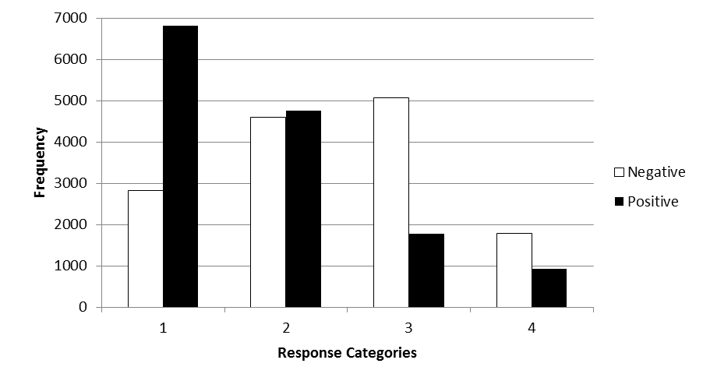
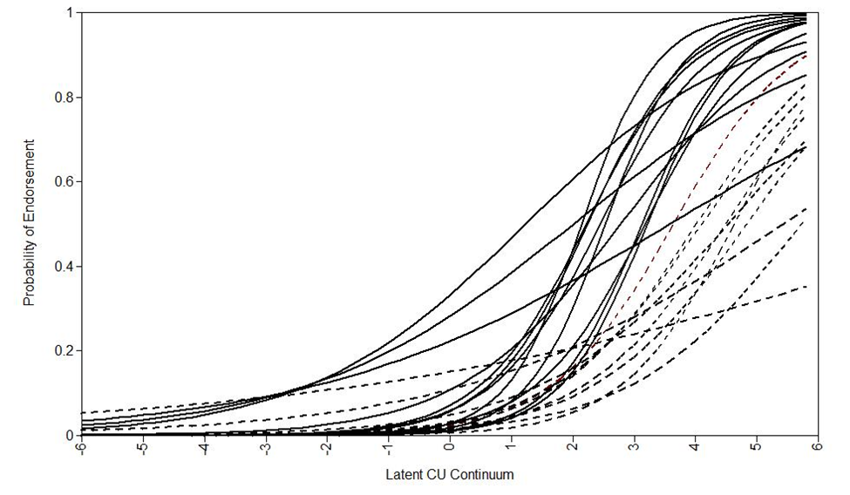
Item Analysis of the ICU
Ray, Frick, Thornton, Steinberg, and Cauffman, 2015
Positive – “I do not care who I hurt to get what I want” .
Negative – “I am concerned about the feelings of others”
Ratings - 1 = “Not at all true”; 2 = “Somewhat true”; 3 = “Very true”; 4 = “Definitely true”

Slide 40
Influence of Item Difficulty on Scale Interpretation
Leads to a factor structure highly influenced by method variance.
Not really a “callous” and an “uncaring” dimension
Positive items discriminate best in more antisocial samples and negative items discriminate best in normative samples.
When using individual items, different cut-scores are needed to equate severity of positive and negative items

Slide 41
Concerns about the Unemotional Scale (Cardinale & Marsh, 2020)
Alpha = .71 (n=26,844)
Inter-correlations
Callous = .24 (n=18,988)
Uncaring = .30 (n=18,988)
Correlations with antisocial behavior
Externalizing = .05 (n = 19,942) vs .35 and .25
Proactive aggression = .06 (n=3,642) vs .44 and .33
Other Correlations
Empathy = -.22 (n=3,592) vs. -.25 and -.35

Slide 42
Increasing Divergence from Antisocial Behavior

Slide 43
Establishing Clinical Cut-offs (Kemp et al., 2021)
Normative
Community samples from Belgium, Cyprus, Germany, and Italy
T- scores for girls ages 11-14 (N = 1,475) and 15-17 (N = 833) and boys ages 11-14 (N = 1,444) and 15-17 (N = 931) (https://faculty.lsu.edu/pfricklab/)
Empirical using RIOC (Kemp et al, 2021)
Self-report - Predicting aggression, delinquency, gun use, and arrests in sample of 1216 arrested male adolescents over 5 years
Self, parent, and teacher - Predicting conduct problems and peer nominations of social preference and being mean in 289 school children ages 8 to 15 years.
Rational
Positive items “very true” or “definitely true”
Negative items “not at all true”
Two or more of six items reach threshold
At least two domains positive

Slide 44
Comparison of Cutoff Methods in Justice Sample (Kemp et al., 2021)

Slide 45
Comparison of Cutoff Methods in School Sample (Kemp et al., 2021)

Slide 46
Range of Cut-Scores (Kemp et al )
Self Report
24 – 37
Parent Report
21-30
Teacher Report
35-46

Slide 47
Comparison of Cutoff Methods in School Sample (Kemp et al., 2021)

Slide 48
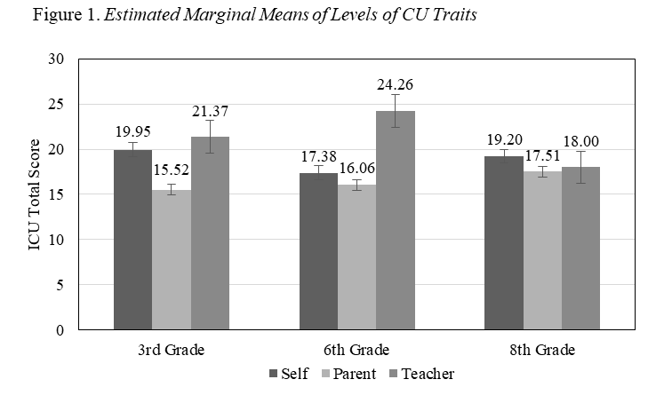
Use of Different Informants (Matlasz et al., 2021)

Slide 49
Use of Different Informants (Matlasz et al., 2021)

Slide 50
B. Clinical Assessment of Prosocial Emotions, Version 1.1 (CAPE)

Slide 51
The Basics of CAPE
Designed for ages 3 to 21
Designed to guide a clinical assessment of the DSM-5 specifier “with Limited Prosocial Emotions”
Does not assess Conduct Disorder

Slide 52
Becoming CAPE-able
Standard Training
Part I. Research on Callous-Unemotional Traits
What are callous-unemotional traits?
Why are they important?
How are children and adolescents with these traits different from other youth with significant behavior problems?
Part II. Administering and Scoring the CAPE
Didactic instruction
2 supervised cases
Ongoing supervision

Slide 53
The CAPE Process: Structure Professional Judgment
Ratings should never be based on a single answer or single source of information
Includes semi-structured interviews
Informant Interview
Self-report Interview
Other sources of information
Inventory of Callous-Unemotional Traits or other assessments of psychopathy
Records (mental health, educational, criminal)
Observations of person being assessed
Other

Slide 54
The CAPE Process: Structure Professional Judgment
Provides prototypes for key indicators of CU traits
Assessor rates how well, based on all available information, the person being assessed matches the prototype.

Slide 55
CAPE Scoring: Rating Anchors
0 | Not Descriptive or Mildly Descriptive
1 | Moderately Descriptive
2 | Highly Descriptive

Slide 56
The CAPE Scoring: Symptom Ratings
Ratings (Circle) | Symptom | Description
0 1 2 | Lack of remorse or guilt | The person rarely, if ever, feels bad or guilty when he or she does something wrong (except if he or she shows remorse when caught and/or facing punishment). The individual shows a general lack of concern about the negative consequences of his or her actions. For example, the individual is not remorseful after hurting someone or does not care about the consequences of breaking rules, unless the consequences inconvenience the person. This lack of guilt occurs in range of situations both serious and non-serious and it occurs with most people (i.e., it is not confined to only certain people or relationships).
Notes:

Slide 57
The CAPE Scoring: Symptom Ratings
Ratings (Circle) | Symptom | Description
0 1 2 | Callous-lack of empathy | The person consistently disregards and is unconcerned about the feelings of others. The individual is described as cold, callous, and uncaring by others. The person appears more concerned about the effects of his or her actions on himself or herself, rather than their effects on others, even when they result in substantial harm to others. The person frequently mocks and teases other people or says things that may hurt others feelings. The person rarely does things to try to make others feel good, like trying to cheer someone up or doing something to help someone without any possible gain from it. This callousness and lack of empathy is evident in range of situations and it occurs with most people (i.e., it is not confined to only certain people or relationships).

Slide 58
The CAPE Scoring: Symptom Ratings
Ratings (Circle) | Symptom | Description
0 1 2 | Unconcerned about performance | The person typically shows little concern about the quality of his performance in most, if not all, important activities. He or she rarely, if ever, puts forth the effort necessary to perform well, even when expectations are clear. The person does not seem concerned by poor performance indicators (e.g., poor grades, poor work evaluations) or negative feedback from others about his or her performance. He or she often blames others or circumstances for his or her poor performance or minimizes the importance of performing well.
Notes:

Slide 59
The CAPE Scoring: Symptom Ratings
Ratings (Circle) | Symptom | Description
0 1 2 | Shallow or deficient affect | The person rarely, if ever, expresses strong feelings or intense emotions to others, except in ways that seem shallow, insincere, or superficial (e.g., actions contradict the emotion displayed; can turn emotions “on” or “off” quickly). When the person describes a distressing event (e.g., an animal or person getting hurt or dying; someone losing a job), it is without showing emotions appropriate to the situation. When the individual shows intense emotional expressions they are typically used for gain such as to manipulate (e.g., get out of a punishment) or intimidate (e.g., scare someone into doing what he or she wants) others.

Slide 60
The CAPE Scoring: Symptom Count
Number of Symptoms Rated “2”
0 | 1 | 2 | 3 | 4
 |  | Meets Diagnostic Threshold for Limited Prosocial Emotions

Slide 61
The CAPE Process: Structure Professional Judgment
Assessor should not consider potential causes of the symptoms
Assessor should consider whether the emotion or trait is the way the person is typically across a range of situations and with most people
Assessor should not focus on whether the person is capable of showing the emotion or trait but whether the person actually shows the emotion or trait

Slide 62
The CAPE Process: Interviews
Typically should have self-report and at least one informant
Semi-structured interview
Each symptom has 2 or 3 key indicators (n=9)
Each key indicator has at least two stem questions
Always try to get a “yes” or “no” answer to these questions

Slide 63
The CAPE Process: Interviews
Each stem question is followed by a request for examples
More detailed information through unstructured follow-up questions
Help the clinician to understand what led to stem answer
Each stem question is followed by a series of structured follow-up questions
Includes questions to determine persistence and pervasiveness
May have additional questions to clarify stem answer

Slide 64
The CAPE Process: Interviews
Introduction: I am going to ask you about _____________ emotions and how he/she gets along with other people. I am going to ask you to answer most of these questions with either a “yes” or a “no” answer. However, if you would like to tell me more about an answer, please do so. Also, please try to be as accurate and honest as possible in trying to answer the questions.

Slide 65
The CAPE Process: Interviews

Slide 66
The CAPE Process: Interviews

Slide 67
The CAPE Process: Interviews

Slide 68
The CAPE Process: Interviews

Slide 69
The CAPE Process: Interviews

Slide 70
The CAPE Process: Interviews

Slide 71
The CAPE Process: Interviews

Slide 72
The CAPE Process: Interviews

Slide 73
The CAPE Process: Interviews

Slide 74
The CAPE Process: Interviews

Slide 75
The CAPE Process: Interviews

Slide 76
Initial Test of CAPE 1.1 Reliability and Validity (Molinuevo et al., 2020)

Slide 77
Initial Test of CAPE 1.1 Reliability and Validity (Molinuevo et al., 2020)

Slide 78
Initial Test of CAPE 1.1 Reliability and Validity (Molinuevo et al., 2020)

Slide 79
Initial Test of CAPE 1.1 Reliability and Validity (Hawes et al., 2020)

Slide 80
Initial Test of CAPE 1.1 Reliability and Validity (Hawes et al., 2020)

Slide 81
Initial Test of CAPE 1.1 Reliability and Validity (Hawes et al., 2020)

Slide 82
An Evidence-Based Approach to Assessing and Diagnosing Limited Prosocial Emotions
What are you trying to assess?
Why are you trying to assess it?
How should you assess it?

