Slide 1
APPLYING TO CLINICAL INTERNSHIPS:
INSIDER TIPS FOR MAXIMIZING YOUR SUCCESS
Presenters:
Eugene J. D’Angelo, PhD, ABPP;
Director of Training in Psychology, Boston Children’s Hospital
Associate Professor of Psychology, Department of Psychiatry, Harvard Medical School
Tina R. Goldstein, Ph.D.
Co-director of Predoctoral Psychology Internship Program, Associate Professor of Psychiatry and Psychology, Western Psychiatric Institute and Clinic, University of Pittsburgh Medical Center
Amy E. West, Ph.D.
Associate Director for Psychology Training, USC University Center for Excellence in Developmental Disabilities, Children's Hospital Los Angeles
Associate Professor of Clinical Pediatrics, USC Keck School of Medicine
Anaid (Aniya) Atasuntseva, M.S.
Ph.D. Candidate at Palo Alto University
Predoctoral Intern at the Multicultural Training Program, University of California San Francisco/Zuckerberg San Francisco General Hospital
Moderator: Yen-Ling Chen, M.A., University of Nevada, Las Vegas; SCCAP Board of Directors, Student Development Committee Chair

Slide 2
Upcoming Webinars
Submit your ideas for our 2021 Webinar Series: sccapdiv53@gmail.com
Previous webinar recordings are available on
https://sccap53.org/resources/education-resources/webinars/
Remaining SCCAP webinars:
Sept. 11 Noon ET Children and Technology Use - Justin Parent, PhD
Sept. 29 Noon ET Cannabis Use in Adolescents - Mary Fristad, PhD
Nov. 4 1pm ET R. Bob Smith Excellence in Assessment Webinar:
New Thoughts About Assessment and Diagnosis of Autism, Catherine Lord, PhD Free Member CE

Slide 3
Audience Questions and Answers
Submit a question during the webinar:
Post your questions for the Q&A segment! On right side of screen, click on the Questions tab on the Go-To-Webinar control panel, and submit your questions

Slide 4
Moving from Contemplation to Action in Applying for a Psychology Internship
Eugene J. D’Angelo, PhD, ABPP
Boston Children’s Hospital and Harvard Medical School
Contact: eugene.dangelo@childrens.harvard.edu
July 8, 2020

Slide 5
Disclosures
1. Support for both my teaching and research efforts come from:
The Linda and Timothy O’Neill Foundation
The Gertrude and Jonathan Weil Foundation
The Sidney Baer Foundation
2. Past Chair of the Association of Psychology Postdoctoral and Internship Centers (APPIC)
Past Member, Commission on Accreditation, American Psychological Association (CoA)
The opinions I express during this presentation are my personal views and do not represent either APPIC or the CoA

Slide 6
The Internship Application Process
Consideration
Deliberation
Application

Slide 7
The Association of Psychology Postdoctoral and Internship Website and the Directory are a Wealth of Free Information to Assist in Your Evaluation of Programs
www.appic.org

Slide 8
Match Statistics Provided on APPIC website
In Phases I and II of the 2020-2021 Match:
3761 individuals submitted rankings
3612 individuals (96%) matched
147 individuals (4%) did not match
261 positions in internship programs remained unfilled

Slide 9
Consideration 1: Accredited vs. Non-accredited internship
From the APPIC Match Statistics for 2020-2021:
3406 accredited positions were filled (97%)
114 accredited positions were unfilled (3%)
206 non-accredited positions were filled (58%)
147 non-accredited positions were unfilled (42%)

Slide 10
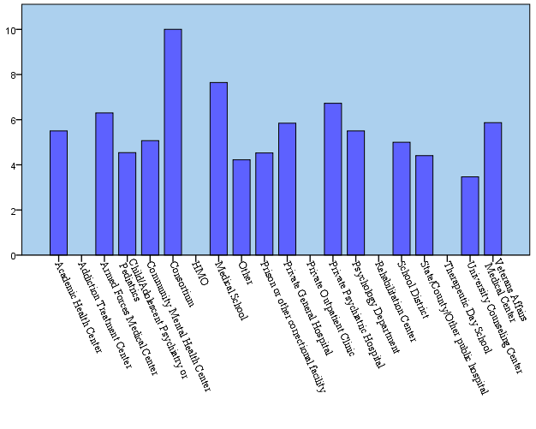
Consideration 2: What type of internship program do you want to attend?
Mean Class Size for Accredited Programs by Internship Program Type

Slide 11
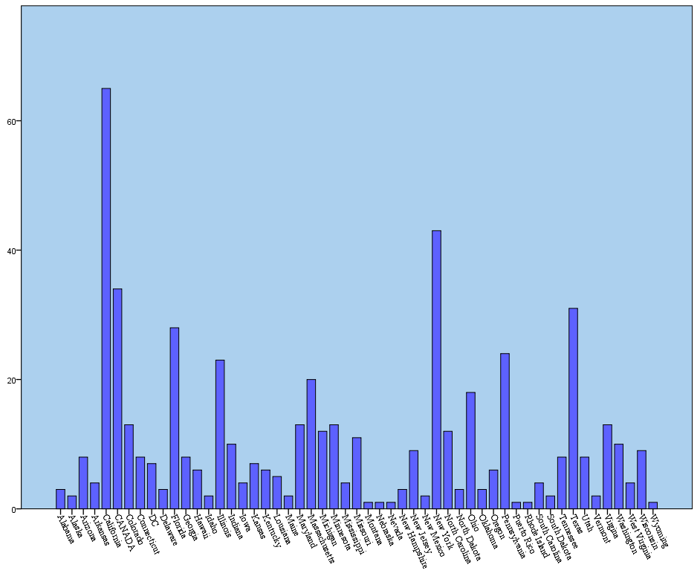
Consideration 3: Where do you want to reside during internship?
Derived From APPIC
Directory

Slide 12
Consideration #4: Check the Internship Brochure and Website for the Potential Programs
Information is provided about size of internship class, training faculty
Stipend and benefits
Internship Application Requirements—
-Minimum intervention and assessment hours
-Years of graduate school education
-Types of doctoral programs preferred
- Types of degrees accepted/preferred
Description of the program and training experience

Slide 13
From Consideration to Deliberation
Discuss the list with your advisor or Director of Clinical Training (DCT)
-How much does the advisor know about the program?
-How recent is the information?
Speak with psychologists and/or other graduate students who may have interviewed or interned at the site for their perspective.
Attend internship discussion groups and/or informational programming at regional or national conferences (eg, APA, ABCT, SPP, APAGS, state association meetings, etc)
Seek candid feedback from trusted advisors about your proposed plans for internship applications

Slide 14
APPIC Surveys of Internship Training Directors
Top 6 factors for ranking interns:
1. Fit between candidate’s experiences/goals and the internship program
2. Interview
3. Experience with clinical population
4. AAPI essays
5. Letters of recommendation
6. Multicultural sensitivity

Slide 15
From Deliberation to Application
Confirm your list with your mentor/advisor
Allow sufficient time to request letters of recommendation from faculty and/or supervisors
Fill in the AAPI Online honestly
Check applications for completeness and accuracy
Determine whether an interview can be scheduled virtually
Mean number of applications submitted by candidates in 2020-2021: 15.4
Thank you for your attention!!!

Slide 16
Internship Application Materials
Amy E. West, Ph.D.
Internship Training Director
University of Southern California/Children’s Hospital Los Angeles

Slide 17
Most Important!
CV
Personal Statement
Cover letter

Slide 18

The Curriculum Vitae

Slide 19
CV Tips -- Do
Tailor it to the type of internship (e.g., clinical vs. clinical science)
  Describe awards
  Describe responsibilities for practica and research projects
Publications – be clear about published vs. in press or under review, and peer review vs. non-peer review
PROOF it! (the importance of this cannot be overstated)
Make it easy to read and visually appealing
  Use bolding, caps, font, etc. to make it easy on the eye and highlight important parts. Include spaces!
  Be concise, consistent with tenses and style, good grammar; use active voice; use psychological jargon cautiously
Ask peers and mentors for examples
Include volunteer service (will speak to your character)

Slide 20
CV Tips – Don’t
Don’t pad it
  Don’t include courses you took or conferences/workshops attended (with no presentation)
  Leave off undergraduate accomplishments unless really impressive (Rhodes scholar)
Don’t get too personal
  Leave off hobbies, marital status, children, other jobs not relevant to psychology
Don’t worry about length – there are no rules
Don’t try to be “cute” or humorous

Slide 21
Vita Checklist
Name and contact information: work, home, address, phone, email
Education, including degrees, places, and dates
Dissertation topic, advisor
Licenses/certifications
Honors, scholarships, fellowship, or awards
Professional Experience
Teaching, research, or clinical experience
Publications
Professional or academic presentations
Professional organization memberships
Volunteer/service work

Slide 22

Personal Statement

Slide 23
Basic Structure
What are your short and long term professional goals?
  Immediate, 5-10 year and ultimate long term plans?
How did these goals develop?
  Specific or personal challenge?
How have you already begun to lay the foundation for these goals?
  Activities?
How does this internship fit into these goals?
  Skills and knowledge?

Slide 24
Personal Statement - Do
Define a central idea
Tell the story (what happened)
Tell what you learned (what you got out of it)
Tell how what you learned applies to success in [the internship] (why it matters)
Highlight your strong points; include interests and goals
Be truthful
Write from the heart
Be positive but avoid excessively altruistic statements (e.g., “I just want to help people.”).

Slide 25
Personal Statement – Don’t
Quote other people
Use clichés
Use altiloquent vocabulary
Negative comments and excuses
Be too candid. For example, avoid references to your mental health. Avoid providing excessively self-revealing information
Use inappropriate humor, attempts to appear cute or clever, and references to religious issues or politics
Adapted from: http://users.clas.ufl.edu/msscha/psych/personal_statement.html https://psych.iupui.edu/sites/default/files/guidetowritingapersonalstatement_1.pdf

Slide 26

Cover Letter

Slide 27
Basics
Cover letters are 1-2 page documents
  Introduce yourself to the program director
  Argue why you would be a good fit for the internship
  Fill in places your curriculum vitae cannot describe
  Further explain other aspects of your curriculum vitae
APA emphasizes that you should:
  Show you are a good fit
  Get past the gatekeepers
  Customize
  Mind the details
  Don't get too personal

Slide 28
Cover letter Structure
Opening paragraph: Clearly state why you are writing. Give a brief introduction of yourself and your status, e.g. “I am completing my PhD in [department or field] and I expect to finish [or defend, or graduate] in [Month, Year]. You could add to this sentence, the name of your dissertation or the topic of your research, as well as the name of your advisor.
Middle paragraphs: You should have several paragraphs that elaborate on how your research and other experiences in graduate school that have prepared you for the internship as it is described. Describe how your research and clinical activities have led you here. In order to stand out from the potentially long list of applicants, you will need to make a coherent argument for why you are a good fit. What kind of contribution will you make to their program? How will you fit in? Make sure you are writing for your target audience.
Closing paragraph: Indicate that your CV and other supporting documentation are enclosed. Express interest in speaking with the addressee further in a personal interview. Thank them for their time and consideration.

Slide 29
Cover Letter -- Do
Address the specific internship materials
Speak to the specific needs of the organization
Highlight key words from the materials
Show your passion
Keep the letter concise
Focus on demonstrating match
Thank your reader
Proofread!

Slide 30
Cover letter – Don’t
Reiterate your curriculum vitae
Have a boring opening statement
Ramble
Use jargon
Underestimate the importance of a good cover letter

Slide 31

Interviewing
for
Internship
Tina Goldstein PhD
Co-Director, Predoctoral Psychology Internship Program
Western Psychiatric Hospital, University of Pittsburgh Medical Center
SSCAP Internship Webinar
July 8, 2020
Western Psychiatric Hospital

Slide 32

It’s all about the FIT!
What kind of career is this site preparing interns for?
How does the site fit with your own career goals?
Consider the environmental culture
and the individuals you meet
Notes:
Consider whether these are the types of people you want to be working with and learning from

Slide 33
The Interview: Basics
Be yourself
Stay calm
Present yourself professionally
Convey (genuine) enthusiasm
We want to know you!
The best interviews are conversations
(…and don’t forget that they’re still interviews)
Practice! (really, practice)

Slide 34
The Interview: Tips for Preparing
Do your homework!
Know the site
tracks
rotations
size
sites
requirements
timeframe
Ask informed questions (come prepared with questions…)
Take notes afterward
Thank you notes / emails

Slide 35
The Interview: Commonly Asked Questions
General
Why are you interested in this site?
What can you bring to this internship?
What are your long-term career goals?
Where do you see yourself in 2/5/10 years post-internship?
Clinical
Describe a recent clinical case that went well.
Describe a clinical case that presented a challenge for you.
Research
Tell me about your dissertation.
Where does research fit into your career aspirations?
Who would you be interested in working with on research here?

Slide 36
Questions for Current Interns at the Site
What is a typical work day like?
What are the expectations for billable/supervision hours?
How does your experience match with what you expected?
What is your experience with faculty/supervisors/trainees?
What are the program's strengths and weaknesses?
To what extent do you feel supported?
What is it like living in [CITY]?

Slide 37

Thank you!
I welcome your questions…

Slide 38
Applying for Internships: A Student Perspective
Anaid (Aniya) Atasuntseva, M.S.
Predoctoral Intern, Multicultural Training Program (MCTP)
University of California, San Francisco/ Zuckerberg San Francisco General Hospital
Postdoctoral Fellowship, Adolescent DBT Program, Stanford University

Slide 39
Applying for Internships: A Student Perspective
My background:
  Clinical Psychology Ph.D. from Palo Alto University (t-minus 6 weeks)
  Clinical interests: Emotion Regulation/ Anxiety; underserved children/adolescents
  Research interests: Consumer-Centric research with the goal of addressing barriers to accessibility of evidence-based practices in marginalized youth
  Major clinical experiences:
    1 year practicum at a community mental health agency providing outpatient therapy to children and adults
    1 year practicum at community mental health agency providing outpatient therapy and assessment to children and adults as well as outpatient therapy in a K-6 school.
    1 year practicum at specialty DBT-informed Intensive Outpatient Program providing individual, group, family therapy and assessment in an outpatient hospital setting.
  Applied in Fall 2018 to evidence-based community mental health agencies and academic medical centers with Child/Adolescent tracks with a focus in interdisciplinary treatment
  Matched to MCTP at UCSF/ZSFGH, a large community mental health agency within an academic medical center in SF

Slide 40
Big Picture
Fit is real, and it is important!
Take care of yourself
It’s only one year…. And…
This is just as much an opportunity for them to get to know you as it is for you to get to know them
Second Match is not the end of the world

Slide 41
Application Tips
Start early! Like NOW
Deciding on what site to apply to
  Brainstorming your goals before searching for sites
    What do you want more training in? What are the gaps you want to fill?
    Location can be a factor but it shouldn’t be the only factor
    If you are geographically restricted on where you can apply, be flexible on other aspects and apply to more sites
    Have a good mix of sites: Red, Yellow, Green
Start a spreadsheet to organize info about sites, application requirements
Consider budget for application & interviews. Don’t apply to a million just because
Ask everyone you know who was a similar applicant to you to share their site lists
Notes:
A bit controversial but you I was land locked due to family and applied east and west coast but rather than compromising on goals applied for places out of my regions a bit. Had to apply to a lot more places as a safety
Don’t decide on a list just on national averages for yearly applications curate your site based on their relationship with your school, your individual lab ect
You really should have like ½ yellow sites, ¼ green back up) ¼ red but honestly it varies so much and don’t leave off a site just cause its hard if it’s a perfect fit
I spent nearly $5000 due to having to fly a lot and applying to 25 places due to being geographically restricted and having requirements from my school

Slide 42
Application Tips
Essays
  Revise, Revise, Revise
  Multiple readers
  Tailor towards type of site
Cover Letters
  Showcase your fit
  Not just about what you can offer, what can you learn?
  Be as specific as possible
  Unique letters are necessary but you can have a template for each type of site
Notes:
No that doesn’t mean have 15 different versions of each essay but varying your essays slightly with 2-3 versions may communicate fit easier

Slide 43
Interview Tips
Create a Calendar with all possible interview dates
Practice!
Check email regularly and have phone handy for interview offers
Schedule strategically
  Interview in December if Possible
  Leave minimum one day between trips to account for weather
  Spend time in the region and get to know your location
Use your cover letter as your study guide and make a list of quick facts from the brochure to review before
Take detailed notes after interviewing at each site or audio record your thoughts
Notes:
Practice with people that you don’t know at your school or with professors that make you nervous. My practice interview with my advisor was by far the hardest/ scariest and it set me up well

Slide 44
Interview Tips
Prepare for both structured and unstructured interviews
  Have generic and site-specific questions to ask
  Send thank-you emails
  Talk to other interviewees to give you a sense of your “fit” with the site
Take advantage of time with current interns
  Ask about:
    Hours, Telehealth options, Day-to-day schedules
    Support for professional development
    What they wish they had known
  Get their email addresses for follow-up Qs
Give your sites numerical rankings based on your own categories
Rank with your gut
Notes:
My categories were Fit, Training experience and Location on a 10 point scale

Slide 45
COVID Caveat
A lot of interviews may be virtual, prepare for both options
If you can/ feel comfortable visit the site in person
Get a sense of what it was like for the current interns
  Did they do telehealth? Where they able to get their hours?
  Leave policies?
Take COVID into account at all steps
Notes:
Lots of things happen and I had virtual interview when I planned to be in person
Make sure you know your schools hours requirements and the requirements of the state you want to get licensed in
Important to consider what it would be like if everything was closed/ you had to WFH

Slide 46
Thank you for participating
Still have questions? Please post them on the SCCAP Listserv to continue the community discussion div53@lists.apa.org

Slide 47
Source Citation for this Presentation
With website link
D’Angelo,E.J., Goldstein,T.R., West,A.E., Atasuntseva,A.,(2020) Applying To Clinical Internships: Insider Tips For Maximizing Your Success [PowerPoint slides]. Retrieved from https://sccap53.org/resources/education-resources/webinars/recordedwebinars/
Without website link
D’Angelo,E.J., Goldstein,T.R., West,A.E., Atasuntseva,A.,(2020) Applying To Clinical Internships: Insider Tips For Maximizing Your [PowerPoint slides]. Webinar sponsored by the Society of Clinical Child and Adolescent Psychology, Division 53 of the American Psychological Association. New York, NY.

Slide 48

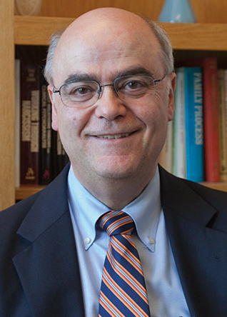
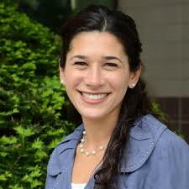
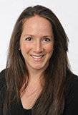
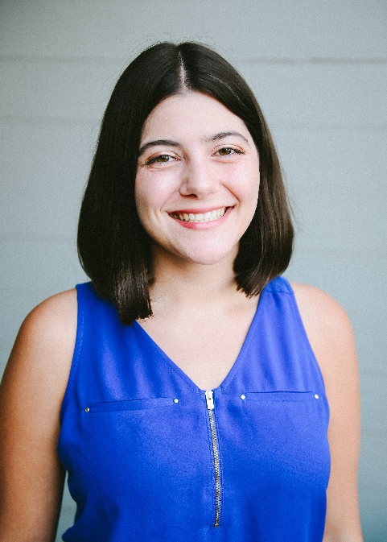
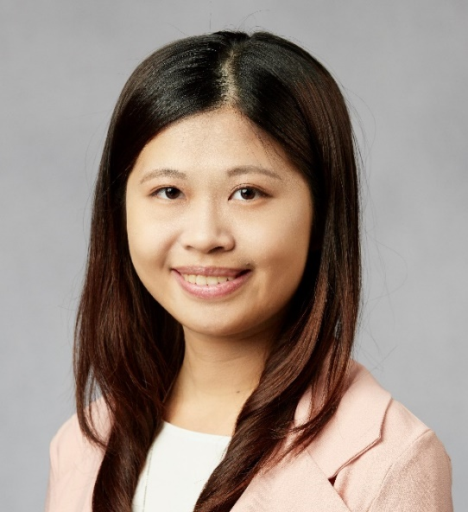
Eugene D’Angelo Tina Goldstein
Amy West Aniya Atasuntseva Yen-Ling Chen

Slide 49
Technical Issues
The webinar will be recorded and made available on SCCAP53.org.
If technical sound issues arise, we will:
1. Change from live stream images of the presenters to a placeholder slide.
2. If audio issues continue, we will request participants submit their questions and to sign-off of the webinar.
The panelist will continue to answer these questions on a recording. The recording will be edited and made available on SCCAP53.org

