Slide 1
Upcoming Webinars
Submit your ideas for our 2021 Webinar Series: sccapdiv53@gmail.com
Previous webinar recordings are available on https://sccap53.org/resources/education-resources/webinars/
July 8 Preparing for Internships Panel Discussion Eugene D’Angelo, PhD, Tina Goldstein, PhD, Amy West PhD, Aniya Atasuntseva, MS
Sept. 11 Children and Technology Use - Justin Parent, PhD
Sept. 29 Cannabis Use in Adolescents - Mary Fristad, PhD
Nov. 4 R. Bob Smith Excellence in Assessment Webinar, New Thoughts About Assessment and Diagnosis of Autism, Catherine Lord Free Member CE

Slide 2


Working in Integrated Pediatric Primary Care Settings
Presenters:
Jennifer Kuhn received her Ph.D. in Clinical Psychology from Western Michigan
University in 2016. She has extensive training and work experience in Integrated
Primary Care. She currently works as a Pediatric Psychologist in Integrated
Primary Care in two pediatric offices at Nemours/Alfred I. duPont Hospital for
Children in Wilmington, DE.
Meghan Walls, PsyD is a Pediatric Psychologist in Integrated Primary Care at
Nemours/Alfred I. duPont Hospital for Children in Wilmington, DE. She holds
appointment as assistant clinical professor of pediatrics at Sidney Kimmel
Medical College, Thomas Jefferson University.
Moderator: Chrissy Cammarata, PhD, ABPP, Nemours/AI duPont Hospital for Children and Member-at-Large for Membership, SCCAP (@SCCAP53)

Slide 3
Audience Questions and Answers
Submit a question during the webinar:
Post your questions for the Q&A segment! On right side of screen, click on the Questions tab on the Go-To-Webinar control panel, and submit your questions

Slide 4

Working in Integrated Primary Care Settings
Meghan Walls, PsyD
Pediatric Psychologist
Clinical Assistant Professor
Jennifer Kuhn, PhD
Pediatric Psychologist
Clinical Assistant Professor

Slide 5

Our Commitment to Integrated Care

Slide 6
Why Integrated Behavioral Health Care?
Physicians are “de facto” mental health providers (but often report not feeling equipped to manage concerns). (Norquist & Regier, 1996; Regier, Goldberg, & Taube, 1978)
25-50% of pediatric office visits are related to behavioral, educational, and/or emotional concerns (Kelleher & Stevens, 2009; Polaha, Dalton, & Allen, 2011)
Pediatricians rank behavior as the most common problem (over ear infections) (Arndorfer, Allen, & Aljazireh, 1999)

Slide 7
Why Integrated Behavioral Health Care?
There are multiple barriers to accessing high quality, evidence-based mental healthcare including stigma, family beliefs, and lack of follow through on referrals (Njoroge, Hostutler, Schwartz, & Matone, 2016)
2 out of 3 families follow through with community referrals within 6 months of a PCP referral
Estimates suggest up 40% of children have mental health disorders but only 30% actually receive care (Njoroge, Hostutler, Schwartz, & Matone, 2016)
Delay of care is about 8-10 years between symptom onset and intervention

Slide 8
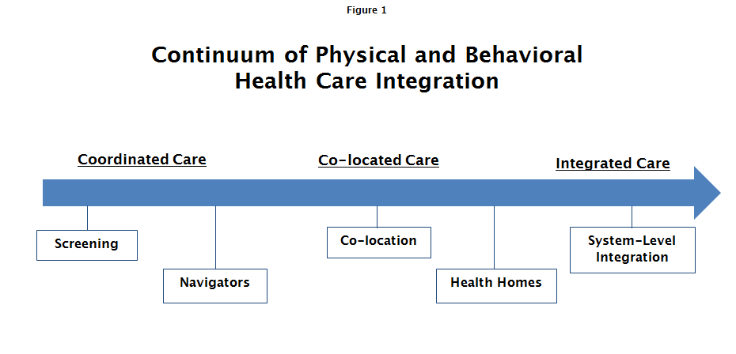
Current role of psychology and primary care

Slide 9
Coordinated, Co-Located, and Integrated Care
Coordinated Care:
Behavioral healthcare that is coordinated with the PCP
Treatment is not provided directly within primary care clinics
Co-Located Care:
Behavioral health provider is located in the primary care clinic
Very little collaboration with the PCP or medical team
Integrated Care:
Behavioral health provider is located within the primary care clinic (own office space or shares medical rooms)
Significant collaboration occurs among the medical team
Warm-handoffs allow for brief consultations with patients

Slide 10
Integration of Behavioral Health into Primary Care Practice
Advantages for PCP’s:
PCP’s have a “ready” referral source
Coordinated care is possible (warm handoffs)
Consultation and education on behavioral health topics
Diagnostic clarity
Appropriate and quick follow-up following screening tools (PHQ-9, MCHAT)
Patients are seen “in” the practice (sometimes in exam rooms)
15-20% more practice productivity

Slide 11
Integration of Behavioral Health into Primary Care Practice
Advantages for Patients:
Comfort in receiving behavioral health care in the PCP’s office
Reduced stigmatization
Coordinated physical and mental health care (medical home)
Reduced usage of inappropriate medical visits
Travel may be reduced
Focus is on prevention of negative outcomes
Improved outcomes (Asarnow, Rozenman, Wiblin, and Zeltzer, 2015).

Slide 12
Integration of Behavioral Health into Primary Care Practice
Advantages for Psychologists:
Consistent referral stream
Coordination of psychotropic medication and therapy approaches
Physician availability for consultations regarding medical conditions affecting behavior
Opportunities for screening and prevention
PHQ-9, MCHAT, Edinburgh
Uniquely situated as part of child’s medical home
Easy to build rapport due to familiarity with medical home

Slide 13
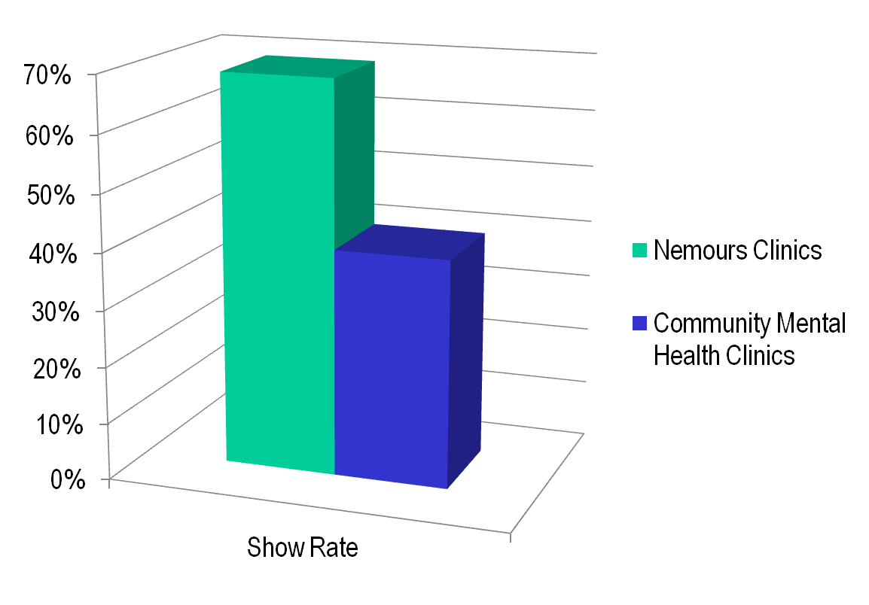
Comparison of Show Rates for Nemours Primary Care Psychology vs. Referral to Community Providers (2012)

Slide 14
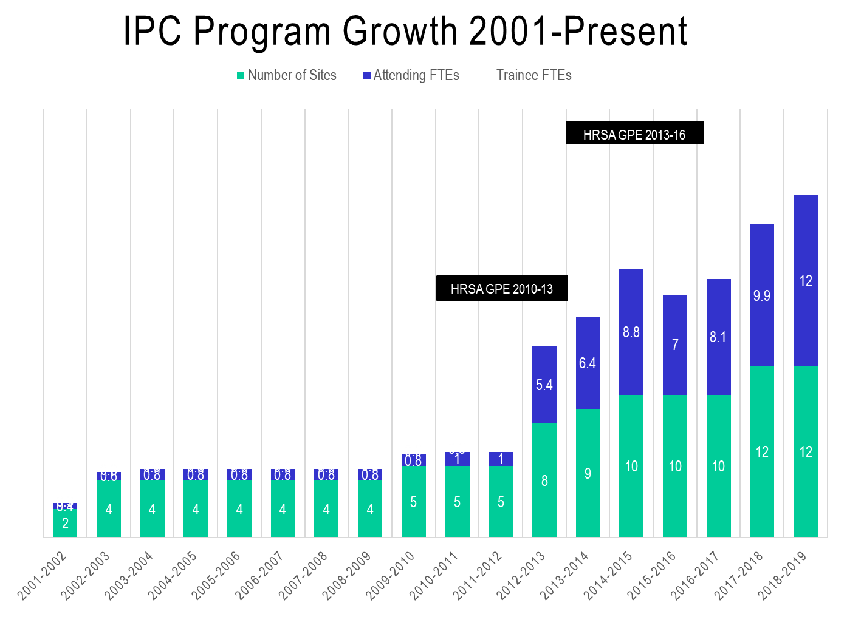
HRSA GPE 2016-19
Project LAUNCH 2014-2019
HRSA BHWET
2017-18
CMMI Asthma Award 2012-15
HRSA GPE 2007-10
HRSA GPE 2004-07
HRSA GPE
2002-04
Internal Grant 2001-02
IBH Track

Slide 15
Like primary care provider, we serve as a home base available continuously for all families of the practice

Slide 16
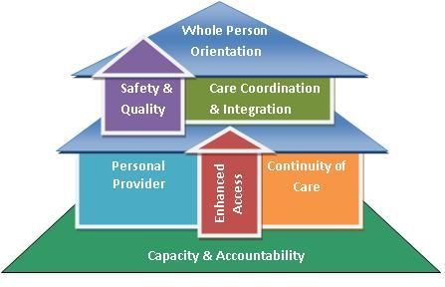

Patient Center Medical Home

Slide 17
Important Pieces of Integrated Primary Care

Slide 18
Provide integrated, evidence-informed, episodic care, and may refer to another level of care if needed

Slide 19
Provide team-based care, communicating with primary care provider, nurses, care team, schools, and other systems of care

Slide 20
Culturally and clinically responsive to the community and clinic in which we serve

Slide 21
How to get started in Integrated Primary Care

Slide 22
Get to Know Your Community and Clinic
Learn about your community by driving around, understand proximity to hospital, transportation, and local news sources to keep
Check out news/resources in the area
Meet with community providers and understand the resources available in the community
Know the local schools and most common schools attended by your clinic’s patients
Get to know the team!!
Get to know the social work or care coordination team at your sites.

Slide 23
Culturally Responsive Patient Care
Example Questions to assess cultural identity
What are aspects of your child/your family background that are important for me to know?
For you, what is the most important aspect of your background or identity?
Does religion or faith play an important role in your/your family’s life? (probe as needed)
Example Questions to reduce interaction barriers
Tell me about your experiences working with the healthcare system (doctors, psychologists, etc.). Have you felt listened to? Cared for? Discriminated against?
Have you had negative experiences with other (doctors/therapists, etc.) that you would like to tell me about?
Has anything prevented you from getting the help you need? (probe as needed)
Example Questions to assess cultural definitions of the problem
People often understand their problems in their own way, which may be similar to or different from how doctors describe the problem. How would you describe the problem?
Why do you think this is happening to you? What do you think are the causes of your [PROBLEM]?
What do others in your family, your friends, or your community think is causing your [PROBLEM]?

Slide 24
The Latest Issues
COVID-19
Disparate health conditions have led to more low in come people of color contracting COVID.
Asking about how COVID is affecting this community specifically.
Deaths of Black individuals by police
Asking about how recent events are impacting patient/families in the area of the primary care clinic.
Understanding what the physicians are seeing/hearing.
Safety assessment of the families living in areas with increased protests/violence.

Slide 25
Childhealthdata.org

Slide 26
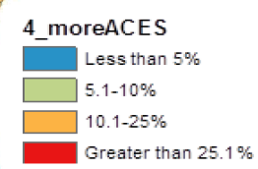
Three hot spot regions with a high concentration (>25%) of children living with adults who have experienced 4 or more ACEs: Wilmington zip codes 19703, 19706, 19713, 19720,19804,19806; Kent County zip code 19953 and Sussex County zip codes 19966, 19968.

Slide 27
What Services does Integrated Primary Care Provide?

Slide 28
Warm Handoffs
PCP Visit
Concern identified
Referral to psychology
Handoff
Opportunity to meet family
Explain psychology services and encourage scheduling
Initial Psychology Consultation
Family encouraged by continuity of care
May encourage show rate given initial meet and greet

Slide 29
Fully Integrated ADHD Management
Assessment
Collaborative assessment approach
Interpretation of assessment results and further assessment of comorbid conditions
Treatment
Conjoint approach to treatment
Medication management
Monitoring
Ongoing monitoring of systems
Behavioral treatment
Data-based decisions to determine dosage and medication changes
Additional therapy as needed

Slide 30
Other Services
Intake/Evaluation
Diagnostic evaluation
Outpatient therapy services.
Brief CBT based therapy for anxiety, depression, ADHD, pain
Some streamlined treatment protocols.
Behavioral approaches to medical adherence
Brief treatment for health behaviors such as eating, sleeping, toileting
Physician Consultation

Slide 31
Consultation Introduction
Who we are/what we do
Set up expectations
Referral reason and provider
Demonstrate team-based coordinated care
Engagement both with parent and child
Confidentiality
Team based care (behavioral health sharing agreement)

Slide 32
Typical Day in Primary Care
Review your own schedule but also review the PCPs schedules
Scan for previous patients, patients coming in for behavioral health concerns (tantrums, depression), med checks
Discuss possible consultations for the day with PCP
See follow-up patients for short-term treatment
While providing patient care, always being open and available for a warm handoff or consultation (open door policy)
Eat lunch and have meetings with the team (it’s important to build relationships within the clinic!!)

Slide 33
Integrated behavioral health providers occupy multiple roles in the office in response to address broad needs of the system (e.g., consultant, advocate, QI specialist, educator, researcher, clinician, supervisor)

Slide 34
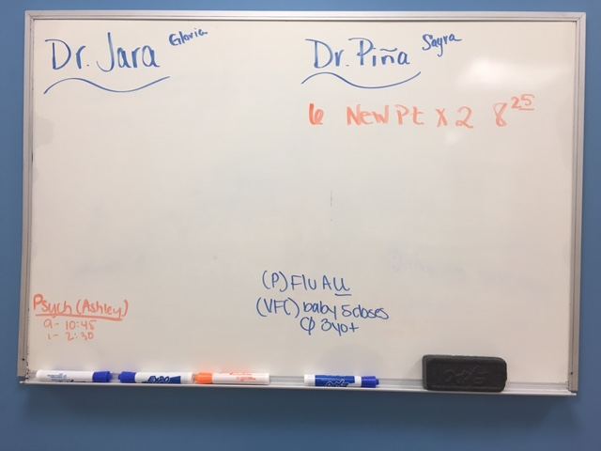
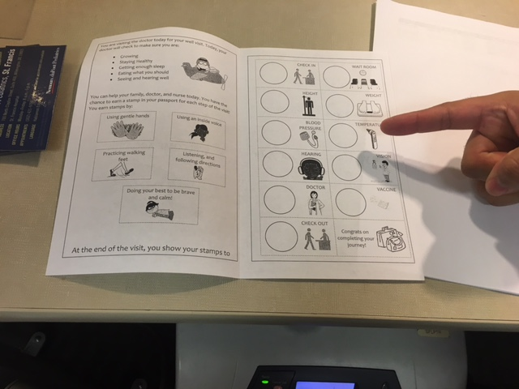
Sample QI Projects
Communication of same day availability
Pilot of disruptive behavior group
Development of behavior plan for well visits
Vaccine coping kit use
Toy cleaning
Protocol for screening Spanish-speaking families
Depression screening

Slide 35
Integrated Well Visits and Healthy Steps
HealthySteps: Zero to Three programming
Population-based, risk-stratified model that helps to operationalize and enhance the American Academy of Pediatrics Bright Futures recommendations.
Integrated primary care visits with pediatrician and behavioral health providers.
Aimed at well visits for children aged newborn-3/5 depending on plan.
Psychologists or “HealthySteps specialists” join the pediatricians during visits
Focus on attachment, baby behavior, parenting.

Slide 36
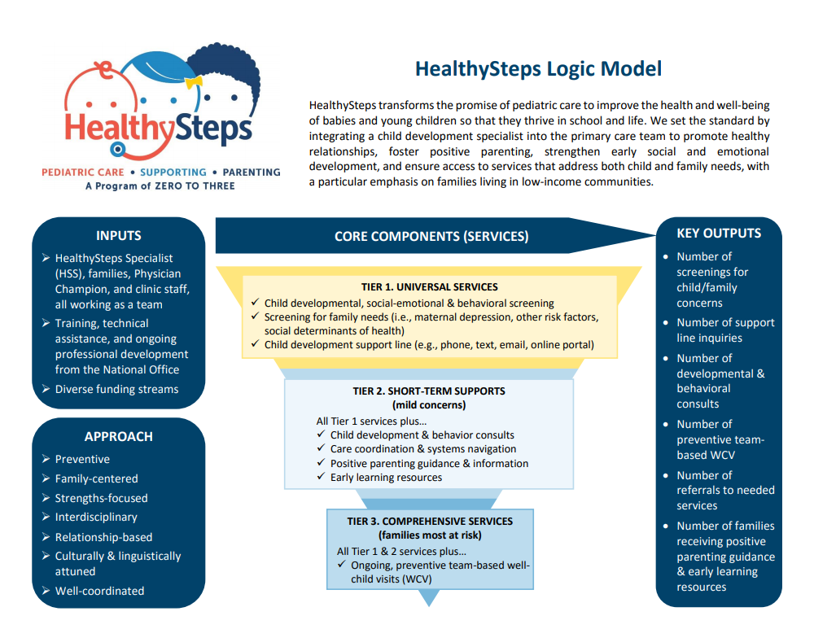

Slide 37
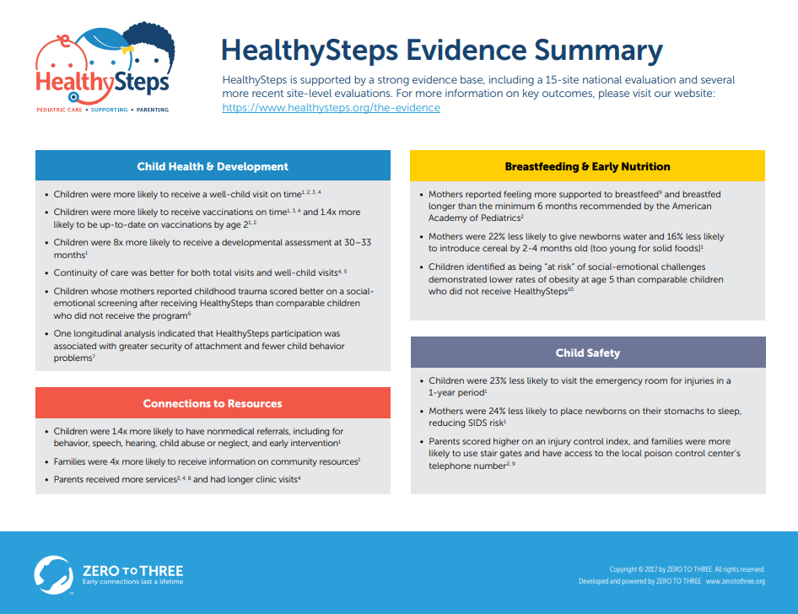

Slide 38
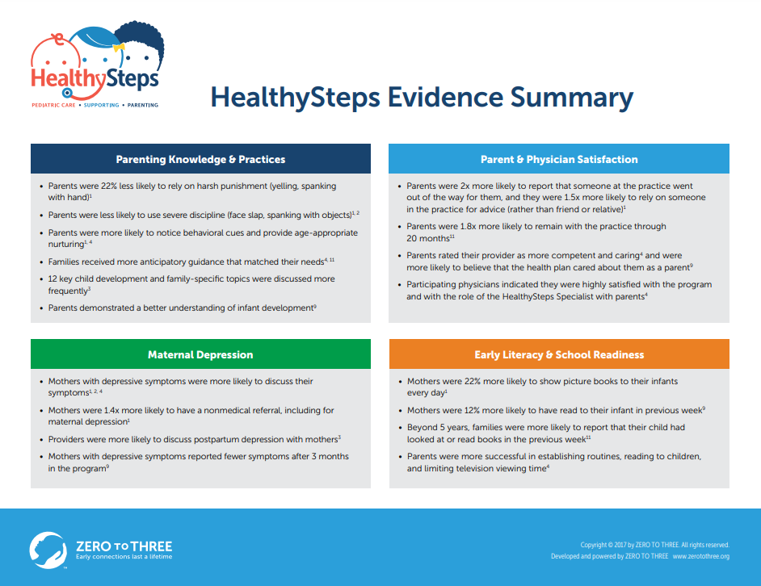

Slide 39
Primary Care Case Examples

Slide 40
Case Example:
2 year old male presents for his well-child visit
Mother reported to PCP that she is having difficulty managing tantrums.
PCP consults psychology to complete a warm handoff.
During warm handoff, psychoeducation regarding typical 2 year old behavior and behavior management was discussed. Mom was provided with a brief intervention.
Mom was encouraged to return for a follow up if needed.
PCP and Psychology consulted after visit.

Slide 41
Case Example:
8 year old presents to pediatrician with complaints of stomach aches over past two weeks and indicates increased teasing in school lately.
PCP sees patient to rule out any underlying issues.
PCP mentions stress as a component of pain upfront when talking about differentials.
PCP consults psychology in office to meet patient.
Psychology introduces self to patient, briefly explains their role, and offers brief advice (10 minutes)
Psychology schedules follow up.
Psychology and PCP consult immediately after brief visit.

Slide 42
Case Example:
15 year old female presenting for a well-child visit
Patient completes the PHQ-9 (depression screener) and scores a 15 (positive score, suicidal ideation endorsed)
PCP consults psychology to assist in completing a crisis evaluation and determine next steps for this patient
PCP steps out of room while psychology provider completes a risk assessment and safety plan with patient.
Once risk is assessed, a follow up appointment is made for the following week
Communicate plan and consult with PCP prior to the patient leaving and following patient’s departure
Treatment plan may even be discussed with family together with PCP.

Slide 43
Questions? Still have questions? Please post them on the SCCAP Listserv to continue the community discussion div53@lists.apa.org

Slide 44
Source Citation for this Presentation
With website link
Kuhn,J., Walls, M. (2020). Working in Integrated Pediatric Primary Care Settings [PowerPoint slides]. Retrieved from https://sccap53.org/resources/education-resources/webinars/recordedwebinars/
Without website link
Kuhn,J., Walls, M. (2020). Working in Integrated Pediatric Primary Care Settings[PowerPoint slides]. Webinar sponsored by the Society of Clinical Child and Adolescent Psychology, Division 53 of the American Psychological Association. New York, NY.

