Slide 1
Addressing Intersectionality When Working With Children & Families: Applying the Multicultural Guidelines
  Presenters: Alfonso Mercado, PhD, Assistant Professor in the Department of Psychological Science and School of Medicine's Psychiatry and Neurology Department at the University of Texas-Rio Grande Valley and is a Licensed Psychologist.
  President-Elect Designate of the Texas Psychological Association and elected to the Committee on Rural Health at APA.
  Erlanger A. Turner, PhD, Assistant Professor of Psychology at Pepperdine University in the Graduate School of Education and Psychology.
  Chair, SCCAP Diversity Committee and SCCAP Board Member at Large (Diversity). SCCAP Leadership Education to Advance Diversity conference, founder and Chair, and President of APA Division 37: Society for Child and Family Policy and Practice.
Moderator: Trista Perez-Crawford, PhD, Clinical Assistant Professor of Pediatrics, University of Missouri-Kansas City School of Medicine

Slide 2
Audience Questions and Answers
Submit a question during the webinar:
Post your questions for the Q&A segment! On right side of screen, click on the Questions tab on the Go-To-Webinar control panel, and submit your questions
Previous webinar recordings are available on https://sccap53.org/resources/education-resources/webinars/

Slide 3
Learning Objectives
After this webinar participants will be able to:
1. Identify the guiding principles of multicultural competency.
2. Understand the Ecological Model of the Multicultural Guidelines.
3. Apply the principles of multicultural practice to working with diverse families
Notes:
After this webinar participants will be able to:
1. Identify the guiding principles of multicultural competency.
2. Understand the Ecological Model of the Multicultural Guidelines.
3. Apply the principles of multicultural practice to working with diverse families

Slide 4
Overview and Application of the Multicultural Guidelines
Erlanger A. Turner, PhD

Slide 5
Why is Multicultural Competence Important?
Multicultural competence is important to therapeutic alliance.
A weak therapeutic alliance has been suggested to account for racial/ethnic minorities’ underutilization and higher dropout rates (e.g., Turner, 2019; Vasquez, 2007).
Turner, 2019

Slide 6
What is Involved in Cultural Sensitivity?
This person-oriented conceptualization of cultural competency is commonly referred to as the tripartite model (Chu et al., 2016; Sue, 2006).
  Focus on therapist’s characteristics
    Cultural awareness and beliefs
    Knowledge of client’s background
    Skills to implement culturally sensitive therapy

Slide 7
Guiding Principles of Multicultural Competence
Understand that identity and self-definition are fluid and complex
Move beyond conceptualizations rooted in categorical assumptions
Understand the role of language and communication
Be aware of the role of the social and physical environment
Understand historical and contemporary experiences with power, privilege and oppression.
Notes:
There are 10 guidelines in the recent APA guidelines.
The guidelines are:
Psychologists seek to recognize and understand that identity and self-definition are fluid and complex and that the interaction between the two is dynamic. To this end, psychologists appreciate that intersectionality is shaped by the multiplicity of the individual's social contexts.
Psychologists aspire to recognize and understand that as cultural beings, they hold attitudes and beliefs that can influence their perceptions of and interactions with others as well as their clinical and empirical conceptualizations. As such, psychologists strive to move beyond conceptualizations rooted in categorical assumptions, biases, and/or formulations based on limited knowledge about individuals and communities.
Psychologists strive to recognize and understand the role of language and communication through engagement that is sensitive to the lived experience of the individual, couple, family, group, community and/or organizations with whom they interact. Psychologists also seek to understand how they bring their own language and communication to these interactions.
Psychologists endeavor to be aware of the role of the social and physical environment in the lives of clients, students, research participants, and/or consultees.
Psychologists aspire to recognize and understand historical and contemporary experiences with power, privilege and oppression. As such, they seek to address institutional barriers and related inequities, disproportionalities, and disparities of law enforcement, administration of criminal justice, educational, mental health, and other systems as they seek to promote justice, human rights, and access to quality and equitable mental and behavioral health services.

Slide 8
Guiding Principles of Multicultural Competence
Promote culturally adaptive interventions
Consider how globalization has an impact
Understanding of how developmental stages and life transitions intersect
Conduct culturally appropriate and informed research
Actively strive to take a strength-based approach
Notes:
Psychologists seek to promote culturally adaptive interventions and advocacy within and across systems, including prevention, early intervention and recovery.
Psychologists endeavor to examine the profession's assumptions and practices within an international context, whether domestically or internationally-based, and consider how this globalization has an impact on the psychologist's self-definition, purpose, role, and function.
Psychologists seek awareness and understanding of how developmental stages and life transitions intersect with the larger biosociocultural context, how identity evolves as a function of such intersections and how these different socialization and maturation experiences influence worldview and identity.
Psychologists strive to conduct culturally appropriate and informed research, teaching, supervision, consultation, assessment, interpretation, diagnosis, dissemination, and evaluation of efficacy as they address the first four levels of the Layered Ecological Model of the Multicultural Guidelines.
Psychologists actively strive to take a strength-based approach when working with individuals, families, groups, communities and organizations that seeks to build resilience and decrease trauma within the sociocultural context.

Slide 9
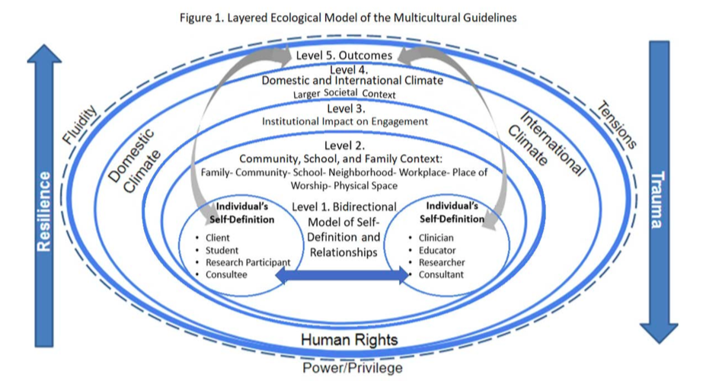
APA Multicultural Guidelines (2017)
Obtain at: https://www.apa.org/about/policy/multicultural-guidelines
Notes:
Discuss levels

Slide 10
APA Multicultural Guidelines (2017)
Guideline 4. Psychologists endeavor to be aware of the role of the social and physical environment in the lives of clients, students, research participants, and/or consultees.
Guideline 5. Psychologists aspire to recognize and understand historical and contemporary experiences with power, privilege, and oppression.
Guideline 10. Psychologists actively strive to take a strength-based approach when working with individuals, families, groups, communities, and organizations that seeks to build resilience and decrease trauma within the sociocultural context.

Slide 11
Applying the Guidelines to African American Families
Case Vignette:
Kimberly is an 8-year-old African American girl that was referred by her parents. The family reported that they identify as African American and occasionally feel that they are mistreated due to their race. Kimberly’s mother stated that she and her husband are very spiritual; and inquired if their therapist believed in God.
[Text modified from Turner, 2019]

Slide 12
Applying the Guidelines to African American Families
Notes:
istockphoto 1167729120

Slide 13
Keys to Remember
One frequent barrier to treatment is the lack of providers’ cultural sensitivity.
Smith and Trimble (2016) note that MC is positively related to clients’ perceptions of therapists’ trustworthiness (r =.50) and clients’ decisions to participate or terminate treatment (r = .26).
Image via istock photo

Slide 14
Applying Multicultural Guidelines to Latinx Populations
Alfonso Mercado, PhD
Notes:
Switch share screen to Alfonso

Slide 15
Applying Multicultural Guidelines
Multicultural Guideline 4
  Psychologists endeavor to be aware of the role of social and physical environment in the lives of clients, students, research participants, and/or consultees.
Multicultural Guidelines 6
  Psychologists seek to promote culturally adaptive interventions and advocacy within and across systems, including prevention, early intervention and recovery.
Multicultural Guidelines 9
  Psychologists strive to conduct culturally appropriate and informed research, teaching, supervision, consultation, assessment, interpretation, diagnosis, dissemination, and evaluation of efficacy as they address the first four levels of the Layered Ecological Model.

Slide 16


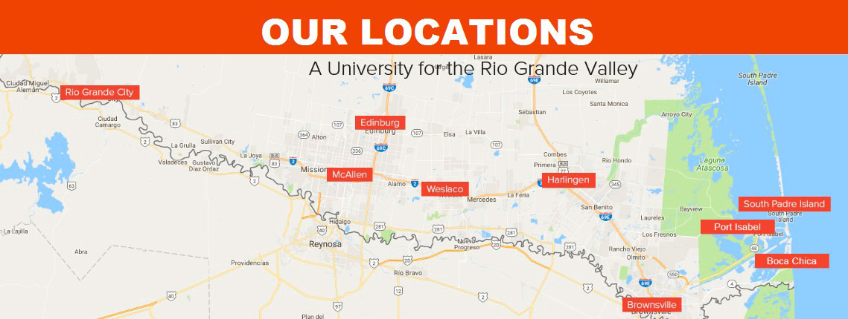

Slide 17
America’s Poorest Cities
The two Rio Grande Valley metropolitan areas (McAllen-Edinburg-Mission & Brownsville-Harlingen) have finished no. 1 and 2 on a list of “America’s Poorest Cities” (2011 U.S. Census Bureau)
There are about 1,200 colonias in the RGV; More than 900 of these low-income neighborhoods are in Hidalgo County
500,000 Texans live in “colonias” along the state’s 1,248 mile border with Mexico. About 100,000 of them are children.

Slide 18
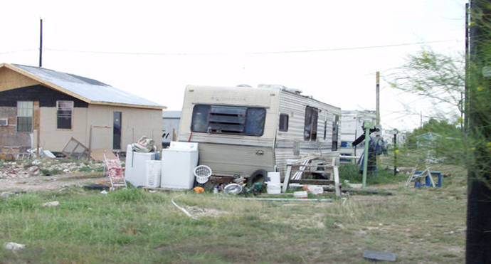
CoColonias on the Texas-Mexico Border
Some colonias lack basic necessities such as electricity or running water;
Homes in these areas are dilapidated trailers or homes without proper foundations and safe construction posing a hazard to the inhabitants.

Slide 19
Highest Rates of Obesity
McAllen-Edinburg-Mission, Texas, ranks No. 1 in the U.S. with a 38.8% obesity rate, and again in 2018 with a 44.5% obesity rate (Office of Border Public Health, Texas State Department of Health Services)
The obesity-related medical expenses cost the city $410.9 million each year – that’s especially steep considering about half the people there don’t have health insurance.

Slide 20
Highest Rates of Diabetes
20.8 million people, approx. 7% of the population, have diabetes -14.6 are diagnosed & 6.2 are undiagnosed (National Diabetes Information Clearinghouse, 2005)
The estimated diabetes prevalence rate in the Rio Grande Valley is 26% (UTPA Border Health Office, 2006)
Centers of Disease Control and Prevention note that nearly one in three people in the Valley are diabetic

Slide 21
Underserved Community
The Rio Grande Valley (RGV) has been deemed a Medically Underserved Area by the federal government for years
Approximately 33 licensed psychologists for 1.5+ million residents in RGV
Many travel outside of RGV to receive specialized healthcare

Slide 22
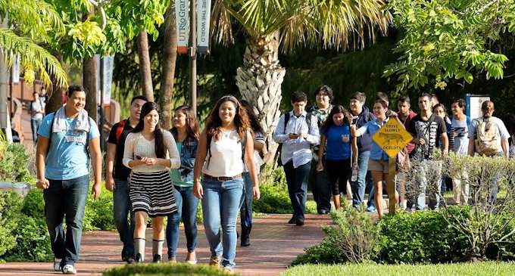
Ph.D. Clinical Psychology-Latino Mental Health Focus
Fall 2019- 1st cohort
30,000 students
89% Latino students
Two community training clinics
Multicultural Clinical Lab

Slide 23
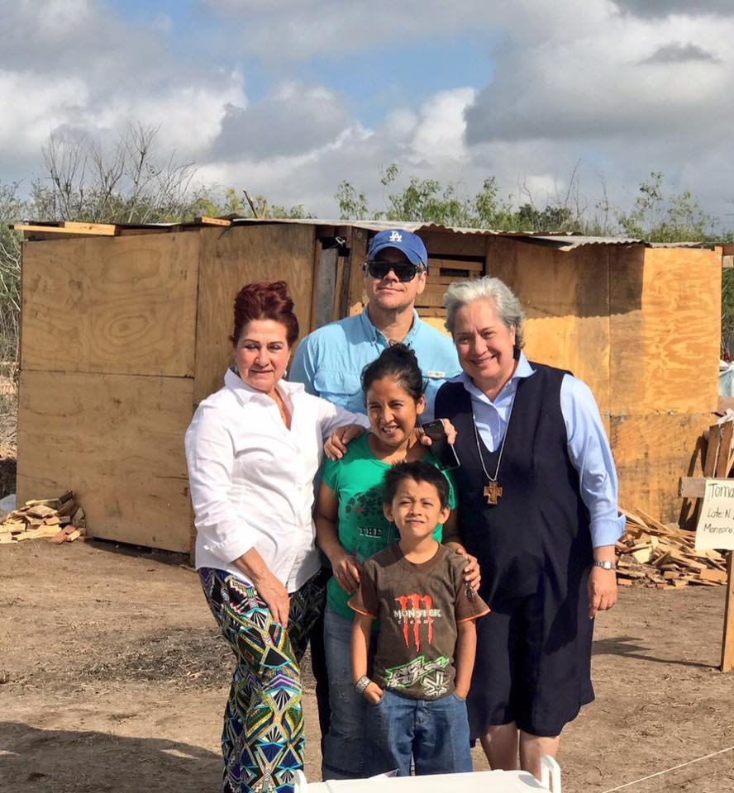
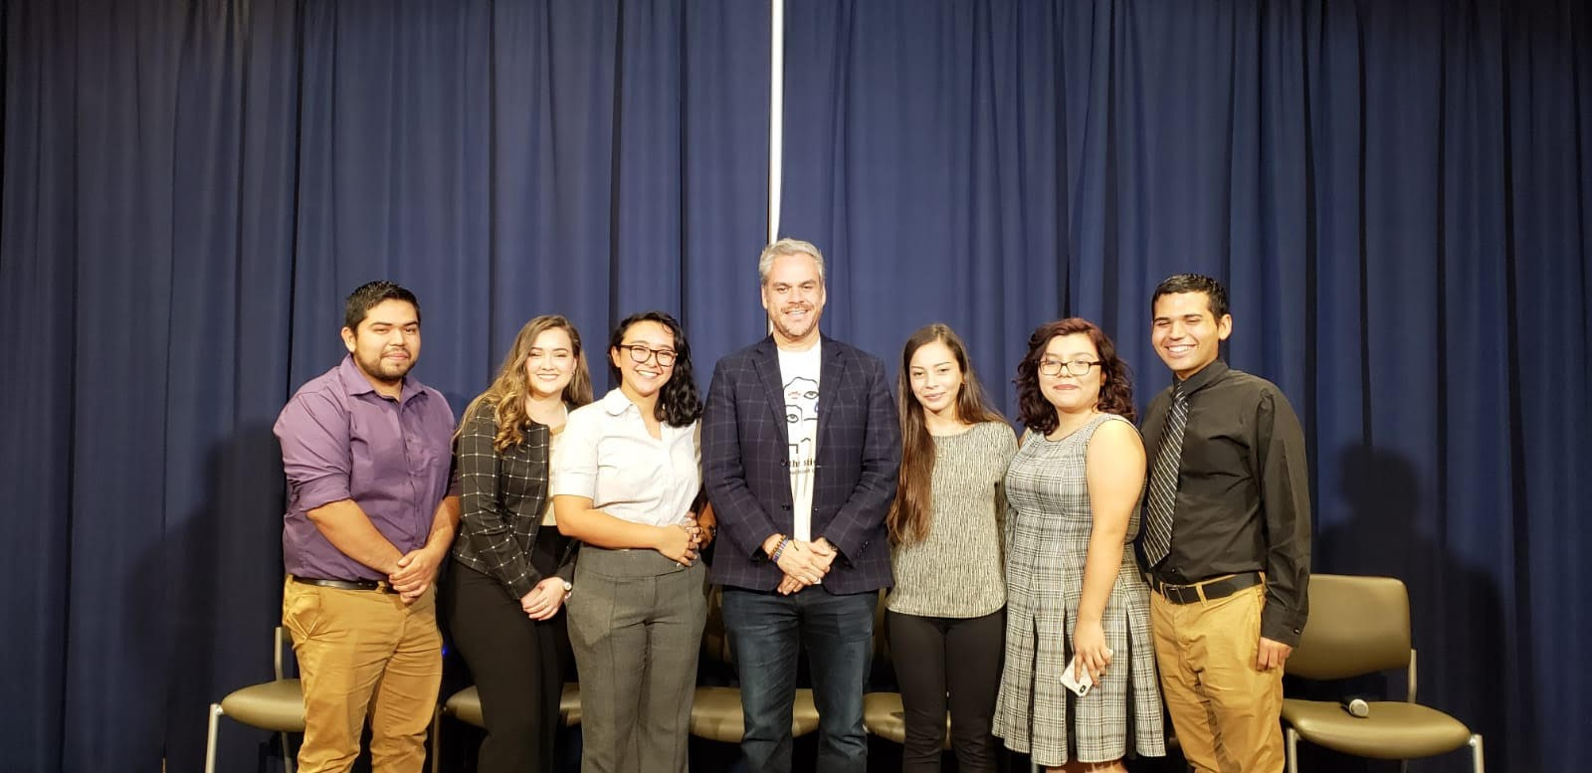
Multicultural Clinical Lab
Trauma, Health, and Culture with recent immigrated families.
International Attachment and Immigration project.
EST’s with Latinx groups
IDD population
Personality assessments with Latinx groups

Slide 24
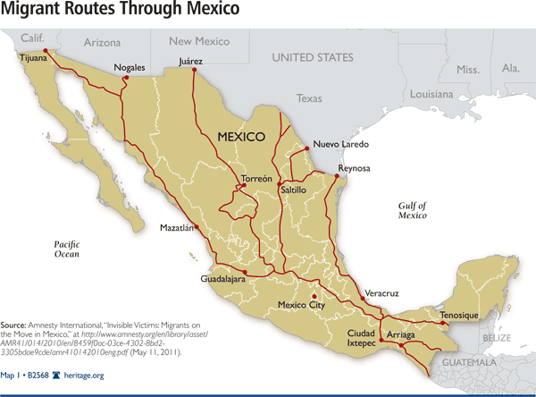

Slide 25
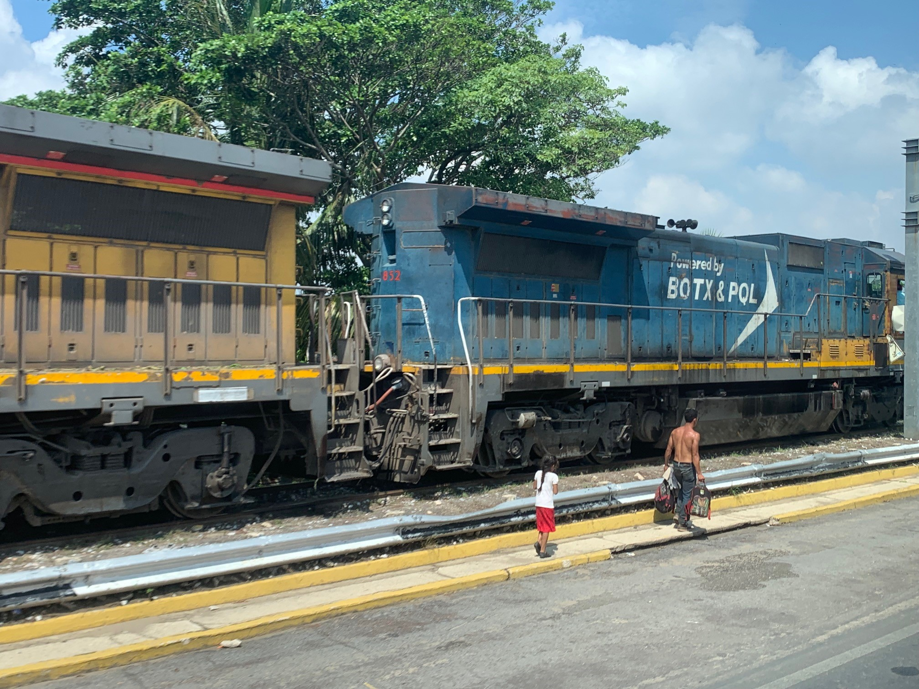
Veracruz, Mexico

Slide 26
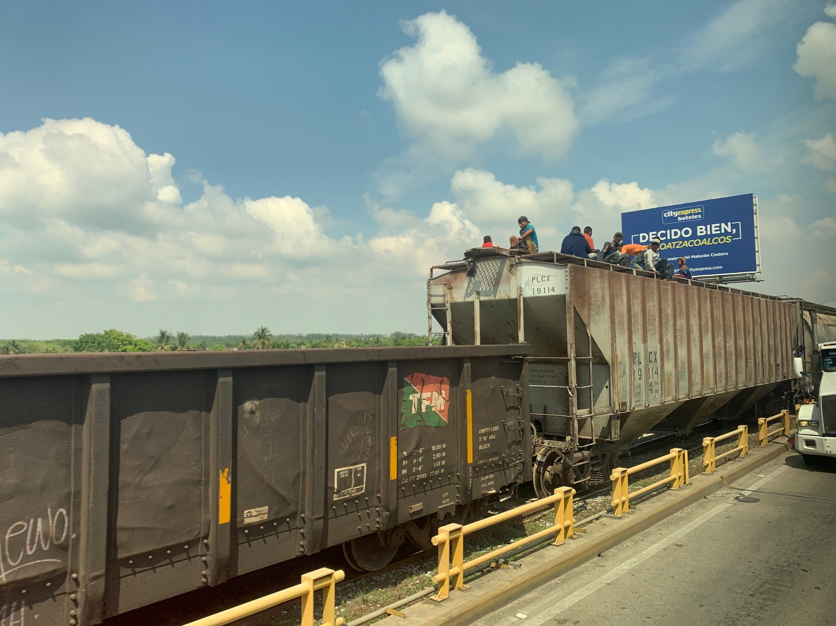

Slide 27
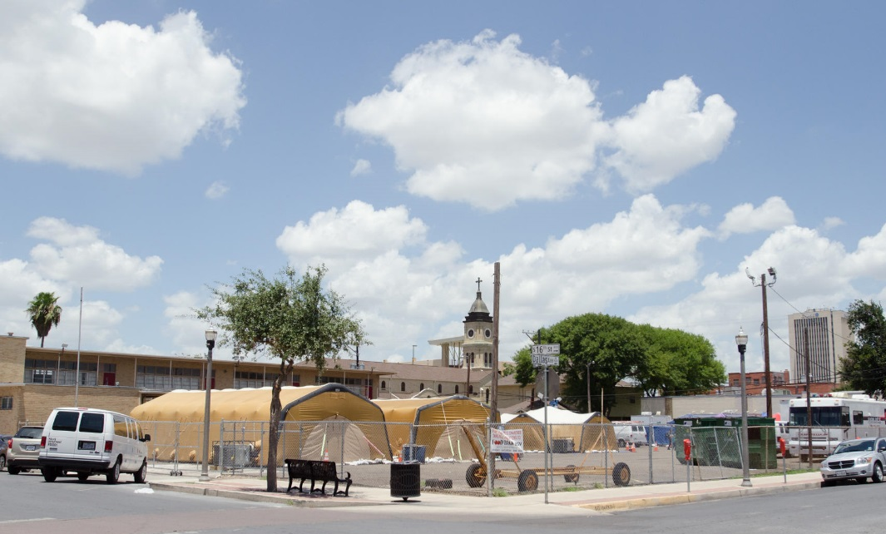
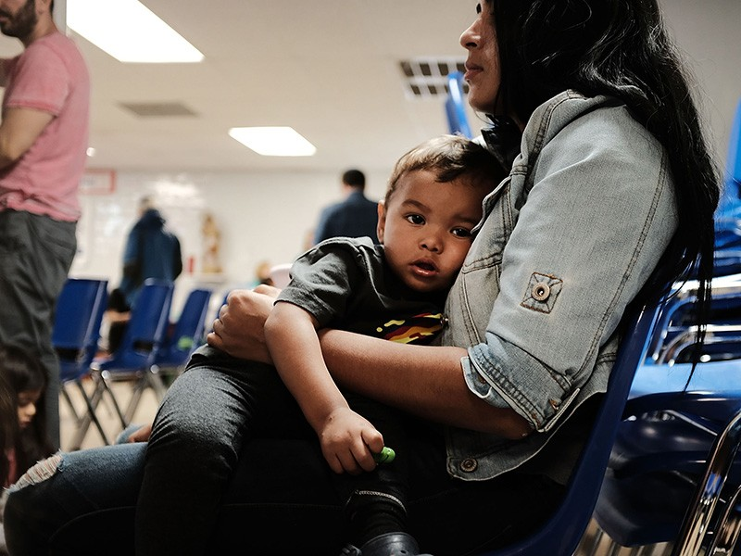
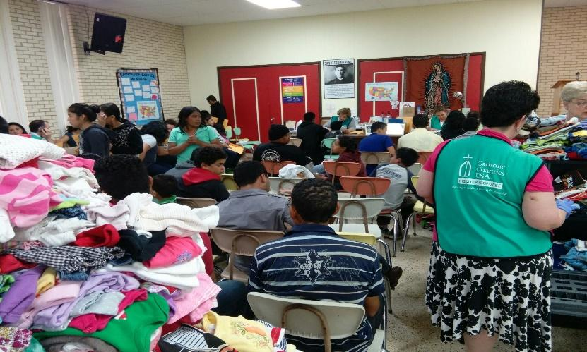
Humanitarian and Refugee Center McAllen, TX

Slide 29
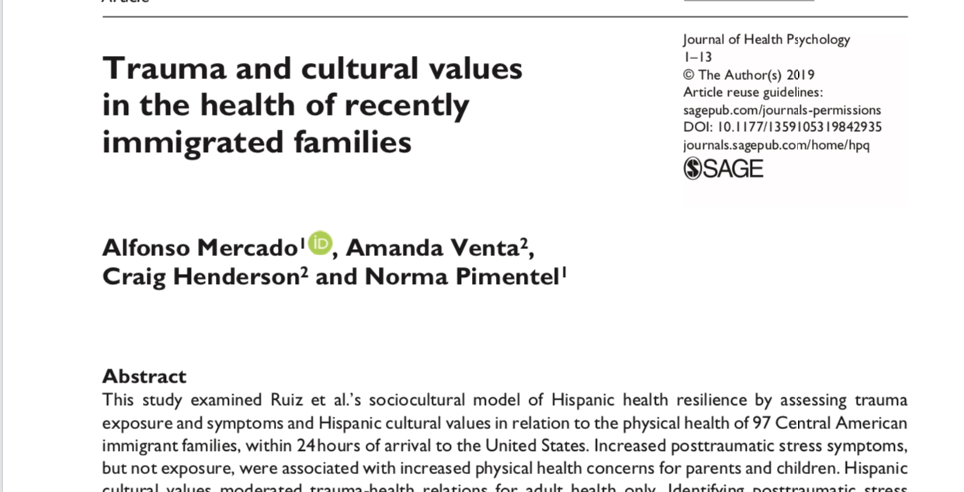

Slide 30
Leveraging Science: Advocacy and Policy
Expert testimony on research findings and clinical cases on the U.S.- Mexico border.
November 2019 favorable ruling in a family separation trauma case
  The judge ordered that the government must make available at a convenient location mental health screenings for class members who have been released and must provide appropriate transitional treatment to those class members requiring treatment until they can enter into the care of other providers.
Contributing to Trauma informed training for case-workers at ORR with APA Office of Violence Prevention.
DACA Advocacy with United We Dream, Org. (UWD, and other organizations

Slide 31
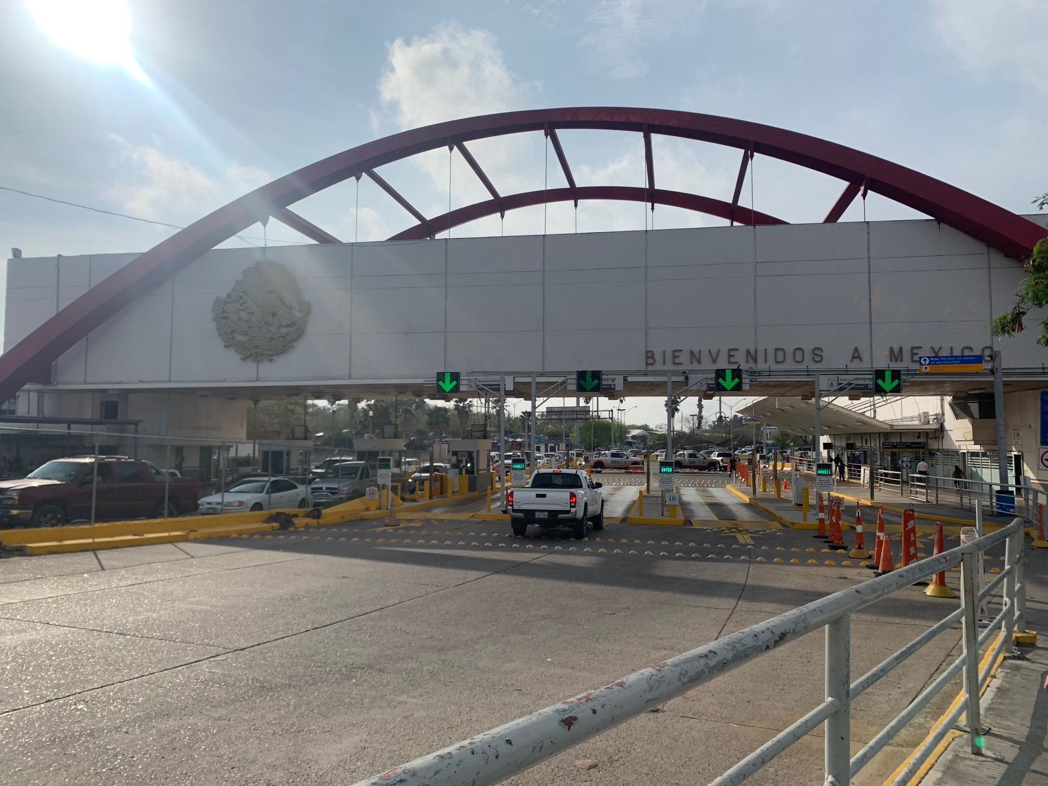
U.S. Remain in Mexico Policy
Remain in Mexico Policy
  May 2019 US Court of Appeals
Approximately 50,000 families have been forced to wait for asylum hearings in Mexican border towns (Tijuana, Juarez, Nogales, Matamoros).
Thousands exposed to life threatening dangers (kidnapping, rapes, torture, assault).
Inhumane living conditions in tent encampments.
Currently over 2,500 families in Matamoros, Mexico border to Brownsville, Texas.
Mixed-Methods Study-IRB pending

Slide 32
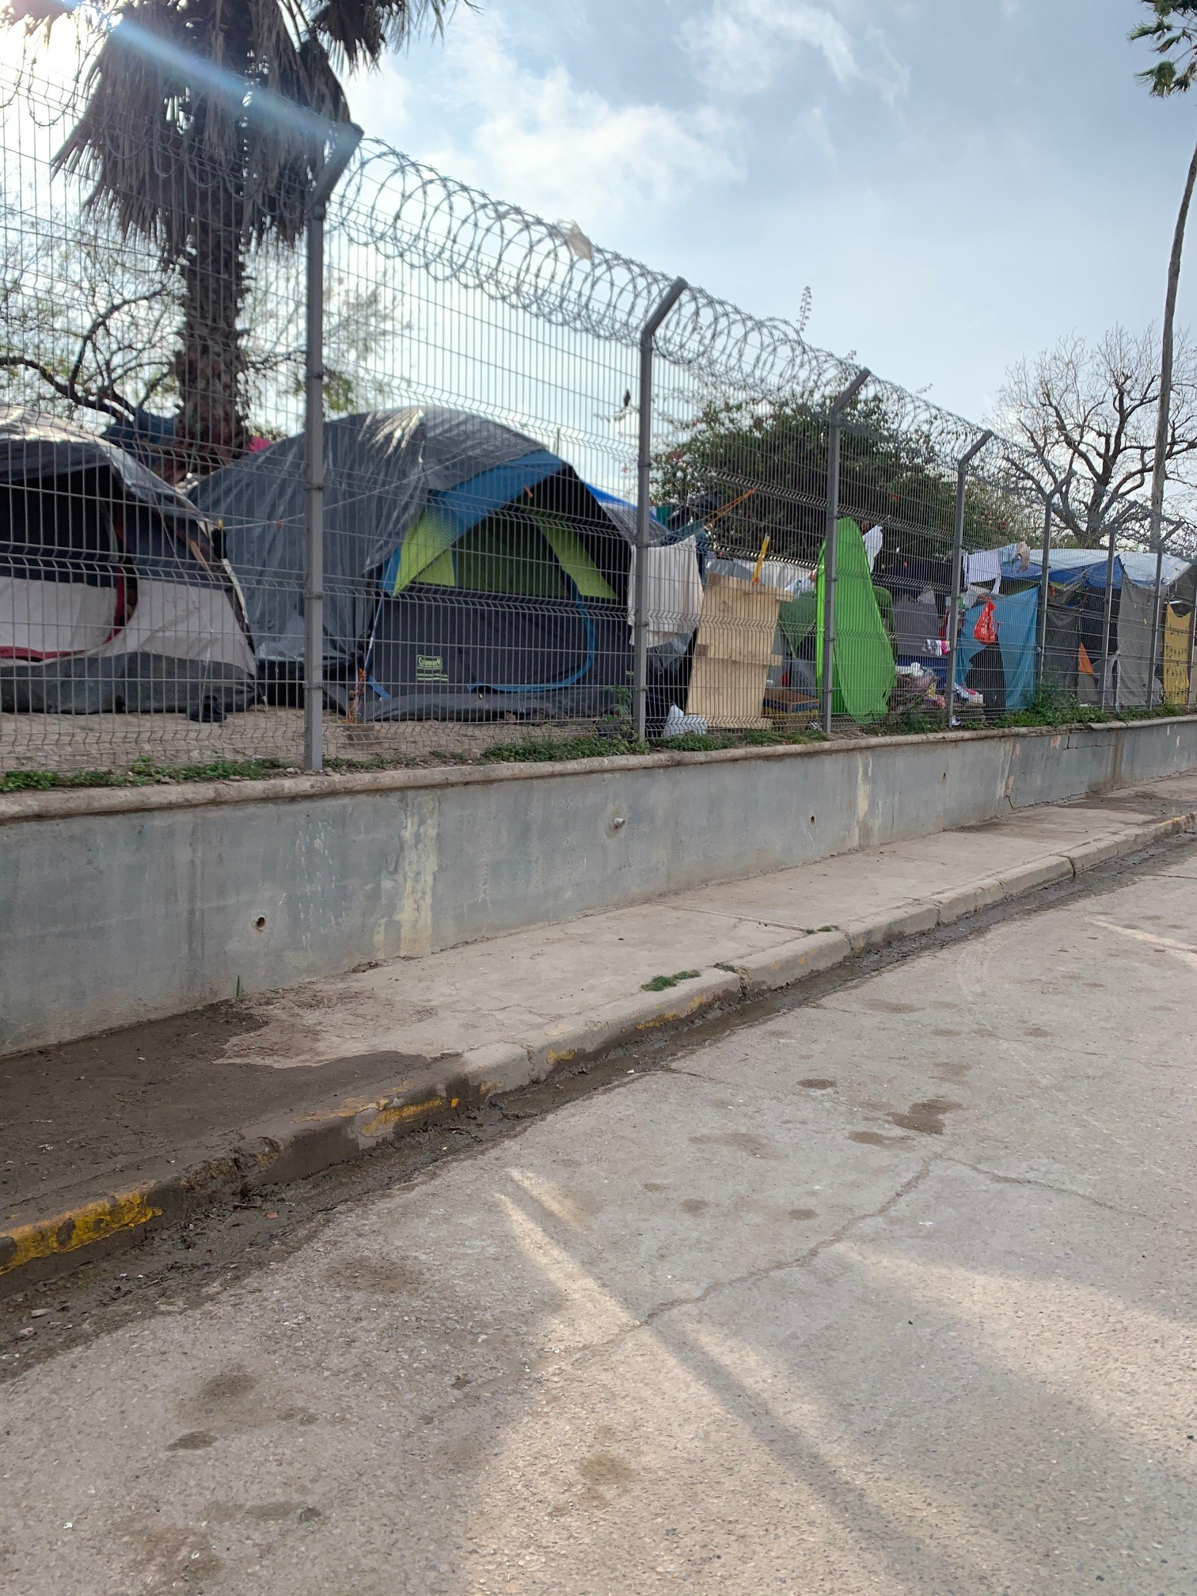

Slide 33
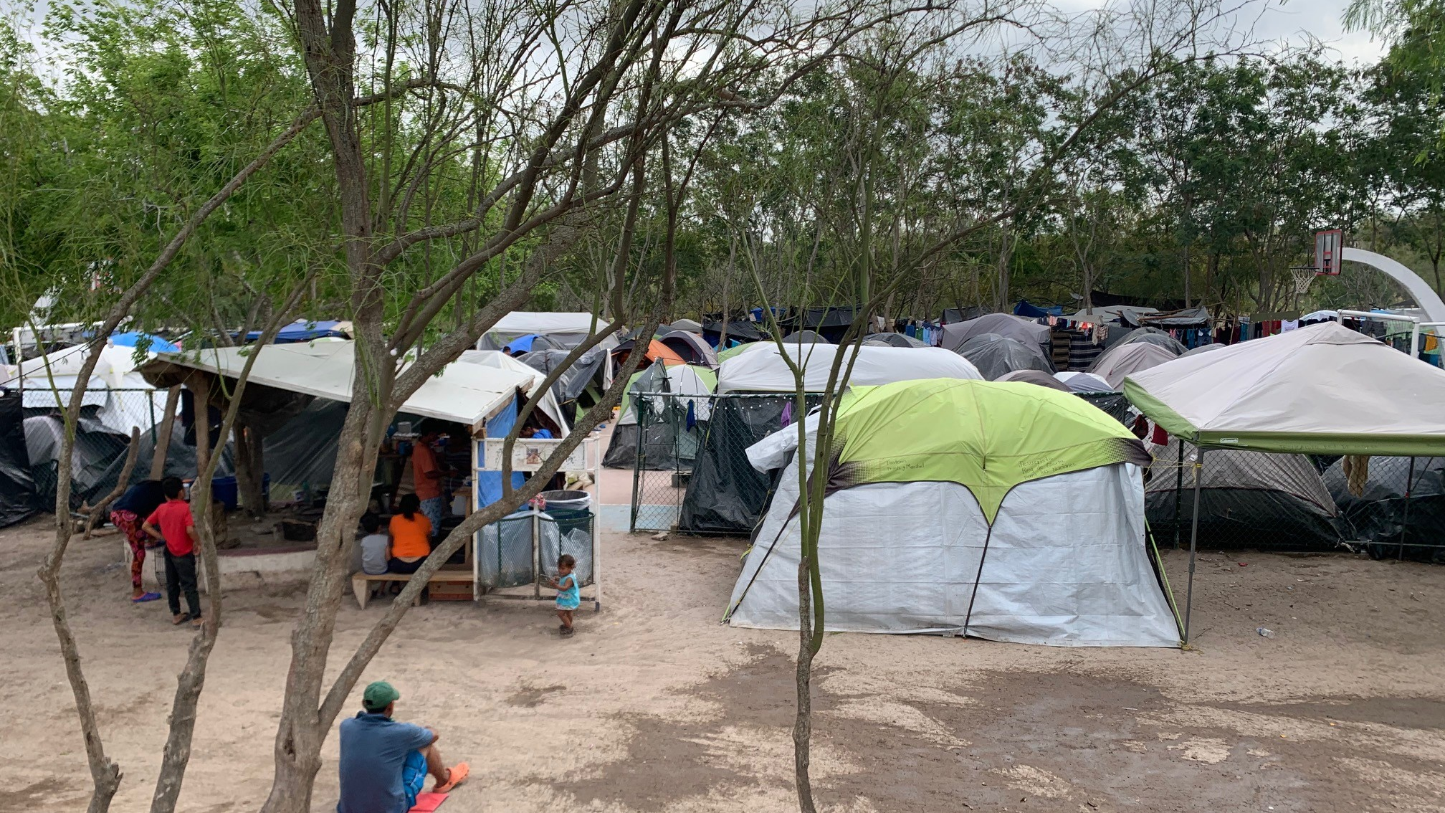

Slide 34
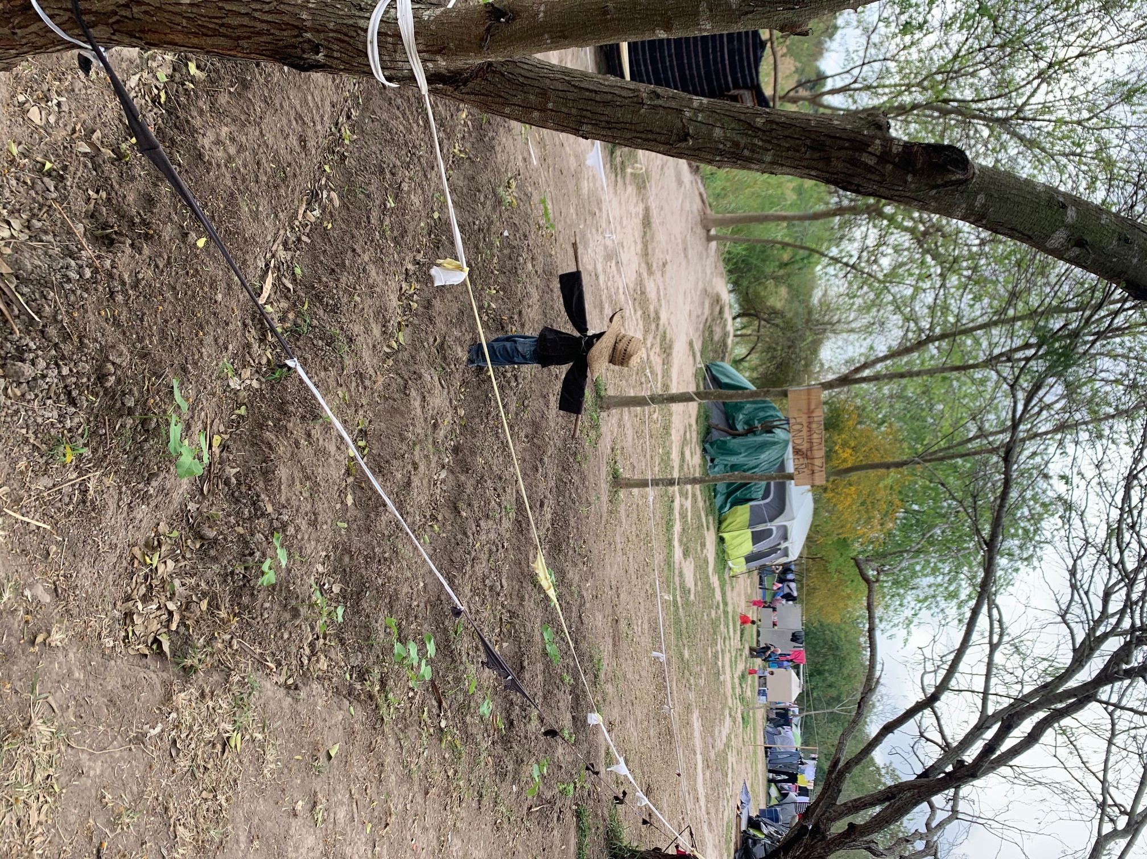
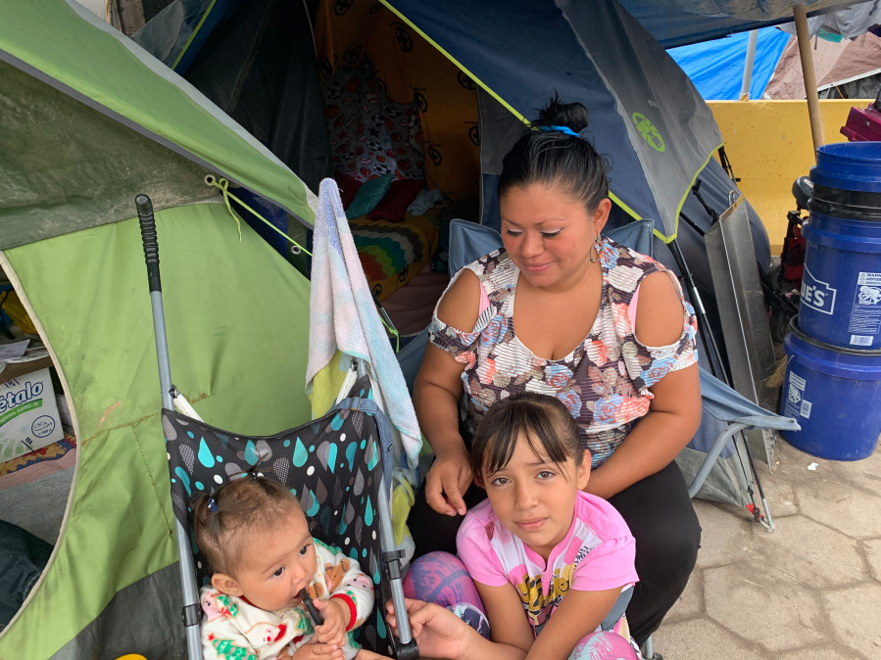
Matamoros, MX Tent-Encampment

Slide 35
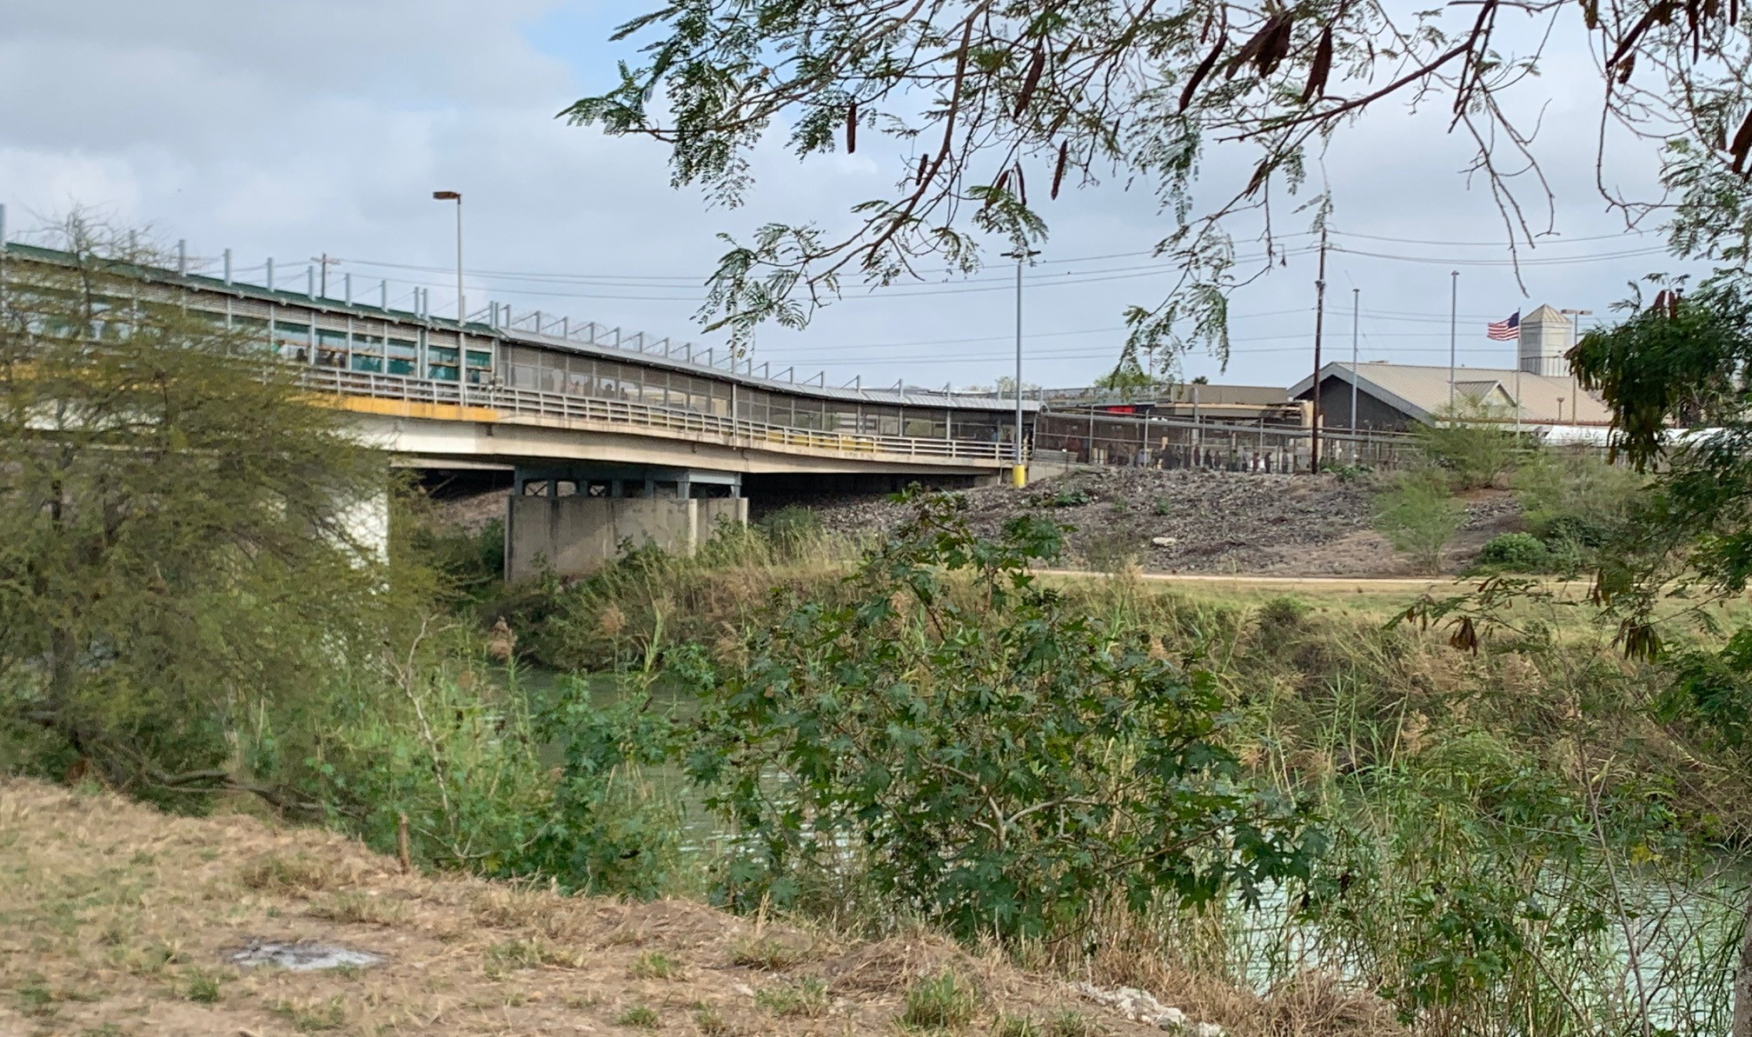
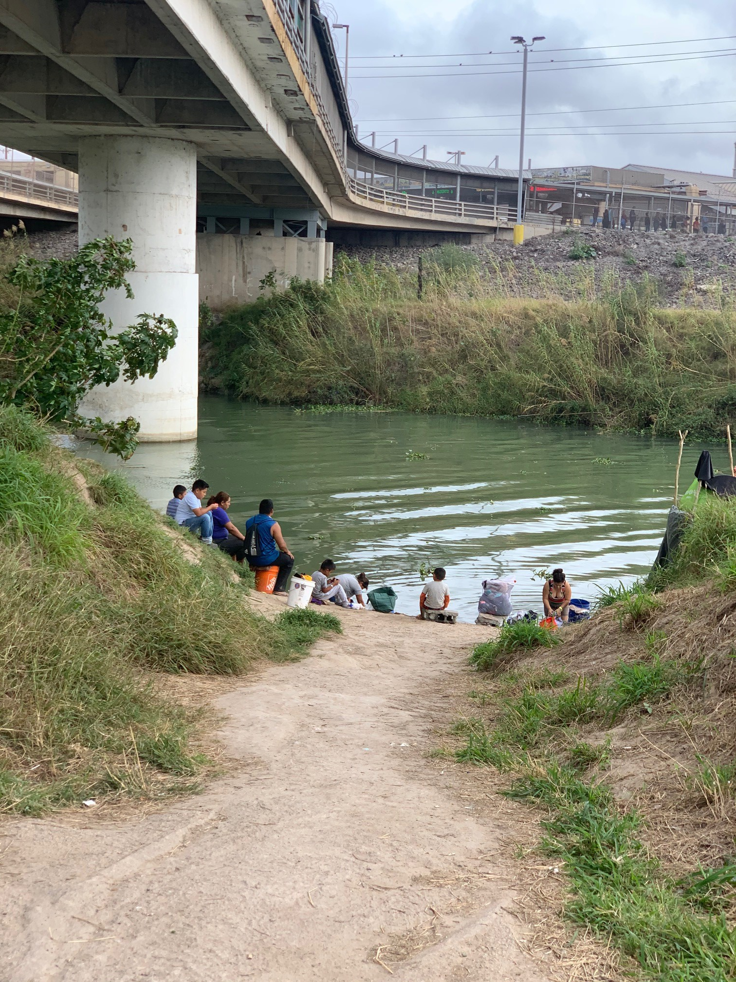
Over 2,5000 Families wait months to over a year for appeal hearings.
Many families returning to home countries due to COVID concerns

Slide 36
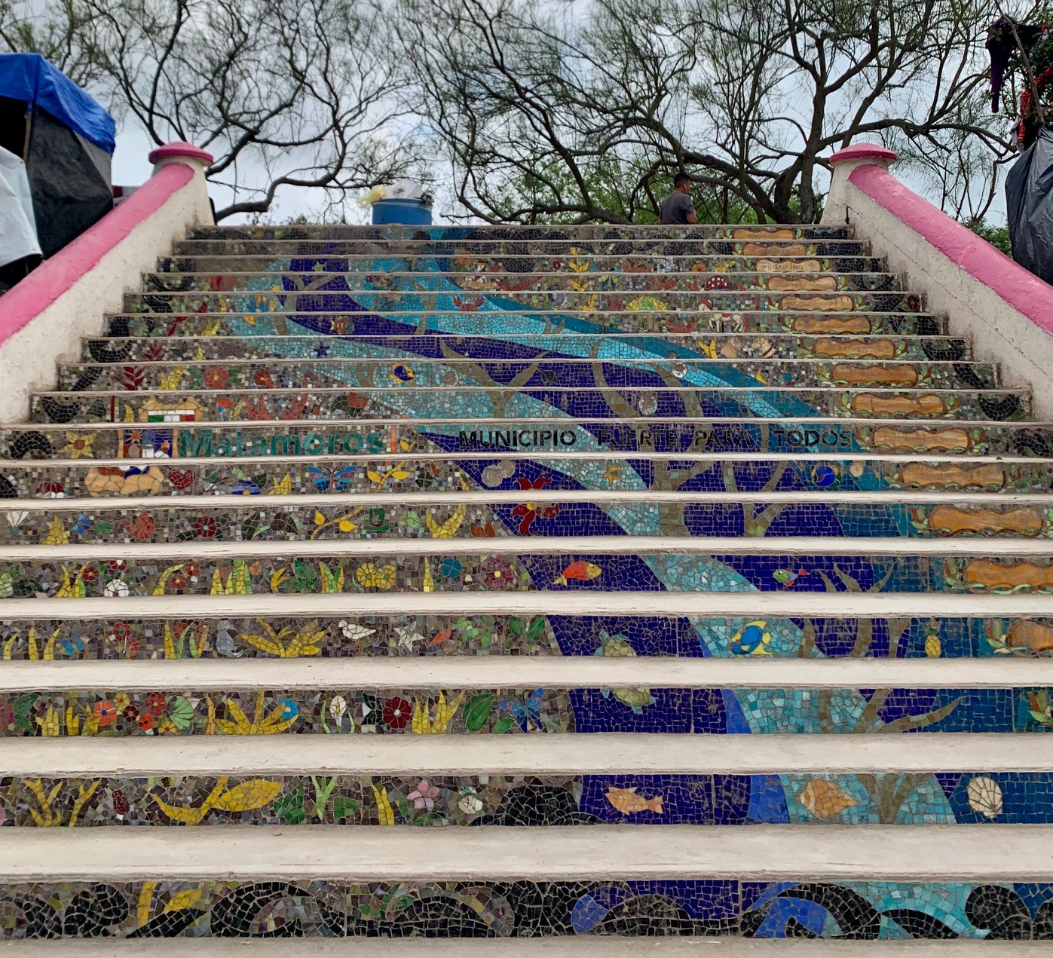
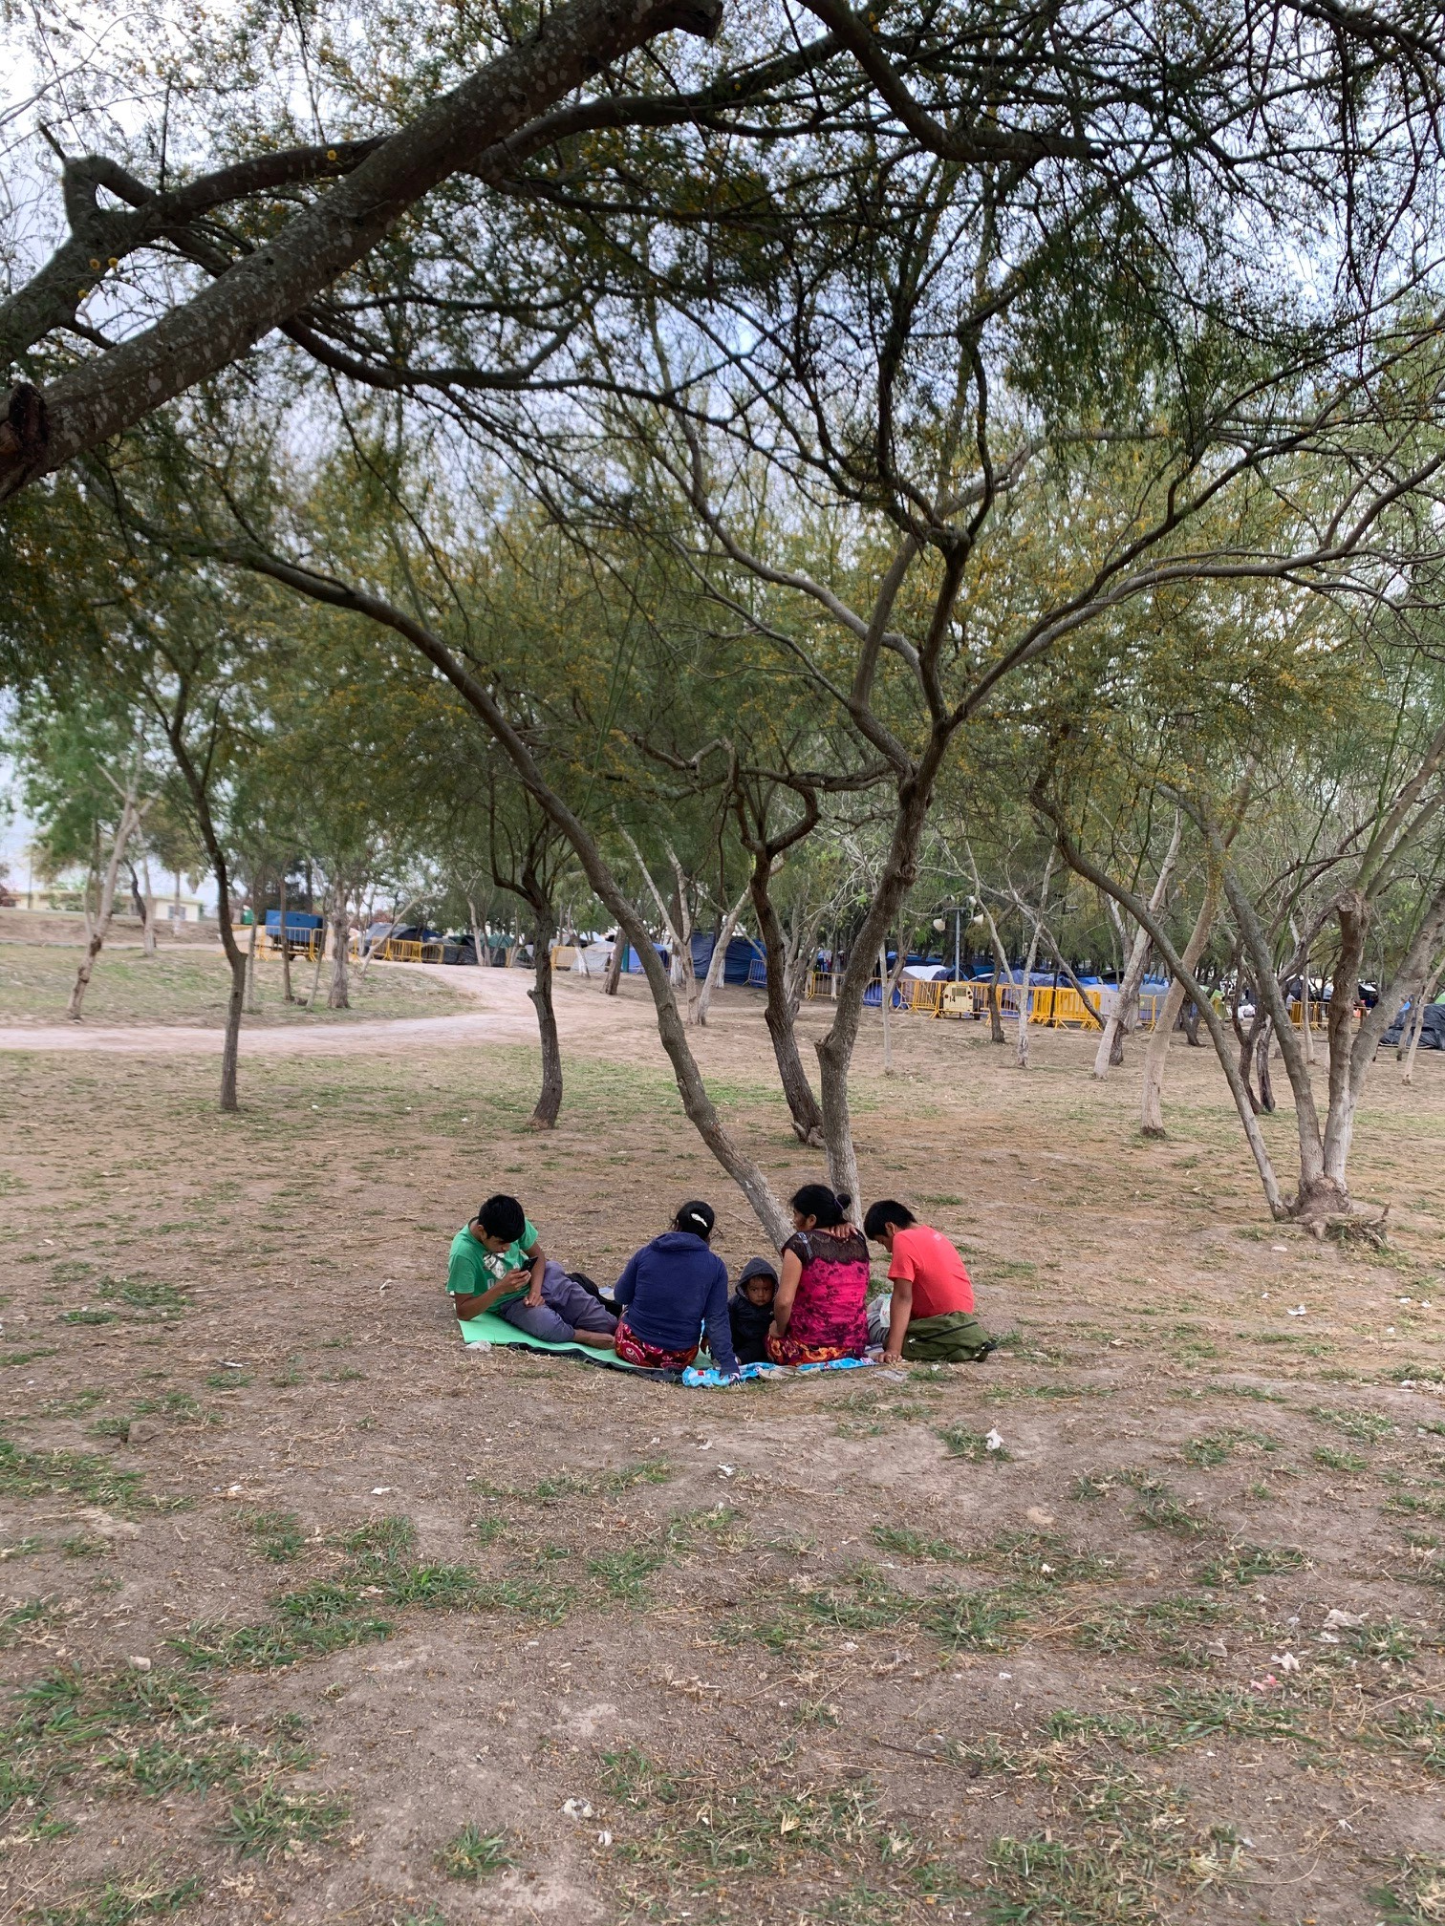

Slide 37
Questions?
Still have questions? Please post them on the SCCAP Listserv to continue the community discussion div53@lists.apa.org

Slide 38
Upcoming Webinars
Submit your ideas for our 2021 Webinar Series: sccapdiv53@gmail.com
June 12 Working in Integrated Pediatric Primary Care Settings - Meghan Lines, PhD and Kuhn, PhD
July 8 Preparing for Internships Panel Discussion Eugene D’Angelo, PhD, Tina Goldstein, PhD, Amy West PhD, Aniya Atasuntseva, MS
Sept. 11 Children and Technology Use - Justin Parent, PhD
Sept. 29 Cannabis Use in Adolescents - Mary Fristad, PhD
Nov. 4 R. Bob Smith Excellence in Assessment Webinar, New Thoughts About Assessment and Diagnosis of Autism, Catherine Lord, PhD, Free Member CE

Slide 39
Source Citation for this Presentation
With website link
Mercado, A., Turner, E.A., (2020). Addressing intersectionality when working with children & families: Applying Multicultural Guidelines [PowerPoint slides]. Retrieved from https://sccap53.org/resources/education-resources/webinars/recordedwebinars/
Without website link
Mercado, A., Turner, E.A., (2020). Addressing intersectionality when working with children & families: Applying Multicultural Guidelines [PowerPoint slides]. Webinar sponsored by the Society of Clinical Child and Adolescent Psychology, Division 53 of the American Psychological Association. New York, NY.

