Slide 1
Providing Evidence-Based Child Treatment During COVID-19:
MORE Lessons (Being) Learned by a Panel of Experts
Presenters:
Anne Marie Albano, Ph.D., ABPP, is a professor of medical psychology in psychiatry at Columbia University, founder of the Columbia University Clinic for Anxiety and Related Disorders and clinical site director of New York Presbyterian Hospital’s Youth Anxiety Center. (Twitter: @AnneMarieAlbano)
Mary Alvord, Ph.D., is the Founder and President of Board of Directors of Resilience Across Borders, Inc. and Director of Alvord, Baker & Associates, LLC. (@DrMaryAlvord)
Lisa Coyne, PhD is director of the New England Center for Anxiety and OCD, the founder of and senior clinical consultant for the McLean Child and Adolescent OCD Institute (OCDI Jr.) and assistant professor at Harvard Medical School. (@Dr_LisaCoyne)
Cheryl McNeil, Ph.D. is a professor at the West Virginia University and certified PCIT Master Trainer.
Moderator: Jill Ehrenreich-May PhD, Professor, University of Miami (@DrEhrenreich) and Member-at-Large for Science and Practice, SCCAP (@SCCAP53)

Slide 2
Resources Mentioned in the Webinar
PCIT International - http://www.pcit.org/covid-19-professional-resources.html
NCTSN - https://www.nctsn.org/resources/all-nctsn-resources?search=COVID&resource_type=All&trauma_type=All&language=All&audience=All&other=All
TF-CBT - https://tfcbt.org/telehealth-resources/
APA - https://www.apa.org/topics/covid-19/
ACBS - https://contextualscience.org/covid19_therapy_resources
ABCT - http://www.abct.org/Home/
Nurture in Place (Lisa Coyne) – Website TBA

Slide 3
Audience Questions and Answers
Submit a question during the webinar:
Post your questions for the Q&A segment! On right side of screen, click on the Questions tab on the Go-To-Webinar control panel, and submit your questions

Slide 4
Questions?
Still have questions? Please post them on the SCCAP Listserv to continue the community discussion div53@lists.apa.org

Slide 5
Upcoming Webinars
Upcoming webinars: Submit your ideas for our 2021 Webinar Series: sccapdiv53@gmail.com
Previous webinar recordings are available on https://sccap53.org/resources/education-resources/webinars/
May 12 Noon ET Addressing Intersectionality When Working with Children and Families: Applying the Multicultural Guidelines - Alfonso Mercado PhD, & Earl Turner, PhD
June TBA Working in Integrated Pediatric Primary Care Settings - Meghan Lines, PhD and Cheyenne Hughes-Reid, PhD
July TBA Preparing for Internships Panel Discussion
Sept. 11 Noon ET Children and Technology Use - Justin Parent, PhD
Sept. 29 Noon ET Cannabis Use in Adolescents - Mary Fristad, PhD
Fall 2020 R. Bob Smith Excellence in Assessment Webinar, Free Member CE – Catherine Lord, PhD

Slide 6
Technical Issues
The webinar will be recorded and made available on SCCAP53.org.
CE will still be awarded to those that registered for CE.
If technical sound issues arise, we will:
1. Change from live stream images of the presenters to a placeholder slide.
2. If audio issues continue, we will request participants submit their questions and to sign-off of the webinar.
The panelist will continue to answer these questions on a recording. The recording will be edited and made available on SCCAP53.org

Slide 7
Source Citation for this Presentation
With website link
Albano,A.M., Alvord,M., Coyne,L., McNeil,C., (2020). High-Quality, Evidence-Based Child Treatment During COVID-19: MORE Lessons (Being) Learned by a Panel of Experts [PowerPoint slides]. Retrieved from https://sccap53.org/resources/education-resources/webinars/recordedwebinars/
Without website link
Albano,A.M., Alvord,M., Coyne,L., McNeil,C., (2020). Providing Evidence-Based Child Treatment During COVID-19: MORE Lessons (Being) Learned by a Panel of Experts [PowerPoint slides]. Webinar sponsored by the Society of Clinical Child and Adolescent Psychology, Division 53 of the American Psychological Association. New York, NY.

Slide 8

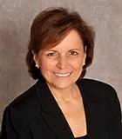
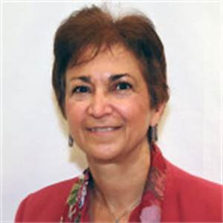
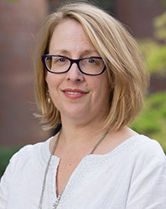
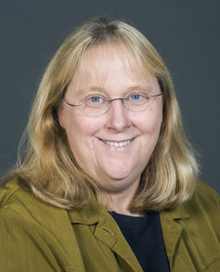
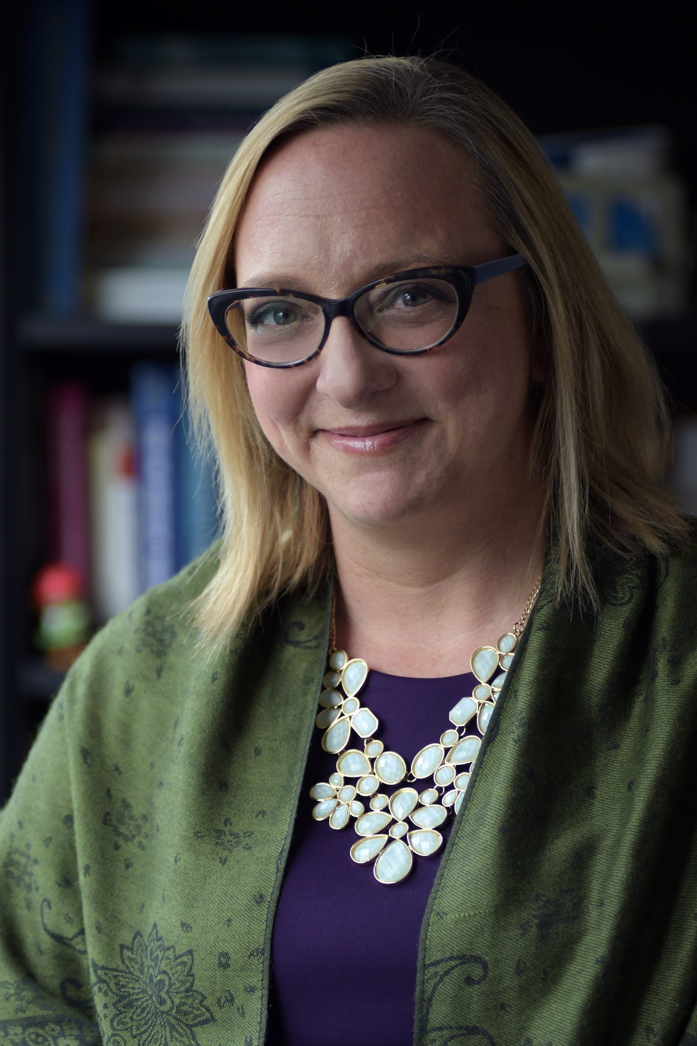
Anna Marie Albano Mary Alvord
Lisa Coyne Cheryl McNeil Jill Ehrenreich-May

