Slide 1



“Will this therapy work for me?”
Applying Research Findings to Individual Patients
Oliver Lindhiem, PhD
Associate Professor of Psychiatry and Pediatrics
University of Pittsburgh
School of Medicine
Twitter: @lindhiem
Moderator:
Eric Youngstrom, PhD
Professor of Psychology and Neuroscience, and Psychiatry
University of North Carolina at Chapel Hill

Slide 2
Audience Questions and Answers
Submit a question during the webinar:
Post your questions for the Q&A segment! On right side of screen, click on the Questions tab on the Go-To-Webinar control panel, and submit your questions
Continue the conversation after the webinar in the SCCAP53.org Forum
For one month, panel members will respond to as many questions as possible
Go to https://sccap53.org
Log in with your member ID and password
Scroll down and click on the “Forum” box
Under Webinar Discussions, click on “Applying Research Findings to Individual Patients”
See the forum rules posted by the Web Editor, and then
Post away!
Up coming webinars: Submit your ideas for our 2020 Webinar Series: sccapdiv53@gmail.com

Slide 3
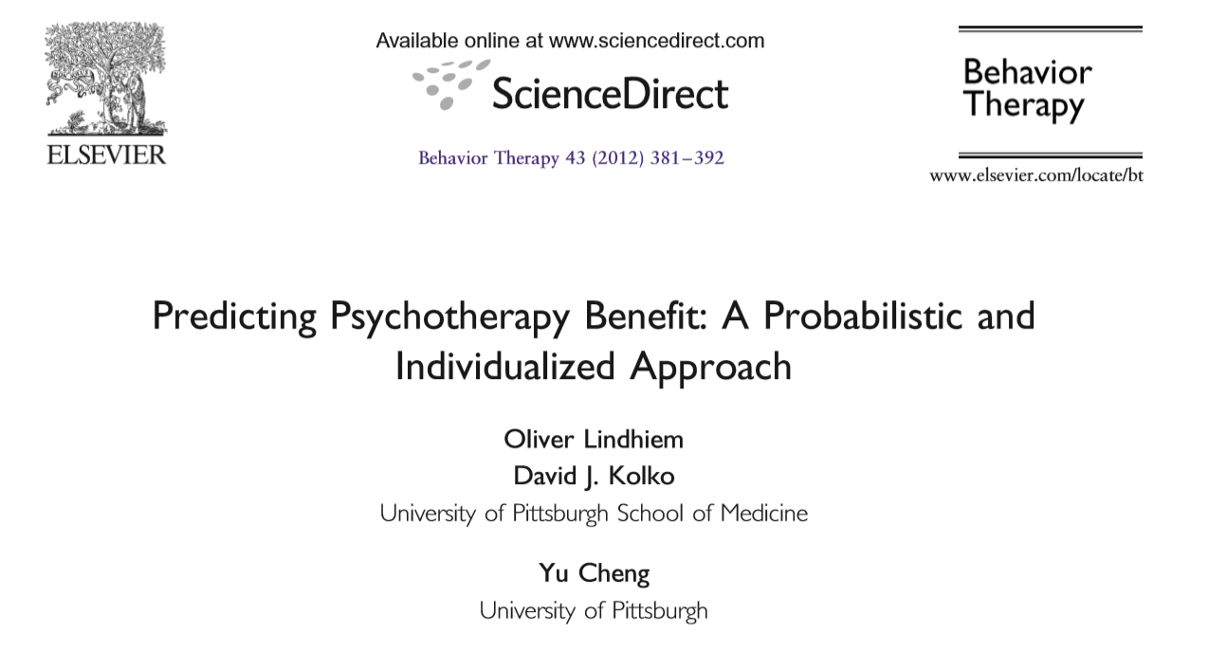
Webinar Outline
1. History and Context
2. Guiding Principles
3. The “PTB Method”
4. Extensions
5. Cautions
5. Final Thoughts

Slide 4
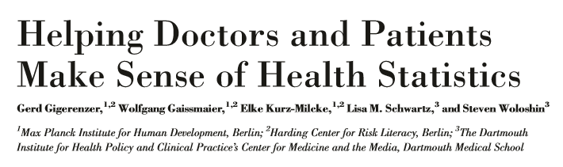
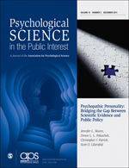
History and Context
(2007)

Slide 5

Gigerenzer et al., 2007
“Collective statistical illiteracy refers to the widespread inability to understand the meaning of numbers.”
  “is created by nontransparent framing of information that is sometimes an unintentional result of lack of understanding but can also be a result of intentional efforts to manipulate or persuade people”

Slide 6

Gigerenzer et al., 2007
Gigerenzer et al., 2007
  “even medical journals often report evidence in nontransparent forms that suggest big beneﬁts of featured interventions”
  “undermines the goals of informed consent and shared decision making”

Slide 7
Cohen’s d

Slide 8
Quick Quiz
An effect size of Cohen’s d = .50 means that the average patient from the treatment group did better than what percentage of patients from the control group?
69% (making some statistical assumptions)

Slide 9

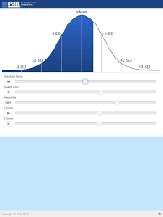
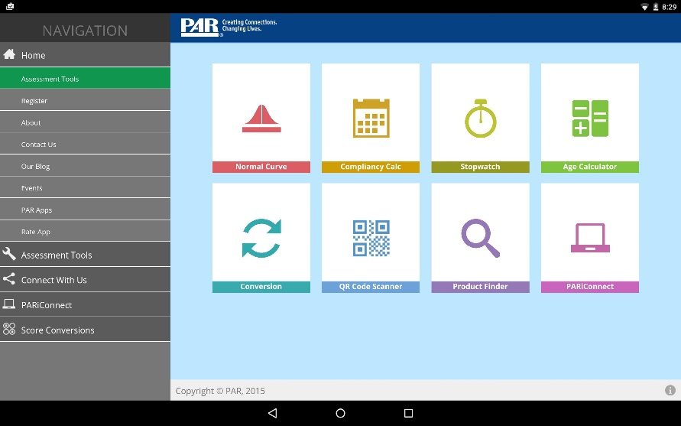
PAR Assessment
Toolkit

Slide 10
Quick Quiz
How large of an effect size is required for a treatment to be considered “empirically supported”?
Trick question!

Slide 11


Slide 12

Why a patient-centered approach?
“Every day, patients and their caregivers are faced with crucial healthcare decisions while lacking key information that they need.”
“The needed information does not deliver verdicts or tell people what to do, but informs them of the trade-offs associated with the options they have. . . based on the facts, perhaps even personalized for them, and their own values, preferences, and goals.”
–PCORI website
www.pcori.org

Slide 13

Guiding Principles
Transparency
Autonomy
Personalization

Slide 14
Challenges to Transparency & Autonomy
Exceedingly inclusive definitions of terms such as “empirically supported” and “evidence based.”
Effect sizes are difficult for people to interpret.

Slide 15
Other Approaches
Success Rate Difference (SRD):
Prob(Tx1>Tx2) - Prob(Tx1<Tx2)
Number Needed to Treat (NNT): = 1/SRD
  i.e. the number of patients one would have to treat with Tx1 to find one more “success” than Tx2
(Kraemer, Frank, & Kupfer, 2011)

Slide 16
PTB Method
Lindhiem, Kolko, & Cheng, 2012
Probabilistic
Transparency
Patient-centered
Autonomy
Stratified
Personalization

Slide 17


Probabilistic
Principle of transparency
Probabilities are (generally) easy to interpret
  Weather forecasts
  Batting averages
Signal some uncertainty

Slide 18
Patient-centered
Principle of autonomy
Statistic is patient-centered rather than treatment-centered
Absolute (e.g., not relative a control group)
Outcomes that matter to the patient
Method versus index

Slide 19
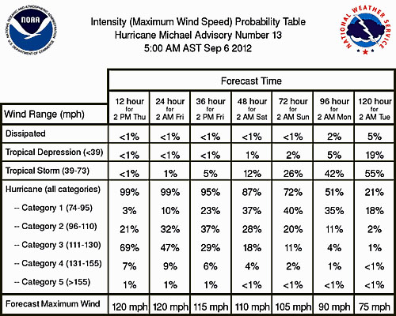
More ideas from meteorology….

Slide 20

Stratified
Principle of personalization
Stratification and matching
Averages can be meaningless when applied to individuals
Two statisticians go hunting….

Slide 21
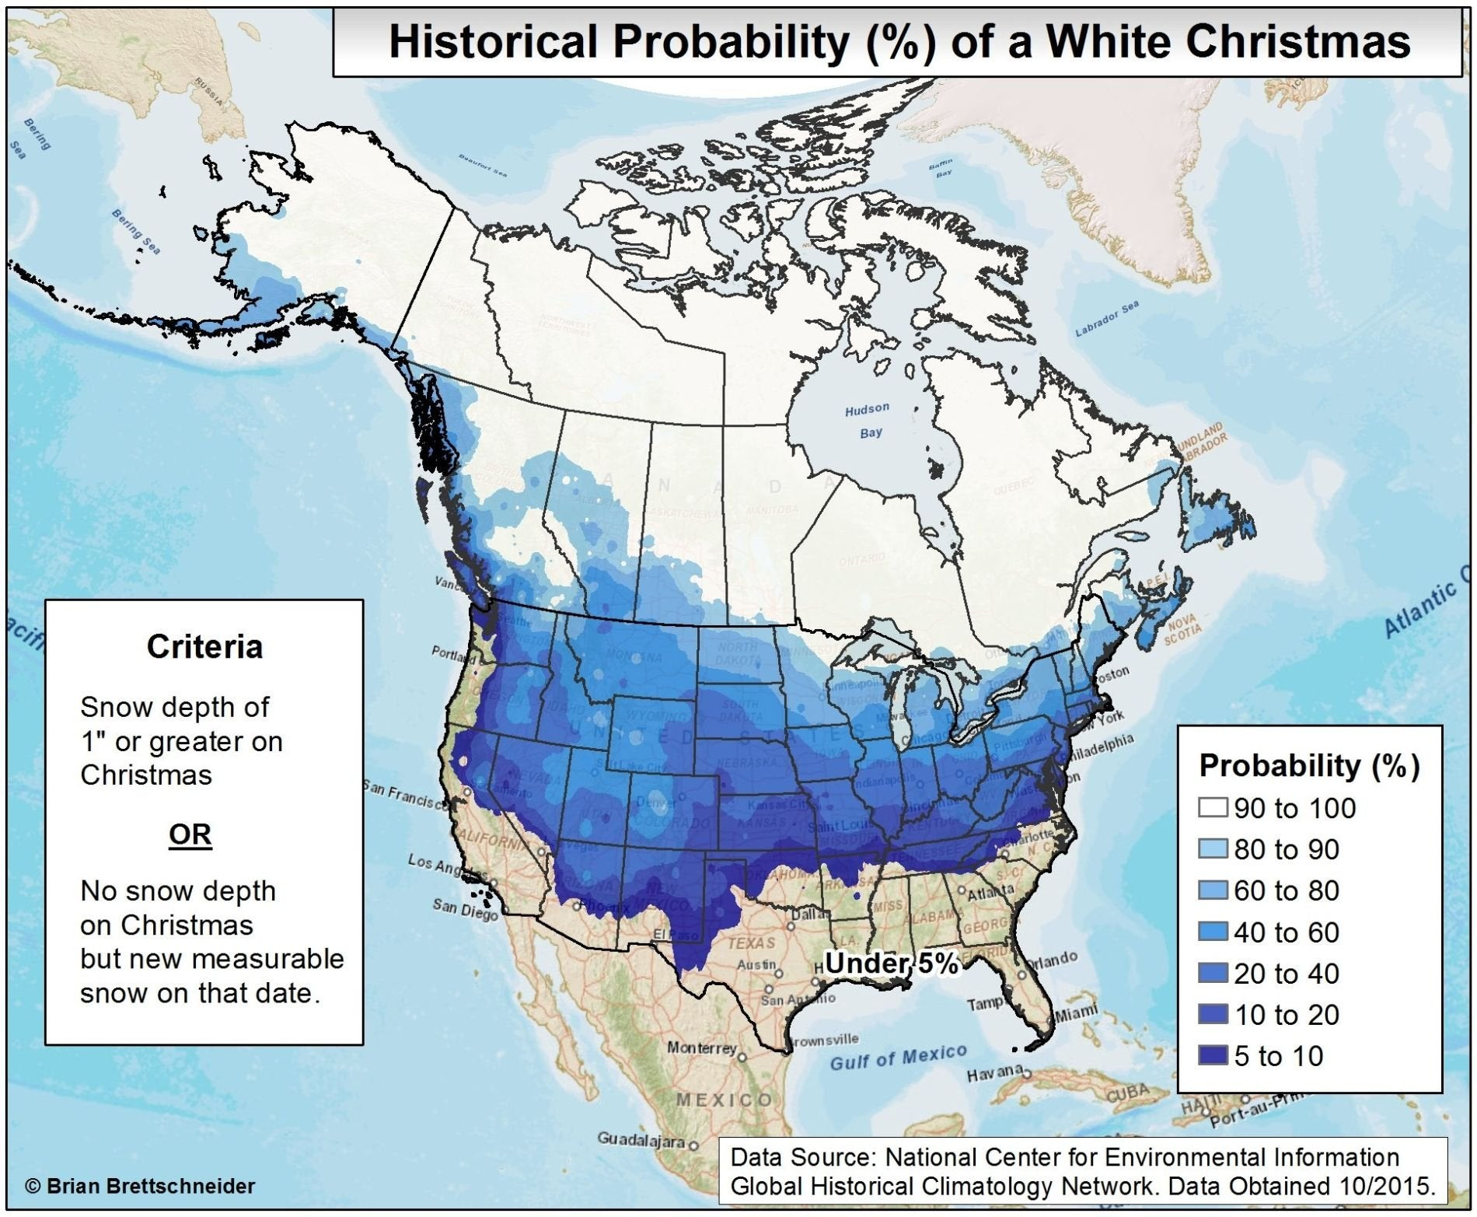

Slide 22

REACH Study: Effectiveness of Community Services for Conduct Problems
Sample (N = 139)
  Ages 6-11 (M = 8.8; SD = 1.6)
  84.9% male
  47.5% White; 46.0% African American
  82.7% ODD
  20.9% CD
R01MH057727; PI: Kolko
Kolko, Dorn, Bukstein, Pardini, Holden, & Hart, 2009

Slide 23
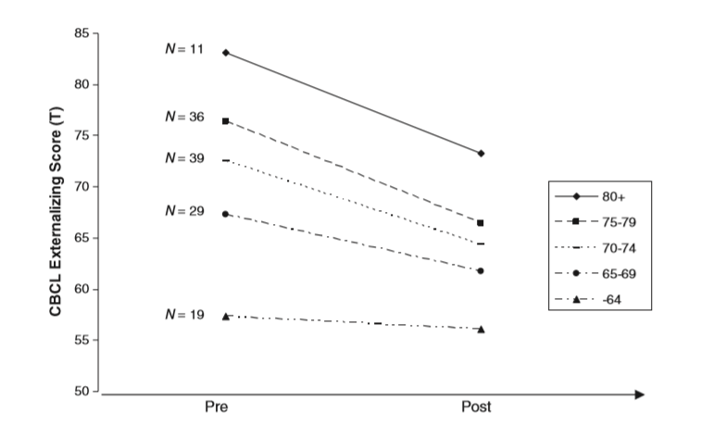

Slide 24
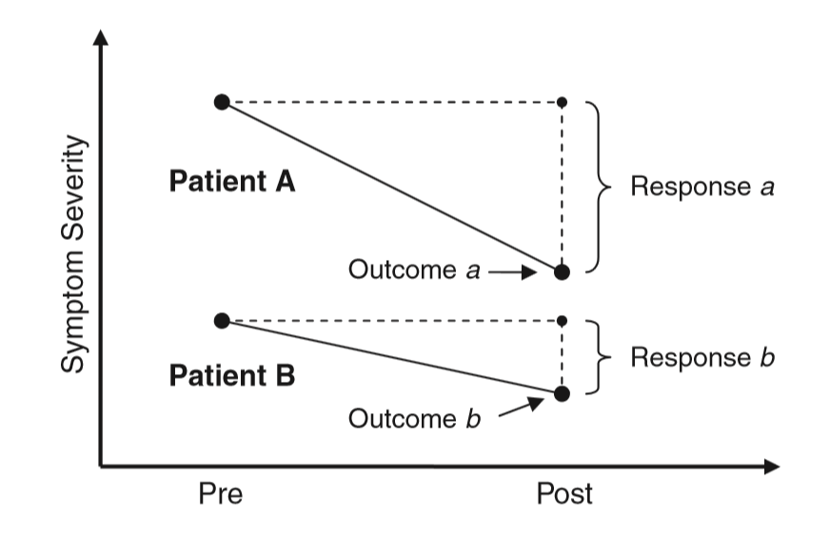

Slide 25
Outcomes and endpoints
CBCL Externalizing Scale
  Clinical Range (T-score ≥ 64)
  Normal Range (T-score ≤ 60)
  Improvement (Reliably better based on RCI of 8pts)
  Deterioration (Reliably worse based on RCI of 8pts)
Columbia Impairment Scale (CIS) Global Impairment Scale
  Clinical Range (score ≥ 15)
  Normal Range (score ≤ 14)
  Improvement (Reliably better based on RCI)
  Deterioration (Reliably worse based on RCI)

Slide 26

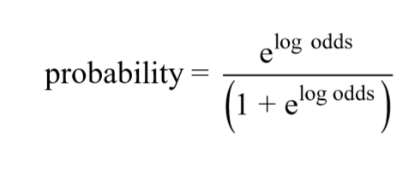
Estimating the probabilities
Estimated from logistic models
After the log odds are estimated from the beta weights, these are converted to probabilities:

Slide 27
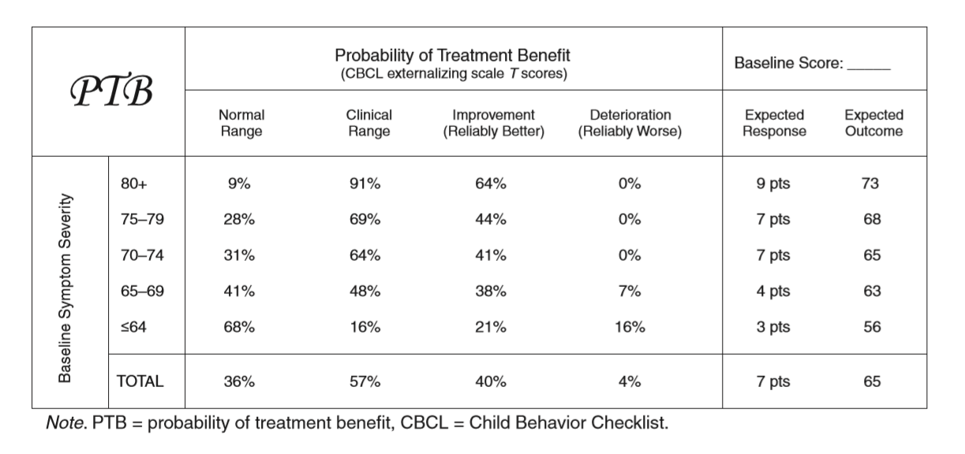
PTB Chart - Symptoms

Slide 28
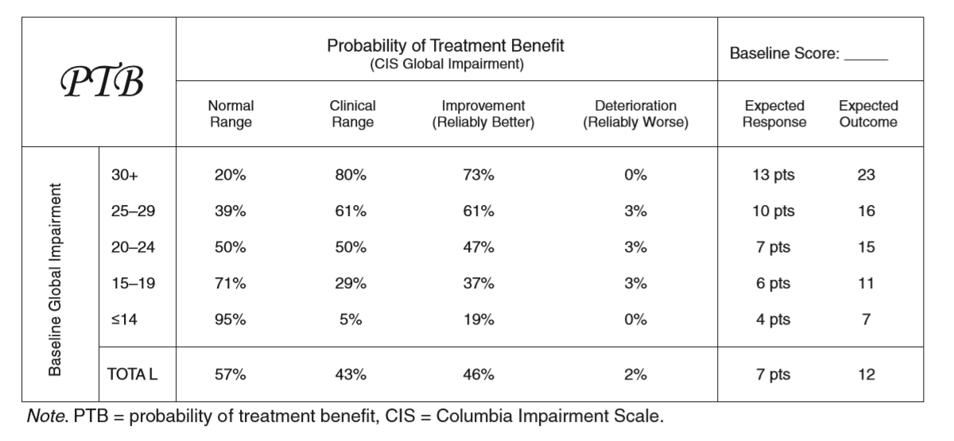
PTB Chart - Impairment

Slide 29
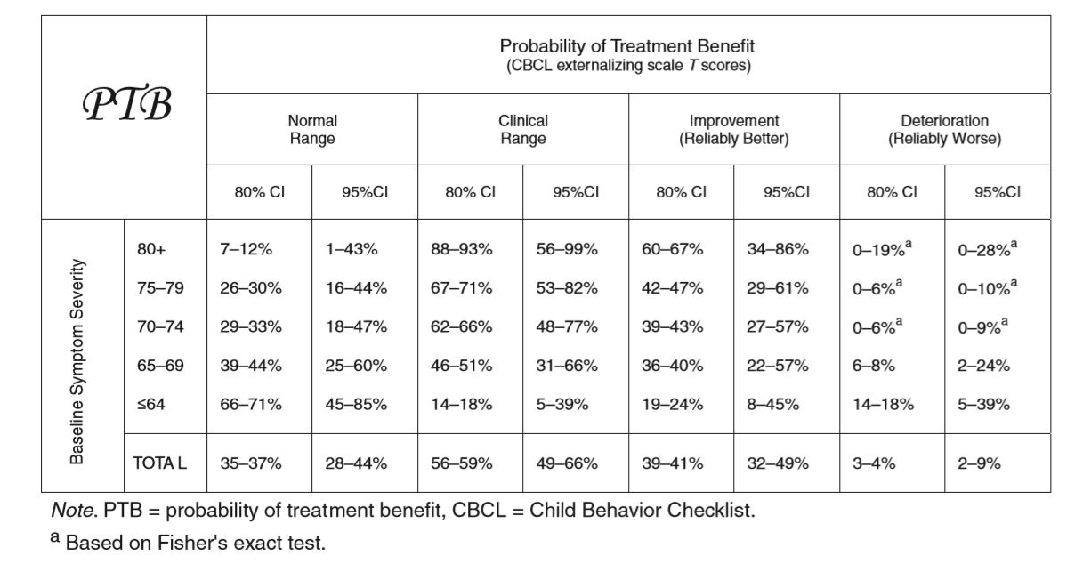
PTB Chart with CIs

Slide 30

Not the only way….
More complicated:
  Machine Learning (ML) algorithms
More simple:
  Laplace’s rule-of-succession
    p = (a + 1)/(b +2),
    where “a” is the number of successes, and
    “b” is the number of trials
Pierre-Simon Laplace

Slide 31
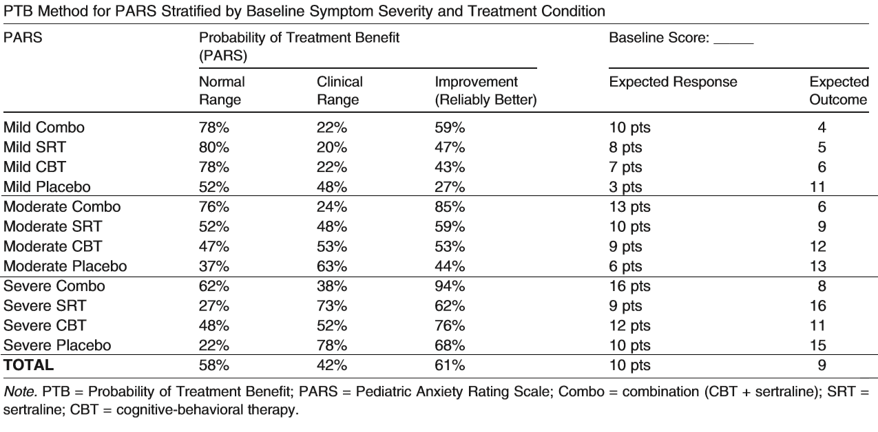
Extension to multiple treatment options
Beidas, Lindhiem, et al., 2014

Slide 32

Preferences Matter
Lindhiem, Bennett, Trentacosta, & McLear, 2014
Meta-analysis of 32 clinical trials
Treatment preference, shared decision making (SDM), or choice associated with:
  Higher satisfaction (ES_{d} = .34; p < .001)
  Treatment completion (ES_{d} = .17; p < .001)
  Better clinical outcome (ES_{d} = .15; p < .0001)

Slide 33

Decision Science
Structuring decisions
Measuring preferences
Decision networks
Influence diagrams
Conditional probabilities
Utility theory

Slide 34
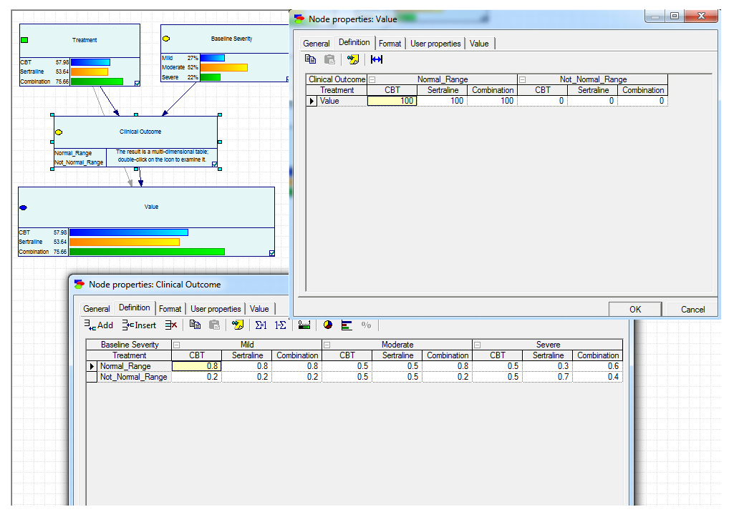
Factoring in preference….
Lindhiem, Bennett, Beidas, Grasso, Sakolsky, & Druzdzel, 2018

Slide 35
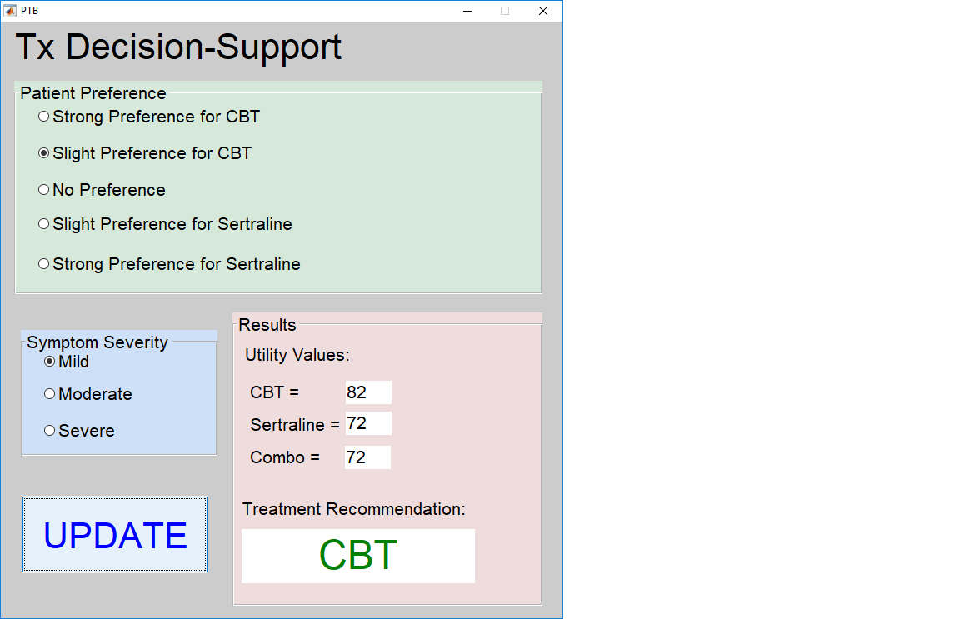
Decision-Support Tool Prototype
Lindhiem, Bennett, Beidas, Grasso, Sakolsky, & Druzdzel, 2018

Slide 36
Grasso, Ford, & Lindhiem, 2016
Step-by-step guide for building your own PTB charts
Includes a tutorial on how to calculate an RCI
Clinical case examples
Side-by-side comparison to other statistics including:
  Cohen’s d
  Number-needed-to-treat (NNT)
  Absolute risk reduction (ARR)

Slide 37
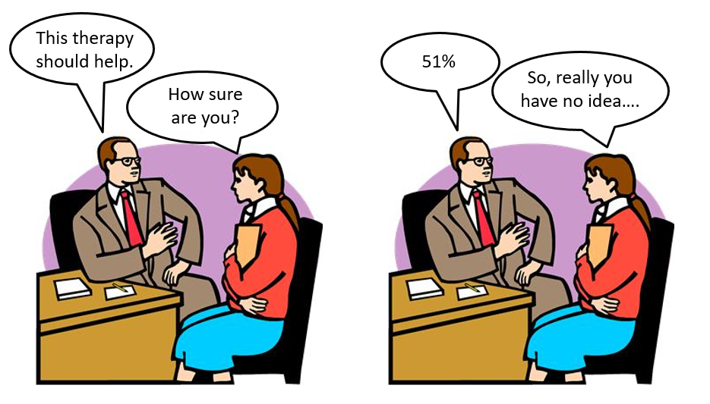
Cautions and caveats
Probabilities don’t tell you what to do
Lots of probabilities are somewhere in the middle

Slide 38

But maybe that’s okay
Knowledge is still valuable…and actionable
Even 50% predictions can be decisive

Slide 39
Calibration checks
Make sure the “wheels are aligned”
How accurate are your probabilities?
The importance of calibration

Slide 40
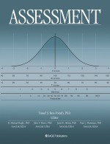
Calibration
Values must match the “true” underlying probabilities
This can be tested with actual data
Lindhiem, Petersen, Mentch, & Youngstrom, 2018

Slide 41
If you remember nothing else….
…remember these principles:
Transparency
Autonomy
Personalization

Slide 42
Acknowledgements
David Kolko
Yu Cheng
Damion Grasso
Rinad Beidas
Charles B. Bennet
Dara Sakolsky
Marek Druzdzel
Eric Youngstrom
Janelle Higa
Jill Ehrenreich-May
Douglas Brodman
Isaac Petersen
Lucas Mentch
Jamie Feldman
Jordan L. Harris
Chris Trentacosta
Caitlin McLear
Lynn Canty
Sonja Wiggins
Thank
You!

Slide 43
Questions?
Taking the webinar for CE? Did you respond to the Moderator in the tool box on the right of your screen?
Your response indicates your attendance.

Slide 44
Source Citation for this Presentation
Lindhiem, O. & Youngstrom, E. A. (2019). “Will this therapy work for me?”
Applying Research Findings to Individual Patients [PowerPoint slides]. Webinar sponsored by the Society of Clinical Child and Adolescent Psychology, Division 53 of the American Psychological Association. New York, NY.

