Slide 1
Like Setting a Home on Fire: How the Stress of Separation ad Detention is Harming Immigrant Children
Presenter: Jack P. Shonkoff, MD, the Julius B. Richmond FAMRI Professor of Child Health and Development at the Harvard T.H. Chan School of Public Health and the Harvard Graduate School of Education; Professor of Pediatrics at Harvard Medical School and Boston Children’s Hospital; and Director of the university-wide Center on the Developing Child at Harvard University.
Moderator: Dr. Erlanger Turner, Assistant Professor in the Graduate School of Education and Psychology at Pepperdine University, SCCAP Diversity Committee Chair.
Up coming webinars:
Nov 12 1:00pm ET; R. Bob Smith III Excellence in Assessment Award Webinar; Improving Mental Health Services with Multicultural Assessment of Child, Youth & Parent Psychopathology, Thomas Achenbach, PhD
Dec 5 Noon ET : “But will this therapy Help me?”: Applying Research Findings to Individual Patients, Oliver Lindhiem, PhD
Submit your 2020 webinar ideas to SCCAP53.org

Slide 2
Audience Questions and Answers
Submit a question during the webinar:
Post your questions for the Q&A segment! On right side of screen, click on the Questions tab on the Go-To-Webinar control panel, and submit your questions
Continue the conversation after the webinar in the SCCAP53.org Forum
For one month, panel members will respond to as many questions as possible
Go to https://sccap53.org
Log in with your member email and password
Scroll down and click on the “Forum” box
Under Webinar Discussions, click on “Border Separation”
See the forum rules posted by the Web Editor, and then
Post away!

Slide 3
Early Life Experiences Are Built Into Our Bodies (For Better or For Worse)
Stable and supportive relationships, mutually responsive “serve and return” interactions, and opportunities to deal with manageable stressors promote sturdy brain architecture and heathy biological systems…
…but excessive or prolonged activation of stress response systems in the absence of the buffering protection of supportive relationships can lead to long-term disruptions in brain circuitry, immune status, metabolic systems, cardiovascular function, and gene expression.

Slide 4
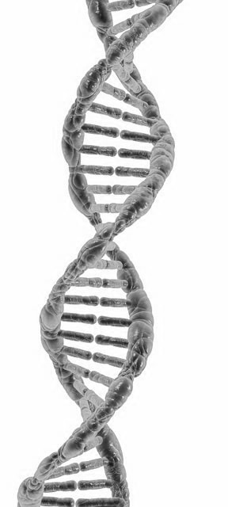
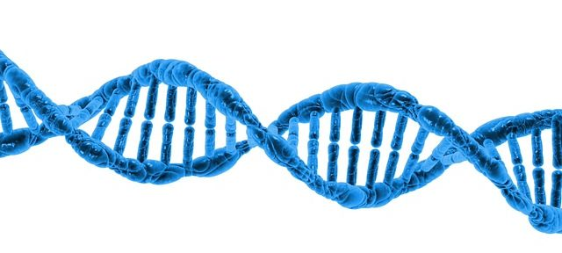
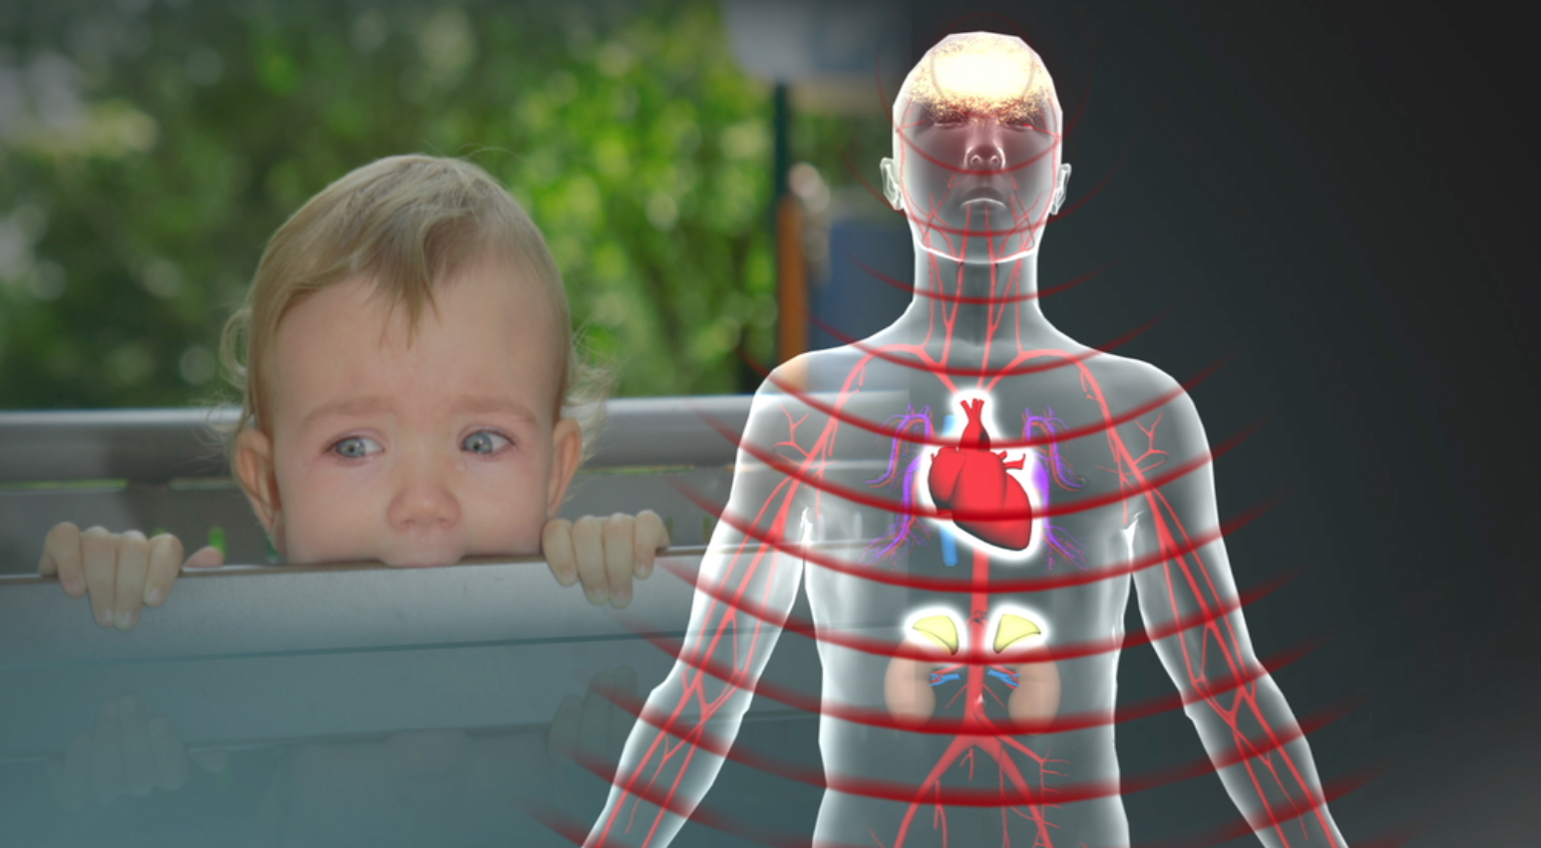
The Biology of Adversity is Reflected in Multiple Effects at the Molecular, Cellular and Systems Levels
Autonomic nervous system
(“flight or fight”)
Genetic Variation
HPA axis
Inflammation
Learning, Behavior & Health
X
Environmental Stressor
Brain circuitry
Oxidative stress
Epigenetic marks
(gene expression and developmental pacing)

Slide 5
Early Matters Because the Brain’s Ability to Change
Decreases Over Time
Normal Brain Plasticity Influenced by Experience
Physiological “Effort” Required to Enhance Neural Connections
Birth
10
20
30
40
50
60
70
80
Age (Years)
Source: Levitt, P. (2009)
Notes:
5
This graph reinforces one important takeaway from the video: it’s easier and more effective to get brain development right in the early years than to fix things later
The graph is a conceptual model that illustrates core developmental concepts – it does not reflect precise measurements. As the maturing brain becomes more specialized to assume more complex functions, it is less capable of reorganizing and adapting. For example, by the first year, the parts of the brain that differentiate vocal sounds are becoming specialized to the language the baby has been exposed to and are already starting to lose the ability to recognize sound distinctions found in other languages. As the brain prunes away circuits that are not used, those that are used become stronger and increasingly difficult to alter. Declining plasticity means it’s easier and more effective to influence a baby’s developing brain architecture than it is to rewire parts of its circuitry in the adult years. In other words, we can invest now by ensuring positive conditions for healthy development, or pay more later in the form of costly remediation, health care, mental health services, and increased rates of incarceration.
Source: Pat Levitt, National Scientific Council on the Developing Child (2009)

Slide 6


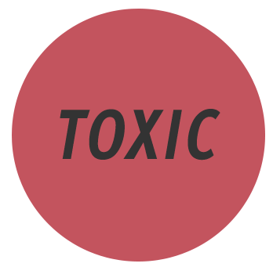
Understanding Different Types of Stress Response Underscores Why Forcible, Parent-Child Separation and Prolonged Detention Are So Threatening
Brief activation of stress response systems with prompt return to baseline levels
Serious but temporary stress responses buffered by supportive relationships
Prolonged activation of stress response systems in the absence of protective relationships
Notes:
6

Slide 7
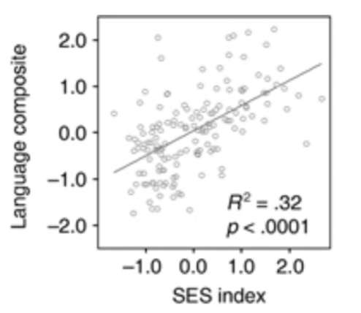
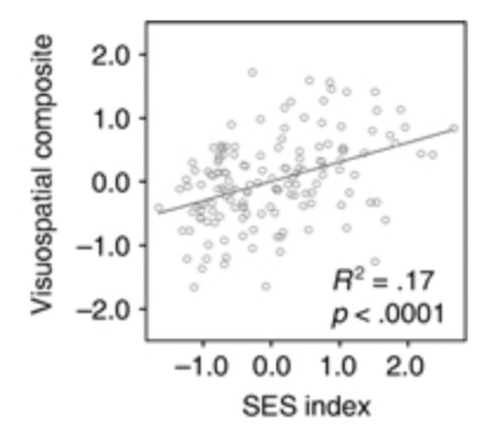
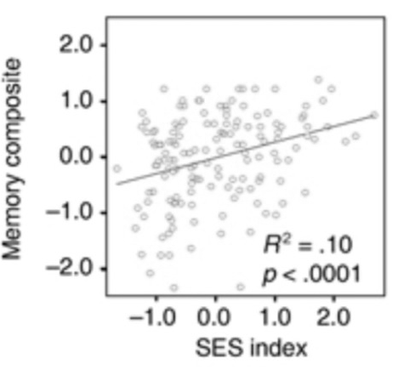
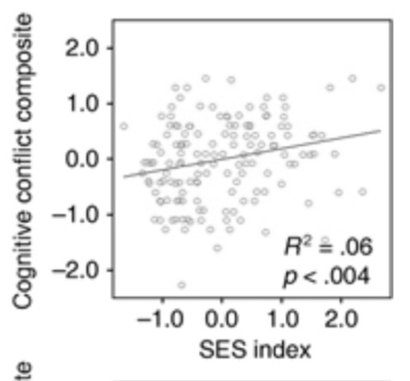
Best Case Scenario: Variation in Sensitivity to Adversity Means Not All Children Will Experience Comparable Consequences
Source: Noble et al. (2007)

Slide 8
Worst Case Scenario #1: The Cumulative Pile Up of Adversity Impairs Development in the First Three Years
100%
80%
60%
Children with Developmental Delays
40%
20%
1-2
3
4
5
6
7
Number of Risk Factors
Source: Barth, et al. (2008)

Slide 9
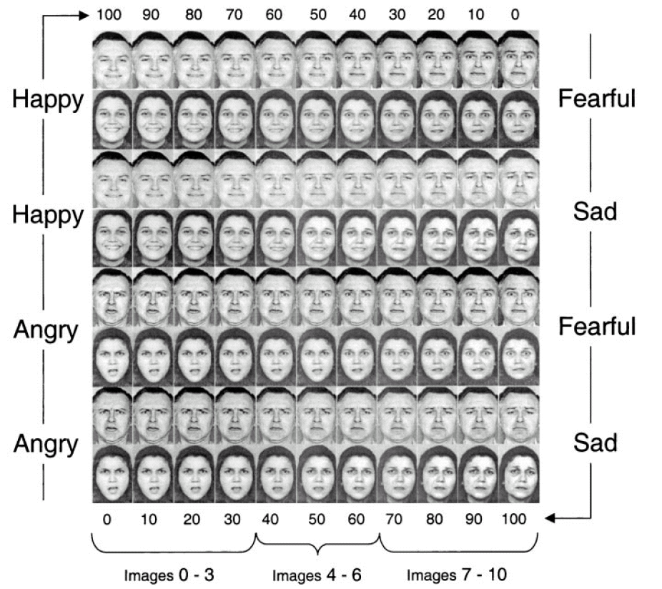
Worst Case Scenario #2: Early Abuse Affects Later Behavior
Source: Pollak & Kistler (2002)

Slide 10
Worst Case Scenario #3: Biological “Memories” Link Maltreatment in Childhood to Greater Risk of Adult Disease
50%
Percent of adults with elevated
C-reactive protein
40%
30%
20%
10%
Control
Depression
(age 32)
Maltreated (as a child)
Depression
(age 32) +
Maltreated (as a child)
Source: Danese et al. (2008)
Notes:
JACK: I THOUGHT THIS ONE MIGHT BE BETTER FOR LONDON THAN THE ACES SLIDE, BUT WE COULD REMOVE IT FOR IL AND MA…
Increased inflammation is related to adult cardiovascular disease -- even mild elevation in inflammation levels predicts increased risk of CV disease in apparently healthy individuals.
On this graph you see measurements of a known marker of inflammation, high-sensitivity C-Reactive protein (more than 3 mg./L). The same study also measured fibrinogen, white blood cell counts, and chronic activation of the inflammatory response system, and all showed the same pattern of increasing elevation in depressed adults, non-depressed adults who had suffered maltreatment in early childhood, and depressed adults who had suffered maltreatment in early childhood. While depression is itself correlated to heart disease, maltreatment as a child even without depression showed a significantly increased risk.
The population tested here is part of a 35-year longitudinal study in Dunedin, New Zealand, in which victims of childhood maltreatment have been tracked since 1972 -- so unlike other studies that depend on adult recall of childhood maltreatment, this one measures actual biological impact of demonstrated maltreatment in a prospectively followed cohort.

Slide 11
Connecting the Dots Between Policy and Science
Forcibly separating children from their parents is like setting a home on fire.
Preventing rapid reunification is like blocking the first responders from doing their job.
Subjecting children to prolonged detention (even with their parents) is like dripping gasoline on smoldering embers that will keep the fire going.

Slide 12
Confronting Complex Interactions Among
Science, Politics, and Policy
A society in which there is no broadly-trusted authority to define established knowledge, assess the credibility of conflicting information, and call out false assertions presents extraordinary challenges.
Credible scientific concepts and rigorous empirical data offer powerful tools to explain the consequences of current policies for immigrant children and families, but significant change will require a well-defined, actionable strategy that transcends partisan politics, activates key constituencies, and addresses broadly-supported values.

Slide 13
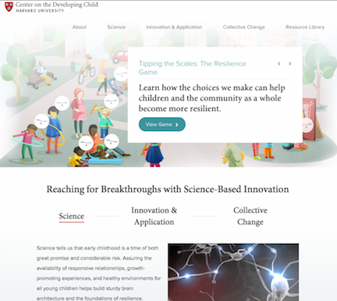
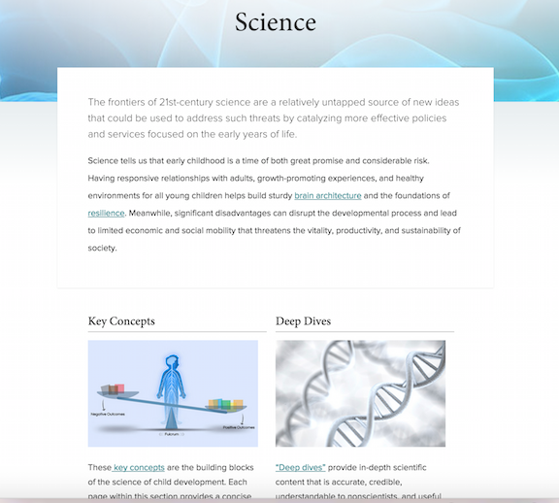
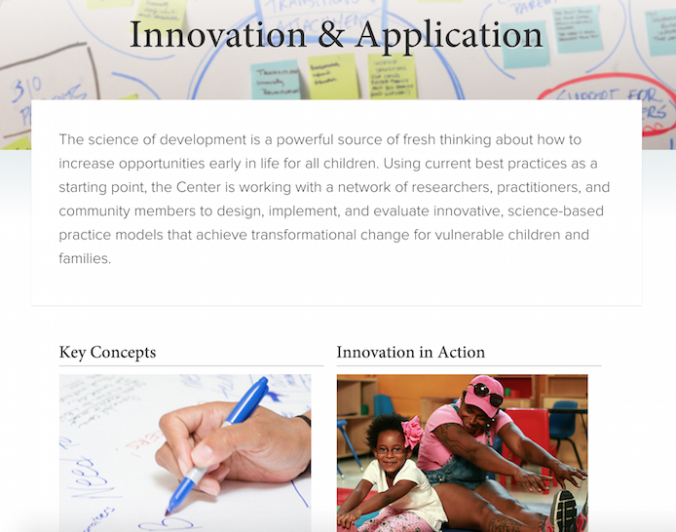



www.developingchild.harvard.edu
@HarvardCenter
@CenterDevelopingChild
@DevelopingChildHarvard
Notes:
13

Slide 14
Audience Questions and Answers
Submit a question during the webinar:
Post your questions for the Q&A segment! On right side of screen, click on the Questions tab on the Go-To-Webinar control panel, and submit your questions
Continue the conversation after the webinar in the SCCAP53.org Forum
For one month, panel members will respond to as many questions as possible
Go to https://sccap53.org
Log in with your member email and password
Scroll down and click on the “Forum” box
Under Webinar Discussions, click on “Border Separation”
See the forum rules posted by the Web Editor, and then
Post away!

Slide 15
Source Citation for this Presentation
With website link
Shonkoff,J.P.,(2019). Like Setting a Home on Fire: The Effects of Separating Families at the Border [PowerPoint slides]. Retrieved from https://sccap53.org/resources/education-resources/webinars/recordedwebinars/
Without website link
Shonkoff,J.P.,(2019). Like Setting a Home on Fire: The Effects of Separating Families at the Border [PowerPoint slides]. Webinar sponsored by the Society of Clinical Child and Adolescent Psychology, Division 53 of the American Psychological Association. Washington, D.C.

