Slide 1
The Impact of 13 Reasons Why on Suicide Behavior in Young People: What We Know So Far
John Ackerman, PhD, Nationwide Children’s Hospital
Megan Chesin, PhD, William Paterson University of New Jersey
Kurt D. Michael, PhD, Appalachian State University
Moderator: Jennifer L. Hughes, PhD, MPH, UT Southwestern Medical Center
Up coming webinars:
October 9 Noon ET ; Like Setting a Home on Fire: The Effects of Separating Families at the Border, Jack P. Shonkoff, M.D.
Nov 12 1:00pm ET; R. Bob Smith III Excellence in Assessment Award Webinar; Improving Mental Health Services with Multicultural Assessment of Child, Youth & Parent Psychopathology, Thomas Achenbach, PhD
Dec 5 Noon ET : “But will this therapy Help me?”: Applying Research Findings to Individual Patients, Oliver Lindhiem, PhD

Slide 2
Audience Questions and Answers
Submit a question during the webinar:
Post your questions for the Q&A segment! On right side of screen, click on the Questions tab on the Go-To-Webinar control panel, and submit your questions
Continue the conversation after the webinar in the SCCAP53.org Forum
For one month, panel members will respond to as many questions as possible
Go to https://sccap53.org
Log in with your member email and password
Scroll down and click on the “Forum” box
Under Webinar Discussions, click on “13 Reasons Why”
See the forum rules posted by the Web Editor, and then
Post away!

Slide 3
The Impact of 13RW on Suicidal Behavior in Young People: What We Know So Far
Kurt D. Michael, Ph.D.
Stanley R. Aeschleman Distinguished Professor of Psychology
Appalachian State University
The Society for Clinical Child and Adolescent Psychology
Division 53 of the American Psychological Association

Slide 4
Epidemiology of Suicide
In the United States during 2017, a person died by suicide every 11 minutes
Approximately 47,000 die annually (CDC, 2018)
Suicide rates are typically twice as high in rural regions (Fontanella et al., 2015)

Slide 5
National, Regional, Local Trends
CDC WONDER, accessed 2019
Notes:
Co Counties included in Wonder analysis (N = 16): Alamosa, Cheyenne, Delta, Eagle, El Paso, Grand, Gunnison, Kit Carson, Las Animas, Mesa, Moffat, Montrose, Pueblo, San Juan, San Miguel. Total suicides in the 16 counties = 4,382 (1999-2017) involving a total population of 21,471,764 during the same period.
Suggested Citation:
Centers for Disease Control and Prevention, National Center for Health Statistics. Underlying Cause of Death 1999-2017 on CDC WONDER Online Database, released December, 2018. Data are from the Multiple Cause of Death Files, 1999-2017, as compiled from data provided by the 57 vital statistics jurisdictions through the Vital Statistics Cooperative Program. Accessed at http://wonder.cdc.gov/ucd-icd10.html on Jun 18, 2019 3:49:12 PM

Slide 6
Trends for Youth Over Time
Epidemiology 1999 - 2017
For females between 10-14, rates increased over 200% (0.5 to 1.7 per 100k)
For females between 15-24, rates nearly doubled (3.0 to 5.8 per 100k)
Rates for males between 10-14 increased significantly (1.9 to 3.3 per 100k), as did the number of deaths by suicide for males between 15-24 (16.8 to 22.7 per 100k)
Source: https://www.cdc.gov/nchs/data/databriefs/db330_tables-508.pdf#3

Slide 7
Engaging the Topic of Youth Suicide
Started my professional work in rural western North Carolina in 1999
Suicide rates 2-3x higher than average
School mental health context
Developed the PEACE crisis intervention protocol which has been used approximately 400 times since 2012
Personal investment in the topic
Raising my own children
Community citizen
Specific focus on the impact of 13RW
2017 American Association of Suicidology Meeting
Escalated conversations with communities of scholars and clinicians

Slide 8
School Mental Health in North Carolina K-12 Schools
Assessment, Support & Counseling (ASC) Center
Mission. Help educators to educate by:
Providing access to high quality, supervised mental health services to children and families regardless of their ability to pay
Training a steady stream of qualified school mental health professionals who join the workforce
Conducting research that informs effective school mental health practices and prevents death by suicide

Slide 9
Findings Regarding 13RW
Ayers et al. (2017)
Internet searches on terms such as: “how to kill yourself” 900k to 1.5 million (more than expected) in the 19 days after Season 1 release
Cooper Jr. et al. (2018)
Unexpected increases in psychiatric admissions for suicidal youth post release of Season 1
Hong et al. (2018)
For youth in the ED who watched at least 1 episode of Season 1 (N = 42), half reported that 13RW increased their suicidal thinking “to some degree”

Slide 10
Findings Regarding 13RW
Bridge et al. (2019)
Approximate 30% increase in suicides among 10-17 year-olds after the release of Season 1
Sinyor et al. (2019)
Time series analyses of suicide deaths for those under 30 in Ontario were conducted in the period before and after the release of Season 1
The Model predicted 224, yet 264 were observed in the period (18% higher than expected)

Slide 11
What Can We Do?
Can we evaluate (or even promote) help-seeking methods in response to high profile media events?

Slide 12
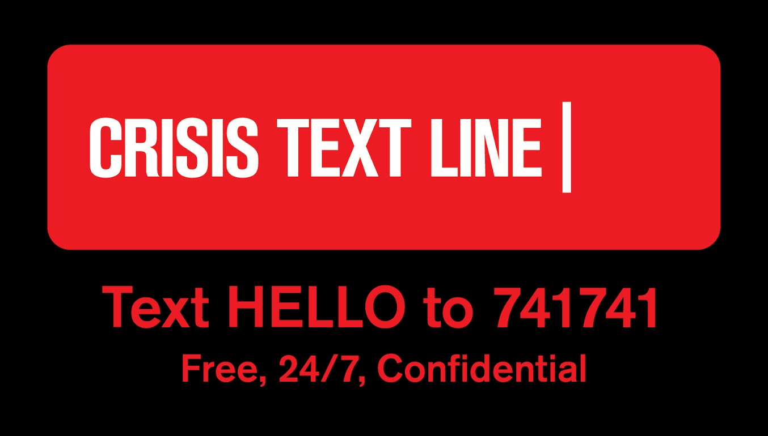
*Crisis Text Line (>105,000,000)
*These opinions are my own and not the views of Crisis Text Line.

Slide 13
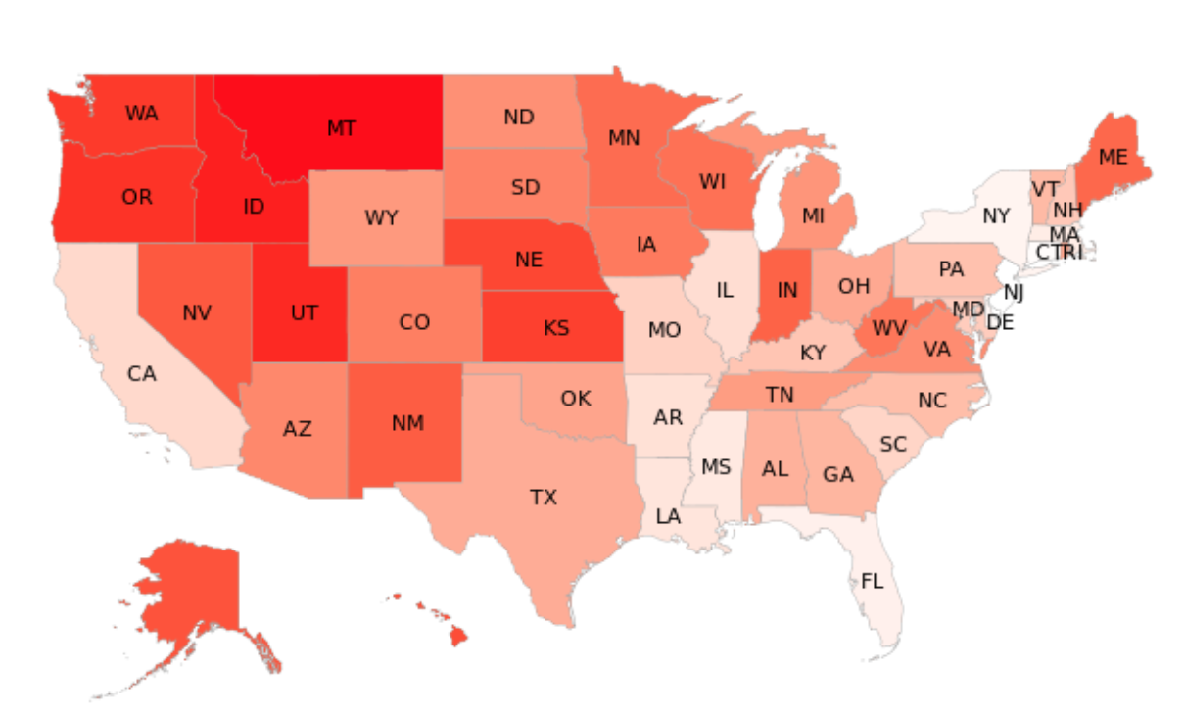
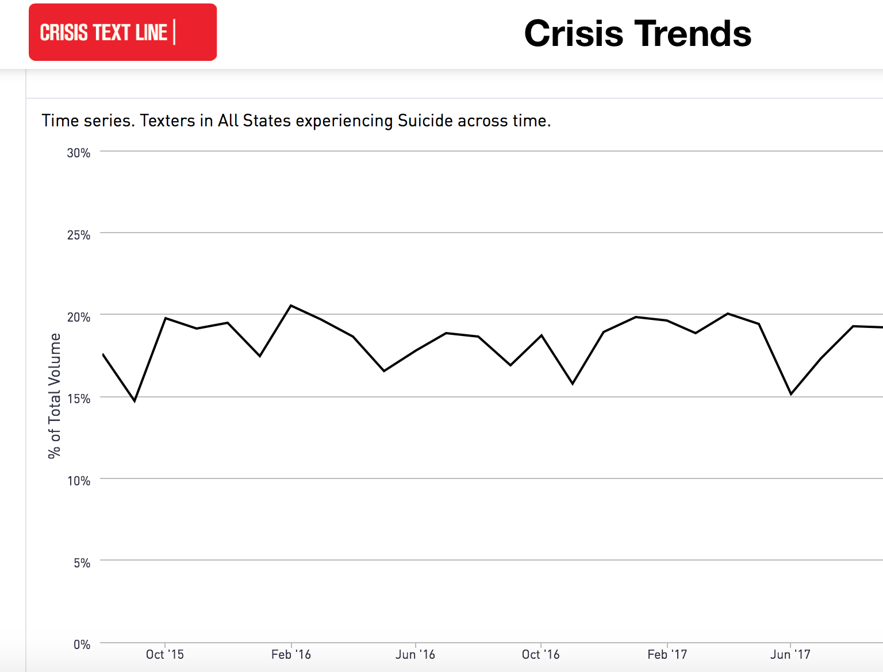
*Crisis Text Line (>105,000,000)
CRISIS TRENDS
US STATES RANKED BY CRISES RELATED TO SUICIDE
*These opinions are my own and not the views of Crisis Text Line.

Slide 14
Thompson, Michael, Runkle & Sugg, 2019
*2017 Crisis Text Line (CTL) data
-Approximately 80% of CTL users are under 25
Assessed CTL conversation volume before and after the release of 13RW Season 1
-Methodologically similar to Ayers et al.
-Substantial and unexpected trough (12.7%) in conversation volume after April 6th
*These opinions are my own and not the views of Crisis Text Line.

Slide 15
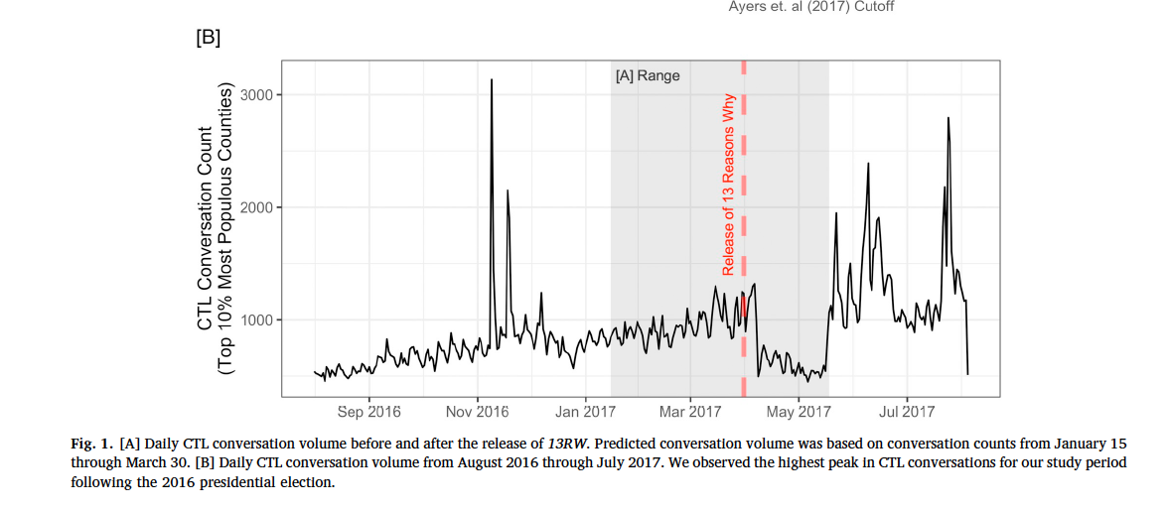
Thompson, Michael, Runkle & Sugg, 2019
*These opinions are my own and not the views of Crisis Text Line.

Slide 16
Thompson, Michael, Runkle & Sugg, 2019
Conclusions and Implications
-Unexpected dip in help-seeking via CTL
-In early 2018, it was difficult to find CTL via key word Google searches
-After a great deal of controversy, Netflix developed a more deliberate partnership with CTL (e.g., health promotion banners, ads)
*These opinions are my own and not the views of Crisis Text Line.

Slide 17
Sugg, Michael, Filbin, Weiser & Runkle, under review
*2018 Crisis Text Line (CTL) data
Assessed CTL conversation volume before and after the release of 13RW Season 2 along with the suicide deaths of Kate Spade and Anthony Bourdain
-Methodologically similar to Thompson et al. (February – December, 2018)
-Unexpected spikes in call volume (i.e., help seeking) after 3 high profile media events related to suicide
*These opinions are my own and not the views of Crisis Text Line.

Slide 18
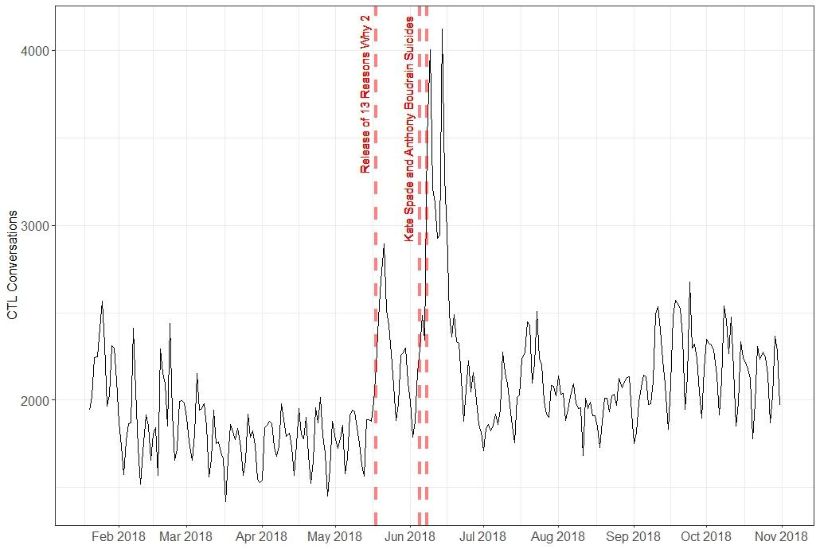
Sugg, Michael, Filbin, Weiser & Runkle (under review)
*These opinions are my own and not the views of Crisis Text Line.

Slide 19
The Science of Prevention and Intervention: Cognitive Behavioral Therapy (CBT) and Means Safety
Clinically significant reductions in psychological symptoms for 65-75% served (Albright et al., 2013; Kirk et al., 2018)
The majority of youth served achieve clinically significant change in 10-14 sessions of CBT (Kirk et al., 2018)
Clinically significant improvements in mood symptoms using 8-12 sessions of modular CBT (Michael et al., 2016)
CBT Works well in tandem with crisis intervention & means safety procedures in schools (Capps et al., 2019; Michael et al., 2015; Sale et al., 2013)

Slide 20
Other Key Findings in K-12 Schools
70% of teens reported having access to lethal means (mostly medications and firearms)
42% of teens reported a history of prior attempts
25% reported having a family member who had either been hospitalized due to suicidal ideation, had attempted, or had died by suicide
In one of our studies, hospitalization occurred for 14% of the cases where the risk of suicide was high and/or access to lethal means could not be adequately reduced
Several studies in progress that show promise when using adjunctive elements: CALM (Counseling on Access to Lethal Means) and CAMS (Collaborative Assessment and Management of Suicidality)
Vast majority of youth find active interventions to reduce suicide to be acceptable

Slide 21
Summary
Media exposure to suicide content is not benign
Yet, the concerns have generated increased resolve to address this longstanding and worsening public health problem
Prevention and intervention science have revealed some promising approaches to deal effectively with suicidal youth

Slide 22
Relevant References
*Thompson, L.K., Michael, K.D., Runkle, J.R., & Sugg, M.M (2019). Crisis Text Line use following the release of Netflix Series 13 Reasons Why Season 1: Time series analysis of help-seeking behavior in youth. Preventive Medicine Reports, 14, 1-4. https://doi.org/10.1016/j.pmedr.2019.100825
*Capps, R.E., Michael, K.D., & Jameson, JP (2019). Lethal means and adolescent suicide risk: An expansion of the PEACE Protocol. Journal of Rural Mental Health, Vol. 43, No. 1, 3-16. http://dx.doi.org/10.1037/rmh0000108
*Kirk, A., Michael, K.D., Bergman, S., *Schorr, M., & Jameson, JP (2018). Dose response effects of cognitive-behavioral therapy in a rural school mental health program. Cognitive and Behaviour Therapy. doi.org/10.1080/16506073.2018.1550527
*Graduate Student

Slide 23
Relevant References
Michael, K.D., George, M. W., *Splett, J. W., Jameson, JP, *Sale, R., *Albright Bode, A., Iachini, A. L., Taylor, L. K., & Weist, M. D. (2016). Preliminary outcomes of a multi-site, school-based modular intervention for adolescents experiencing mood difficulties. Journal of Child and Family Studies, 25(6), 1903-1915. https://doi.org/10.1007/s10826-016-0373-1
Michael, K.D., Jameson, JP, *Sale, R., *Orlando, C., *Schorr, M., *Brazille, M., *Stevens, A., & *Massey, C. (2015). A revision and extension of the Prevention of Escalating Adolescent Crisis Events (PEACE) protocol. Children and Youth Services Review, 59, 57-62. https://doi.org/10.1016/j.childyouth.2015.10.014
*Graduate Student

Slide 24
Relevant References
*Sale, R., Michael, K.D., Egan, T., *Stevens, A., & Massey, C. (2014). Low base rate, high impact: Responding to teen suicidal threat in rural Appalachia. Report on Emotional & Behavioral Disorders in Youth, 14(1), 4-8.
Michael, K.D., *Albright, A., Jameson, J.P., *Sale, R., Massey, C. S., *Kirk, A., & Egan, T.E. (2013). Does cognitive-behavioral therapy in the context of a rural school mental health program have an impact on academic outcomes? Advances in School Mental Health Promotion, 6, 247-262.
*Albright, A., Michael, K.D., Massey, C.S., *Sale, R., *Kirk, A., & Egan, T.E. (2013). An evaluation of an interdisciplinary rural school mental health program in Appalachia. Advances in School Mental Health Promotion, 6, 189-202.
*Graduate Student

Slide 25
Closing and Contact Information
Thank you!
Kurt Michael (michaelkd@appstate.edu)

Slide 26

The Impact of
13 Reasons Why on Young People: What We Know So Far
Megan Chesin, Ph.D., Associate Professor,
William Paterson University
SCCAP Webinar, September 19, 2019
Moderator: Jennifer Hughes, Ph.D., MPH, Psychologist, UT Southwestern Medical Center

Slide 27
Audience Questions and Answers
Submit a question during the webinar:
Post your questions for the Q&A segment! On right side of screen, click on the Questions tab on the Go-To-Webinar control panel, and submit your questions
Continue the conversation after the webinar in the SCCAP53.org Forum
For one month, panel members will respond to as many questions as possible
Go to https://sccap53.org
Log in with your member ID and password
Scroll down and click on the “Forum” box
Under Webinar Discussions, click on “The Impact of 13 Reasons Why on Young People: What We Know So Far”
See the forum rules posted by the Web Editor, and then
Post away!
Upcoming webinars: Submit your ideas for our 2020 Webinar Series: sccapdiv53@gmail.com

Slide 28
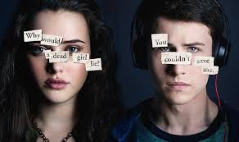
13 Reasons Why is a Hit TV Show
On March 31, 2017, a fictional television series about the suicide of a high-school student, 13 Reasons Why, was released on Netflix, a streaming, on-demand broadcast service.
The first season of 13 Reasons Why was the second most in-demand digital series in the United States in 2017 (Global Television Demand Report, 2018).

Slide 29
THE CONTENT OF 13 REASONS WHY IS PROVOCATIVE

Slide 30
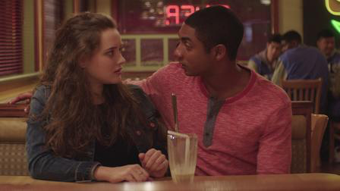
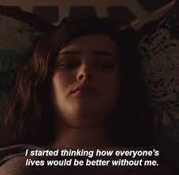
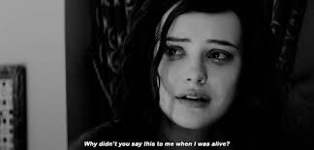
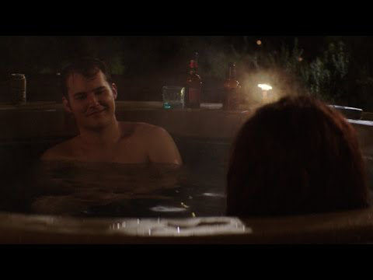
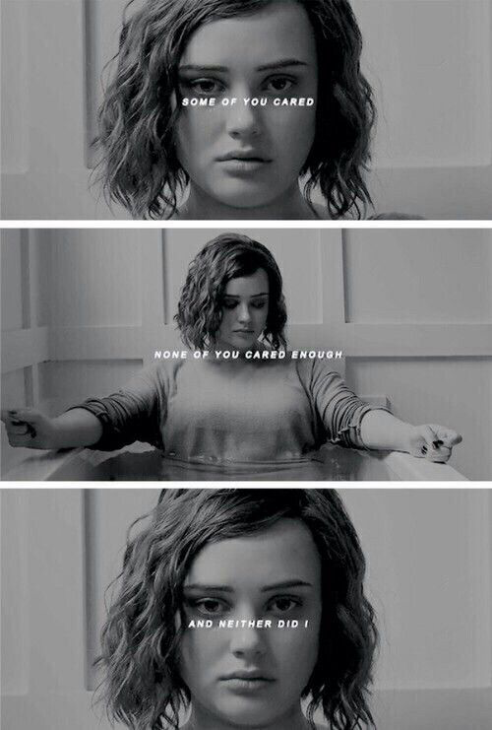
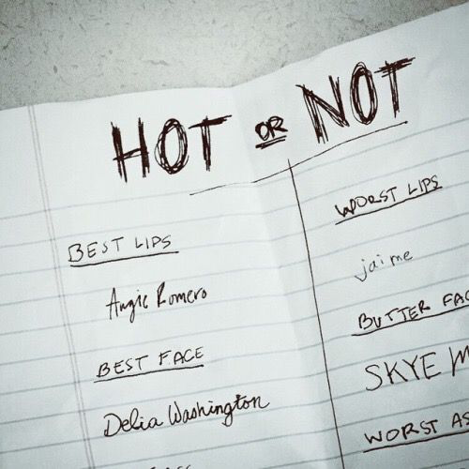

Notes:
Scenes from 13 Reasons Why
Depicted Suicide, Rape, Bullying

Slide 31
AND, THERE WAS PROFESSIONAL AND PUBLIC CONCERN ABOUT THE SHOW AND ITS GLORIFICATION OF SUICIDE

Slide 32
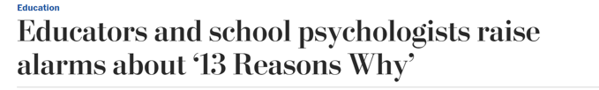
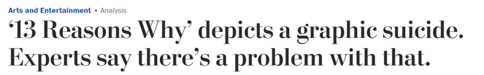
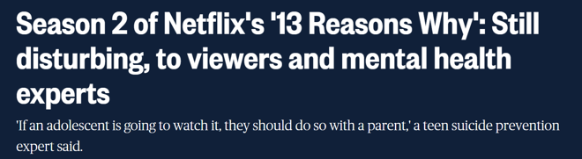
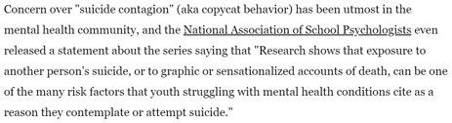
Notes:
This Society among others issued statements of concern that suicide contagion may result from the show.
There was much concern over how the suicide was depicted on the show. It was viewed as unsafe. Particularly problematic was: 1. including a graphic scene in which a teen dies by suicide
2. the portrayal of this death by suicide as an effective means of gaining a desired outcome (revenge on peers who Hannah feels have mistreated her), which can increase risk for "contagion" or "copycat" suicidal behavior by other teens
3. not providing information about how to easily access help if a viewer is feeling suicidal or struggling with mental health concerns (i.e., suicide hotline numbers)

Slide 33
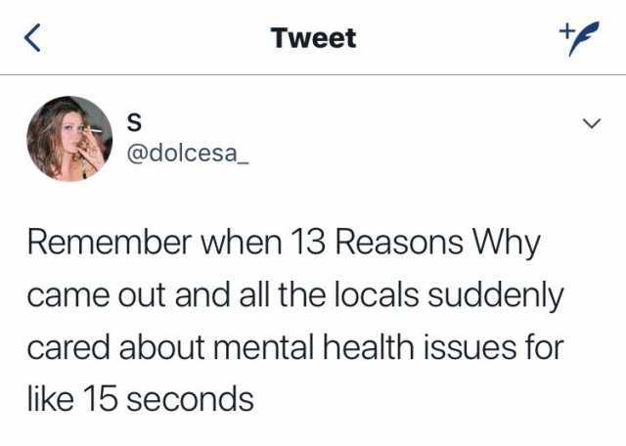
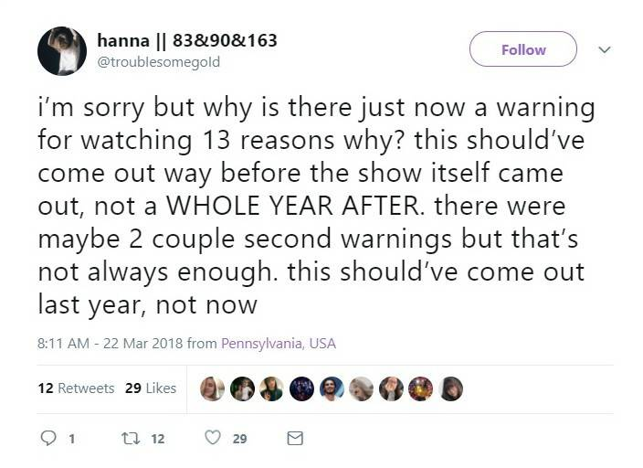
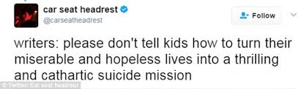
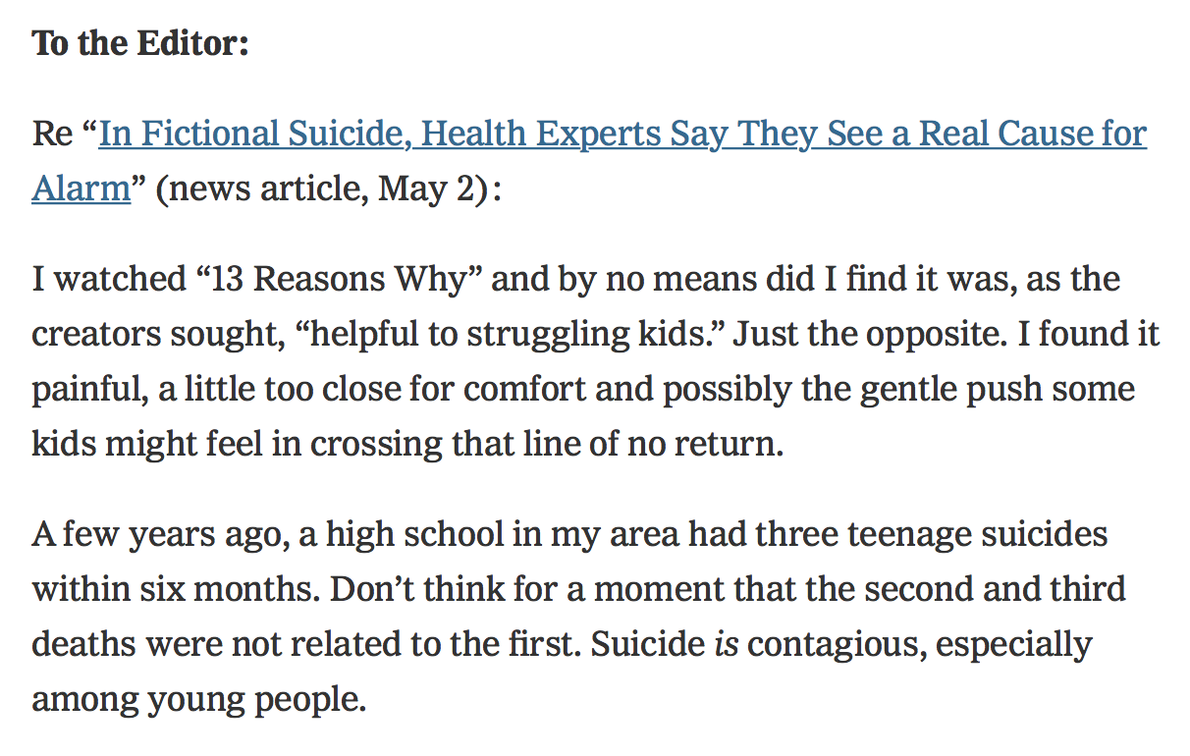
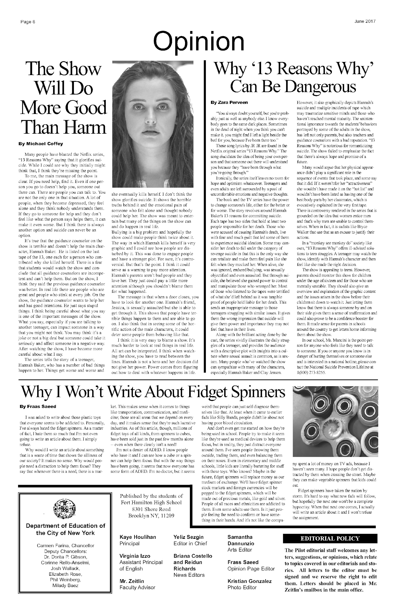
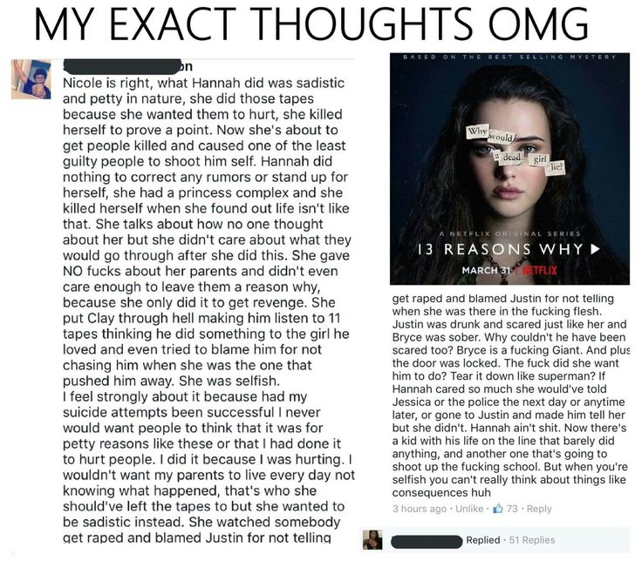
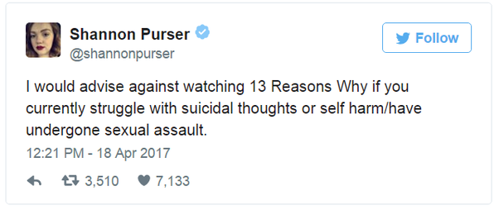

Slide 34
SO WHAT DO THE DATA SAY?

Slide 35
Suicide among Young People
is a Public Health Problem
Suicide is the second leading cause of death in the United States among 10-25 year olds (CDC, 2018).
The prevalences of suicide ideation, plans and non-fatal attempts are much higher (Mortier et al., 2018).
Notes:
among college students are 11% and 3%, respectively (

Slide 36
Media Depictions of Suicide May Increase Suicide Risk in Young People
Fictional stories about suicide in film and television are associated, inconsistently, with increased suicide attempt and ideation among young people (Gould, 2001).
Exposure to fictional stories about suicide is associated with decreased stigma and increased knowledge of suicide among young people (Beautrais, Horwood, & Fergusson, 2004)
So, media exposure may increase suicide ideation and behavior risk and change suicide beliefs and knowledge among young people.
Notes:
In general, young people in the community report that they obtain knowledge of suicide from fictional suicide in the media (Beautrais et al., 2004).
suicide stigma, defined as negative beliefs about people who die by suicide, and increased suicide knowledge, defined as understanding of risk factors for suicide attempt.

Slide 37
This Phenomenon is Called Suicide Clustering and Contagion
This phenomenon of increased suicide behavior near to a suicide is referred to as mass or temporal suicide clustering (Cheng, Li, Silenzio, & Caine, 2014).
Suicide contagion refers to increased suicides and suicide attempts among individuals who were definitely exposed to the suicide
I.e., watched a suicide by drug overdose of a character on a fictional television series
Heard about a celebrity suicide in the media (Hawton et al., 1999; Stack, Kral, & Borowski, 2014).
Suicide clustering and contagion are particularly prevalent among adolescents and college-aged adults relative to other age groups (Gould, Wallenstein, Kleinman, O'Carroll, & Mercy, 1990; Niedzwiedz, Haw, Hawton, & Platt, 2014).

Slide 38
There is Evidence of Suicide Behavior Clustering with 13 Reasons Why
Evidence of mass clustering in the 20-60 days subsequent to the release of 13 Reasons Why have been reported.
Excess suicides among adolescents in the 60 days after 13 Reasons Why was released (Niederkrotenhaler et al., 2019)
30% increase in suicides among adolescents in month after release of 13 Reasons Why (Bridge et al., 2019)
Increased pediatric emergency department presentations and admissions for suicide behavior in the month(s) after 13 Reasons Why was released (Feuer & Havens, 2017; Cooper et al., 2018)
Increased internet searching for suicide methods in the 20 days after the release of the 13 Reasons Why (Ayers et al., 2017)
Notes:
Bridge study controlled for increasing trend in monthly suicides among adolescents and found significant increase in suicides among boys but not girls.
Less is known about contagion and there isn’t much evidence that increase in clustering persists among emerging adults or older adults (e.g., Niederkrotenhaler)…
Bullet 1b: Again not known whether searchers had watched the show.
Last Bullet: E.g., have begun to test for suicide contagion with 13 Reasons Why

Slide 39
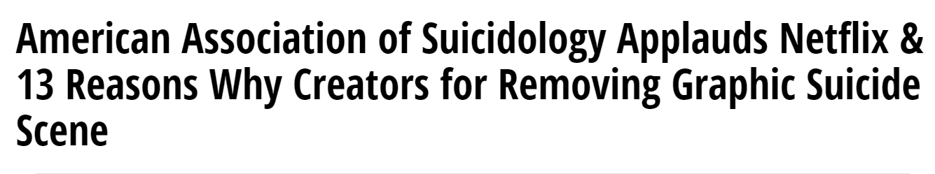
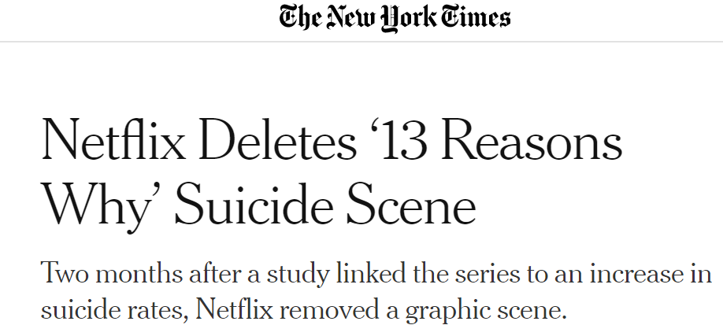
…In response, in July 2019, Netflix Removed the Suicide Scene

Slide 40
13 Reasons Why also Changes Suicide Beliefs & Knowledge
Adolescent and young adults self-reported understanding of suicide and risk factors after viewing 13 Reasons Why (Lauricella et al., 2018).
In emerging adults, suicide knowledge is greater and stigma is lower among those who watched 13 Reasons Why (Chesin et al., 2018).
In our study, there was no relationship between media exposure to fictional suicide in 13 Reasons Why and current suicide ideation severity among college students.

Slide 41
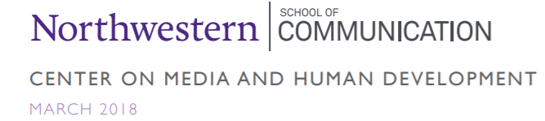
Specific Changes to Suicide Beliefs & Knowledge after viewing13 Reasons Why
After viewing, almost all young people understood:
People suicide for different reasons.
The signs of suicide risk are not always evident.
Depression and mental health difficulties are risk factors for suicide.
After viewing, a significant minority of young people:
sought additional information on suicide & depression
discussed the topic of suicide with their adults and friends
Reported feeling more sympathetic towards peers struggling with suicide (Lauricella et al., 2018).
Notes:
Late 2017-2018 Survey of 471 13-22 year olds in U.K., Brazil, Australia and New Zealand who watched 13 Reasons Why.
Commissioned by Netflix.

Slide 42
Why did we not find increased suicide behavior?
On average, participants completed the survey 8 months (sd=3 months) after watching the first episode. Data were collected prior to the airing of the second season.
Our participants were 18-25. Increased suicide behavior seen among adolescents
We controlled for viewing. Other studies have not.

Slide 43
Implications for Young Viewers and their Community
Adolescent suicide behavior seems particularly linked to 13 Reasons Why
Watching 13 Reasons Why may not be appropriate for certain vulnerable young people.
E.g., those at risk for suicide given mental health difficulties, substance use, history of suicide behavior, limited social support, those who identify with the main character who died by suicide in 13 Reasons Why (Reidenberg, 2017).
13 Reasons Why can be a vehicle for psychoeducation on suicide, as well as discussions among young people and their community about suicide and mental health difficulties.
Notes:
It is important to pair show viewing with suicide prevention and mental health resources.

Slide 44
Acknowledgments
Collaborators
Michele Cascardi, Ph.D.
Elizabeth Jeglic, Ph.D.
Research Assistants
Michele Rosselli, M.A.
Billy Tsang, M.A.

Slide 45
Citations for this Presentation
Chesin, M.S. (2019). The Impact of 13 Reasons Why on Young People: What We Know So Far [PowerPoint slides]. Webinar sponsored by the Society of Clinical Child and Adolescent Psychology, Division 53 of the American Psychological Association. New York, NY.
For the full article: Chesin, M., Cascardi, M., Rosselli, M., Tsang, W., & Jeglic, E. L. (2019). Knowledge of suicide risk factors, but not suicide ideation severity, is greater among college students who viewed 13 Reasons Why. Journal of American College Health. Advance online publication.
For a blog post on this content: Chesin, M. (March 2019). Does Watching 13 Reasons Why Increase Suicide Risk Among Youth? Blog post for the Youth Suicide Research Consortium Blog.

Slide 46
Thank You
Taking the webinar for CE? Did you respond to the Moderator in the tool box on the right of your screen?
Your response indicates your attendance.
For more information: Megan Chesin, Ph.D., chesinm@wpunj.edu

Slide 47
The Impact of 13 Reasons Why on Suicidal Behavior in Young People
John P. Ackerman, Ph.D.
Nationwide Children’s Hospital Center for Suicide Prevention & Research
Notes:
Good afternoon. My name is John Ackerman, suicide prevention coordinator at Nationwide Children’s Hospital in Columbus, O-H-. It is a privilege to be part of this webinar panel engaging with an audience that values psychological science, child development, and public health. I hope the data I share speak to the importance of depicting suicide responsibly. Partnering with entertainment media to help them portray suicide accurately and in a way that provides understanding, resources, and generates hope by modeling effective coping while reducing stigma towards those impacted by suicide can be live saving.
I have no conflicts of interest to disclose.

Slide 48
Overview
Identify specific ways that 13 Reasons Why deviates from best practices in media depiction of suicide and why this matters
Describe 3 recent studies that have examined associations between the release of Season 1 of 13 Reasons Why and suicide
Highlight recommendations for improving media content while reducing suicide risk
Notes:
With my 12 minutes, I’d like to introduce a few of the many ways that 13 Reasons Why deviates from national and international recommendations for depicting suicide in the media and the consequences of these decisions. There have been a number of studies including several by this panel that explore various responses to 13 Reasons Why and these are critical to differentiating how media depiction of suicide can influence viewers differently. I will only focus on 3 studies all published within the past 5 months that evaluate associations between the release of 13 Reasons Why and suicide rates. I will wrap up by highlighting what I believe are resources that can positively influence future efforts by the entertainment industry at portraying suicide authentically, responsibly, and with the public health of viewership in mind (i.e., first “do no harm”) so that we can spend more time effectively educating and increasing awareness.

Slide 49
Does depicting suicide responsibly matter?
Yes!
Inaccurate or oversimplified portrayals of suicide can increase stigma and reinforce harmful myths
Focus on method and memorialization can increase identification and view that suicide achieves a goal → increased chance for contagion
Missed opportunities to highlight alternatives to suicide and model help-seeking in a crisis
Solely increasing attention is not the answer
Notes:
We start with a critical question: does depicting suicide responsibly actually matter or is this entire uproar much ado about nothing?
So decades of research and well over 100 studies suggest that how we discuss suicide, especially when it involves the death of someone who is highly identifiable or relatable such as a celebrity or loved one, matters. The science is imperfect and most studies are ecological for obvious ethical reasons. On balance, these studies clearly indicate that at a population level fictional and non-fictional media depictions of suicide can increase imitative suicides. Historically, non-fictional reports such as the suicide of Robin Williams or Marilyn Monroe have shown stronger effects than fictional accounts but there are several studies that have found increased rates of suicide following a media event including a German tv show called “Death of a Student” in the 1980s.
We have also learned that inaccurate or oversimplified portrayals of suicide can increase stigma and reinforce harmful myths that stifle help-seeking. Assigning blame and guilt to one party (or 13 parties in some cases) is typically unfair and inaccurate based on data indicating that the majority of individuals who die by suicide are dealing with intense emotional distress and do not want to burden others.
A focus on death rather than the life of the individual who died by suicide is problematic especially when the method of suicide is emphasized or glorified. Not only is it dehumanizing but modeling the details of a suicide method may consciously or unconsciously remove psychological barriers to engaging in suicidal behavior. Providing a blueprint for escaping psychological pain or in the case of 13RW insinuating that the fulfilment of a teen payback fantasy is possible after death is particularly concerning and is inconsistent with kind of learning we hope to foster. By suggesting that suicide is the inevitable result of trauma and unmet needs as is done in 13 Reasons Why season 1, there is also a missed opportunity to highlight alternatives to suicide, recovery, and the process of getting psychological or emotional support from adults who are universally clueless and unethical in season 1. At the end of the day, the notion that we should be happy because people are talking about suicide more, is problematic. We know higher volume of conversation when it isn’t the right conversation can lead to harm and that those who are already most vulnerable to suicide are disproportionately affected.

Slide 50

And if so, what role does entertainment media play?

Slide 51
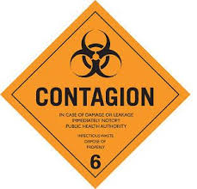
What is “suicide contagion”?
Process by which suicide-related behaviors spread quickly & spontaneously through a group (Gould, 1990)
Youth, particularly those with elevated suicide risk factors, are most vulnerable but vast majority of youth are not negatively affected
Mechanisms: in social identification; trauma or distress; exposure; modeling; acquired capability
Notes:
Due to time I will only introduce the concept of suicide contagion which underlies the concerns expressed by many mental health professionals and suicidologists. First, although “contagion” sounds mysterious, the processes involved likely are not. Suicide contagion is defined by Dr. Madelyn Gould of Columbia University as the “process by which suicide-related behaviors spread quickly & spontaneously through a group.” We know that youth are most susceptible to this form of imitative behavior and that those with underlying vulnerabilities to suicide are most likely to be influenced. That said, the vast majority of youth do not respond negatively to even the most inappropriate depictions of suicide and we are not great at predicting who is impacted at an individual level. However, contagion is very real and likely a product of underlying psychological distress, increased social identification, exposure to suicide or loss, access to lethal means, and a connection with the idea that suicide would serve a function that is reinforced by the media depiction.

Slide 52
Evidence for suicide contagion?
Adolescents exposed to suicide directly or indirectly are at increased risk for attempts (Insel & Gould, 2008)
Existence of suicide clusters (Gould, 1990)
Media coverage can influence suicide rates positively AND negatively (Niederkrotenthaler et al., 2010)
Some matching of decedent characteristics
Age, gender, method
Notes:
Other research showing that suicide exposure increases suicide risk of an adolescent further drive home this idea that adolescence is a time period of vulnerability to contagion and why targeting a show towards this age group carries extra responsibility. Suicide cluster or disproportionate increases in terms of geography or time also impact youth at higher rates. It is very clear that the type of reporting or media depiction can influence rates of suicide and we will highlight that fortunately this works as a risk AND a protective factor. Finally, there is often matching of characteristics from the media depiction and those who die by suicide at a higher rate including age group, gender and method although this is not as clear cut as direct copycat behavior – a term I don’t love.

Slide 53
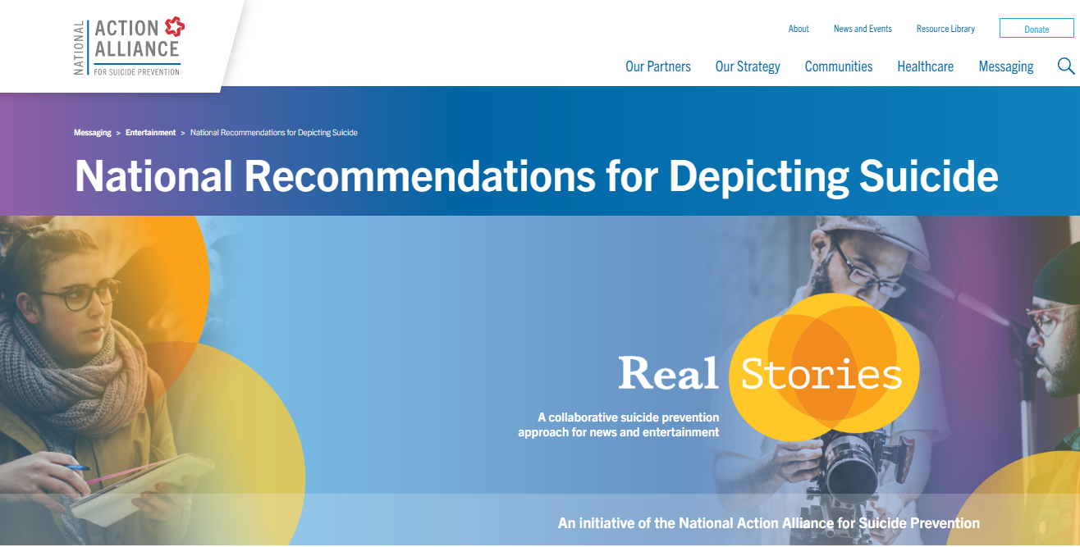
https://theactionalliance.org/messaging/entertainment-messaging/national-recommendations
Notes:
Fortunately the National Action Alliance for Suicide Prevention has provided guidance for media depictions of suicide. I have taken their core recommendations and applied them to 13 Reasons Why, Season 1.

Slide 54
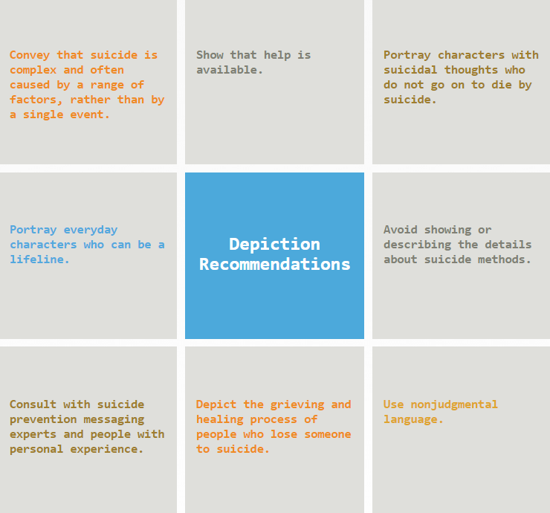
Notes:
We know the underlying causes of suicide are complex, and that a treatable mental health condition commonly plays a role (although psychologists should understand there are many pathways to suicide as an outcome). Most suicidal crises are short-lived, especially in young people, and there are numerous evidence-based treatments and competent providers able to help those in need to develop effective strategies to manage suicidal thoughts. There are supports in nearly every school and every community but it may require persistence and outreach by the impacted youth and those around them. Sadly, these truths are all missing in the first season of ‘13 Reasons Why’, replaced by popular myths and inaccurate information. Rather than providing valuable information about ways to cope with suicidal thoughts and behavior, the show glorifies its protagonist’s death including a graphic depiction of how she died. Most importantly, the show portrays getting help for suicidal thoughts as futile, even counterproductive. This is a dangerous message to vulnerable teens who could benefit from mental health treatment. Ultimately, the show violated the majority of expert recommendations for safe portrayals of suicide in the media. We are appreciative that Netflix did remove the graphic suicide scene but because contagion effects when present occur in the first weeks of an event this delay may have been very costly.

Slide 55
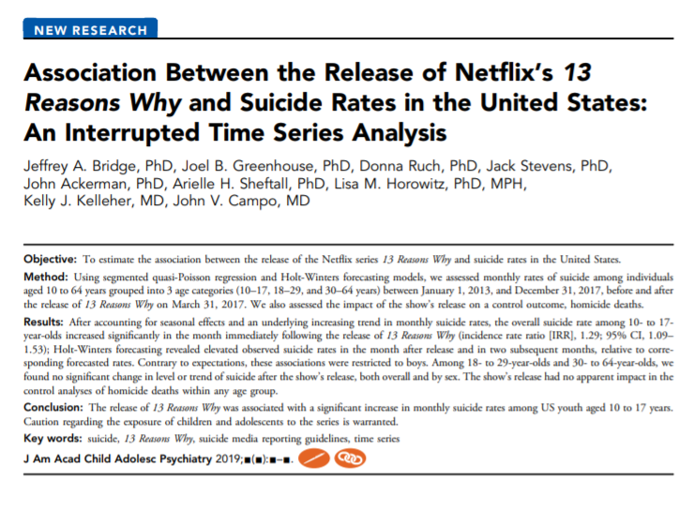
Notes:
I next want to shift to 3 studies that have assessed the association between release of 13RW and suicides reported using National Mortality Data in the US and data from Ontario. In the interest of transparency I was an author on the first study published in April led by Dr. Jeff Bridge. The goal of our study was to investigate whether the release of 13 Reasons Why season 1 was associated with an increase in suicide rates particularly among children and adolescents. We collected national mortality data for suicide from the Centers for Disease Control and Prevention. We also collected information about homicide, which served as a control outcome. Given all of the concerns raised by hospitals and youth serving organizations nationally after season 1, we wanted to evaluate the most suicide mortality which were just released by the CDC in March 2019.

Slide 56
13 Reasons Why Trailer Released
(March 1, 2017)
Association Between the Release of 13 Reasons Why and Suicide Rates in 10- to 17-Year-Old Children and Adolescents in the United States
Blue circles indicate observed suicide rates between January 1, 2013 and December 31, 2017. Orange solid line indicates fitted values that best account for
underlying level, trend, and seasonal variation prior to release. The leading edge of the shaded area indicates the initial airing of the 13 Reasons Why trailer. The trailing edge of the shaded area indicates the release date of 13 Reasons Why. Orange triangles indicate forecasted suicide rates; curved orange dashed lines indicate the upper and lower 95% prediction intervals. Observed suicide rates in March, April, June, and December 2017 were significantly higher than corresponding forecasted rates.
Notes:
We used Holt-Winters forecasting models to control for underlying trends of suicide and seasonal effects to help solidify a link. This creates a very conservative estimate of the association but we caution that is can not be deemed causal.
Although there is a lot of movement in this slide, the findings are clear and striking. 13 Reasons Why season 1 was released in its entirety on March 30, 2017 and the suicide rate in April 2017 was the highest monthly rate for entire 5-year study period and a further evaluation not part of this investigation found it to be the highest rate in the prior 19 years. If the producers hoped that getting a conversation started in any form would reduce youth suicide, this was clearly not the case.

Slide 57
Association Between the Release of 13 Reasons Why and Suicide Rates in 10- to 17-Year-Old Children and Adolescents in the United States, Stratified by Sex
Females
Notes:
A few nuances of the study were that our research team defined youth conservatively as 10-17 and in this group female suicide rates although elevated were not significantly outside the predicted range after the release.

Slide 58
Association Between the Release of 13 Reasons Why and Suicide Rates in 10- to 17-Year-Old Children and Adolescents in the United States, Stratified by Sex
Males
Notes:
Males age 10-17 displayed the greatest increase in suicides in the US and seemed to drive findings for this age group.

Slide 59
Association Between the Release of 13 Reasons Why and Suicide in the US, by Age Group
Characteristic |  |  | Pre-13RW Trendª (IRR) (95% CI) | p |  | Post-13RW Trend^{b} (IRR) (95% CI) | p |  | Step Change^{c} (IRR) (95% CI) | p
10 to 17 Years
Overall |  |  | 1.005 (1.003-1.008) | <.001 |  | 0.97 (0.95-1.00) | .057 |  | 1.29 (1.09-1.53) | .004
Sex
 | Female |  | 1.007 (1.003-1.010) | <.001 |  | 0.97 (0.93-1.01) | .163 |  | 1.15 (0.89-1.50) | .279
 | Male |  | 1.005 (1.002-1.007) | <.001 |  | 0.97 (0.94-1.00) | .098 |  | 1.35 (1.12-1.64) | .002
18 to 29 Years
Overall |  |  | 1.004 (1.003-1.005) | <.001 |  | 0.99 (0.98-1.01) | .443 |  | 1.07 (0.98-1.18) | .135
Sex
 | Female |  | 1.003 (1.001-1.005) | .006 |  | 0.98 (0.95-1.01) | .252 |  | 1.15 (0.97-1.38) | .111
 | Male |  | 1.004 (1.003-1.005) | <.001 |  | 1.00 (0.98-1.01) | .675 |  | 1.05 (0.96-1.16) | .285
30 to 64 Years
Overall |  |  | 1.001 (1.000-1.002) | .060 |  | 1.00 (0.99-1.01) | .914 |  | 1.03 (0.95-1.12) | .448
Sex
 | Female |  | 1.002 (1.000-1.003) | .008 |  | 0.99 (0.98-1.01) | .465 |  | 1.00 (0.90-1.11) | .980
 | Male |  | 1.001 (1.000-1.002) | .184 |  | 1.00 (0.99-1.02) | .879 |  | 1.04 (0.96-1.13) | .333
Notes:
First column – there is a sig increasing underlying trend for 10-17 year olds; post-trend is not significant (April 2017-December 2017); April (step change is sig)
Second column – females did not show evidence of a significant change; change in suicides in April 2017 driven by males
18-29 or 30-64 year (overall rates had been increasing) no changes related to the study time period

Slide 60
Bridge et al. (2019) Main Findings
Significant increase in suicide rate among 10-17 year-olds in the month after the release of 13RW controlling for temporal trends and seasonality
Suicide rates remained elevated in two subsequent months above forecasted rates as well
Increase in suicide rates in boys but not girls sig.
Estimated additional 195 suicides among 10-17 year-olds from April-December than predicted
No associations between 13RW release and suicide in the two older age groups (18-29, 30-64)

Slide 61
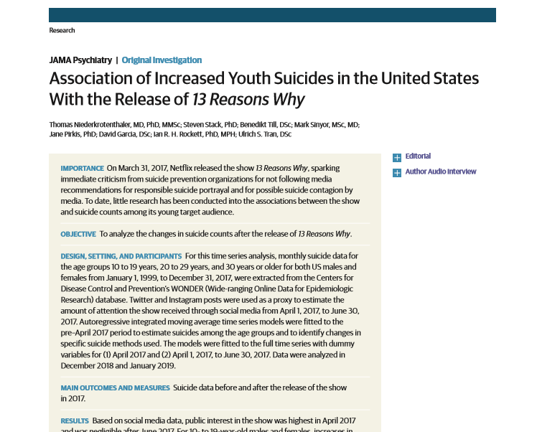
Notes:
At nearly the same time our research team was evaluating the impact of 13RW season 1 on national suicide rates, an international team led by Dr. Thomas Niederkrotenthaler and colleagues conducted a strikingly similar study given that there was no contact between groups prior to manuscript acceptance. This group also used a conservative time series analysis controlling for upward suicide trends in the US, seasonality and autocorrelation and obtained similar results with some additional nuanced findings.

Slide 62
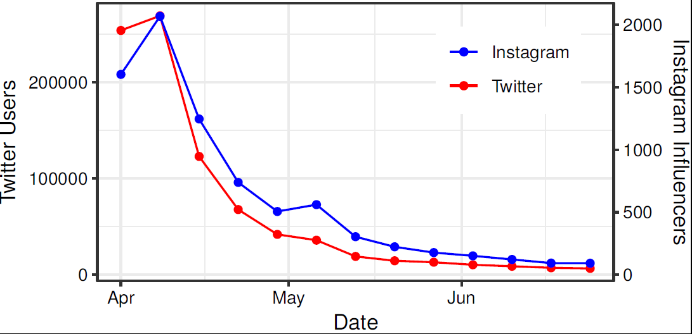
Public interest in the series
Niederkrotenthaler, Stack, Till, Sinyor, Pirkis, Garcia & Tran, 2019
Notes:
Because Netflix does not release viewership data, Niederkrotenthaler and colleagues took the additional step of evaluating intensity and duration of social media attention which matches Netflix’s claim that 13RW season 1 was the 3rd most binge watched show of 2017. Volume of tweets in red and the number of Instagram influencers with first-time posts about 13RW were dramatically elevated in the first few days of April (actually the end of March) through the middle of the month before returning to at or below baseline. This helped to validate the idea that exposure and intensity was sufficient for a possible media contagion event and this initial attention tapered over time.
Do not state due to time:
“Past studies have validated that Internet searches mirror real-world suicide rates, so suicide rates have likely gone up as a result of this program” (Ayers, Althouse, Leas, Dredze, & Allem, 2017). In fact, 25% of youth who died by suicide conducted a suicide-related Internet search shortly before their deaths (O'Brien et al., 2017).

Slide 63
Association with suicide rates
Notes:
This study likewise found an immediate spike in April 2017 which persisted for the study’s 3 month window of assessment among only the 10-19 year-olds. By increasing the age range, the associations with gender changed. However, in the first 3 months alone there were 94 additional youth suicides that occurred beyond what would typically occur in that time frame.

Slide 64
Association with suicide rates
Notes:
In this study, an increase in suicide rates was found among girls age 10-19 (21.7% compared to 12.4% in boys) which is more consistent with the suicide contagion literature. Excess suicides over predicted from April to June 2017 – 66 boys; 37 girls.
So 18-19 year old females were driving this change in gender findings.

Slide 65
Association with suicide rates
Notes:
As with the Bridge study, young adults and older adults were not significantly impacted by the release of 13RW.

Slide 66
Association with suicide rates
Notes:
Notable increases in suicide by hanging and the cell sizes were too small to evaluate suicide by cutting which is typically much less lethal. We should also note that suicide attempt data may reflect different characteristics but is not as readily available.

Slide 67
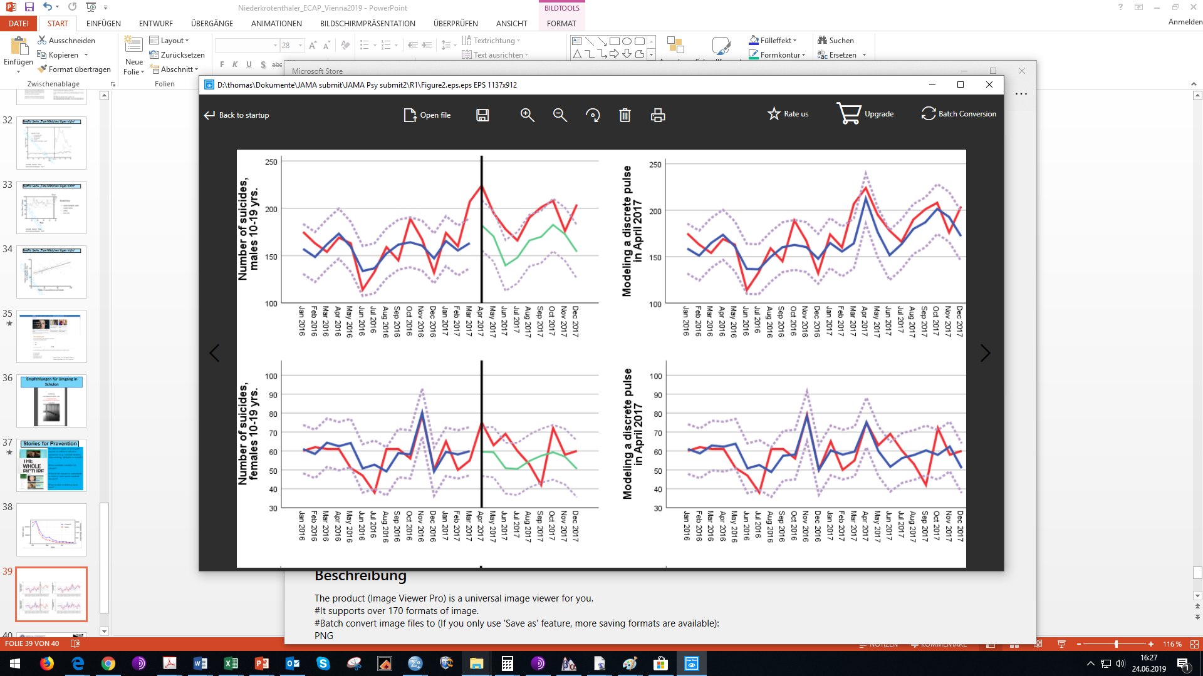
Notes:
Forecasting models with confidence intervals for reference

Slide 68
Niederkrotenthaler et al. (2019) Main Findings
Significant increase in suicide rate among 10-19 year-olds in 3 months after the release of 13RW controlling for temporal trends and seasonality
Increase in suicide rates found among girls by extending the range to age 10-19 (21.7% compared to 12.4% in boys)
Excess suicides over predicted – 66 boys; 37 girls
Notable increases in suicide by hanging
No associations between 13RW release and suicide in the two older age groups (18-29, 30-64)

Slide 69
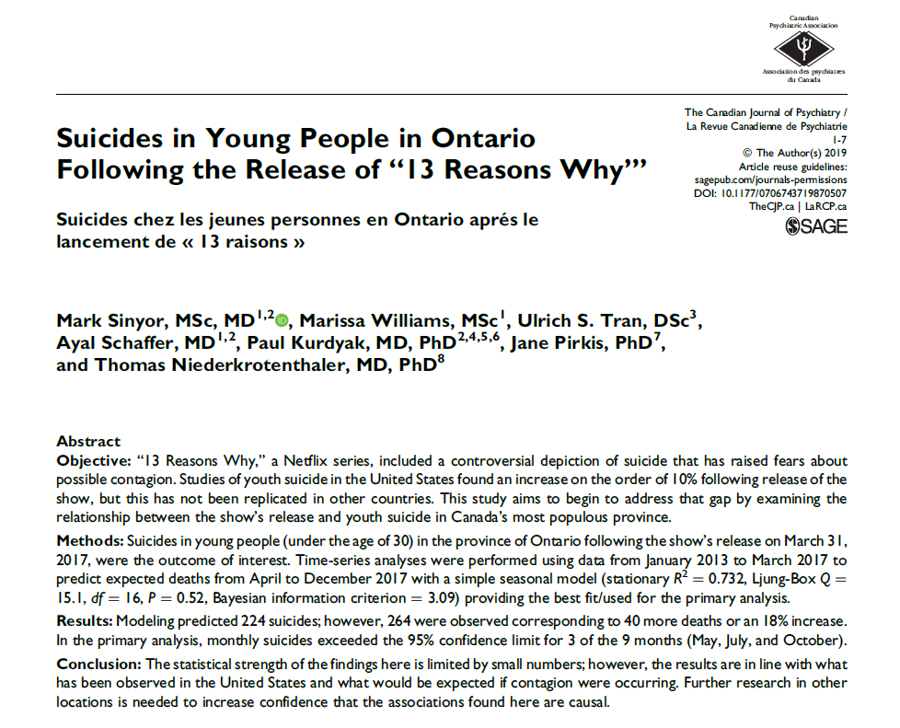
Study of youth in Ontario by Sinyor et al. (2019)
Notes:
I will just briefly mention a smaller but relevant study in Canada’s largest province, Ontario, population around 14 million, that used a similar time-series analyses.
This study demonstrated that there were 40 more deaths by suicide than expected controlling for underlying trends in those aged 29 and under in Ontario in the 9 months following the release of 13RW equating to an 18% increase. Although there was more variability in this study, less power to detect differences and an unusual spike in October 2017, a similar pattern consistent with suicide contagion effects emerged in the months just after the release. Not surprisingly since the series was released in many country’s all at once, seeing findings replicated in other countries is important.

Slide 70
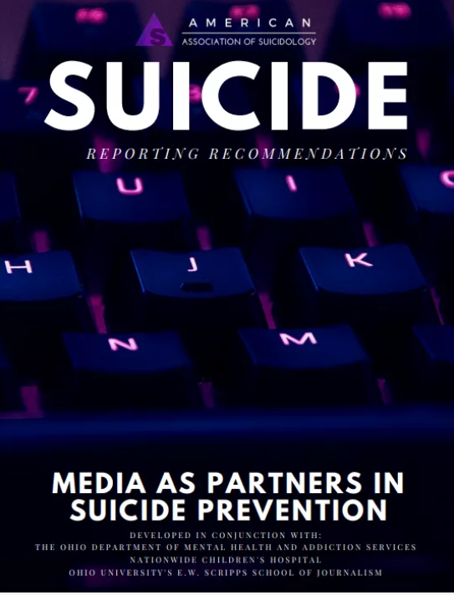
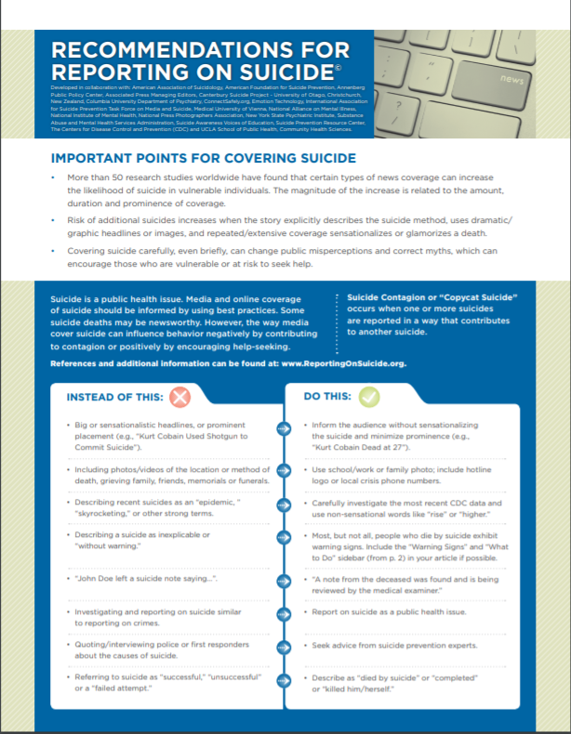
Guidelines for reporting on suicide including social media recommendations
https://suicidology.org/reporting-recommendations/
http://reportingonsuicide.org/
Notes:
I take these studies as a call to action. They suggest that we have an opportunity to better message and disseminate psychological and epidemiological science to those who stand to make a considerable impact – the entertainment industry and the news media. Partnerships that promote responsible and impactful storytelling are happening but there needs to be a collaborative approach. Media guidelines for depicting suicide (Action Alliance, American Association of Suicidology, Mindframe, Samaritans, and Reportingonsuicide.org) continue to evolve incorporating more research and critically the perspective of those who have struggled with suicidal thoughts or behaviors or through suicide loss. We need to talk about suicide more, but these discussions would be better done around models the are accurate, reflective of the challenges most common to those who are in crisis, and an understanding that there are viable avenues of support.

Slide 71
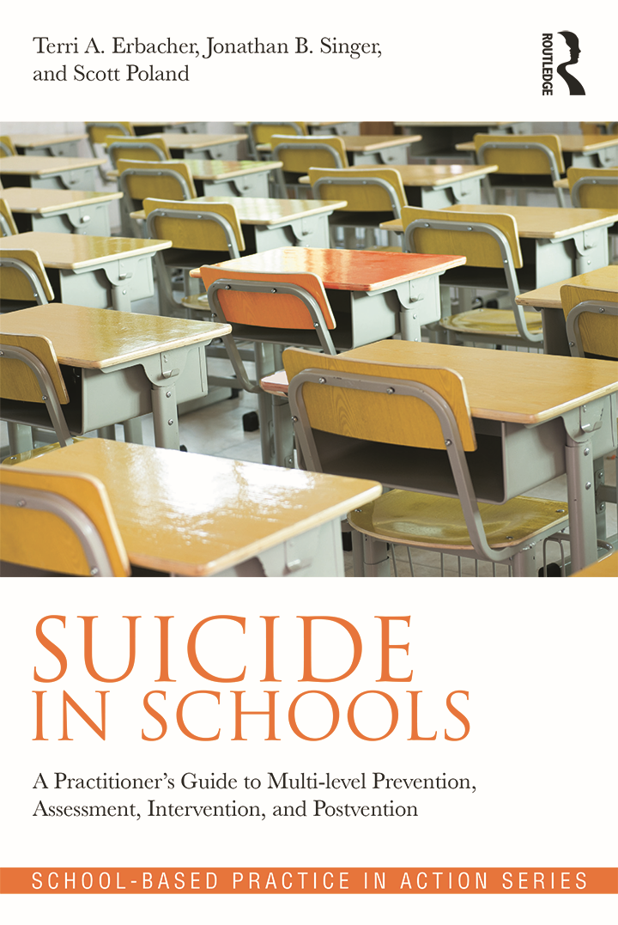
Comprehensive Resource for Suicide Prevention in the Schools
Erbacher, T. A., Singer, J. B., & Poland, S. (2015). Suicide in schools: A practitioner’s guide to multi-level prevention, assessment, intervention, and postvention. New York: Routledge.

Slide 72
Questions & Comments
The Center for Suicide Prevention and Research
http://www.nationwidechildrens.org/suicide-prevention
Email:
John.Ackerman@nationwidechildrens.org
Thank you!

Slide 73
Additional Resources
https://www.13reasonswhytoolkit.org/
Developed by workgroup of 75 leading experts in mental health, suicide prevention, and education
Sponsored by SAVE (Suicide Awareness Voice of Education)
https://13reasonswhy.info/
Developed by Netflix
Includes cast videos
https://en.wikiversity.org/wiki/Helping_Give_Away_Psychological_Science
For Practitioners, Personnel and Parents to discuss 13 Reasons Why:
https://afsp.org/campaigns/talk-about-mental-health-awareness-month/13-reasons-why/
http://www.jedfoundation.org/wp-content/uploads/2017/03/13RW-Talking-Points-JED-SAVE-Netflix.pdf;
https://www.schoolcounselor.org/school-counselors/professional-development/learn-more/13-reasons-why-resources

Slide 74
Additional Resources
https://www.nasponline.org/resources-and-publications/resources-and-podcasts/school-climate-safety-and-crisis/mental-health-resources/preventing-youth-suicide/13-reasons-why-netflix-series/13-reasons-why-netflix-series-considerations-for-educatorshttps://13reasonswhy.info/
Developed by National Association of School Psychologists
https://www.nationwidechildrens.org/family-resources-education/700childrens/2017/04/13-reasons-why-should-parents-be-concerned-about-this-netflix-series
Blog post by Dr. Ackerman

Slide 75
Questions? Taking the webinar for CE? Did you respond to the Moderator in the tool box on the right of your screen? Your response indicates your attendance. Continue the conversation after the webinar in the SCCAP53.org Forum For one month, panel members will respond to as many questions as possible Go to https://sccap53.org Log in with your member email and password Scroll down and click on the “Forum” box Under Webinar Discussions, click on “13 Reasons Why” See the forum rules posted by the Web Editor, and then Post away!

Slide 76
Source Citation for this Presentation
With website link
Ackerman,J., Chesin, M., Michael, K., (2019). The Impact of 13 Reasons Why on Suicide Behavior in Young People: What We Know So Far [PowerPoint slides]. Retrieved from https://sccap53.org/resources/education-resources/webinars/recordedwebinars/
Without website link
Ackerman,J., Chesin, M., Michael, K., (2019). The Impact of 13 Reasons Why on Suicide Behavior in Young People: What We Know So Far [PowerPoint slides]. Webinar sponsored by the Society of Clinical Child and Adolescent Psychology, Division 53 of the American Psychological Association. Washington, D.C.

