Slide 1
Source Citation for this Presentation
Fristad, M.A. (2019). Anxiety, Depression, and Social Media in Adolescents: What to Do? Webinar sponsored by the Society of Clinical Child and Adolescent Psychology, Division 53 of the American Psychological Association. Washington, District of Columbia.

Slide 2
Conflicts of Interest
Royalties:
  Guilford Press
  American Psychiatric Press
  Child & Family Psychological Services
Research:
  Janssen

Slide 3
Learning Objectives
1. Recognize the rates of anxiety and depression in adolescents
2. Know the trends in social media usage for adolescents
3. State the high risk group for use of social media in adolescents
4. List protective steps adolescents and their families can take to reduce negative impact of social media

Slide 4
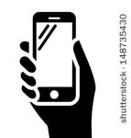










Social Media

Slide 5
Overview
Current rates of anxiety and depression in adolescents
Normative adolescent development
Characteristics of social media
Current use of social media by adolescents
Research findings on the impact of social media on adolescent mental health
Prevention strategies

Slide 6

Rates of Anxiety in Adolescence
Merikangas et al, J Amer Acad Child Adol Psychiatr, 2010
National Comorbidity Survey Adolescent Supplement (NCS-A)
32% lifetime prevalence of any anxiety disorder among US 13-18 yr olds
  Girls, 38%; Boys, 26%
  Similar across age range
  8.3%, severe impairment
Notes:
1 in 12 have severe impairment

Slide 7
12-Month Prevalence of
Major Depressive Episodes
Motjabai et al, Pediatrics, 2016
Adolescents Young Adults
2005: 8.7% 8.8%
2014: 11.3% 9.6%
Significant ↑ for 12-20 year olds, even after adjusting for substance use disorders and sociodemographics
Mental health care contacts did not change overall
However, ↑ use of
  specialty mental health providers (Adol, YA)
  prescription medications (Adolescents)
  inpatient hospitalizations (Adolescents)

Slide 8
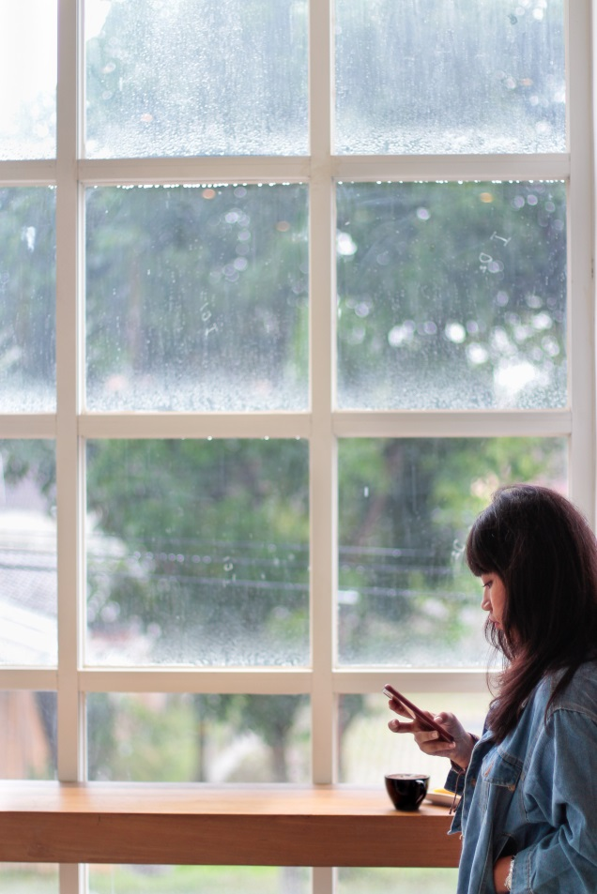
Loneliness in Adolescence
Holt-Lunstad et al, PLOS, 2010; Rodriguez et al, Psychosomatic Med, 2008; Hinzey et al, Breast Cancer Research, 2016; Hostinar et al, Psych Bull, 2014; Klinenberg, New York Times, 2018
Loneliness: “the magnitude of this effect is comparable to…smoking and it exceeds many well-known risk factors for mortality (e.g., obesity, physical inactivity).”
Social support affects a wide range of health conditions, including blood pressure
and cardiovascular health
Social environment can change
basic physiology→ ∆ physical health
little is known about stress-buffering
effect of social support in teens
Loneliness is more prominent
in younger generations

Slide 9
Overview
Current rates of anxiety and depression in adolescents
Normative adolescent development
Characteristics of social media
Current use of social media by adolescents
Research findings on the impact of social media on adolescent mental health
Prevention strategies

Slide 10
Social Tasks of Adolescence
Normative Development
Establish and maintain more complex, intimate peer relationships
Navigate emerging sexuality and romantic relationships
Develop cohesive self-identity
Strive for autonomy from parents and other adults
↑ focus on peer status and approval
↑ social comparison, reflected appraisal, feedback-seeking

Slide 11
Normative Aspects of
Adolescent Development
Social-affective brain circuits develop before cognitive emotion-regulation circuitry (the gas comes before the brakes)
  ↑ motivation to engage in socially rewarding behavior
  ↓ interest in evaluating potential negative consequences of behavior
  Risk-taking increases when with peers
Puberty (not age) affects parental buffering of HPA reactivity; while potent in earlier childhood, parental buffering loses its effectiveness by puberty

Slide 12
Overview
Current rates of anxiety and depression in adolescents
Normative adolescent development
Characteristics of social media
Current use of social media by adolescents
Research findings on the impact of social media on adolescent mental health
Prevention strategies

Slide 13

Social Media Transforms Teen Peer Relations
Nesi et al (2018) Clinical Child & Family Psychology Review
Changes the frequency or immediacy of experiences
Amplifies experiences and demands
Alters the qualitative nature of interactions
Facilitates new opportunities for compensatory behaviors
Creates entirely novel behaviors

Slide 14

Characteristics of Social Media
Peer experiences aren’t inherently better or worse
on social media, just different
Asynchronicity
+ time to think of a response
- time to wonder about the response
Permanence
- poor judgement doesn’t go away
- more time to ruminate/compare
Publicness
+ can receive support
- need to “prove” competence
- social flaws are seen by all

Slide 15
More Characteristics of Social Media
Availability
+immediate, frequent access
- expectations go up for availability
- increases multi-tasking
+/- can have “on-line only” friends (might be adults “posing” but could be groups with common interests)
+ can stay in touch with friends who move away
(Physical) Cue absence
-social support may be less “rich”
-less chance to practice social skills
+may be less threatening for socially anxious kids
- easy to misinterpret comments
- more likely to be disinhibited→poor behavior choices

Slide 16
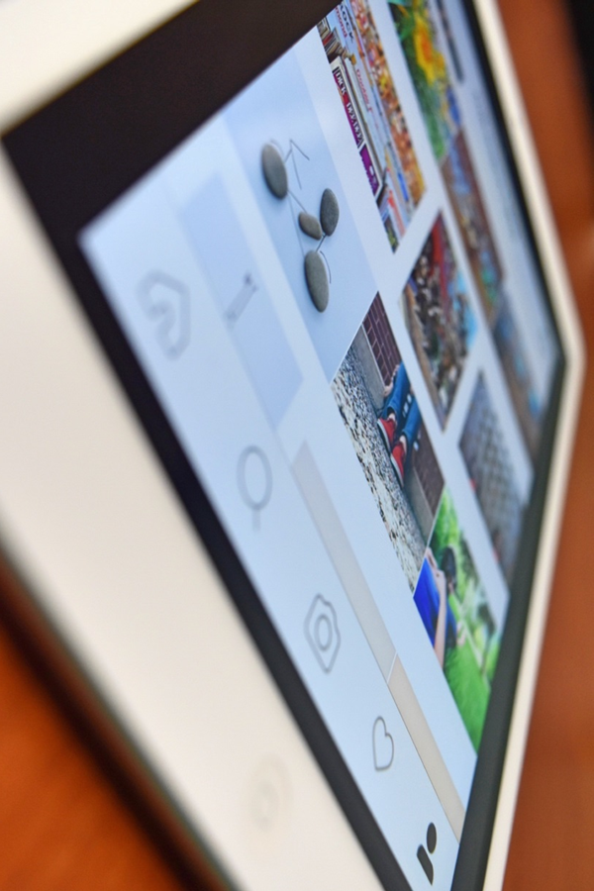
More Characteristics of Social Media
Quantifiability
-“scores” friendships
- may increase disclosure of more
dramatic information
- can reinforce problematic behavior
Visualness
+/- opportunity for more visual communication
- focus on how friendship appears to others
- expect friends to comment on appearance

Slide 17
Overview
Current rates of anxiety and depression in adolescents
Normative adolescent development
Characteristics of social media
Current use of social media by adolescents
Research findings on the impact of social media on adolescent mental health
Prevention strategies

Slide 18
Common Sense Media Survey
2012, 2018--1,141 adolescents aged 14-17
+
Strengthens relationships w/ others
Means of self-expression
Less lonely/more connected
+ effect on mood
-
Detracts from face-to-face communication
Feel left out or “less than” friends
Vulnerable teens—worsens self-esteem if no comments/posts or not invited to activity
Notes:
methodology: This report is based on a nationally representative survey of 1,141 13- to 17-year-olds in the United States. The survey was administered online by the research group GfK using their KnowledgePanel© from March 22, 2018, through April 10, 2018. Participants were recruited using address-based sampling methods. The margin of error for the full sample at a 95 percent confidence level is +/-3.4 percent. The overall design effect for the survey is 1.4048.

Slide 19
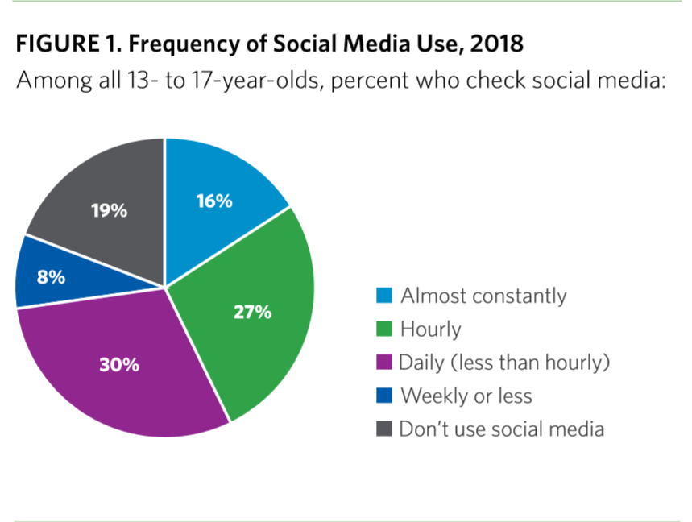
Notes:
43% almost constantly or hourly

Slide 20
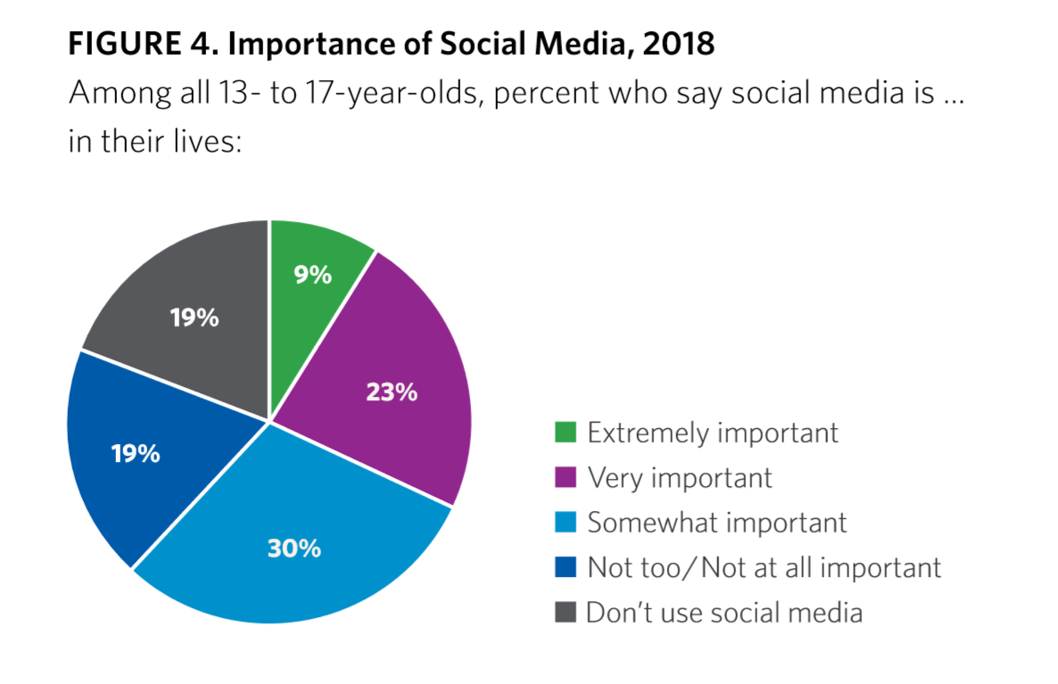
Notes:
32% extremely or very important

Slide 21
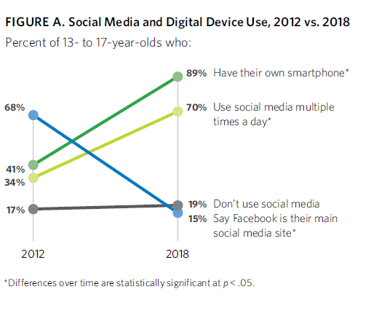
93%, some mobile device
16% “almost constantly”
22% several times/hour
Snapchat: 41% Instagram: 22%

Slide 22
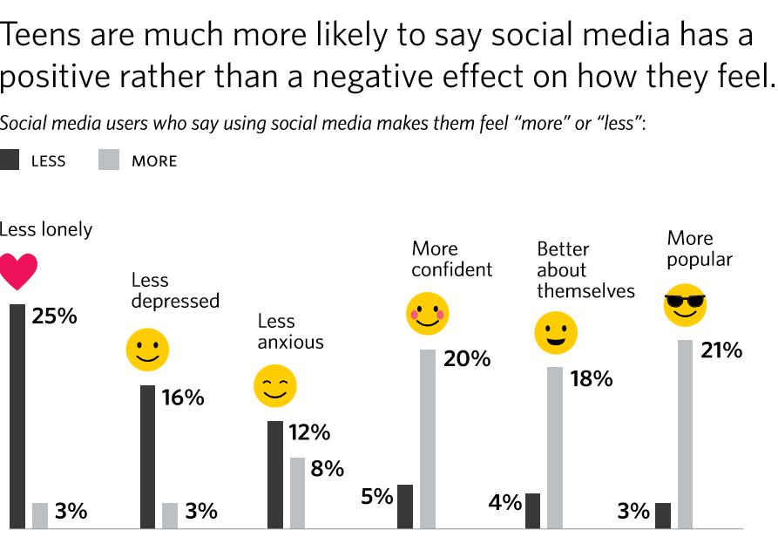
All statistically significant, p<.05

Slide 23
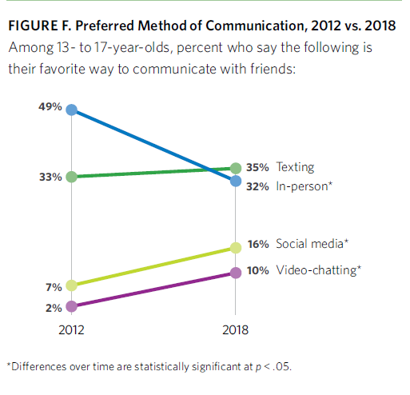
Social media distracts FtF communication: 44%→54%
Social media takes up time for FtF communication: 34%→42%

Slide 24
Concerns about Social Media
72%: believe tech companies manipulate users to ↑ SM time
57%: SM distracts from homework
44%: Frustrated w/ friends being on SM while together
68%: Agree that “SM has a negative impact on many people my age” (20%--”strongly agree”)
29%: Have been wakened at night by smartphone
33%: Wish their parents would spend less time on SM (2012, 21%)
20% check messages while driving (44% say “never”)

Slide 25
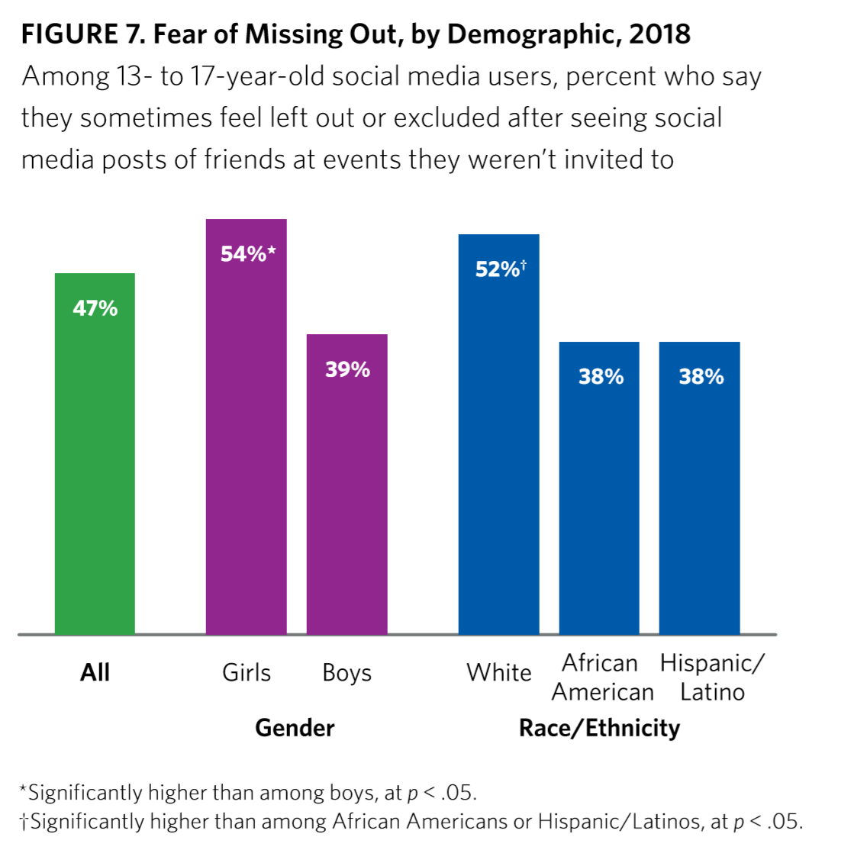

Slide 26
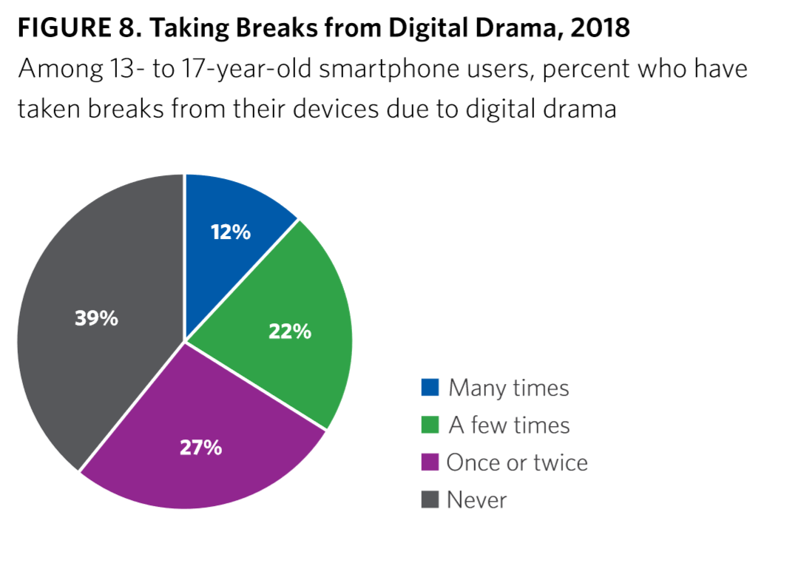
Girls 39%, Boys 29%--Many/a few times
Notes:
1/3 –a few or many times; girls more than boys

Slide 27
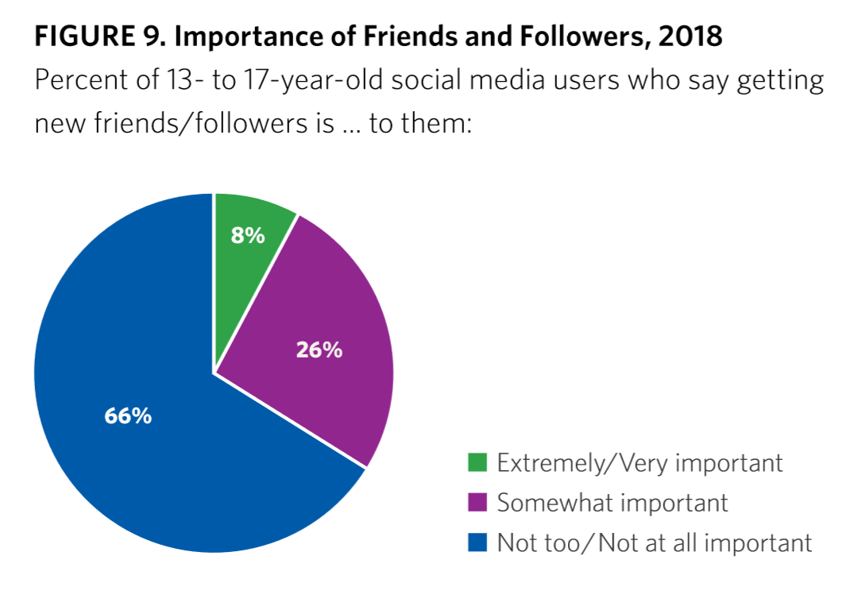
Notes:
34% extremely or somewhat important

Slide 28
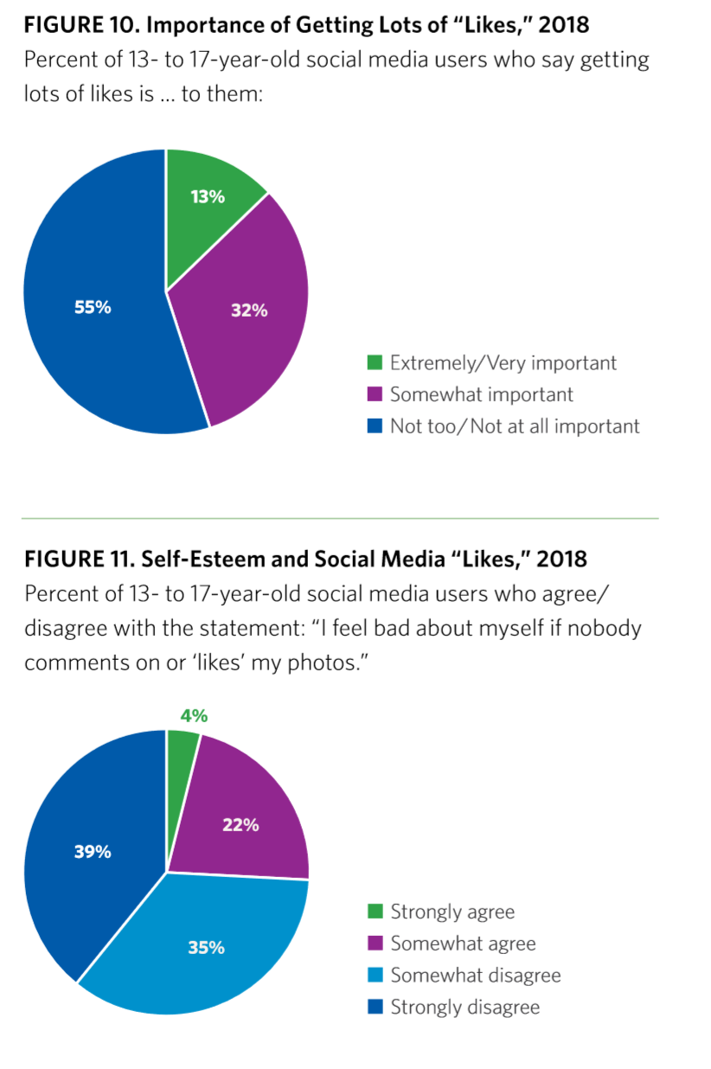
Notes:
45% somewhat or very important to get “likes”; 26% feel bad about themselves if they don’t get comments/likes on their posts

Slide 29
Do Teens Think Parents Should Worry?
54%: “If parents knew what actually happens on social media, they’d be a lot more worried about it
46%: Parents worry too much about teens’ use of social media

Slide 30
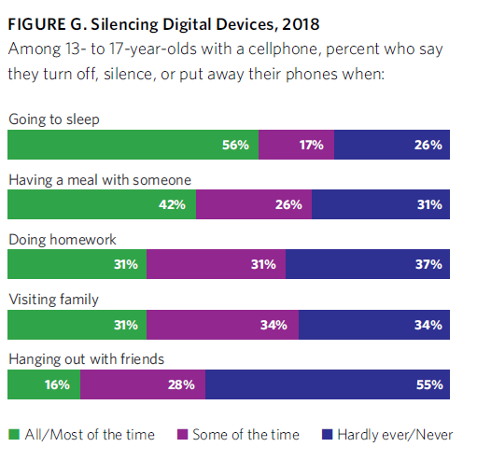

Slide 31
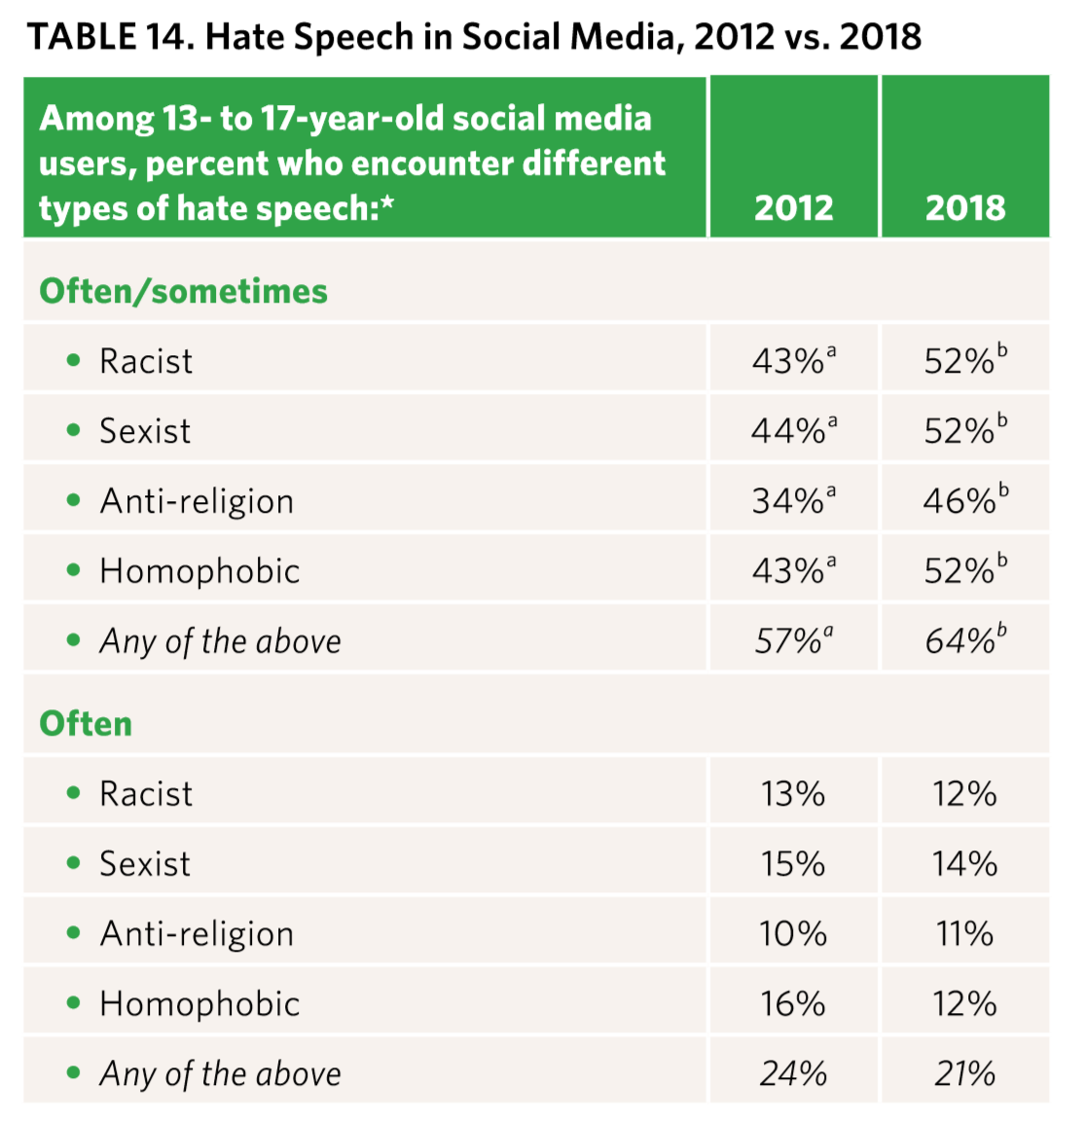
Notes:
Question wording changed substantially between 2012 and 2018, and findings should be interpreted with caution. in 2012, the question asked how often teens encountered this type of content “online” or “in various types of social media” and included “online chatting in video or computer games.” in 2018, the question was limited to how often teens encounter this type of hate speech “on social media.” Note: Percentages with different superscripts differ significantly at p < .05. Significance should be read across rows.

Slide 32
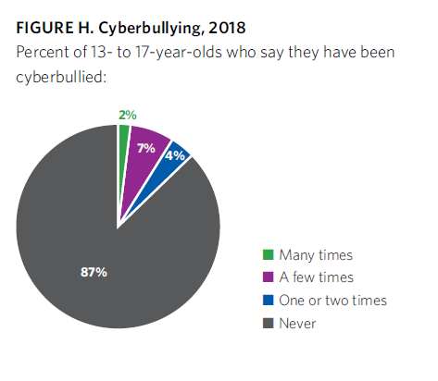
23% have tried to help someone who has been cyberbullied (talk to them, report to adults, and/or post positive content about the victim on-line)
Notes:
13% report having been cyberbullied

Slide 33
Social-Emotional Well-Being (SEWB) of Participants
Scale includes items re: happiness, depression, loneliness, confidence, self-esteem, and parental relations
  High SEWB: 19% ☺
  Medium SEWB: 63%
  Low SEWB: 17% ☹
Social media is “extremely” or “very” important
  High SEWB: 32% ☺
  Low SEWB: 46% ☹

Slide 34
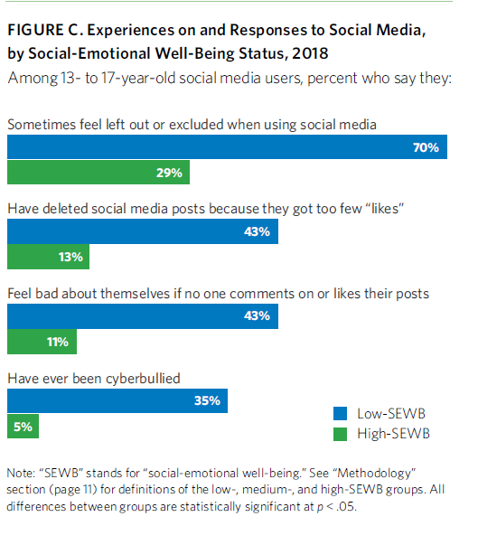

Slide 35
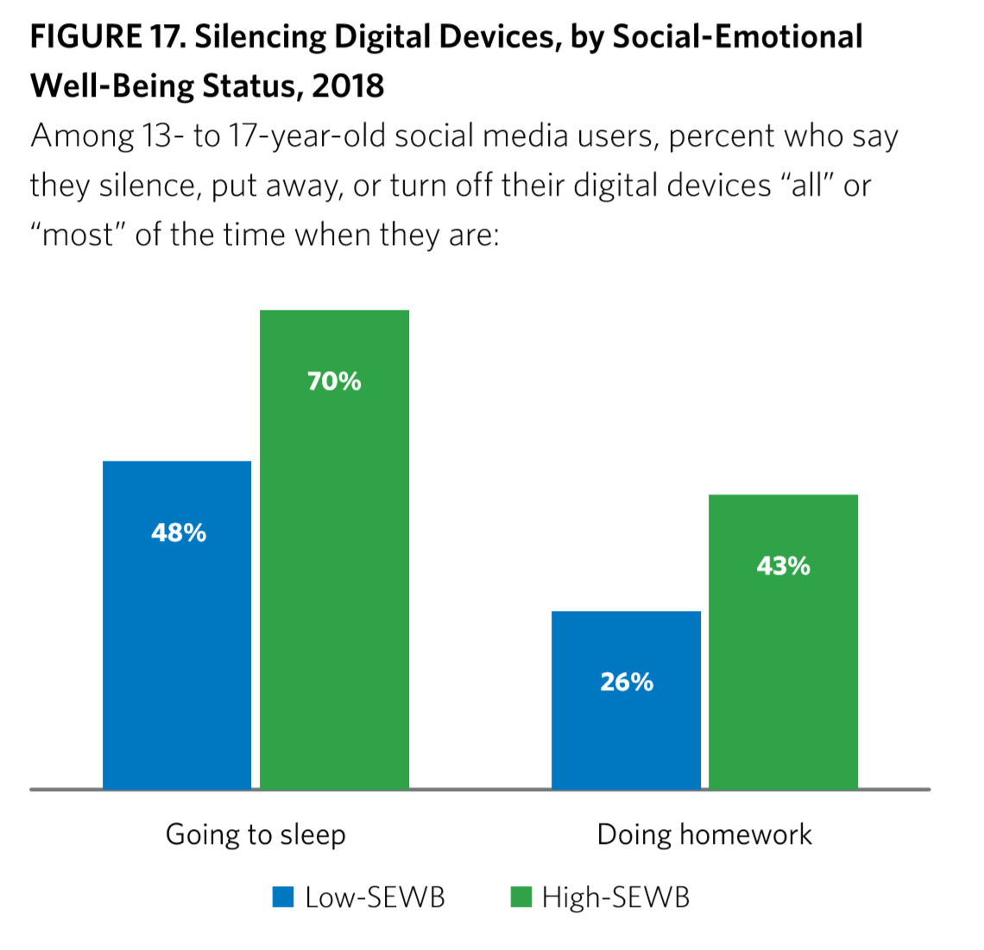

Slide 36
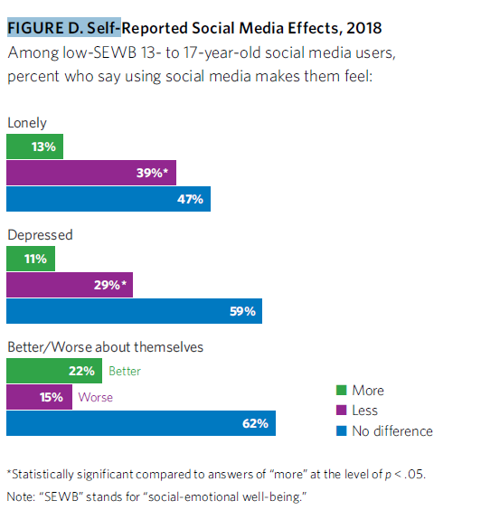
Notes:
Some good news! Less lonely and depressed, feel better about themselves

Slide 37
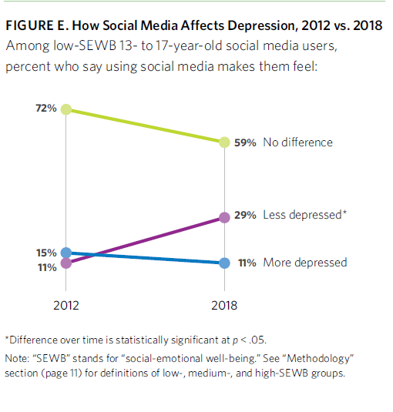

Slide 38
Social Media as Creative Expression
27% say SM is very/extremely important for creative self-expression
  37%: low SEWB
  21%: high SEWB

Slide 39
Overview
Current rates of anxiety and depression in adolescents
Normative adolescent development
Characteristics of social media
Current use of social media by adolescents
Research findings on the impact of social media on adolescent mental health
Prevention strategies

Slide 40
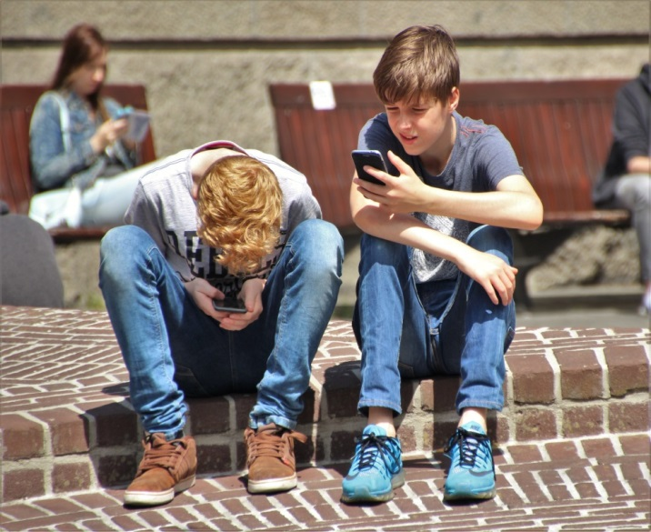
Social Media and Adolescents
Baker & Algorta, CyberPsychology, Behavior, and Social Networking, 19(11):638-648, 2016.
Systematic review of 30 studies
It’s complicated…
Social media is not “good” or “bad”, how it is used matters
  Frequency, quality, and type of use
  Personality characteristics, social factors

Slide 41
The Good, the Bad, & Problem Behaviors
Baker & Algorta, 2016
GOOD
+ Social support
+Access on-line treatment
+Promote positive image
BAD
Social comparison (worse than in “real life”)
Males: feelings of inadequacy re: dating competitiveness
Females: focus on looks
PROBLEM BEHAVIORS
Friending ex-partners
Following strangers
Excessive use
Frequent posting
Negative status updates
Reduced face-to-face time

Slide 42
How Does Social Media Impact Adolescents?
Depending on use, there can be an increase in:
  Depression
  Anxiety
  Feelings of loneliness
  Rumination
  Social comparison
  ↓ Self-esteem
  Fear of Missing out (FoMo)
  Body dissatisfaction
  Fatigue
  Exhaustion
  Daytime sleepiness
  Maladaptive behaviors
  Internet addiction
  Ostracism
  Cyberbullying and online harassment

Slide 43
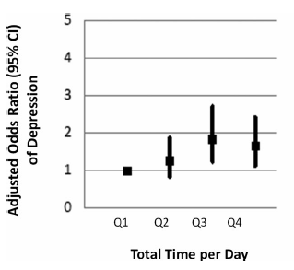
Association between Social Media & Depression
Lin et al, Depression & Anxiety, 33: 323-331, 2016
Depression: leading cause of disability in high-income countries by 2030
Randomly surveyed 1,787 young adults aged 19-32
97% of young adults use social media
Compared low (0-30 minutes/day) to high (> 2 hours) users (median, 61 minutes/day)
High users had greater odds of being
depressed
Possible reasons: social comparison,
wasted time, cyber-bullying

Slide 44
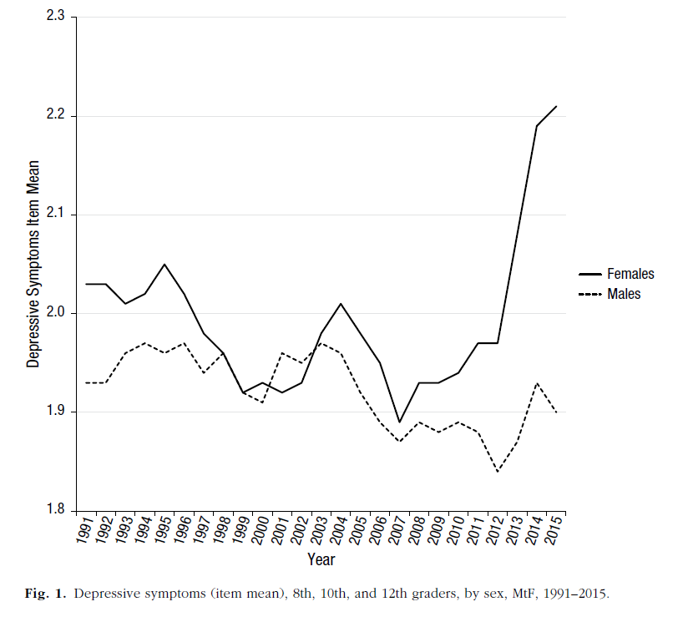
Screen Time Linked to Decreased Mental Health
Twenge et al., Clinical Psychological Science, 6(1), 3-17, 2018
Examined 3 teen outcomes: depression, suicide-related (ideation, plan, attempt), completed suicide
Declined or remained stable for decades
↑ from 2010-2015—females
Smart phone use: ≈50%, 2012; 92%, 2015
Notes:
Compared two nationally representative samples:

Slide 45
Screen Time & Mental Health:
Changes from 2010-2015…
33% ↑ high levels of depressive symptoms: 16→21.5%
12% ↑ suicide-related outcome: 32%→36%
31% ↑ completed suicides: 5.38→7.04/100,000
↑ screen time: ↑ negative outcomes
↑ non-screen activities (eg, reading, homework): ↓ negative outcomes
↑ screen time & ↓ face-to-face time: highest depression
↑ suicide-related outcome
  ≥ 3 hrs/day screen time: 34% more likely
  ≥ 5 hrs/day screen time: 48% more likely
Notes:
If high FtF time, social media did not have a significant effect
While some think academic pressure is to blame, HW time decreased slightly from 2012 to 2015, AND increased HW assoc’d w better outcomes
Watching TV assoc’d w depressive symptoms, but amount declined in this interval

Slide 46
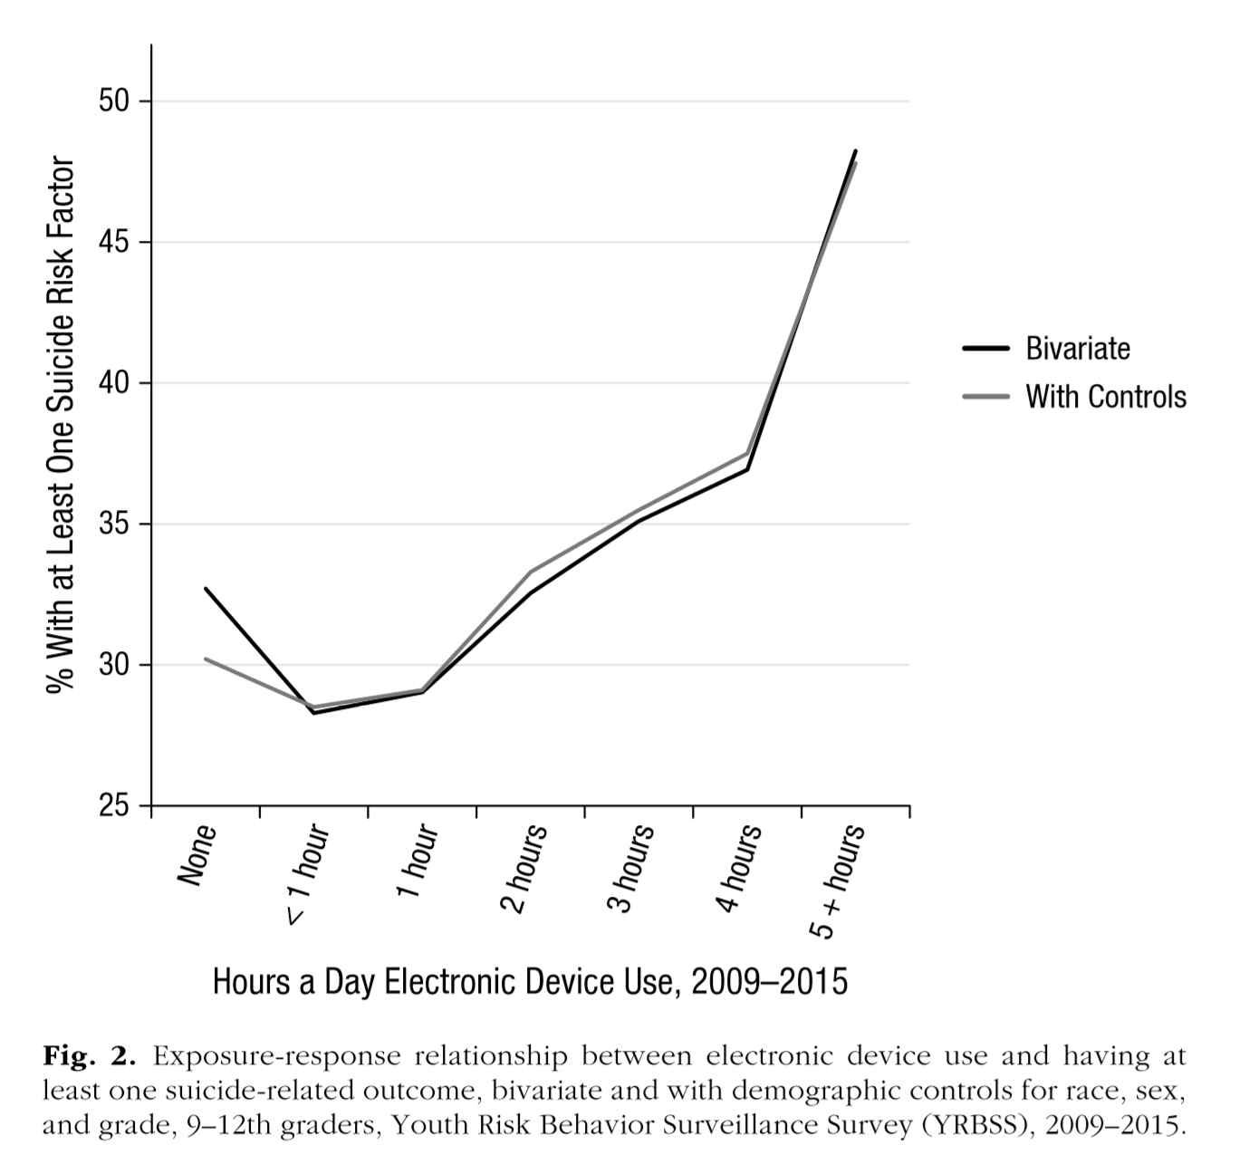
Suicide Risk Increases with Increased E-Device Use

Slide 47
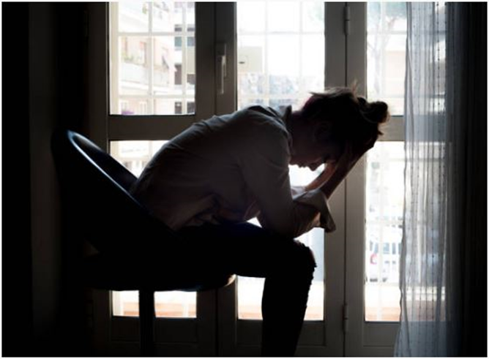
Screen Time & Mental Health (Cont’d)
↑ electronic device use, social media use, and reading Internet news
  ↑ at a disproportionate rate from 2011-12 to 2015
  ↑ depressive symptoms or suicide-related outcomes
↓ face-to-face interactions, reading, sports/exercise, religious service attendance
  disproportionately
  2011-12 to 2015
  ↑ depressive symptoms
Economic factors: unrelated to
mental health outcomes
Notes:
If high FtF time, social media did not have a significant effect
While some think academic pressure is to blame, HW time decreased slightly from 2012 to 2015, AND increased HW assoc’d w better outcomes
Watching TV assoc’d w depressive symptoms, but amount declined in this interval

Slide 48
Screen Time & Mental Health (Cont’d)
Teens with ↑ levels of face-to-face time were not impacted by social media
Academic pressure is not to blame: homework time decreased slightly from 2012 to 2015 AND more time spent on homework is associated with better outcomes
Watching TV: associated with depressive symptoms BUT the amount of time spent watching TV declined from 2012 to 2015

Slide 49
Screen Time Diminishes Social Skills
Uhls et al (2014) Computers in Human Behavior, 39:387-392
Nesi et al (2016) Journal of Research on Adolescence, 48(2): 275-298
Misra et al (2016) Environment and Behavior, 27(2): 471-477
Summer Camp Controlled Trial
After 5 days w/o screens, ↑ ability to read nonverbal cues
Adolescent Romantic Relationships
Teens who had ↑ on-line communication with their partner had ↓ social skills one year later
Presence of a Cell Phone
Holding a phone or placing it on a table during a conversation → ↓ feelings of connectedness and empathy between conversation partners

Slide 50
Social Media Use Increases
Depression & Loneliness
Hunt et al (2018), J Social and Clinical Psychology DOI: 10.1521/jscp.2018.37.10.751
143 Penn undergraduates
  completed a mood & well-being survey
  Tracked active minutes of use—Facebook, SnapChat, Instagram
2 groups – 3 week trial
  Experimental: ≤ 10 minutes of use/platform/ day
  Controls: No alteration to typical use
7 measures: anxiety, depression, loneliness, FOMO
↓ depression and loneliness scores in EXP group
Particularly pronounced in those with higher baseline depression scores

Slide 51
Internet Addiction in Adolescents
Dalcubak et al., CyberPsychology, Behavior, & Social Networking, 16, 272-278, 2013
Criteria based on DSM-5 pathological gambling:
Preoccupation with the internet
Tolerance, need for ↑ time spent online to achieve satisfaction
Repeated efforts to stop or decrease internet use
Withdrawal, irritability, depression, or other mood fluctuation when internet use is limited
Stay online longer than anticipated
Put a job or relationship in jeopardy because of internet use
Lie to others about time spent online
Use the internet to regulate mood

Slide 52
European Problematic Use of the Internet
(EU-PUI) Research Network
Manifesto published October 8, 2018 in European Neuropsychopharmacology
Goal: Identify and understand problems associated with Internet use (eg, gambling, pornography, bully, excessive use)
EU-PUI has 123 researchers from 38 countries
Awarded €520,000 (~$600k) from the EU to study
ICD-11 includes Gaming Disorder
Nine areas of focus
1. What is problematic use of the internet? 2. How do we measure problem use, especially in different cultures and age groups? 3. How does problem use affect health and quality of life? 4. What long-terms studies do we need to show if the problems change over time? 5. How can we make it easier to recognize problem use? 6. What does genetics and personality tell us? 7. Do different cultures, family influences or design features of websites and applications impact on problem use? 8. How can we develop and test preventative interventions and treatments? 9. Can we develop biomarkers?

Slide 53
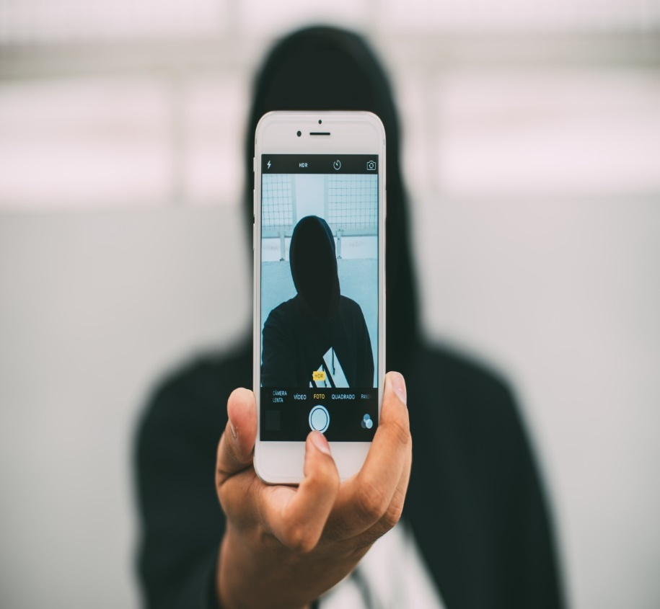
Selfies – How Filters are Changing Self-Image
Rajanala et al., JAMA Facial Plastic Surgery, E1-E2, 2018
Multiple apps allow people to alter their appearances to look more “ideal” with today’s beauty standards
  Snapchat
  Facetune
  Photoshop
  VSCO
This is changing the
perception of beauty
worldwide
Can lead to feeling
inadequate and trigger
body dysmorphic disorder

Slide 54

Body Dysmorphic Disorder (BDD)
Excessive preoccupation with a perceived flaw in appearance
Classified on the obsessive-compulsive spectrum
May go to great lengths to hide imperfections, engage in behaviors like skin picking or grooming, seek dermatologists or plastic surgeons to alter their appearance

Slide 55

“Snapchat Dysmorphia”
Rajanala et al, JAMA Facial Plastic Surgery, E1-E2, 2018
% of plastic surgeons who report patients request surgery to improve how they appear in selfies
42%, 2015
55%, 2017

Slide 56

Appearance-Related Social Media Consciousness
Choukas-Bradley et al, 2018, Psychology of Popular Media Culture
Appearance-related social media consciousness (ASMC): the tendency for a woman’s thoughts and behaviors to reflect an ongoing awareness of whether she might look attractive to an online audience
More than 1.8 billion photos are shared on SM daily
339 college females, M_{age}=18.4 self-reported ASMC
¾ endorsed frequent ASMC experiences
Notes:
Objectification theory: cultures that sexually objectify female bodies→girls and women are socialized to believe their physical appearance is critically important AND that their appearance does not measure up to the societal ideal—Fredrickson & Roberts, 1997; ASMC: eg, When I am at an event in which people are taking photos of me (eg, party), I feel distracted by thoughts about how the photos will look on SM (4 items, 7 point scale)
Body surveillance: eg, During the day, I think about how I look many times (8 items, 7 point scale); Body comparison: eg, I pay attention to whether or not I am as thin as, or thinner, than my peers (6 items, 7 point scale)
Body esteem: eg, I’m pretty happy about the way I look (14 items, 5 point scale)

Slide 57
Appearance-Related Social Media Consciousness
Choukas-Bradley et al, 2018, Psychology of Popular Media Culture
Appearance-related social media consciousness (ASMC): the tendency for a woman’s thoughts and behaviors to reflect an ongoing awareness of whether she might look attractive to an online audience
More than 1.8 billion photos are shared on SM daily
339 college females, M_{age}=18.4 self-reported ASMC
¾ endorsed frequent ASMC experiences
↑ ASMC significantly associated with:
  ↑ body surveillance, body comparison, ↓ self-esteem (controlling for time spent on SM)
Notes:
Objectification theory: cultures that sexually objectify female bodies→girls and women are socialized to believe their physical appearance is critically important AND that their appearance does not measure up to the societal ideal—Fredrickson & Roberts, 1997; ASMC: eg, When I am at an event in which people are taking photos of me (eg, party), I feel distracted by thoughts about how the photos will look on SM (4 items, 7 point scale)
Body surveillance: eg, During the day, I think about how I look many times (8 items, 7 point scale); Body comparison: eg, I pay attention to whether or not I am as thin as, or thinner, than my peers (6 items, 7 point scale)
Body esteem: eg, I’m pretty happy about the way I look (14 items, 5 point scale)

Slide 58
Appearance-Related Social Media Consciousness
Choukas-Bradley et al, 2018, Psychology of Popular Media Culture
Appearance-related social media consciousness (ASMC): the tendency for a woman’s thoughts and behaviors to reflect an ongoing awareness of whether she might look attractive to an online audience
More than 1.8 billion photos are shared on SM daily
339 college females, M_{age}=18.4 self-reported ASMC
¾ endorsed frequent ASMC experiences
↑ ASMC significantly associated with:
  ↑ body surveillance, body comparison, ↓ body-esteem (controlling for time spent on SM)
  ↑ depressive symptoms (controlling for body surveillance and time spent on SM)
Notes:
Objectification theory: cultures that sexually objectify female bodies→girls and women are socialized to believe their physical appearance is critically important AND that their appearance does not measure up to the societal ideal—Fredrickson & Roberts, 1997; ASMC: eg, When I am at an event in which people are taking photos of me (eg, party), I feel distracted by thoughts about how the photos will look on SM (4 items, 7 point scale)
Body surveillance: eg, During the day, I think about how I look many times (8 items, 7 point scale); Body comparison: eg, I pay attention to whether or not I am as thin as, or thinner, than my peers (6 items, 7 point scale)
Body esteem: eg, I’m pretty happy about the way I look (14 items, 5 point scale). Sample 67% White, results same when controlling for race.

Slide 59
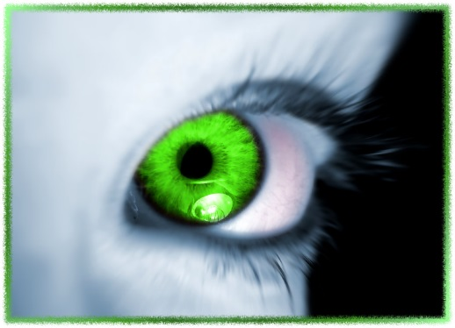
Facebook Surveillance, Depression & Envy
Scherr et al, 2018, Journal of Media Psychology
Stress ↔ Depression
Stress generation hypothesis suggests depressed Fb users would be more prone to surveillance
Wave 1: 1,530 ≥ 14 yrs; Wave 2: 841
“How often do you look through others’ profiles/conversations”
↑ depression: ↑ Fb surveillance: ↑ envy
Envy → ↑ Fb surveillance
Depression→ ↑ envy
Fb surveillance + envy does not → ↑ depression

Slide 60
Focus Group-Observations about Social Media
4 20/21-year olds; all got smart phones at 13-14
“It’s another realm of things to worry about”
Can share too much
↑ (unfair) comparison to others-most only post ++
Friends are constantly on phones instead of having face-to-face interactions
“It’s the new normal”
Young teens focus on “building their brand”
Worry about being judged, especially females
  Girls are raised to be a visual product (look good)
  Boys are raised to have economic value (strong)
Pressure to always be available

Slide 61
Overview
Current rates of anxiety and depression in adolescents
Normative adolescent development
Characteristics of social media
Current use of social media by adolescents
Research findings on the impact of social media on adolescent mental health
Prevention strategies

Slide 62
Focus Group- Recommendations
Emphasize face-to-face interactions
Use social media to supplement, not as only way to socialize
Parents should
  give guidance about dangers, don’t just restrict
  Kids will mimic their parents’ (over)use
Make it fun to NOT use your phone (eg, everyone silences and stacks their phone at a meal, first to pick up pays for the meal)
“Phones off, friends on”
Buddy system to restrict as needed

Slide 63

What Can Parents (and Therapists) Do?
Set a good example
Monitor
Discuss
Emphasize non-social media recreation/activities-Remember the Twenge study…(face-to-face, sports/exercise, reading, religious activities)
Focus on “healthy habits”: SEE your way to a healthy life
  Sleep
  Eating
  Exercise

Slide 64

Parental Control Over Social Media Use in Pre-Teens
Fardouly et al., Journal of Youth and Adolescence, 47, 1456-1468, 2018
> ½ of preteens use social media (rules say ≥ 13 yrs)
284 10-12 yr olds and their parents completed on-line surveys (Australia)
↑ parental monitoring:
  ↓ time on social media
  ↓ appearance comparisons
  ↑ mental health
.

Slide 65
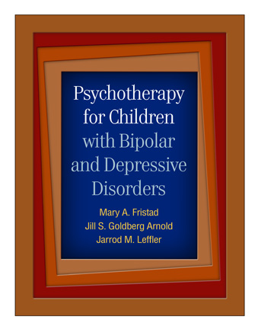
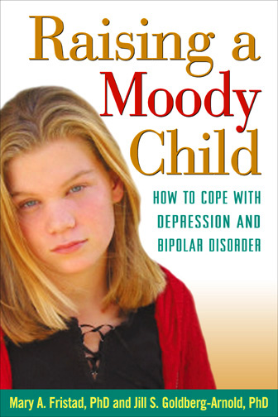

Slide 66
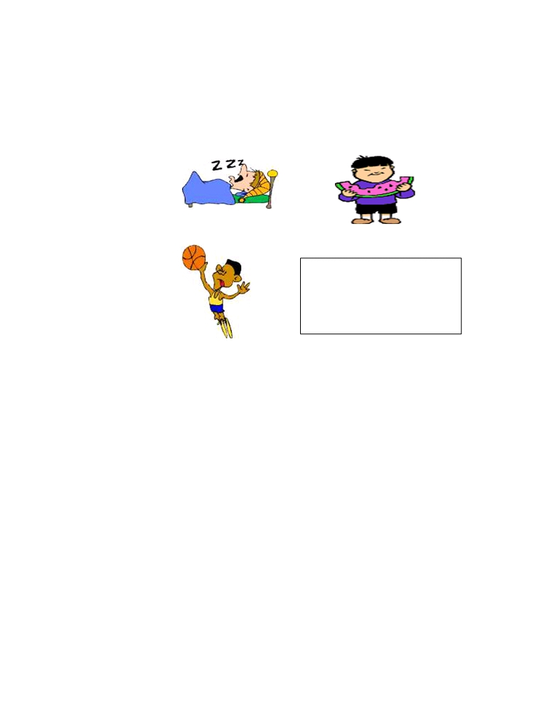
Healthy Habits
Three very important healthy habits
1.
SLEEP
2. EATING
Enough sleep on a
consistent schedule +
healthy eating + regular
exercise = healthier body +
better mood
3. EXERCISE
What daily activities help you stay healthy?
1. ___________
3. __________
2.___________
4. __________
What are some of your and your family’s
unhealthy habits?
1. ___________
3. __________
2.___________
4. __________
Why are healthy habits important?
☺ feel good about self
☺ improve mood
☺ deal with stress
☺ avoid illness
☺ improve schoolwork
☺ healthy weight
☺ reduce side-effects of medication
IF-PEP Child Workbook
39

Slide 67

Sleep in Adolescence
Milman et al, Pediatrics, 2005; Owens et al, Pediatrics, 2014; Zhang, Education and Information Technologies, 2017; Wong et al, J Psychiatr Res, 2016; Chennaoui, Sleep Med Review, 2015
↓ sleep in adolescents →
  ↓ academic success, physical health, psychological health (depression, suicidal risk-even when controlling for substance use, mood, and anxiety disorders), safety (driving)
  ↑ obesity
4 out of 5 high school students get < 8 hours of sleep/night
Subjective and objective sleep matter
Sleep, exercise, and health status
(inflammatory markers) are all
related

Slide 68
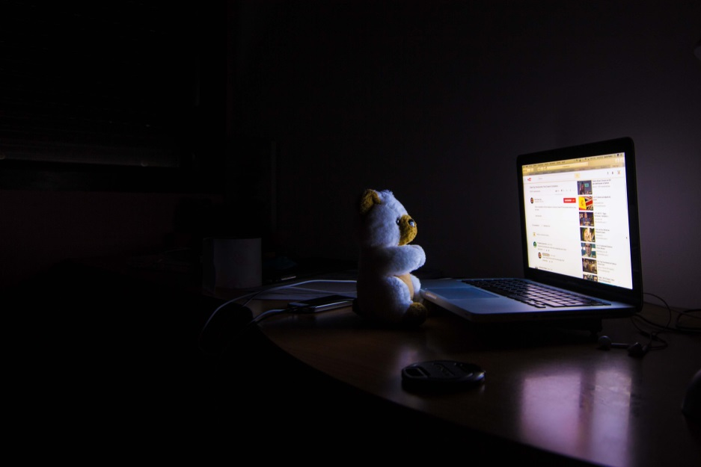
Causes of Decreased Sleep
Owens et al, Pediatrics, 2014
Electronic media*
School start times
Caffeine
Parental influence
Employment
Extracurricular activities
Insomnia/circadian rhythm disorders
Sleep disordered breathing
*Not sleeping if using AND blue light inhibits melatonin production, impairing sleep onset

Slide 69
Sleep Hygiene Strategies
Keep a consistent sleep schedule.
Set a bedtime that is early enough for you to get at least 7 hours of sleep.
Don’t go to bed unless you are sleepy.
If you don’t fall asleep after 20 minutes, get out of bed.
Establish a relaxing bedtime routine.
Use your bed only for sleep (and sex).
Make your bedroom quiet and relaxing.
Keep the room at a comfortable, cool temperature.
Limit exposure to bright light in the evenings.
Turn off electronic devices at least 30 minutes before bedtime.
Don’t eat a large meal before bedtime. If hungry at night, eat a light, healthy snack.
Exercise regularly and maintain a healthy diet.
Avoid consuming caffeine in the late afternoon or evening.
Avoid consuming alcohol before bedtime.
Reduce fluid intake before bedtime.

Slide 70
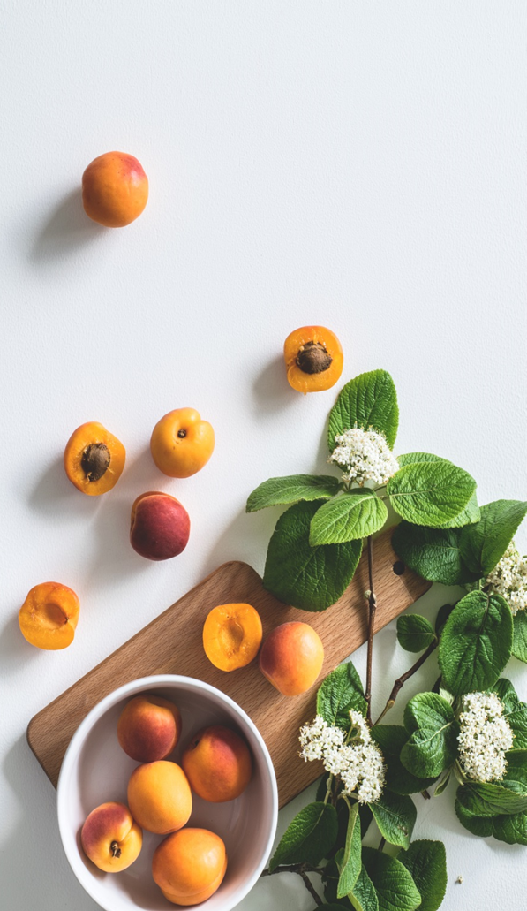
Diet and Mental Health in Youth
Khalid et al, 2016, British Journal of Nutrition, 116(12): 2097-2108
Systematic review of 20 studies
overall support for
  healthy dietary patterns and ↓depression and ↑ mental health
  unhealthy diet and ↑ depression or ↓ mental health
Effect sizes were small
Future research should use more clearly
defined constructs to define diet and
include or control for important confounders

Slide 71
Diet and Mental Health in Youth
Lassale et al, 2018, Molecular Psychiatry, on-line, 9-26-18
Systematic review of 20 longitudinal and 21 cross-sectional studies
Mediterranean Diet: relative risk 0.67 (comparing highest to lowest adherence in 4 long’l studies)
Dietary Inflammatory Index RR=0.76 (4 long’l studies)
Healthy Eating Index RR=0.65 (fewer studies)
↑ anti-inflammatory and ↓ pro-inflammatory
diet confers protection against depression
Notes:
2 wks ago!

Slide 72
Dietary recommendations for the prevention of depression Opie…Jacka, Nutr Neurosci. 2017 Apr;20(3):161-171
*Converging evidence from lab, population research, and clinical trials suggests dietary patterns/ factors may influence depression risk.→ 5 dietary recommendations:
follow 'traditional' dietary patterns, such as the Mediterranean, Norwegian, or Japanese diet;
increase consumption of fruits, vegetables, legumes, wholegrain cereals, nuts, and seeds;
include a high consumption of foods rich in omega-3 polyunsaturated fatty acids;
replace unhealthy foods with wholesome nutritious foods
limit intake of processed-foods, 'fast' foods, commercial bakery goods, and sweets.

Slide 73

Importance of Physical Activity
Foster et al, Br J Sports Med, 2018; Suetani et al, J Psychiatr Res, 2017; Radovic et al, J Paediatric Child Health, 2017
Insufficient exercise is a global problem; the WHO has launched a Global Action Plan to ↑ physical activity→ ↓ non-communicable diseases worldwide
Lack of physical activity at age 14 is associated with increased likelihood of affective disorders at age 21
Exercise →moderate reductions
in depressive symptoms among
adolescents with clinical levels
of depression (meta-analysis)

Slide 74
Mindfulness/Meditation/Prayer
Mind-Body Therapies in Children and Youth. Pediatrics, 2016. 138(3); Kallapiran et al, Child and Adolescent Mental Health, 2015. 20(4): p. 182-194; Ong et al, Sleep, 2014. 37(9): p. 1553-63.
Meditation→↓ mental health symptoms and ↑ coping and self-regulatory processes in youth
Meta-analysis of 11 studies with 1,454 participants: mindfulness-based interventions→ ↓symptoms of anxiety and depression in youth (need large, high-quality studies
Mindfulness meditation→ ↓insomnia in adults

Slide 75

Mindful Movement (Yoga, Tai Chi, Pilates)
Bao & Jin, Int’l J Psychol, 2015. 50(2):101-105; Caldwell et al, Nat Sci Sleep, 2016, 8:305-314
160 13-16 yr olds, daily 1-hr TaiChi for 1 school yr→ ↑ self-esteem compared to gymnastics control group
75 young adults, twice-weekly for 10-wks TC class, TC taught via DVD, or a control group. TC→ ↑ sleep and ↓ anxiety

Slide 76
Increase Face-to-Face Time
Home
  Family dinners
  Maximize commuting time
School/Work
  Co-curricular activities
  Volunteer activities
Peers
  Plan FtF activities
  Phones off, friends on

Slide 77
Therapeutic Recommendations
Use good CBT principles
  Increase self-awareness by monitoring
  Use Socratic questioning to increase insight
  Emphasize behavioral activation to increase
    FtF time
    Exercise
    Healthful meal planning
  CBT-I as needed

Slide 78
Summary
Social media isn’t “good” or “bad”, it depends on how it is used
Rates of anxiety/depression have risen dramatically, especially for girls
This rise coincides with increased smart phone use
Strategies to improve health include
  Maintain face-to-face contact
  Use social media to enhance social contacts, not to be the primary contact
  Parents: monitor and discuss with your children
  Maintain healthy habits
    Sleep *Eating
    Exercise
    Mindfulness/meditation/prayer

Slide 79
Questions?

Slide 80
Thank You*
Mary A. Fristad, PhD, ABPP
Mary.Fristad@osumc.edu
*Taban Salem, PhD
*Casey Kaiser
*Casey Kaiser, Lindsay Gillikin, Ethan McIntyre, McKenzie Slone

