Slide 1
From Brain to Bedside: Translating Neuroscience Findings to Develop Innovative Interventions
Dr. Amy Krain Roy, Ph.D
Associate Professor of Psychology
Fordham University
Associate Professor of Child & Adolescent Psychiatry
NYU Langone School of Medicine
Visit www. fordham.edu/info/22235/pediatric_emotion_regulation_lab
Follow on Facebook: @fordhamPERL
Moderator: Dr. Jill Ehrenreich-May, Ph.D.
Associate Professor, Child Division
Director, Child and Adolescent Mood and Anxiety Treatment (CAMAT) Program
Department of Psychology
University of Miami

Slide 2
Audience Questions and Answers
Submit a question during the webinar:
Post your questions for the Q&A segment! On right side of screen, click on the Questions tab on the Go-To-Webinar control panel, and submit your questions
Continue the conversation after the webinar in the SCCAP53.org Forum
For one month, panel members will respond to as many questions as possible
Go to https://sccap53.org
Log in with your member ID and password
Scroll down and click on the “Forum” box
Under Webinar Discussions, click on “From the Brain to Bedside: Translating Neuroscience Findings to Develop Innovative Interventions”
See the forum rules posted by the Web Editor, and then
Post away!
Up coming webinars: Submit your ideas for our 2019 Webinar Series: sccapdiv53@gmail.com

Slide 3
From Brain to Bedside: Translating Neuroscience Findings to Develop Innovative Interventions
Dr. Amy Krain Roy, Ph.D
Associate Professor of Psychology
Fordham University
Associate Professor of Child & Adolescent Psychiatry
NYU Langone School of Medicine
Visit www. fordham.edu/info/22235/pediatric_emotion_regulation_lab
Follow on Facebook: @fordhamPERL
Moderator: Dr. Jill Ehrenreich-May, Ph.D.
Associate Professor, Child Division
Director, Child and Adolescent Mood and Anxiety Treatment (CAMAT) Program
Department of Psychology
University of Miami

Slide 4
Learning Objectives
Explain how neuroimaging methods are used to assess brain structure and function
Become a critical reader of neuroimaging research
Recognize the utility of brain-based models to distinguish child clinical disorders and develop interventions

Slide 5
How can neuroscience inform clinical care?
Improve classification
Development of interventions based on underlying constructs rather than DSM classifications
Personalized medicine
Notes:
Distinguish groups that were previously “lumped” together or create new ones that might combine previous diagnoses in new ways based on underlying pathophysiology

Slide 6
The Issue of Pediatric Irritability
Multiple definitions
Transdiagnostic- characteristic of internalizing and externalizing disorders
Predictive of mood disorders/symptoms later in childhood (Dery et al., 2016; Dougherty et al., 2016), in adolescence (Brotman et al., 2006; Burke et al., 2010; Whelan et al., 2013) and in adulthood (Althoff et al., 2014)

Slide 7
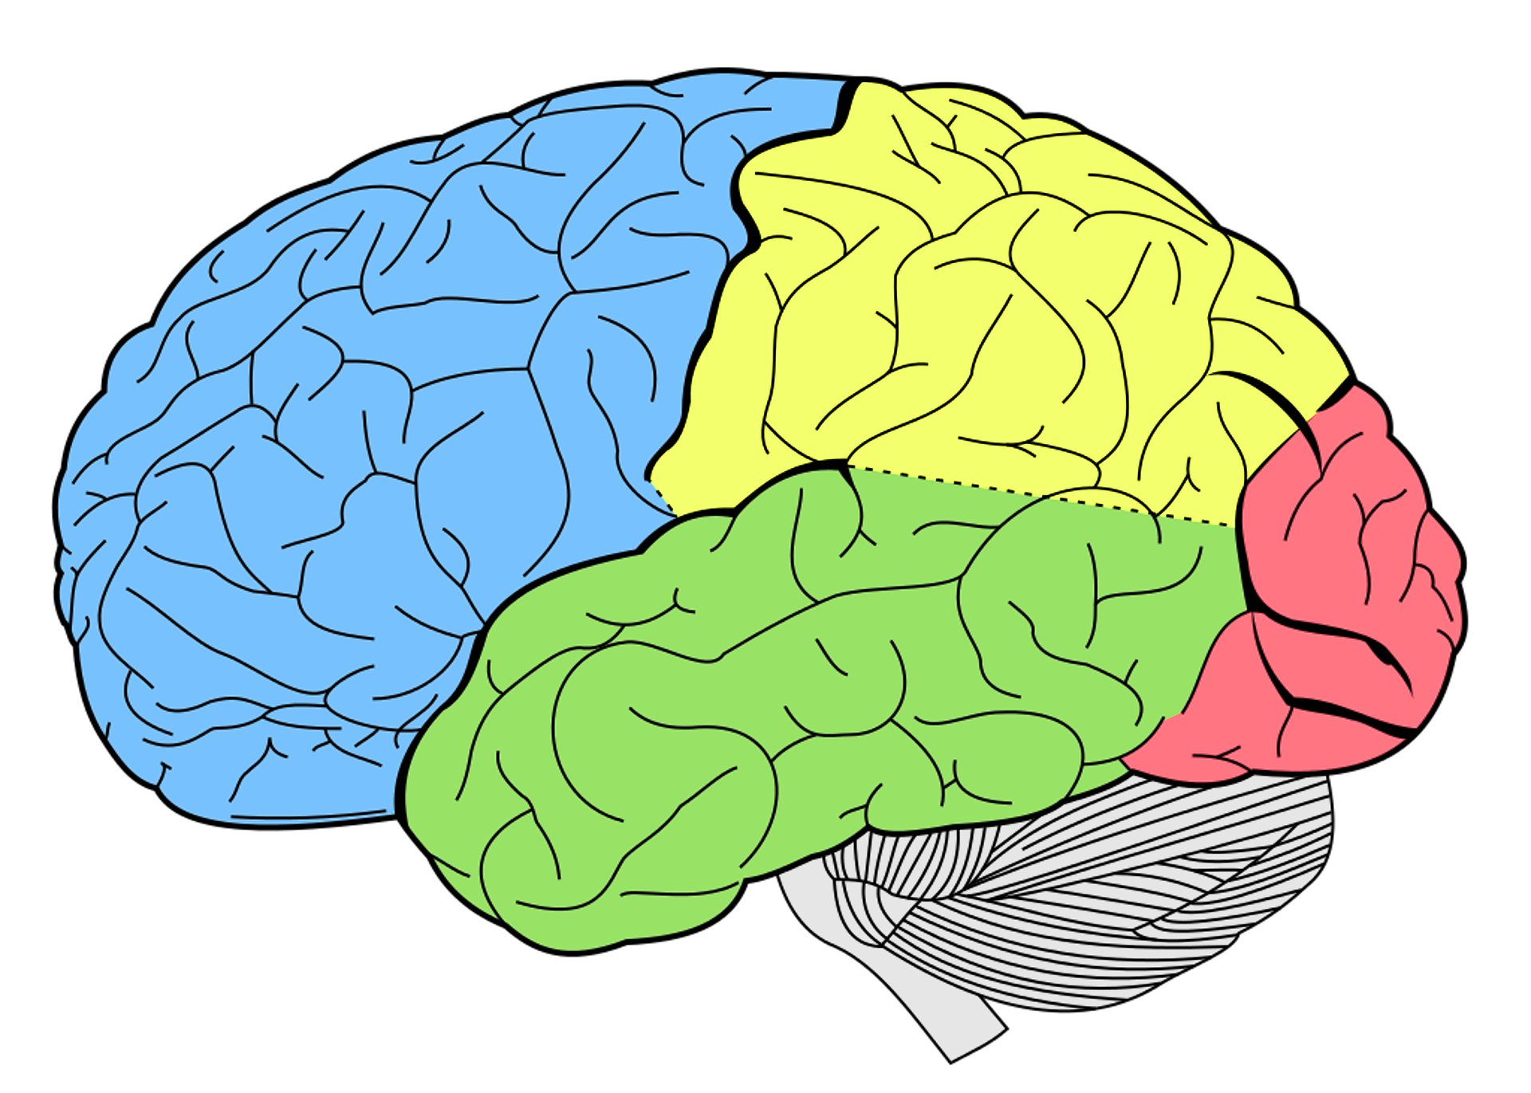
Historical Context
Debate regarding pediatric form of bipolar disorder (Biederman et al., 1998)
Characterization of unique phenotype characterized by chronic irritability termed severe mood dysregulation (SMD)
Changes in DSM 5
Disruptive Mood Dysregulation Disorder (DMDD)
Partitioning ODD sxs into Angry/Irritable and Argumentative/ Defiant
What is core mechanism underlying irritability?
Notes:
Longitudinal data supported differences:
in 2+ year follow up, only one SMD patient (out of 84) had 1 (hypo) manic or mixed episode compared to 58 of 93 patients with narrow phenotype BP (Stringaris et al., 2010)

Slide 8
Know your Neuroanatomy
Striatum
ACC
Amygdala
DLPFC
PFC
MFG
OFC
Ventral striatum
Insula

Slide 9
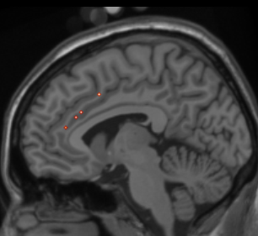
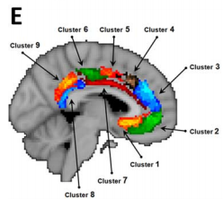
Know your Neuroanatomy
Example of anterior cingulate cortex (ACC)
Beckmann et al., 2009

Slide 10
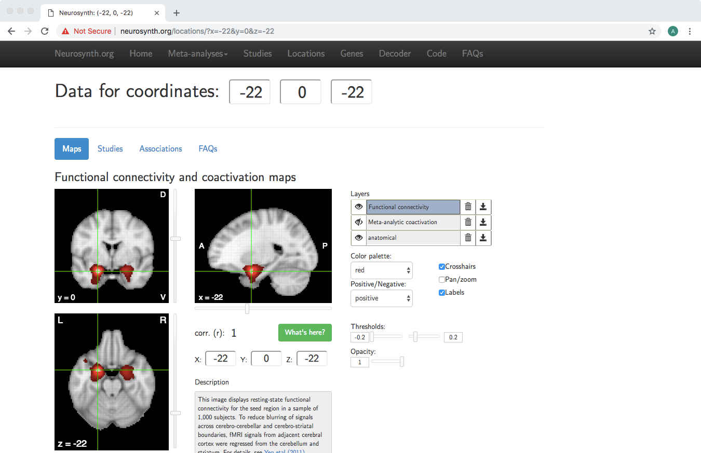
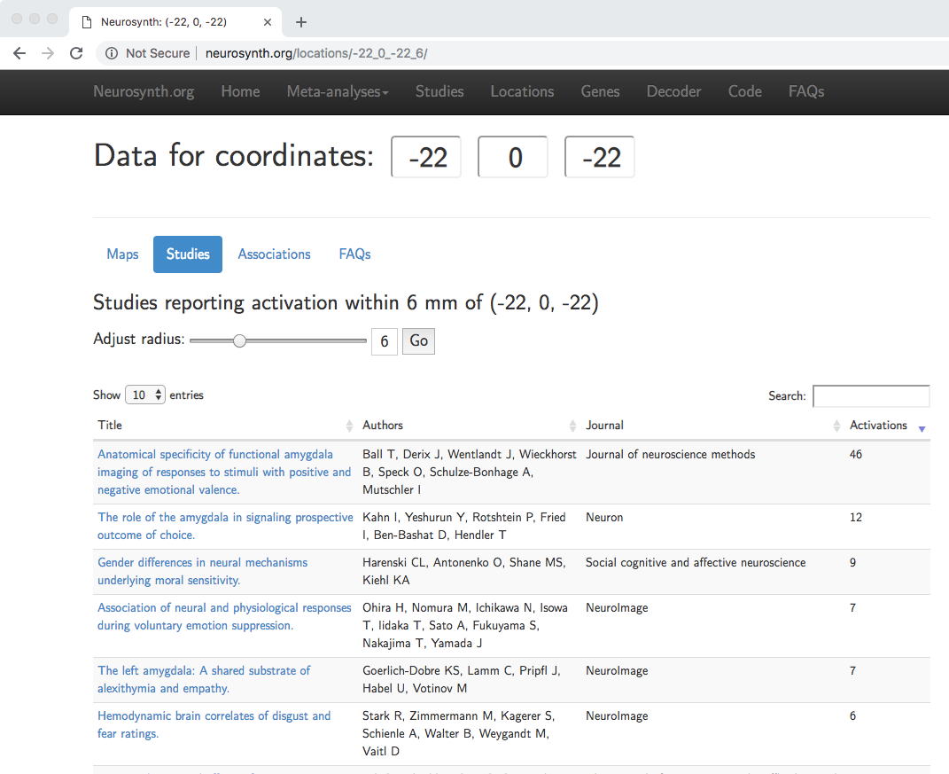
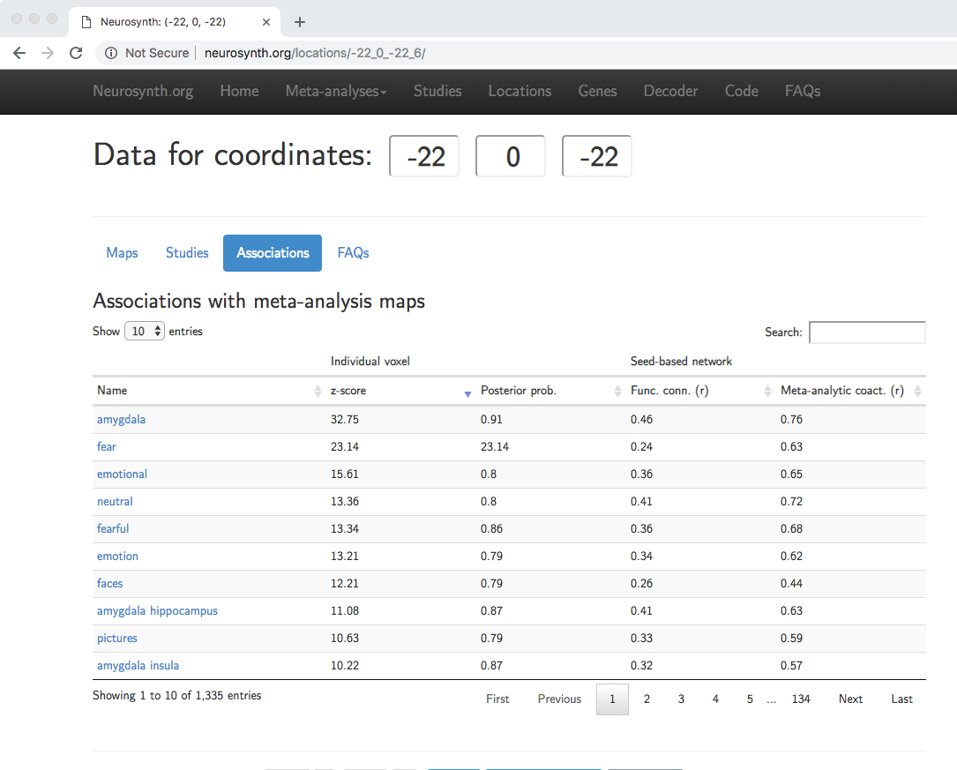
Neurosynth.org

Slide 11
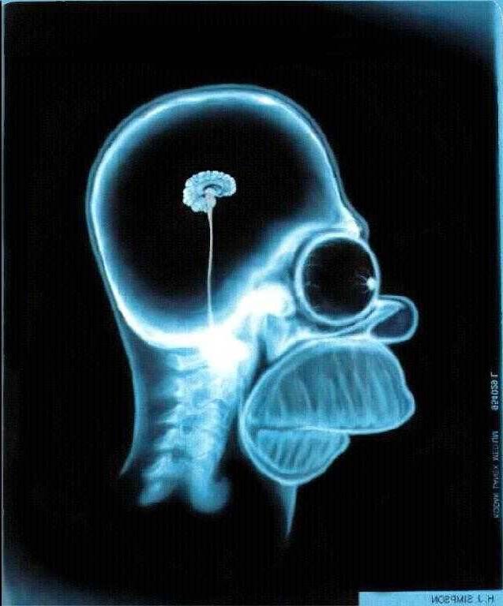
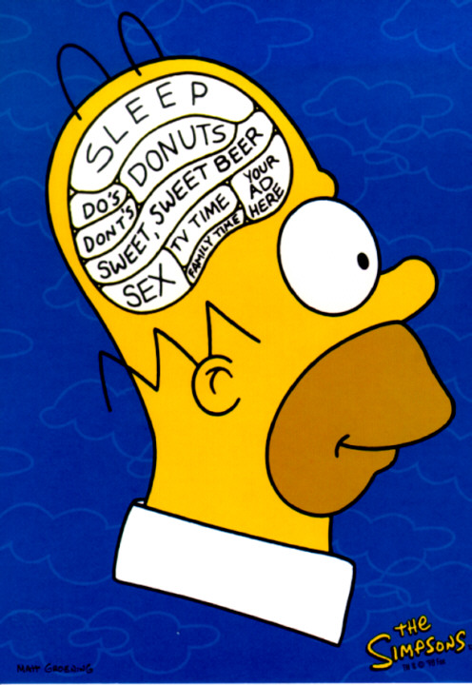
Know your Methodology
Magnetic Resonance Imaging (MRI)
Structural
Functional
Task-based
Resting state

Slide 12
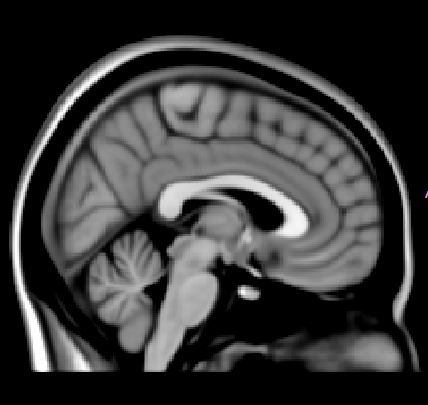
Structural Methods
Structural MRI
Gray matter volume (e.g., voxel-based morphometry [VBM])
Cortical thickness
Gyrification
Christian Gazer, University of Jena)

Slide 13
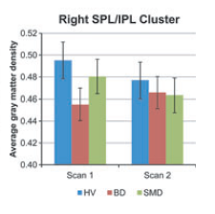
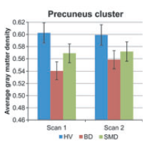
Differentiating BD from SMD: Structure
VBM Study (Adleman et al., 2012)
Cross sectional analyses (78 SMD vs. 55 BD vs. 68 HV)
BD and SMD both show reduced gray matter volume in insula, pre-SMA and right DLPFC
BD showed increased volume in globus pallidus
Longitudinal analyses (31 SMD vs. 34 BD vs. 27 HV)
Possible effects of age? medication? comorbidity?

Slide 14
Functional MRI
Measure the blood oxygenation level dependent (BOLD) signal
Flow of oxygenated blood suggests which areas of the brain are active
Task-Based
Uses a specific task to assess brain activity; relies upon comparisons of task conditions

Slide 15
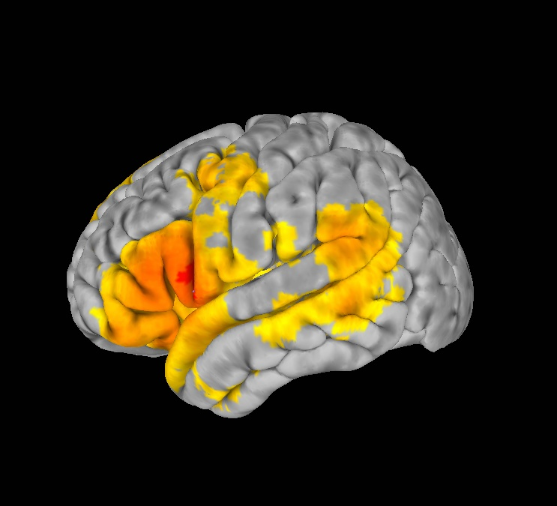
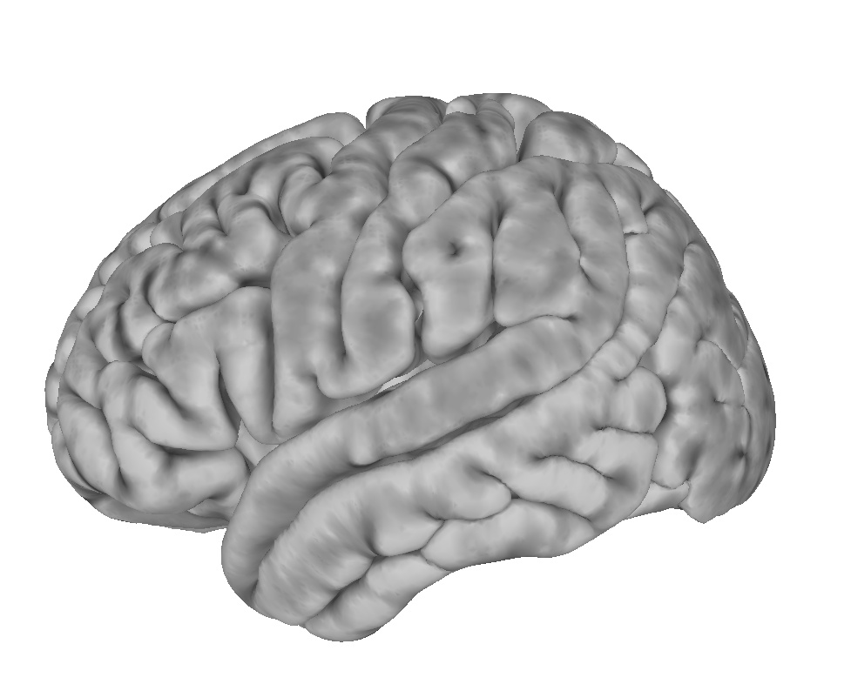
Functional MRI
Resting State
Intrinsic functional connectivity (iFC): Correlated BOLD signal across brain regions; no task
Correlate
Notes:
How do we measure this organization?
Functional connectivity defined as the temporal correlations of these fluctuations across regions

Slide 16
Task-Based fMRI | Resting State fMRI
Which regions respond to a specific task or set of stimuli? | Which regions work together within a functional network?
Analysis involves comparison of 2+ conditions including baseline | Analysis involves correlations of activity across the time period of the scan
Taps into specific cognitive processes and targeted brain regions | Can explore any areas of the brain using the same data
Confounds: practice effects, developmental differences, reconcile behavioral + brain results, fatigue | Confounds: movement can influence results, falling asleep, relating to measures obtained outside scanner

Slide 17
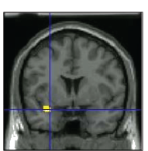
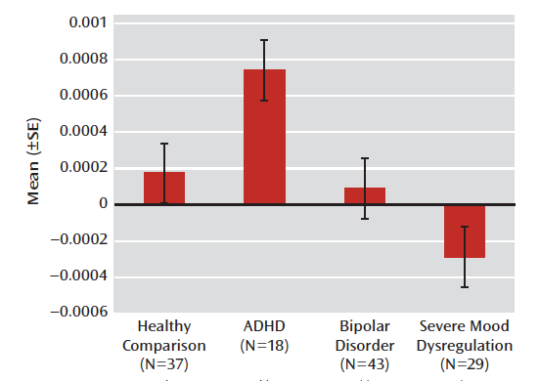
Differentiating BD from SMD: Function
Task Based (Brotman et al., 2010)
Amygdala activation during face ratings
During neutral faces, fear vs. nose-width (SMD: hyperactivation to nose-width vs. fixation)
Region-of-interest vs. whole brain?
Baseline condition?
Medication status? Comorbidity?

Slide 18
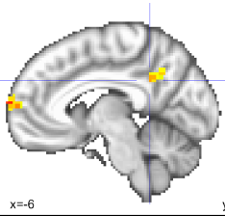
Differentiating BD from SMD: Functional Connectivity
Resting State (Stoddard et al., 2015)
BD shows increased iFC of basolateral amygdala
19 SMD (37% unmedicated) vs. 14 BD (29% unmedicated) vs. 20 HV
Scanning parameters: 3 different scanners
Use of seed ROI or voxel-wise exploration of whole brain?
How is movement managed in scanner & statistically?

Slide 19
Next Steps?
Test hypotheses regarding underlying bases for irritability and associated symptoms- focus on basic mechanisms, translational work
Chronic irritability: quick to anger, easily frustrated Severe temper outbursts: response to frustration (not receiving reward, something rewarding is removed)
Frustrative Non-Reward

Slide 20
Frustrative Non-Reward
Animals show increased motor activity and aggression when expected reward is not presented
Neurally, observe a negative prediction error (decrease in midbrain dopamine) when expected reward is not received
Two components:
Learn to expect reward (reward learning)
Inhibitory control
Do children with severe irritability show altered frustrative non-reward?
Notes:
Provides a framework for further study

Slide 21
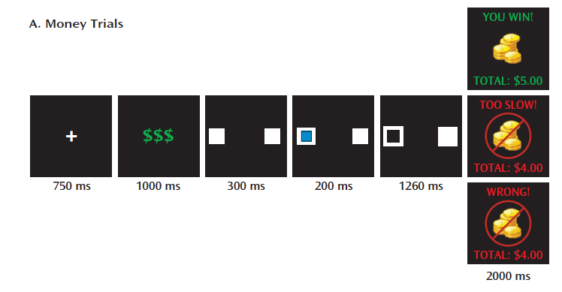
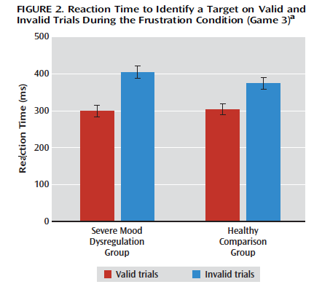
Evidence of altered frustrative non-reward in children with severe irritability
SMD children show difficulty shifting attention when frustrated
Affective Posner Task
Deveney et al., 2013

Slide 22
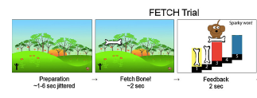
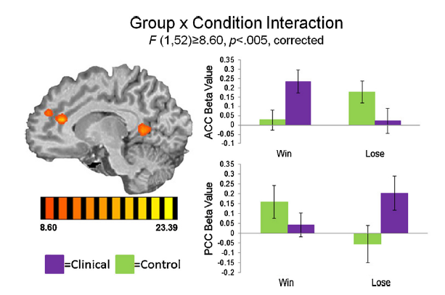
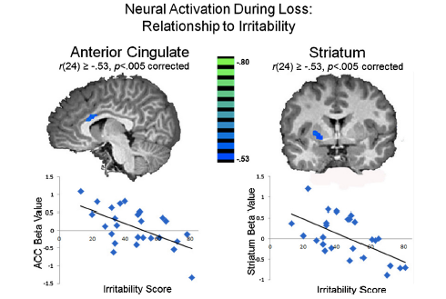
Task-Based Evidence
Terminology?
Medication status? Comorbidity?

Slide 23
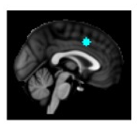
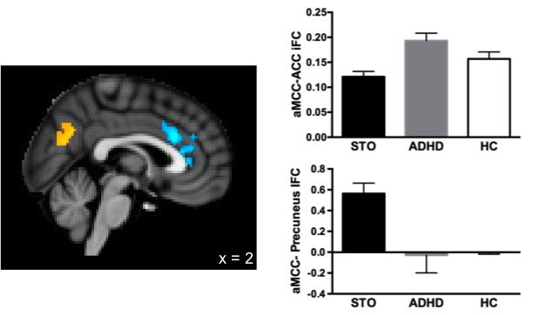
Resting State fMRI
Intrinsic functional connectivity (iFC) of aMCC altered in children (ages 5- 9 years) with severe temper outbursts
Uniquely associated with
emotion regulation
Definition of sample?
How is movement managed in scanner & statistically?
Roy et al., 2017

Slide 24
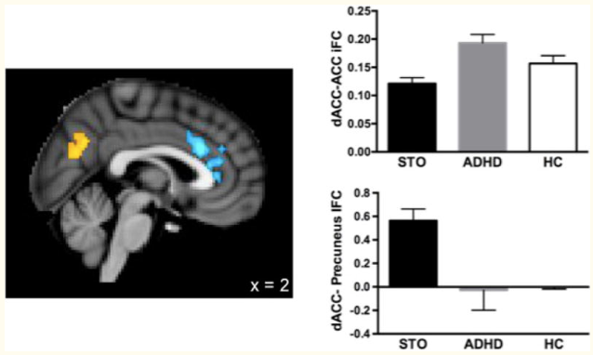
Support for frustrative-non reward
For children with severe irritability, frustration may impact attentional/cognitive processing
Children with severe irritability exhibit altered neural responses to frustration and intrinsic functional connectivity
Highlights ACC and PCC/ precuneus as well as striatum
Putative role of comorbidity (i.e., ADHD)

Slide 25
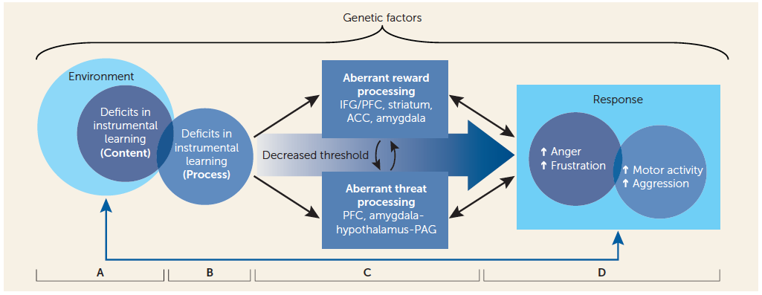
Support for frustrative-non reward
Conceptual model by Brotman et al., 2017: frustration-related affective and attentional dysfunction prevents children with severe irritability from recognizing how their actions relate to outcomes and learning from outcomes

Slide 26
Novel CBT for Pediatric Irritability (DMDD)
Graduated exposure to increase tolerance of feelings of frustration and practice new coping skills
Common exposures: doing household chores, having technology taken away, losing in a game, completing challenging schoolwork
Patients provide “temperature ratings” 0- 10, focus on tolerating emotion and reduction as needed
PMT: help parents tolerate emotions in response to child’s irritability; targets parental contingencies to improve instrumental learning in child
Joint parent-child sessions to practice exposures
Kircanski et al., 2018

Slide 27
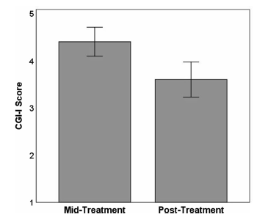
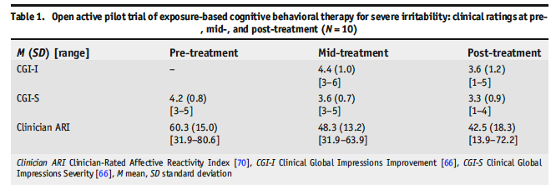
Open Pilot Study
Open pilot study of 10 children to develop manual
12- 16 sessions, 60- 90 minutes each
Kircanski et al., 2018

Slide 28
Overall Summary
Neuroimaging methods can provide important information about underlying neural mechanisms but critical review is necessary
Sample: Age? Comorbidities? Medication effects?
Task-based functional MRI
Does the task make sense for the question?
Are analyses whole brain vs. region-of-interest?
Resting state functional MRI
How to select a region to start from vs. whole brain?
Cautious about movement in data

Slide 29
Overall Summary
Clear evidence of distinction between children with bipolar disorder and those with chronic irritability
Support for use of frustrative non-reward as a basic construct to examine in children with severe irritability
Alterations appear to be in regions involved in reward learning, error monitoring, and self-reflection.
Studies already underway aimed at developing novel interventions based on this work.

Slide 30
Questions?

Slide 31
Source Citation for this Presentation
Roy,A. (2018). From the Brain to Bedside: Translating Neuroscience Findings to Develop Innovative Interventions [PowerPoint slides]. Webinar sponsored by the Society of Clinical Child and Adolescent Psychology, Division 53 of the American Psychological Association. New York, NY.

